Slide 1


Slide 2


Personalisation:
have we reached the promised land?
HWSW Mobile! / 21 november 2018

Slide 3




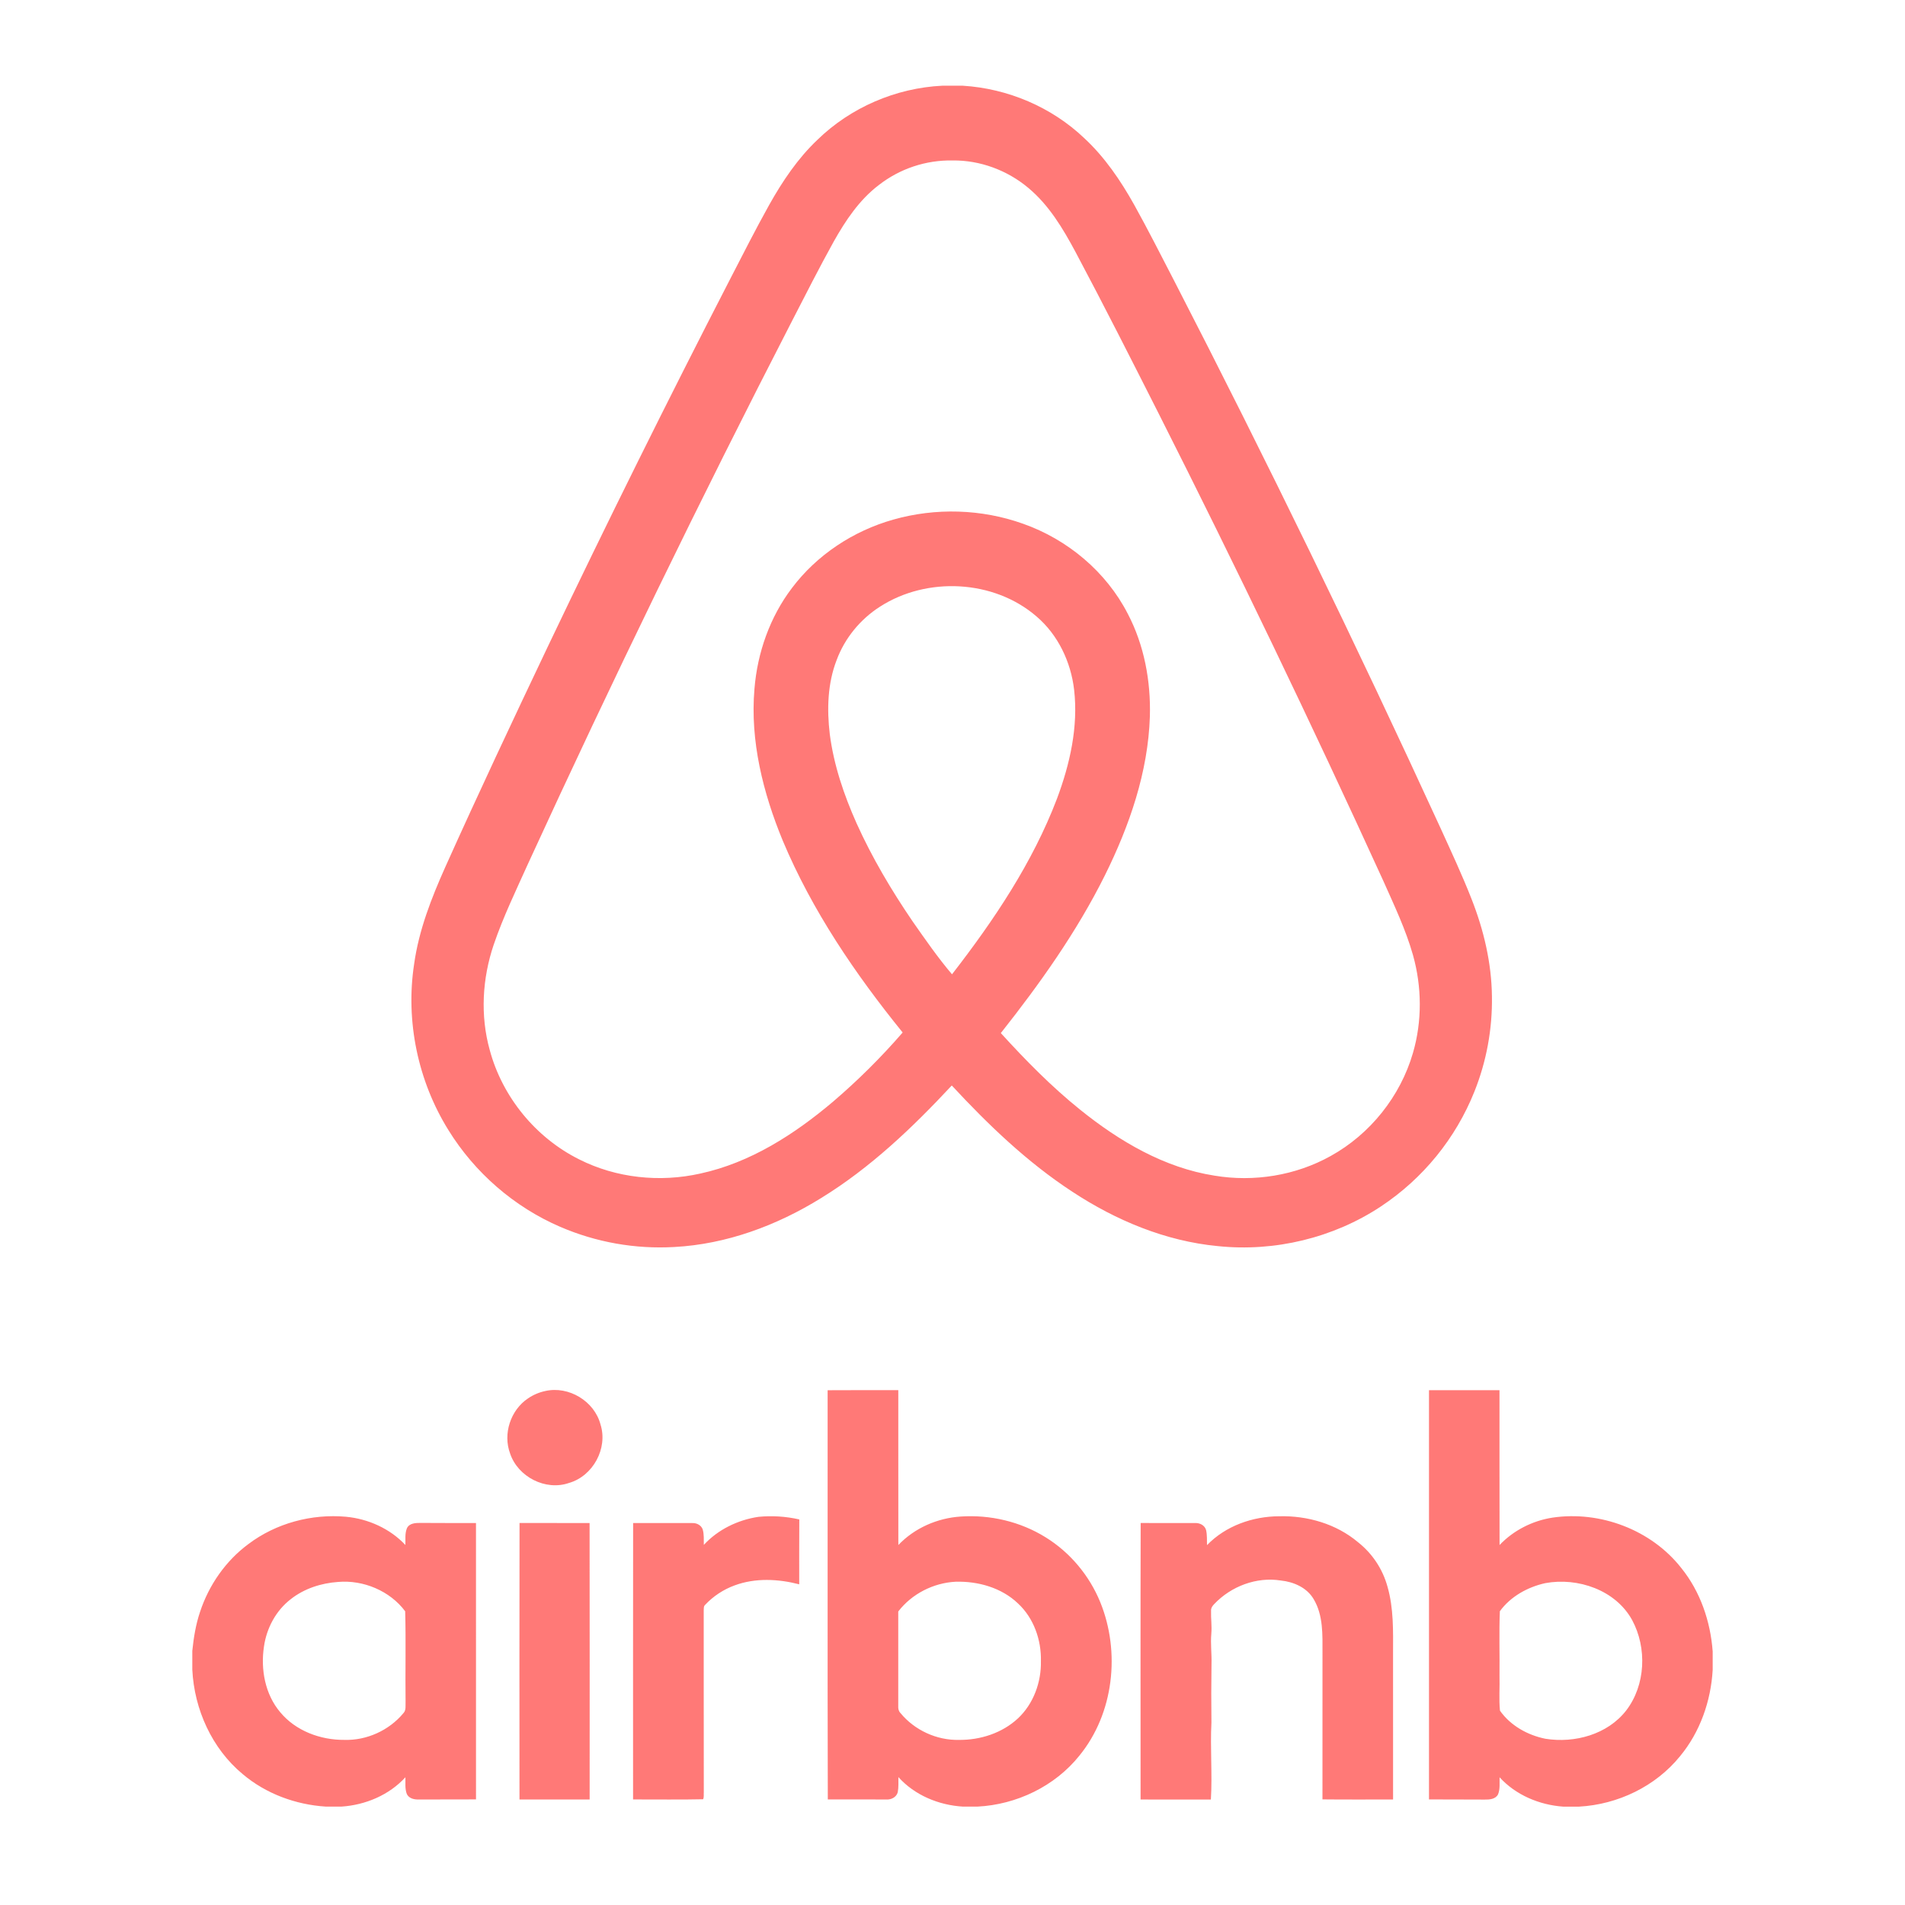
Netflix did not kill Blockbuster.
Ridiculous late fees did.
Uber did not kill the taxi business.
Limited taxi access and fare control did.
Apple did not kill the music industry.
Being forced to buy full-length albums did.
Amazon did not kill other retailers.
Bad customer service and experience did.
Airbnb did not kill the hotel industry.
Limited availability and pricing options did.
TECHNOLOGY BY ITSELF IS NOT THE REAL DISRUPTOR.
BEING NON-CUSTOMER CENTRIC IS THE
BIGGEST THREAT TO ANY BUSINESS.
Notes:
Amazon, Google and other tech and retail giants have already mastered the art of personalizing offers. Just think of product recommendations customers receive based on their past purchases. Or take the example of Uber or Airbnb (or any other pioneer in the sharing economy) who have been at the forefront of personalizing customer journeys.

Slide 4
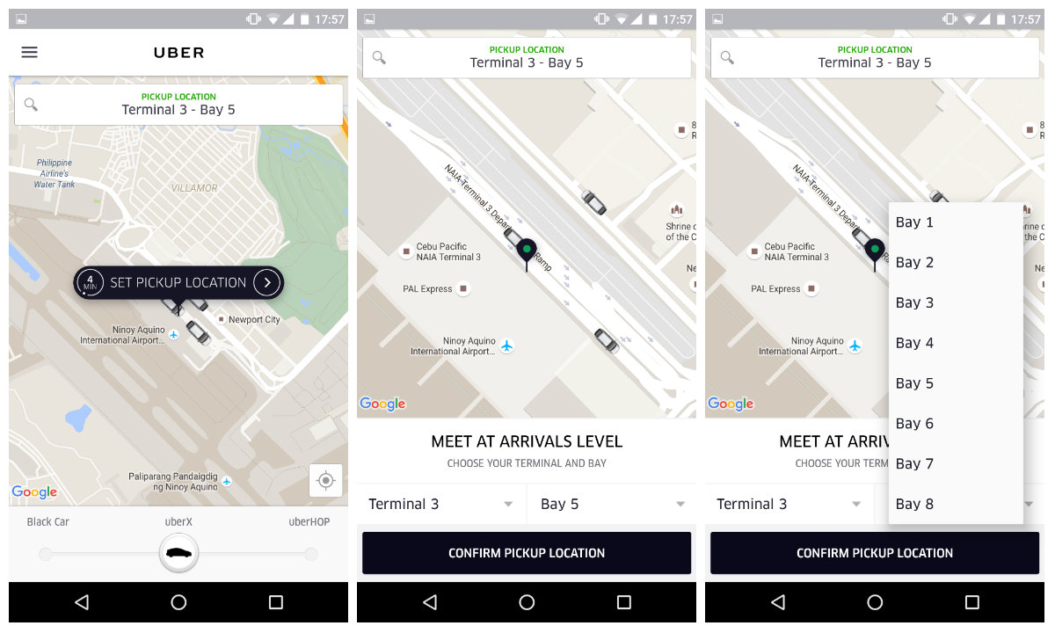
Notes:
Uber for example not only fixed the taxi challenge almost a decade ago, they are still polishing their experience. Reducing uncertainty. The example I want to share with you today is one that happened to me last week in Amsterdam. Imagine walking out of a conference venue, in this case, the Beurs van Berlage in Amsterdam and request an uber. For those who live in Amsterdam you know it’s going to be a hassle. It’s an historic site with special traffic rules and taxis are not allowed to stop here. So you run into challenge number 1. The requested location is often not the pick-up location.For many of us in the room we’ve had this problem before, your requested pickup location was not the actual pickup location The second challenge you will then run into is you will have to pick up the phone and start having a conversation with your driver. For many of us frequently travelling, and sometimes for W.UP you go all over the globe, it’s quite hard to have a proper conversation with these taxi drivers. And then you need to negotiate where you actually meet. For those of you unfamiliar with the city, good luck. You don’t really know the district or the area. This causes this fear of uncertainty I mentioned early. Finally, the taxi arrives, but at the other side of the building. And then again, you have to make the trade-off. Do I go there to find the taxi or call the driver to turn around? A lot of friction.
The example is on the screen because Uber is a company like Amazon & Spotify, dedicating a squad of 1 year to just fix this customer journey. This is their solution. You might have seen it by now in the uber app, you get a dictated pick up point. It’s basically a common understanding between the driver and the rider, this is where we meet. Next, you have an in-built chat app so you don’t have to go outside of the app the communicate with your driver. On top, you get progress updates all the time, where is the taxi, how long with it take, etc. This is how they solved super-detailed pain points into a seamless journey on their mobile application.

Slide 5

Era of the segments of one
Notes:
No wonder that banking consumers expect the same first-class experience from their banks. Most financial institutions, however, still struggle with matching up to these expectations.
And it’s high time they did something about it. We live in the “Age of the Customer” and the “Era of the Segments of One,” where privileged players who can dominate the the financial services sector are a thing of the past. With today’s consumers demanding more than ever, it’s time financial institutions adopt a new mindset which puts their people’s needs first, instead of throwing sales pitches for banking “products” at them.
Before jumping in and completely redrawing marketing strategies, financial institutions must first understand why people crave personalization. As explained in another article on The Financial Brand, giving consumers the impression that they aren’t receiving some generic sales message makes them feel in control, which, in turn, makes them happier. They feel more satisfied with the end product when they feel it’s more tailored to their unique needs and preferences.
Personalized products, experiences and yes, even marketing messages, are welcome relief to consumers drowning in mass market brands where everything is generic, impersonal and cookie-cutter. Consumers actually like messages and offers that are specifically relevant to them.
Gone are the days when financial institutions could gin up results using “spray-and-pray” marketing campaigns. Financial marketers that insist on sustaining such strategies keep generating lackluster returns and conversions because customers are simply ignoring messages they deem irrelevant, and doing so with increasing frequency.
Geographic and demographic segmentation doesn’t do the trick anymore, either. How come? Such crude targeting strategies don’t yield greater insight into consumers, according to EY. More often than not, this elementary information has little- to no correlation with the actual needs of real people, who “are much more than the sum of their banking deposits and loans, and do not align neatly to basic or broad demographic characteristics,” as EY puts it.

Slide 6
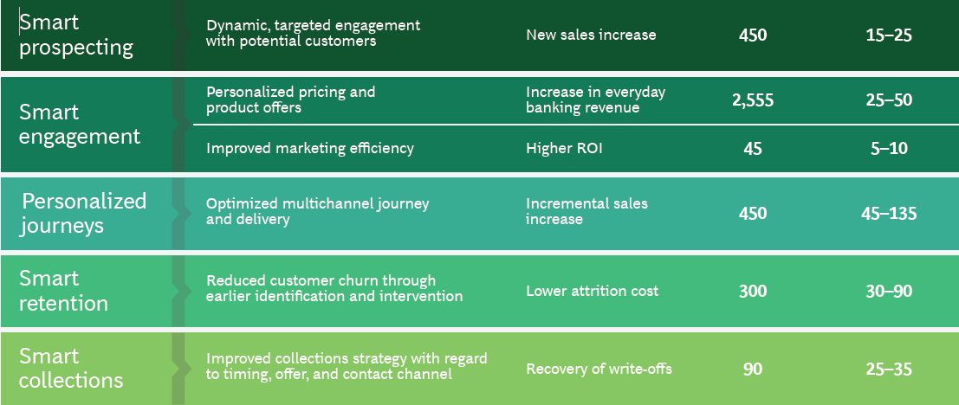
$100 billion Bank: Financial potential of personalisation
Revenue
impact range
($millions)
Baseline
($millions)
Use case
Goal
Notes:
According to a report from BCG, a retail bank with $100 billion in assets could bring in up to $50 million in revenues daily simply by personalizing pricing and product offers.
But the overall effect of personalization is even more far-reaching: it can generate an estimated 30-40% sales bump in certain product areas, reduce customer churn rates by 10-30%, and double or triple customer engagement scores. In absolute terms, the hypothetical bank in BCG’s example can increase revenues by up to a whopping $345 million thanks to personalization across its functions.

Slide 7
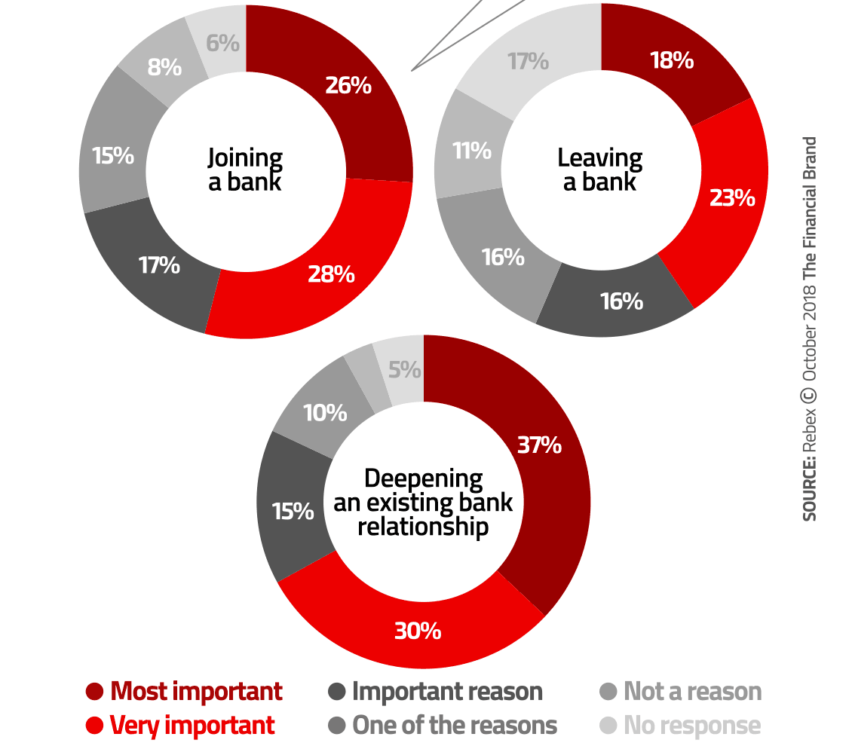
Impact of personalisation on key customer decisions
Notes:
Yet many retail financial institutions are still slow to personalize their products and services. True, tailoring products to customer needs might require a fundamental change in operations throughout the entire value chain. But there’s no doubt that the gains are well worth the effort. About 68% of customers deepened their relationship with their existing bank, and purchased more products and services after the bank had rolled out a new, personalized approach, BCG research has found. And it’s just as telling that 41% had left a bank partially because they didn’t think they had received a sufficiently personalized treatment.
Offering custom banking experiences instead of pushing products has become the new mantra in financial services. Who really needs a credit card, a short-term loan or a mortgage? No one, really. In all honesty, they don’t need such “products” at all. What they really need is financing solutions that fit certain life events or life stages. But banking providers can only offer tailor-made solutions if they understand the specific needs of individual customers, and if they personalize their offers based on their behavior and habits.

Slide 8




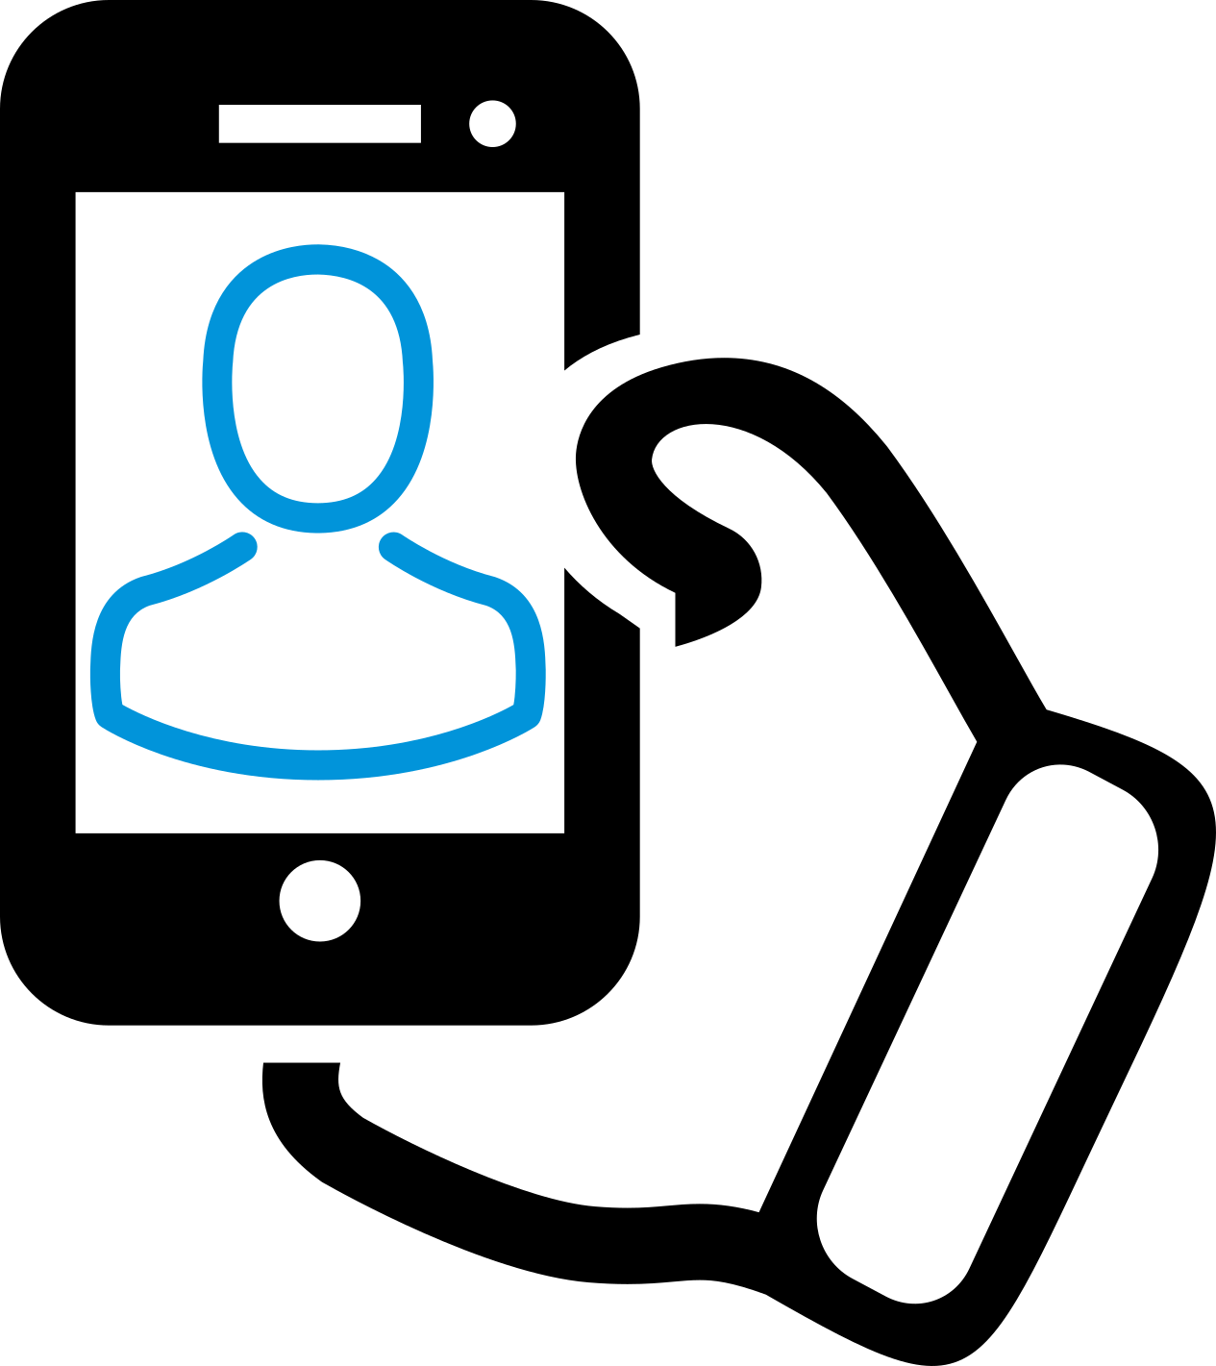
Go digital end to end in customer journeys
Banks should identify and digitalize critical processes. If they do this well, they will have a systematic approach to end-to-end digitization that makes it possible to redesign a customer journey.
A European bank used this approach to develop a new customer onboarding process that only requires “12 swipes and a selfie”.
The required time to open an account was cut by 80% and the amount of required information by 65%.
1X
12X
Notes:
Providing end to end digital customer journeys is one of the first steps into personalised digital sales.
Processes must be fast, simple and consistent to make digitalization complete. Banks should prioritize the most important customer journeys and create fully digital customer experiences, McKinsey suggests. There are about 15 journeys that matter most to retail customers, including opening an account, debit or credit card application or taking out a mortgage.
Banks should identify critical processes and digitalize these. If they do this well, they will have a systematic approach to end-to-end digitization that makes it possible to redesign a customer journey from scratch in 3-4 months, according to McKinsey. One European bank, for instance, used this approach to develop a new customer onboarding process that only requires “12 swipes and a selfie”. The time needed to open an account was cut by 80% and the amount of required information by 65%.
The future of customer-led retail banking distribution, McKinsey, 2017

Slide 9







Personalised products help sell experiences
One in five customers would be ready to pay 20% more for personalised products or services…
…and 22% would be happy to share personal data in return for a more personalised service or product.
Notes:
Besides their expectations for easy and fast banking services, digital customers also want personalized offers. One in five clients would be ready to pay 20% more for tailored products or services and 22% would be happy to share some of their personal data in return for a more personalized customer service or product, according to the survey by Marketforce.
The digital-banking interface should demonstrate that banks understand their customers. Getting familiar with clients’ individual habits helps banks to send relevant content and guidance intuitively, when customers actually need it. But only 20% of banks adapt their online interface based on customer habits, Marketforce finds.
Financial service provider firms are increasingly realizing that customer relationships must be based on experiences rather than products, as people are no longer loyal to companies, brands or products. They are loyal to great experiences. Traditional customer data should be aggregated with non-traditional information from social media platforms or mobile devices to build detailed client profiles and get in-depth customer insights.
Made to Order: The rise of mass personalisation, Deloitte, 2015
Customer insights: Why data aggregation is key, W.UP, 2017

Slide 10

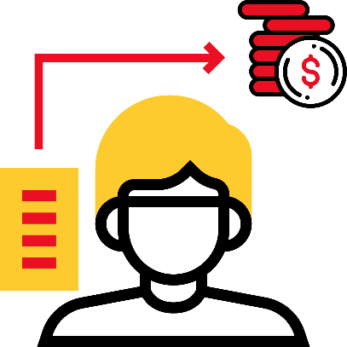
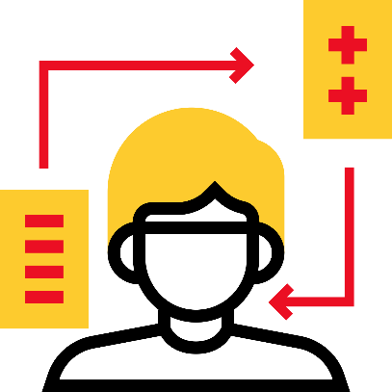
Monetize DATA to enable
personalised Sales
Banks are sitting on plenty of customer data: demographic & social background, purchase history, amounts paid household income.
Monetizing data to enable personalised, insight-driven sales creates new opportunities.
Algorithms detect patterns and learn how to make predictions and recommendations by processing data and experiences.
Notes:
Banks shouldn’t forget that, as ironic as it sounds, technology is key in personalization. It is mostly an automated process that relies on collecting and analyzing customer data. AI tools and advanced analytics are just what banks and credit unions need to go one step further in customizing their marketing campaigns based on behavioral information and micro-segmentation.
With predictive targeting methods, financial institutions can map out customer behavior, ranging from sporting schedules, mobile usage and online entertainment preferences to eating out habits, shopping or even what days someone may like to go out for drinks. Setting up customer profiles based on these characteristics can accurately predict what products these customers are likely to buy.
A grocery shopping profile, for example, tells a financial marketer whether a customer has a big shopping day at the beginning of each month after their salary arrives or shops every Friday before the weekend kicks off. Once these profiles have been created, they also offer an opportunity for banking providers to cooperate with third-party merchants, as they also include information about the individual’s favorite brands and stores.
Financial institutions are sitting on a huge amount of traditional customer data. All they need to do is merge it with non-traditional information, like digital behavioral patterns, social media activities, geolocation and even weather forecasts, to create insight-driven campaigns. These campaigns are built on rich insights, which are processed and knitted together by artificial intelligence and advanced analytics tools.

Slide 11
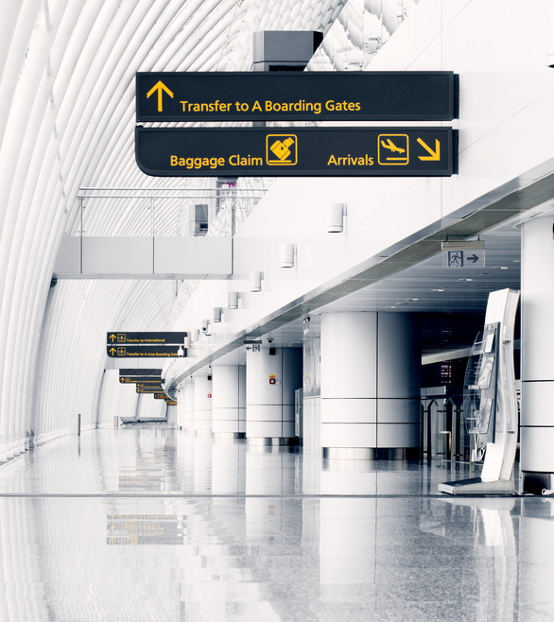
beING At an
airport
1. SUZI TRAVELS ABROAD
Transaction history
Card and insurance products
Location data
2. HER BANK IDENTIFIES SOMETHING
Card limit is set too low
3. ONE-TAP BANKING
Increase card limit to a pre-calculated amount with just one tap
Notes:
The good news is that such insights don’t necessarily have to be overly complex. Even the simplest insights can make a huge difference. For example, studying digital usage patterns can reveal how individuals use online and mobile banking channels, when, what problems they had when performing certain functions, and what digital products or services they might also be interested in. With this information at hand, financial marketers can proactively offer assistance or send out the right offer at the right time.
Predictive analytics helps financial institutions foresee when a consumer will arrive at certain life events or need a financial service solution. And this is not something nice to have. This is the future of marketing in banking. This advanced form of needs analysis, once only accessible to the largest industry players, is now financially and operationally available to organizations of any size.

Slide 12

THIRD PARTY OFFERING
1. KATIE IS AN AVID RUNNER AND NEAR
A SPORTS STORE
Transaction history
SALES.UP analytics sports profile
Location data
Deals at partner stores
2. HER BANK REACTS
Push message: 15% off running shoes
3. BUY IMMEDIATELY
Katie uses her bank card to activate
the deal upon purchase

Slide 13



BANKS must take action
Origination and sales generate 65% of global banking profits, totaling $1,152 billion.
These two profit drivers are in the biggest danger.
Banks must take action now not to lose them.
Notes:
Having the right tools and solutions to boost digital sales has never been more important to banking providers. They’re grappling with rapidly increasing expectations and a new generation of consumers who demand convenience and 24/7 availability on their mobile devices. Incumbents in the financial industry also face fierce competition from digital-only challenger banks and tech giants, which have already ventured into financial services and are feared to enter mainstream banking in the very near future.
Digital disruptors are threatening to chip away at origination and sales income, the two most important profit drivers of incumbent banks. Customer loyalty is at an all-time low: clients can be gone in just three clicks, should they receive a better offer. And this will only get worse with the emergence of open banking, PSD2 regulations and competitors pushing ahead.
Stepping up digital sales and personalization efforts is essential to win new customers and keep the existing ones. Not to mention profitability. Origination and sales generate 65% of global banking profits, totalling about $1,152 billion. These two profit drivers are in the biggest danger. Banks must take action now if they don’t want to lose this profitability, otherwise they could easily end up as commodity providers with very thin margins within 3 to 5 years.

Slide 14


THE DIGITAL
SALES COMPANY
FOR BANKS

Slide 15

BALÁZS VINNAI
President
Balazs.Vinnai@wup.hu
www.wup.digital

