Slide 1

IoT Security – fel vagyunk rá készülve?
Kovács Krisztián | 2018. November 21.

Slide 2


Silicon Labs
FOUNDED IN 1996
LISTED SLAB
~35,000 CUSTOMERS
>1,600 PATENTS
A track record of multiple industry
firsts, transforming and disrupting
large markets
  Core competencies in mixed-signal and
  RF CMOS silicon architectures, software,
  and systems
  Focus on high-quality, diversified markets
  Well positioned for sustainable growth
Krisztián Kovács
  Leading the WW IoT Applications team
  Managing the Engineering Design Center in Budapest

Slide 3



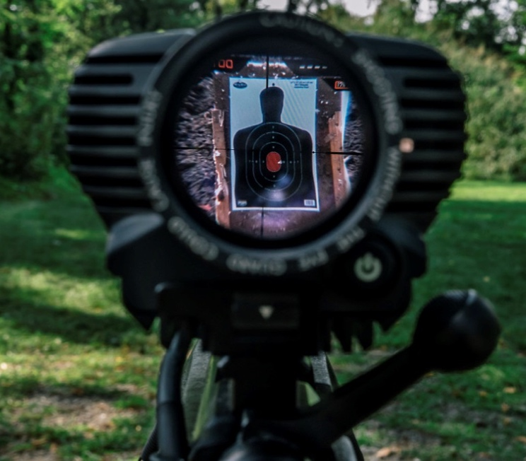
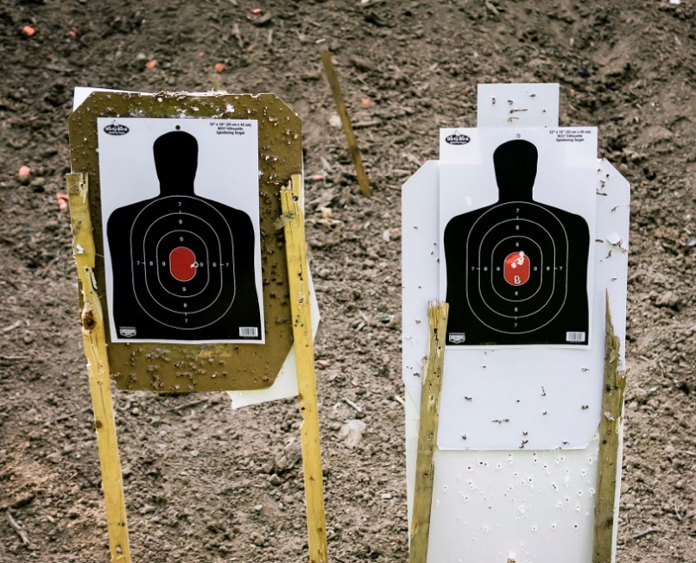
Is it a real concern?
Smart Engineers
What you see
You aimed
here
The gun
shot here

Slide 4

Yes, it IS…
Mirai botnet enslaved poorly defended IoT devices:
10/12/16 - launched DDoS attack against Dyn
shut down much of the internet service in the US
Mirai is still enslaving new devices today!
How it works?
Attack through Telnet with default passwords
Does two things:
  Tries to login to random IP to deploy itself
  Enables a CLI being able to trigger a DDoS attack
Built for most common IoT CPU architectures:
  x86, ARM, PowerPC, etc.
Lives in memory until reboot

Slide 5




Governments start to act
Guidelines
Code of Practice
IoT Security law
  Educating the industry
  Collection of technology related best practices, white papers
  https://www.nist.gov/itl/applied-cybersecurity/nist-initiatives-iot
“Code of Practice for consumer IoT security”
13 outcome-focused guidelines, covering the whole device life cycle
https://www.gov.uk/government/publications/secure-by-design/code-of-practice-for-consumer-iot-security
California issued the first “IoT Security Law”
Device makers are mandated to establish “reasonable” security
https://www.cnet.com/news/california-governor-signs-countrys-first-iot-security-law/
  (CNET, US-California, Sept 28, 2018)

Slide 6
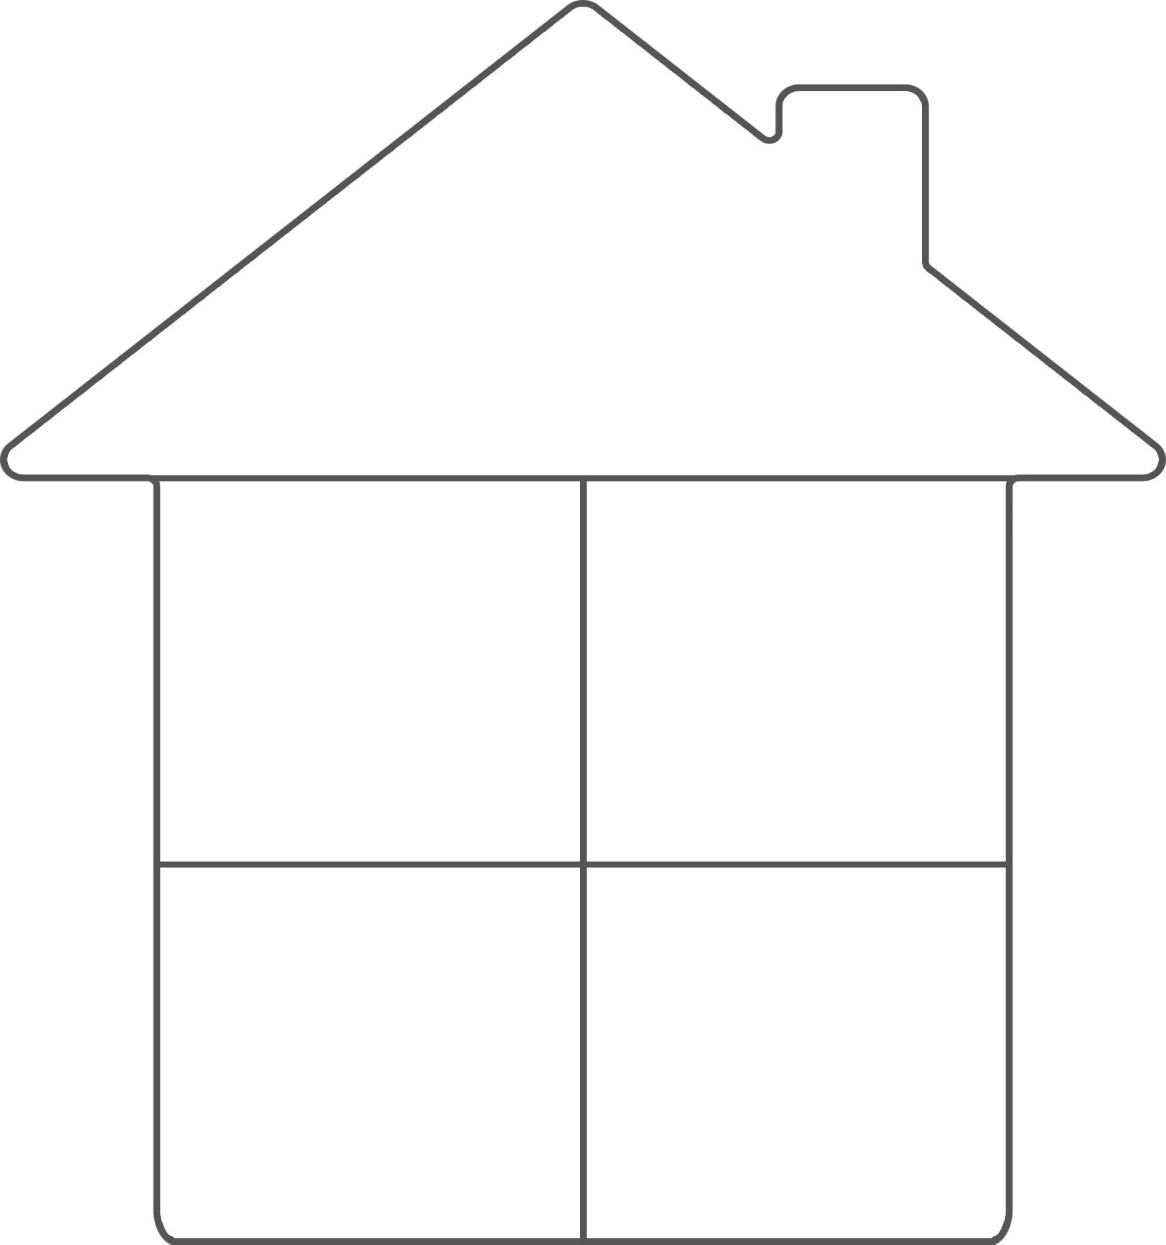











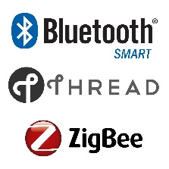





Increased attack surface
Accessibility to hardware
Limited processing power in end nodes
/
Proprietary
/

Slide 7
Industry incorporates HW security features
Secure Enclave:
  Isolates keys and key usage from application
  Application can use, but not see keys
Enhanced Cryptography:
  Lightning fast HW engines for IoT chipers
  Mbed TLS library that uses the HW engines optimally
HW Crypto
Engines w/DPA
Secure
Identities
True Random Numbers
TrustZone
Secure
Debug Lock
Secure Key Storage w/PUF
Secure Boot
Tamper Detectors

Slide 8
Industry incorporates HW security features
True Random Number Generation:
  Needed for cryptography & communication protocols
  HW peripheral with conditioning and health test
Secure Debug Lock:
  JTAG permits full access to code and data on a device
  Desired to protect, but reopen for RMA or upgrades
Tamper protection:
  Voltage, clock, temp. and magnetic tamper detection
  Detection of broken enclosure via buttons and trace
HW Crypto
Engines w/DPA
Secure
Identities
True Random Numbers
TrustZone
Secure
Debug Lock
Secure Key Storage w/PUF
Secure Boot
Tamper Detectors

Slide 9
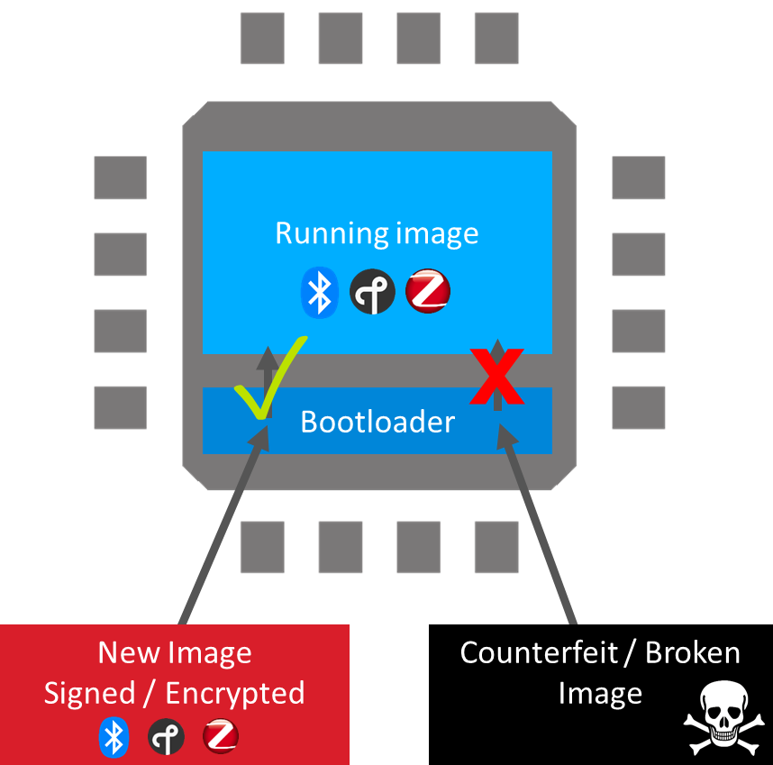
Industry incorporates security SW features
Secure boot:
  Most attacks rely on changing/controlling the code running on a device
  Secure the firmware running on the device
Over The Air update:
  There is no such things as “SECURE DEVICE”
  Critical to build in a secure way of upgrading the device on the field

Slide 10
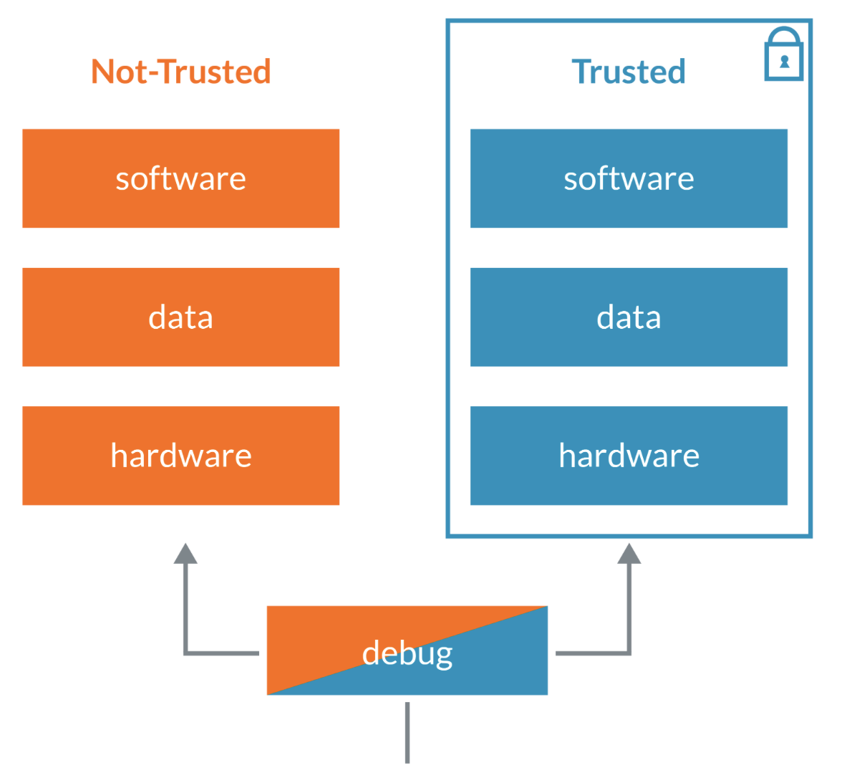
Industry incorporates security SW features
TrustZone:
  Added security in case of bugs or an attack
  ARM Armv8-M TrustZone (Cortex-M23/33) offers software isolation to code, memory and I/O while retaining real-time deterministic response and minimal switching overhead
  Secure state is kept as small as possible to reduce the attack surface and vulnerabilities
  Programs running in secure state can access both secure and non-secure information, whereas non-secure programs can only access non-secure resources

Slide 11
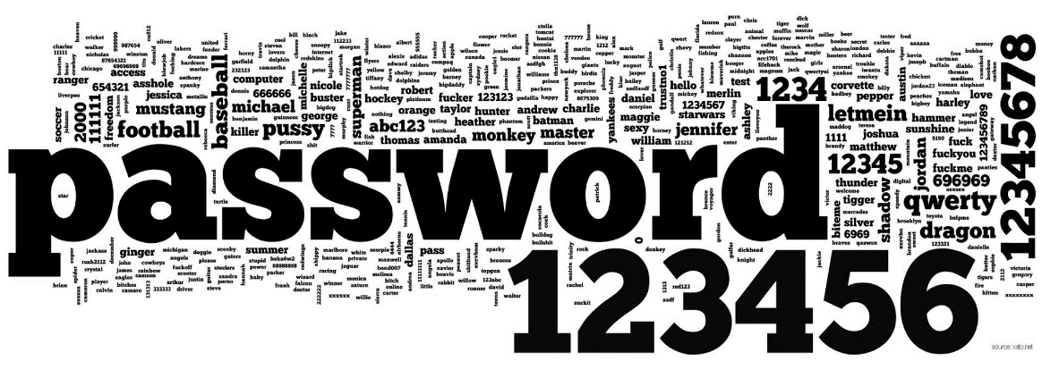
Application security
Never use static passwords
Force user to set password
Don’t allow common passwords

Slide 12
Final thoughts
Security is a process, not a feature!
  IoT devices will need to evolve, continuously monitored and protected against cyber attacks
Be a good citizen!
  Secure your IoT applications!
Technology is there: USE it correctly!
  Encryption, authentication, secure updates, etc.

Slide 13
Thank you!

