Slide 1
Territorial Dispute – NSA’s perspective on APT landscape
Boldizsár Bencsath PhD
BME CrySyS Lab / www.crysys.hu - Budapest University of Technology and Economics
Short: Boldi / CrySyS Lab

Slide 2
Territorial Dispute
What is it?
Scanners
SIG1..SIG45
windows\Resources\TeDi\PyScripts\ - sigs.py
tedilog = getLogger('TERRITORIALDISPUTE')
windows\Resources\Ep\Scripts\malfind
windows/Resources/Ep/Scripts/ifthen/gwdef_other_peeps.txt
windows\Resources\Ops\Databases\DriverList.db
windows\Resources\Ops\Data\drv_list.txt
windows\Resources\Ep\drv_list.txt

Slide 3
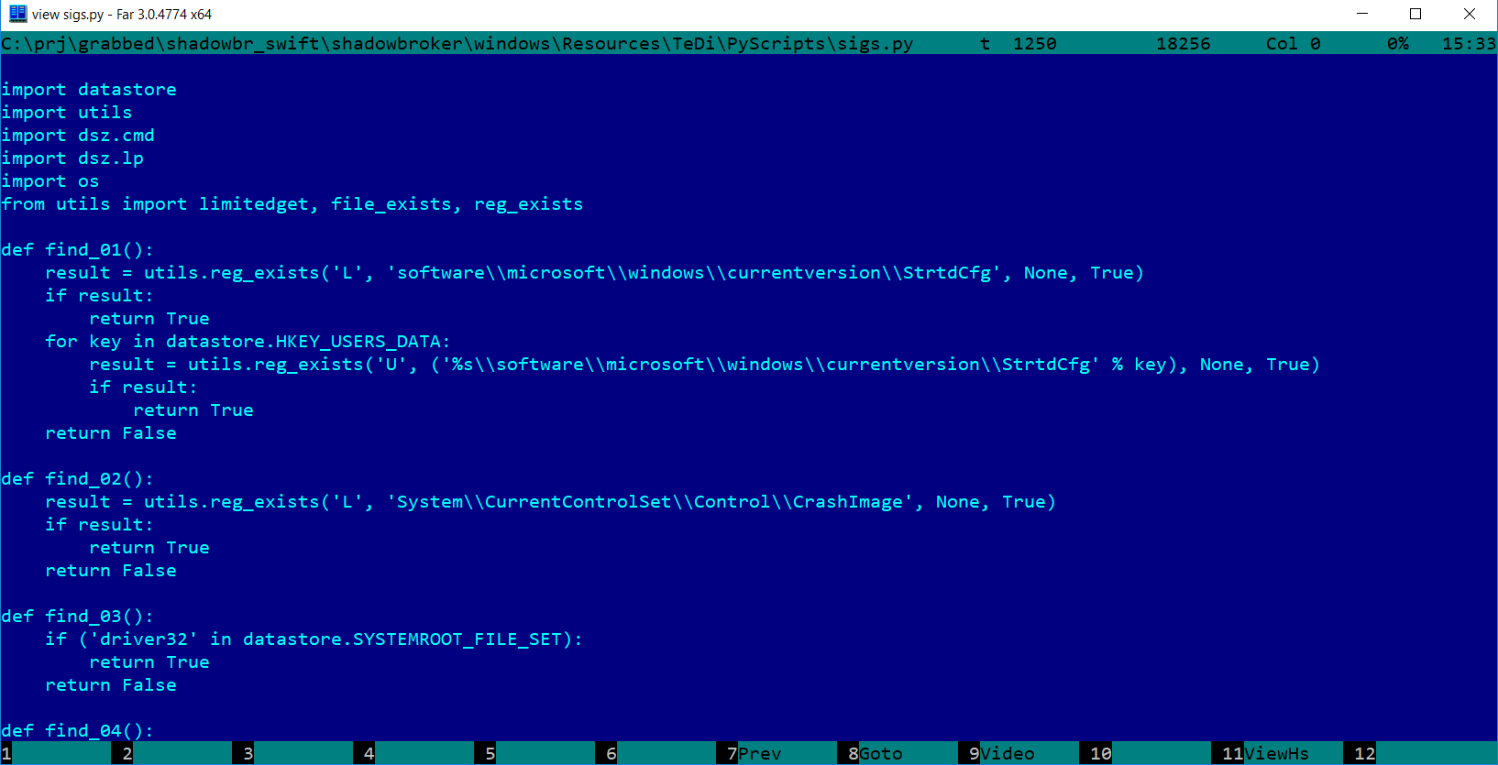

Slide 4
Seems familiar? Yes, SIG8 is Stuxnet!

Slide 5
“GET” script for SIG8/Stuxnet

Slide 6
Interactivity…

Slide 7
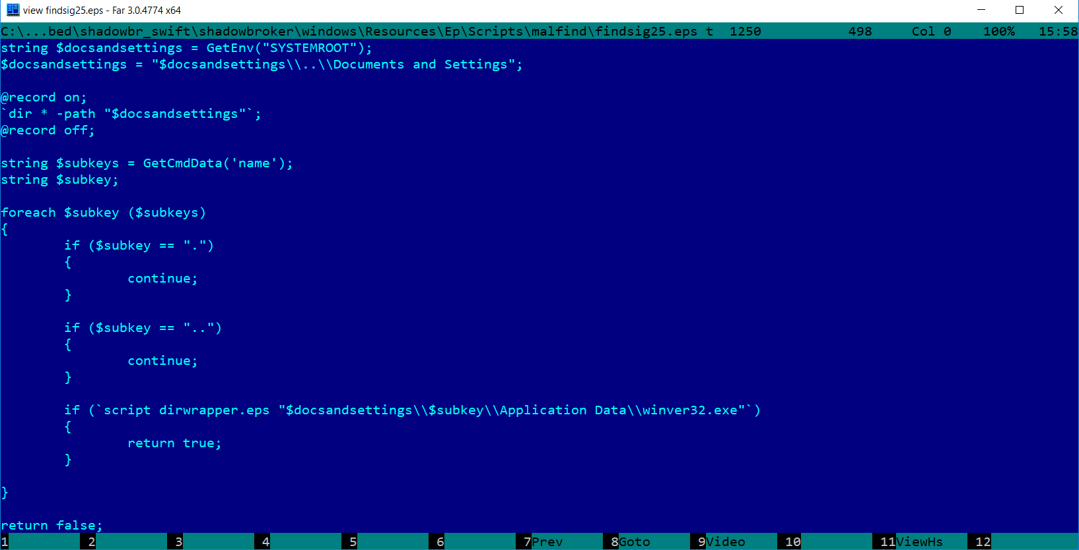
SIG25

Slide 8
SIG25 – Dark Hotel

Slide 9
An example – exforel SIG30
A short list of IoCs
Three file names and one driver
IoC | type, method | remarks
SYSPATH\msdxofg.dll | file
SYSPATH\ocmsiecon.hlp | file
SYSPATH\atllib.dll | file
ndisxapi.sys | driver

Slide 10
Exforel 2
http://sha1.virscan.org/492dc600e22de6da96898e097566bc01309b5996.html
http://artemonsecurity.blogspot.hu/2012/12/analysis-of-virtoolwinntexforela-rootkit.html
https://www.microsoft.com/en-us/wdsi/threats/malware-encyclopedia-description?Name=VirTool:WinNT/Exforel.A

Slide 11
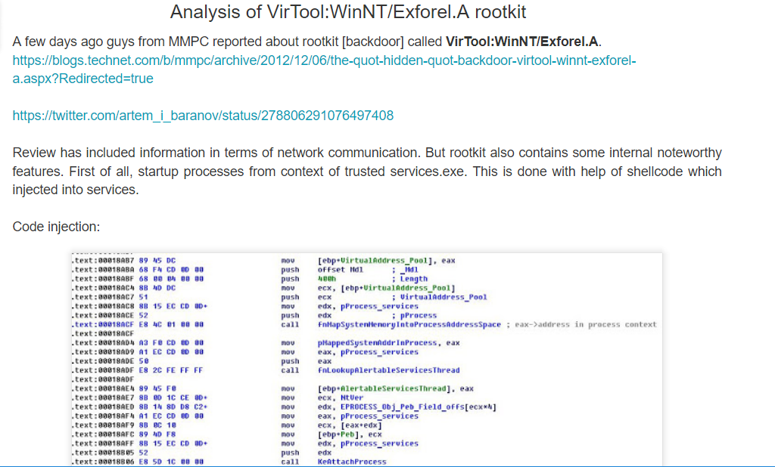

Slide 12
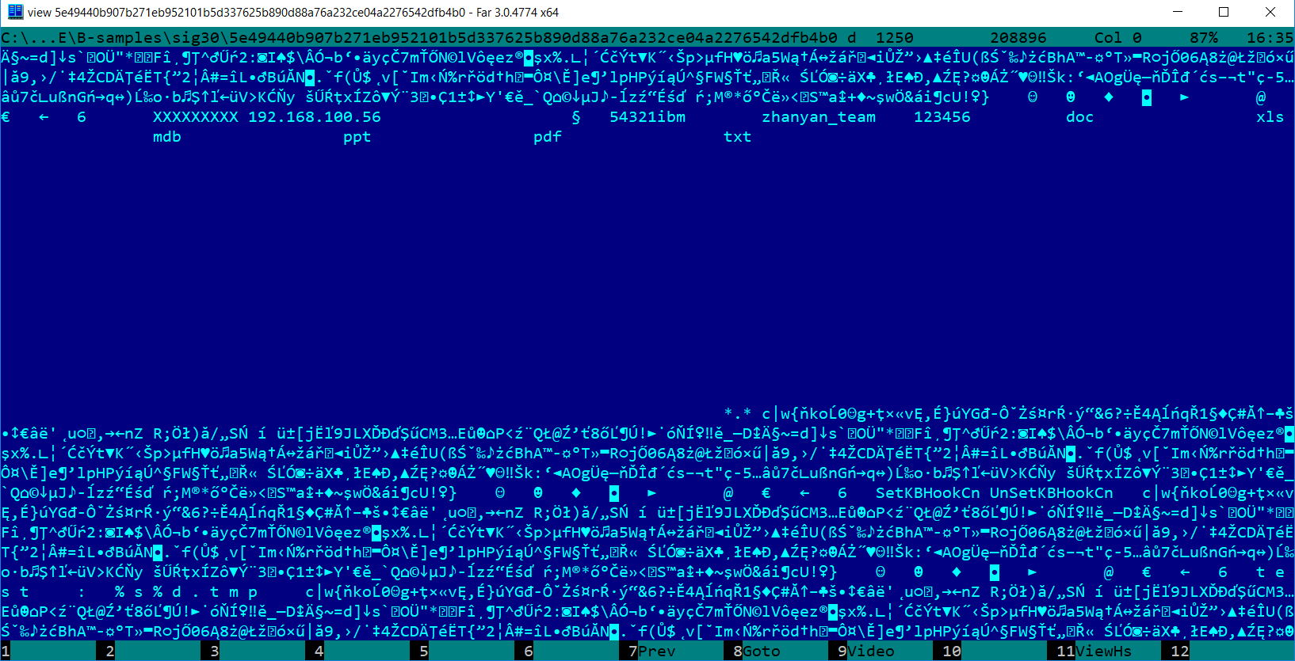
Strange thins in 5e49440b907b271eb952101b5d337625b890d88a76a232ce04a2276542dfb4b0

Slide 13
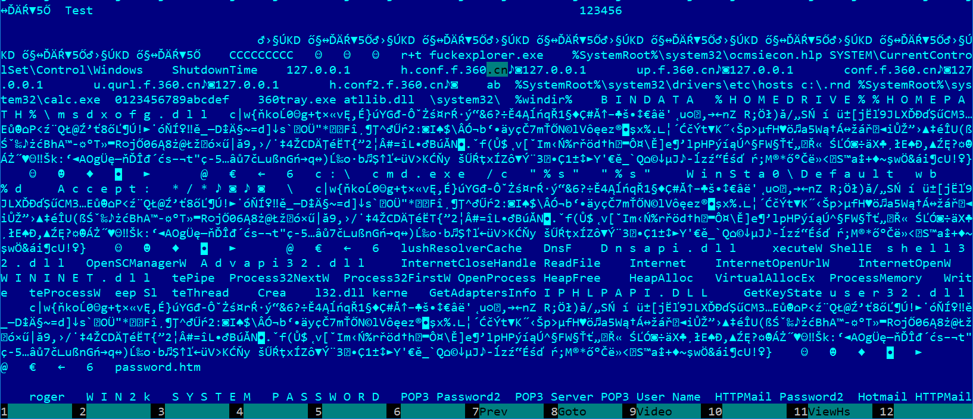
668ce24473d788791d2bfee0caec2d10dca52b5bc8c021bf06f9eb3527688ade might also relate exforel

Slide 14
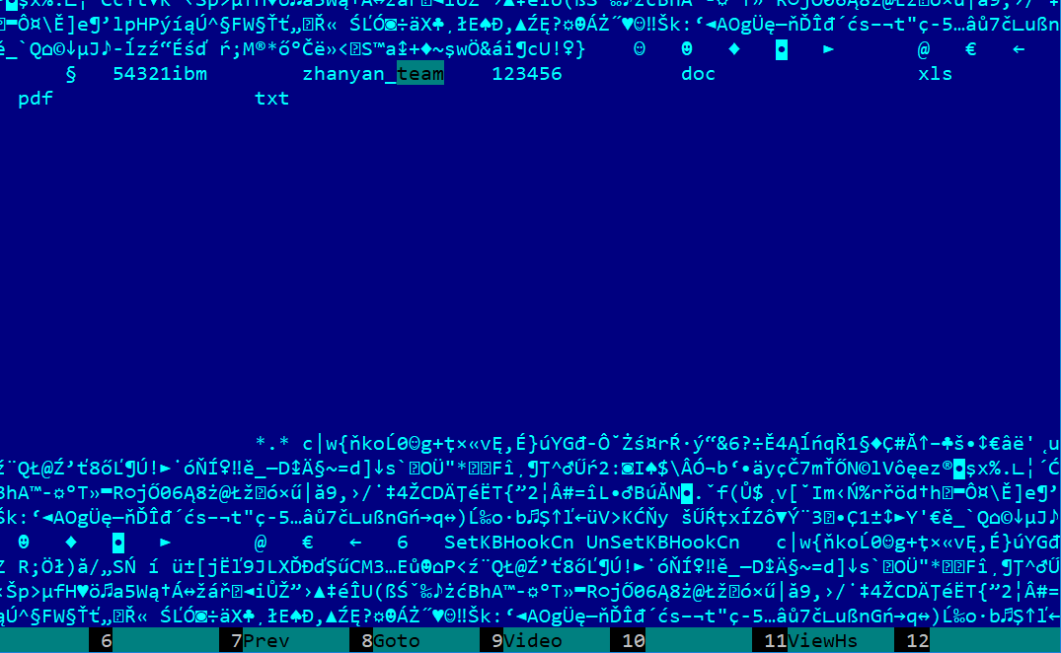
The latter sharses zhanyan_team id
Is it Exforel?
Maybe
More research is needed!

Slide 15
Sig35 – Duqu – “9N”
Very strange rule. Looking for “NNNNNNNNN” ?

Slide 16
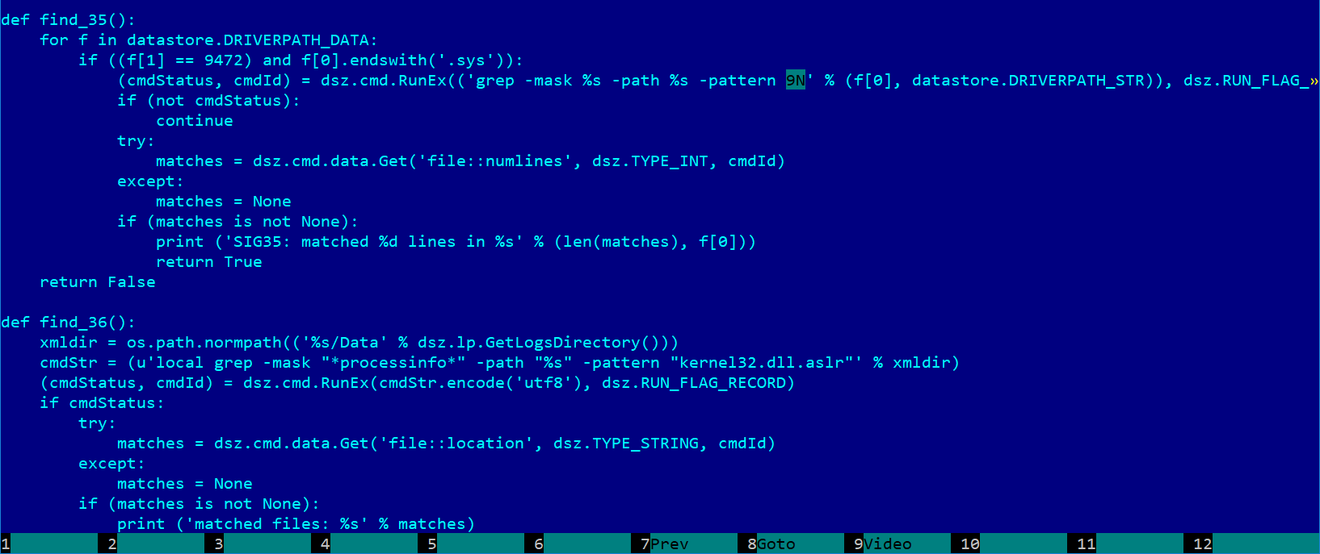
Would you check for exact size? Sig35/Duqu

Slide 17
Findings summary
SIG no. | Possible APT other name | First public report | remarks
SIG1 | Agent.BTZ (Turla) | 2008.06.X ? 2008.11.19.
SIG2 | Turla | 2008.11.X. 2014.02.15. ?
SIG3 | ShipUp? | 2008.10.29.
SIG4 | Snake/Uroburos | 2014.02.28. | dated 3+ years old
SIG5 | Trojan dropper Agent.ikcb Turla tool? | 2013.10.15.
SIG6 | ? | ?
SIG7 | GhoTex | 2007.03.04. | Octa-B?
SIG8 | Stuxnet 2 drivers unknown s7otbxdxa.sys s7obxsx.sys | 2010.06.15. | Dated dev.: 2005~
SIG9 | Flame | 2012.05.28. | Dated dev.: 2010~
SIG10 | miniFlame | 2012.10.15.
SIG11 | ? | ?
SIG12 | Spuler? | 2012.11.26?
SIG13 | Agent.BTZ? | see 1
SIG14 | ? | ?
SIG15 | Turla/Snake/Uroburos | PDF:2015

Slide 18
SIG16 | Flame | 2012.05.28.
SIG17 | SunFlower / Chesire Cat / Flowershop | ~2015 | samples point back to 2002
SIG18 | Moonflower / Chesire Cat / Flowershop (sunflower moonflower) | ?
SIG19 | ? | ?
SIG20 | Animal Farm | 2015.03.06. | in use since 2013?
SIG21 | ? | ?
SIG22 | Aurora/Hydraq | 2010.01.12. | Op: 2009.06-12
SIG23 | Turla (Epic Turla) | 2014.08.07. | Under analysis for 10 months
SIG24 | ? | ?
SIG25 | Dark Hotel | 2014.11.10.
SIG26 | ? | ?
SIG27 | ? | ?
SIG28 | Rotinom | 2011.01.11.
SIG29 | ? | ?
SIG30 | Exforel | 2012.11.28.

Slide 19
SIG31 | ? | ?
SIG32 | ? | 2008.06.13.
SIG33 | ? | ?
SIG34 | ? | 2014.05.14.
SIG35 | Duqu | 2011.09.01.
SIG36 | Stuxnet/Duqu? | see 8 / 35
SIG37 | IronTiger_ASPXSpy | ?
SIG38 | ? | ?
SIG39 | Teamspy | 2013.03.10.
SIG40 | Sednit/Sofacy | 2015.02.09.
SIG41 | ? | 2011.03.29.
SIG42 | ? | ?
SIG43 | Turla | see 2, 2014.01.X
SIG44 | ? | ?
SIG45 | ? | ?

Slide 20
Samples from the malware repo
Used the IoC strings as search strings with yara
In our ~150 TB size of malware samples
Amazingly high FP rate (e.g. adobe.dll string)
We found some ~5000 samples with possible relationship
Most likely 90% is FP,
Your help is needed to find out clues!
sig2 | 14
sig3 | 6
sig4 | 300
sig5 | 1
sig6 | 370
sig7 | 139
sig8 | 186
sig9 | 794
sig10 | 1
sig12 | 6
sig13 | 21
sig15 | 60
sig16 | 4
sig17 | 770
sig19 | 1
sig20 | 15
sig22 | 25
sig25 | 695
sig28 | 7
sig30 | 25
sig31 | 112
sig35 | 4
sig38 | 41
sig40 | 2
sig44 | 6
sig45 | 1557

Slide 21
LET'S TALK!
Boldizsár Boldi Bencsáth – BME CrySyS Lab
www.crysys.hu

