Slide 1
Gépi tanulás a végpontvédelemben
Bányai Árpád
Technológiai megoldásszakértő
CISSP
Notes:
Windows Defender Advanced Threat Protection is a new service that will enable our enterprise customers to detect, investigate, and respond to advanced and targeted attacks on their networks.

Slide 2
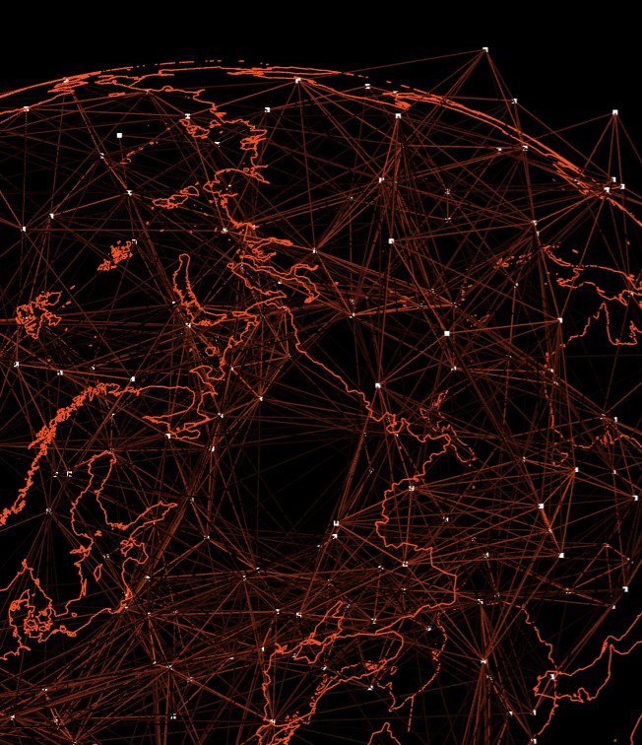
A probléma
Naponta 300.000-nél több rosszindulatú software készül
A malware-ek 96 % -át egyszer látjuk
Notes:
https://blog.openai.com/openai-and-microsoft/

Slide 3
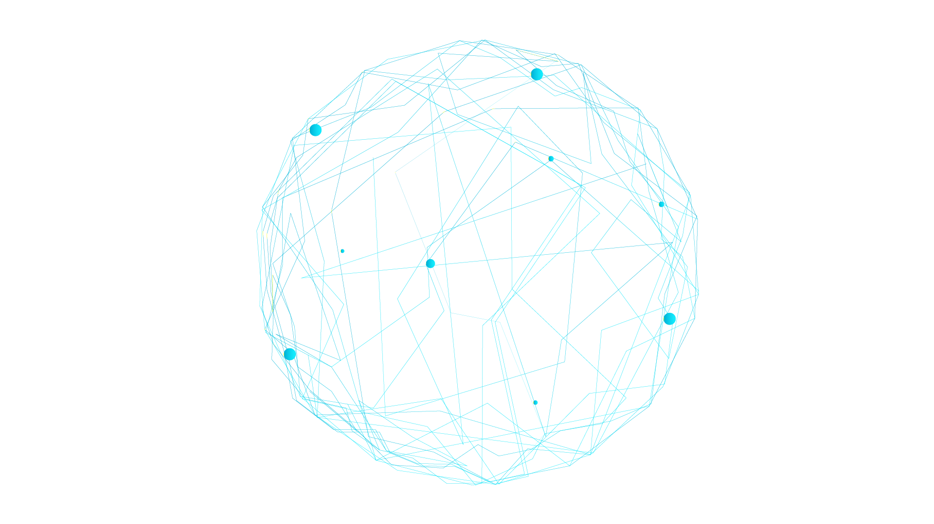
THE MICROSOFT INTELLIGENT SECURITY GRAPH
1 Milliárd
Windows eszköz frissítése
200+ globális felhős szolgáltatás
300 milliárdnyi hitelesítés havonta
18+ milliárd web lap ellenőrizve
Havi 200 milliárd e-mail vírusvizsgálata
Notes:
The Microsoft Intelligent Security Graph is a platform that uses advanced analytics to link threat intelligence and security signals from Microsoft and partners to combat increasing cyberthreats. The Intelligent Security Graph offers real-time threat protection for Microsoft products and services and unified APIs to support an ecosystem of integrated solutions.
The Intelligent Security Graph contains unique insights informed by Microsoft’s vast perspective on the security landscape. Consider that:
400 billion emails get analyzed by Outlook.com and Office 365 email services every month
1.2 billion devices get scanned every month by Windows Defender
We operate 200-plus global cloud, consumer, and commercial services. Everything from outlook.com to Xbox Live to Office 365 to Azure, and so on.
Enterprise Security from Microsoft is employed by 90% of the Fortune 500.
We see 450 billion monthly authentications
Bing scans about 18 billion web pages every month
We have over 3,500 full time security staff

Slide 4
Registry változtatás
Adat titkosítás
Script végrehajtás
Kernel EoP
Malware detektálás
Alkalmazásfuttatás
INTELLIGENCE
Csatlakozás IP-hez
SIGNAL
User log-ins
File létrehozás változtatás
Phishing
Memory in
Process/threads létrehozás
Web böngészés
Notes:
This could easily multiply the value that each product that you have provides, by combining and correlation from the different sources that you will be able to consume.
OPTICS + DATA + EXPERTISE = market leading INTELLIGENCE
We believe that MS is in a very unique position to play in this field

Slide 5
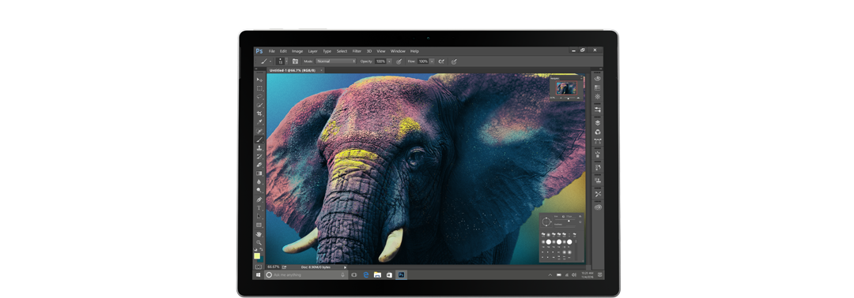
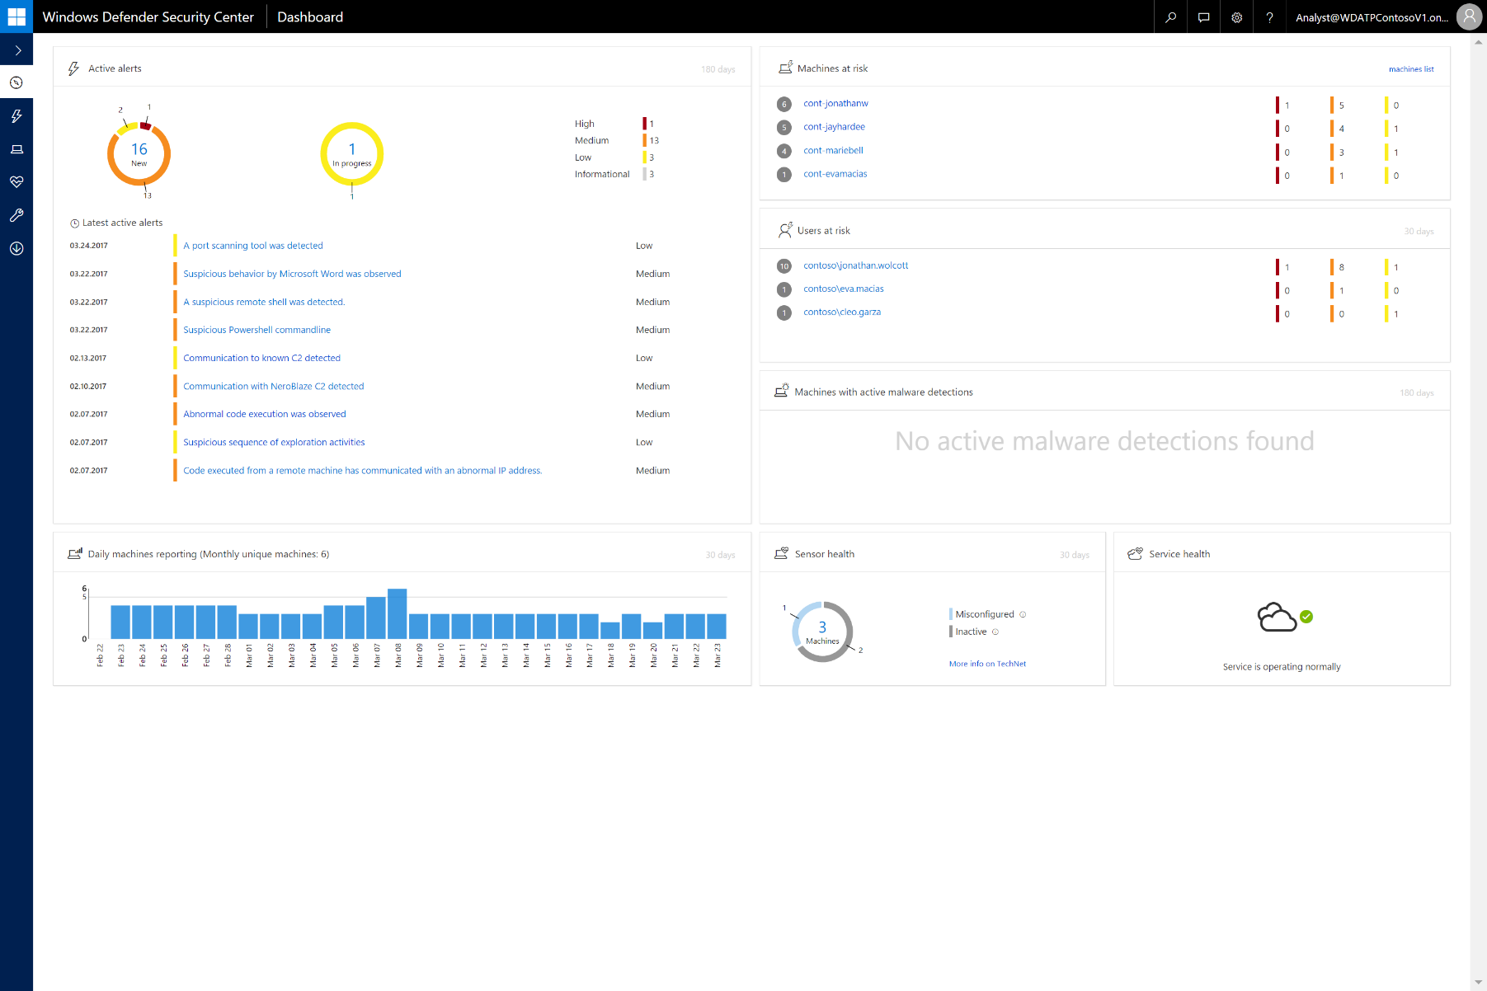
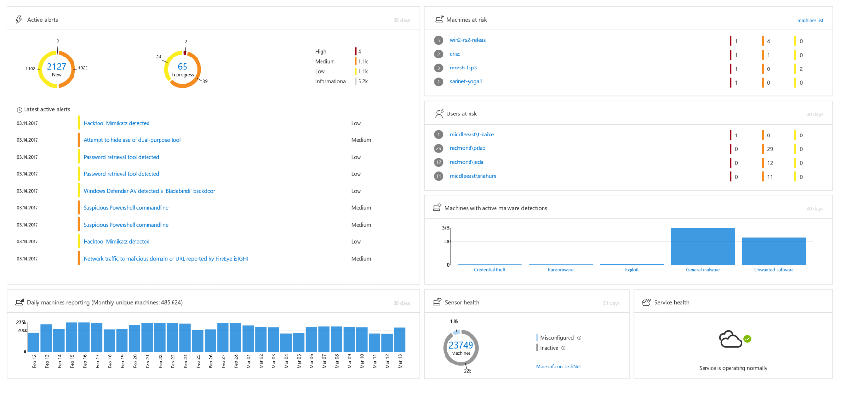
Malware felderítés DEMO
Notes:
URL: http://securitycenter.windows.com (in the InPrivate window)
U: SecOps@WDATPContosoV1.onmicrosoft.com ​
P: WicdPass!
Investigation part of the demo – you can also find screenshots of the investigation walkthrough in the appendix section
Investigation
Open Dashboard and view Latest alerts and Machines at risk. Click on cont-jonatanw
View Related alerts on cont-jonathanw (from bottom to top):
Click on “Process privilege escalation due to kernel exploit” alert to highlight it in Timeline
Scroll down to show “Outlook saved an attachment to disk” behavior (how it got here)
See email details (sender, subject, attachment name)
[Optional] Click on “More details in Office 365” to go to O365 ATP Threat Explorer
See the attachment was blocked based on Behavioral detection (WDATP)
Same email was sent to 3 recipients, and blocked for eva.macias, and jay.hardee
Click on cont-jayhardee to investigate the machine in WDATP
Click on “Abnormal code execution” alert (link) to view Alert Process Tree
Click on back/Breadcrumb to return to cont-jonathanw
Click on “Process privilege escalation due to kernel exploit”
Click on circle next to Winword and then next to “Access token modified” to display details panes and show the different privileges
Click on back/Breadcrumb to return to cont-jonathanw
Select alert “A suspicious reverse shell was detected“ to navigate to and highlight the alert and related events in the machine timeline
Point out the same external IP Address appears several times since the original alert
Click on the IP Address (40.69.149.89) to show the IP Page (ignore NeroBlaze alerts)
The first alert was generated on cont-jonatanw, the others on cont-jayhardee, connecting the two machines
The same user account is involved – on both machines, indicating lateral movement
Click on contoso\jonathan.wolcott and navigate to the User account page
The User Account shows additional alerts generated on both machines
Click on “More details on this user in ATA” to navigate to ATA
ATA Profile page of cont-jonathanw
Return to contoso\jonathan.wolcott
Notice that there are 3 machines that jonathan.wolcott was logged in to
Scroll down to the grid at the bottom of the page and see the third machine is cont-evamacias
Click on cont-evamacias to navigate to investigate the machine
See a Medium alert on cont-evamacias: “Communication to NeroBlaze C2 was detected”

Slide 6
Cross-platform és partner támogatás
Windows Defender ATP végponti támogatása
Windows | Windows Server |  | iOS | Android | Mac | Linux
Windows 10 | Server 2016
Windows 8.1 | Server 2012 R2
Windows 7 SP1
NEW
NEW
Notes:
WDATP support for Windows 7 & Windows 8.1 blog post - https://blogs.windows.com/business/2018/02/12/announcing-windows-defender-atp-support-for-windows-7-and-windows-8-1/#Bt1AjmbWKlLGiy7Q.97
WDATP partner support blog post - https://blogs.windows.com/business/2017/11/08/microsoft-partners-extend-windows-defender-atp-across-platforms/#GQL0xyGVRqbGETdh.97
Natively managed by Microsoft Intune and System Center Configuration Manager (SCCM)
Support for 3rd party MDM platforms
Provides coverage for the modern diverse network

Slide 7
The Microsoft Security Model
Combined Microsoft Stack:
Maximize detection coverage throughout the attack stages
Office 365 ATP
Windows ATP
ATA
Email
End Point
User
User receives an email
Opens an attachment
Brute force an account
Lateral Movement
Domain Dominance
Clicks on a URL
Exploitation
Installation
C&C channel
Reconnaissance
Office 365 ATP
Windows Defender ATP
Azure ATP
Email protection
End Point protection
Identity protection
User browses to a website
User runs a program

Slide 8
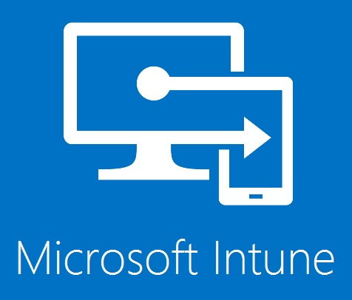
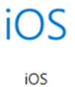
Microsoft Intelligent Security Graph API-t
Security Providers
Azure ATP
Azure AD Identity Protection
Windows Defender ATP
Azure Security Center
Office 365 ATP
Cloud Application Security
Azure Information
Protection
Intune
Ecosystem
Partners
Data and Actions
Microsoft Graph Security API
Other Microsoft Graph Services
Office 365 | Intune | Active Directory | More…
Alerts
Security Profiles
Host | User | File | App | IP
Actions
Configurations
Users
Groups
Mail
Files
Calendar
Insights and relationships
Authentication & Authorization
OAuth 2.0 and OpenID Connect 1.0
Supported SDKs and
Sample Code

Slide 9
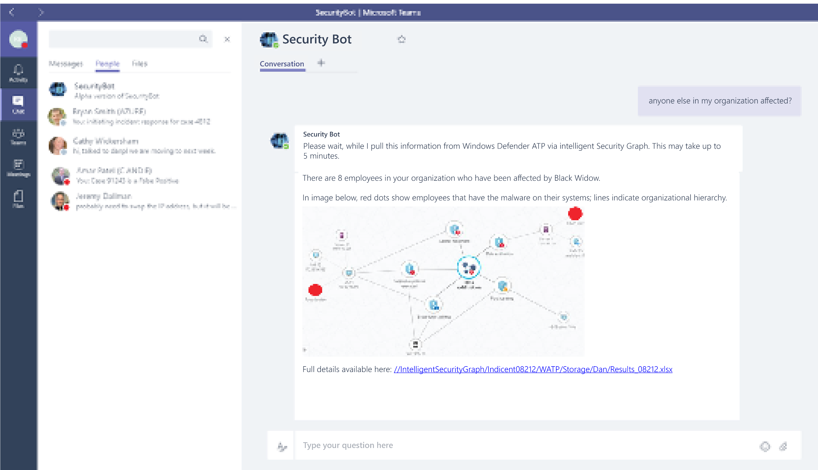
Vizió SecOps ChatBot
Security Bot | Microsoft Teams

