Slide 1

The Largest Independent
Marketing Platform Company
Notes:
The Largest Independent Marketing Platform Company

Slide 2
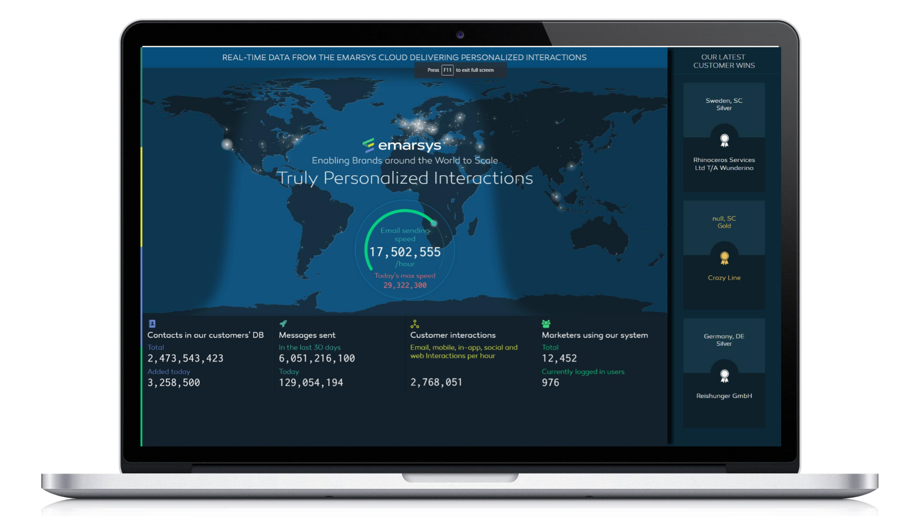
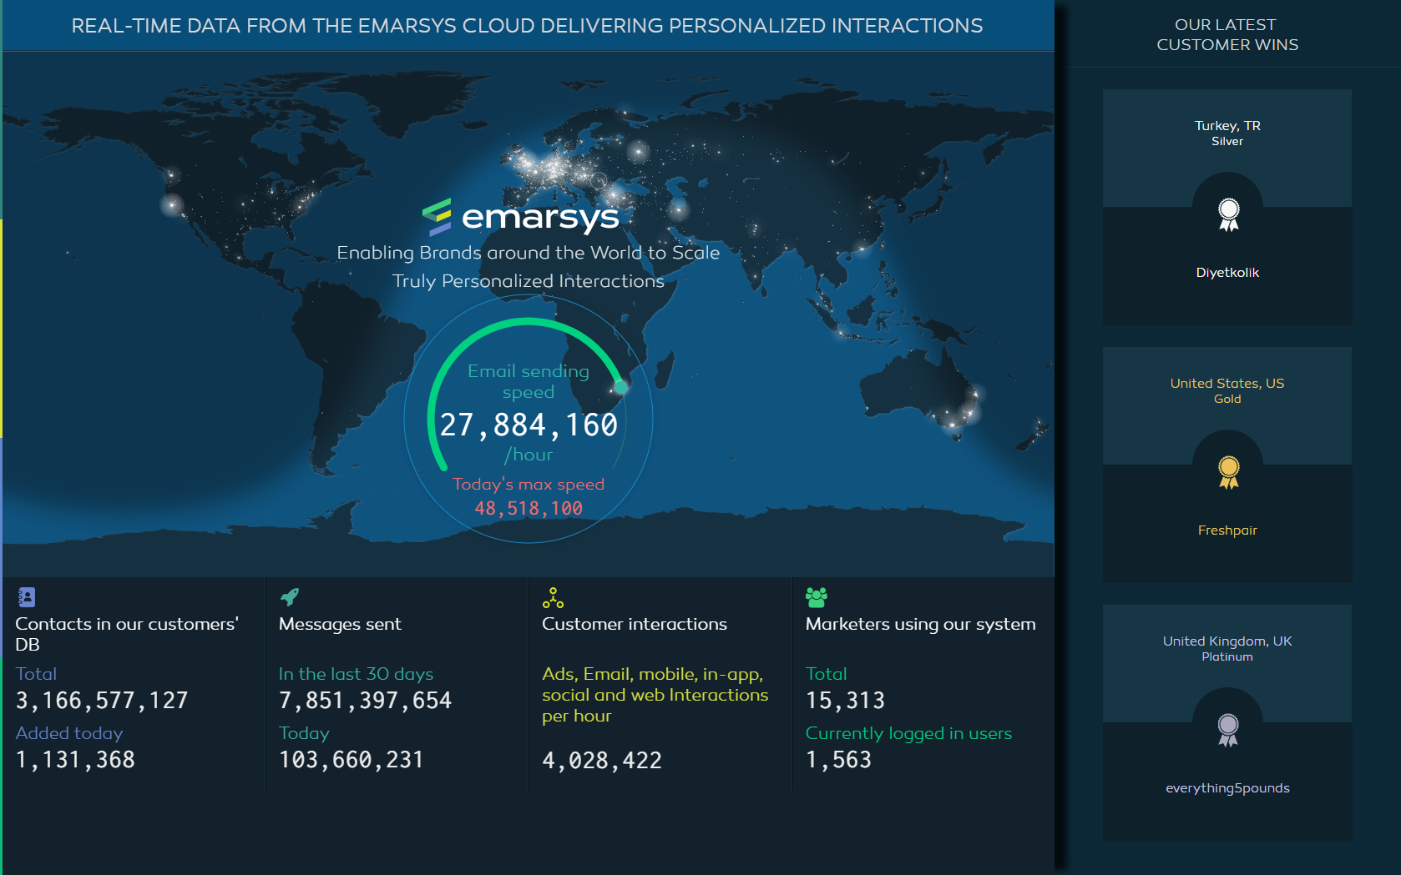
Notes:
1p cégről, rólam

Slide 3
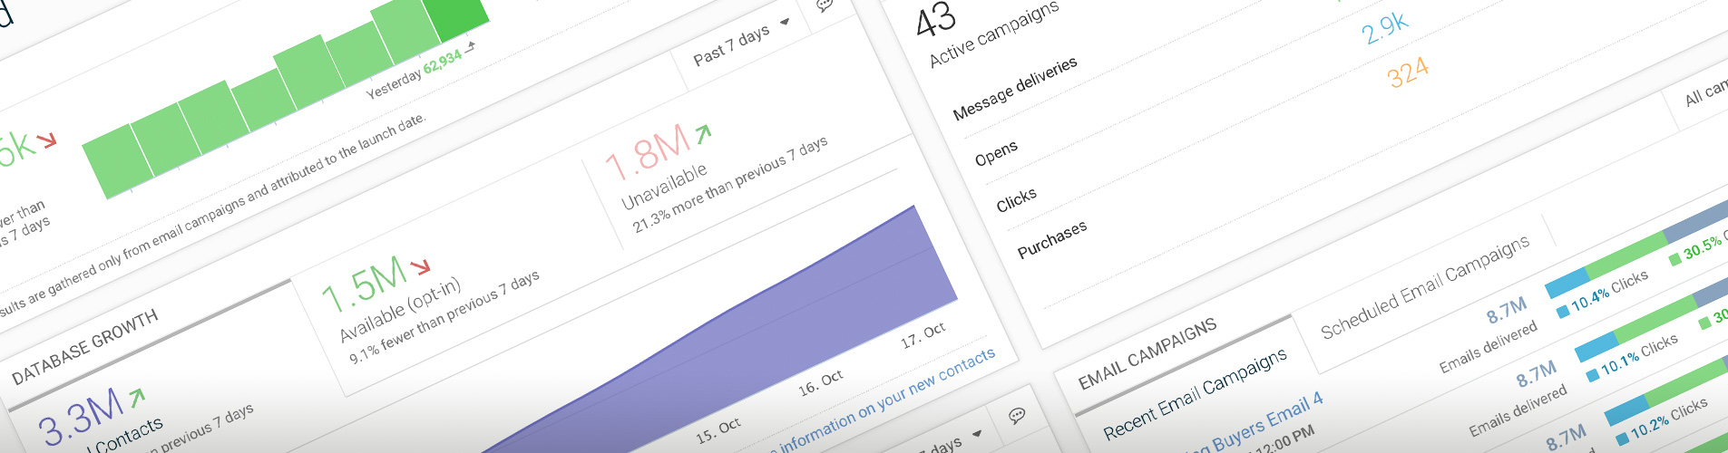
AGENDA
1. Arhitecture 2. Why GCP?
3. Experiences 3. Conclusions

Slide 4
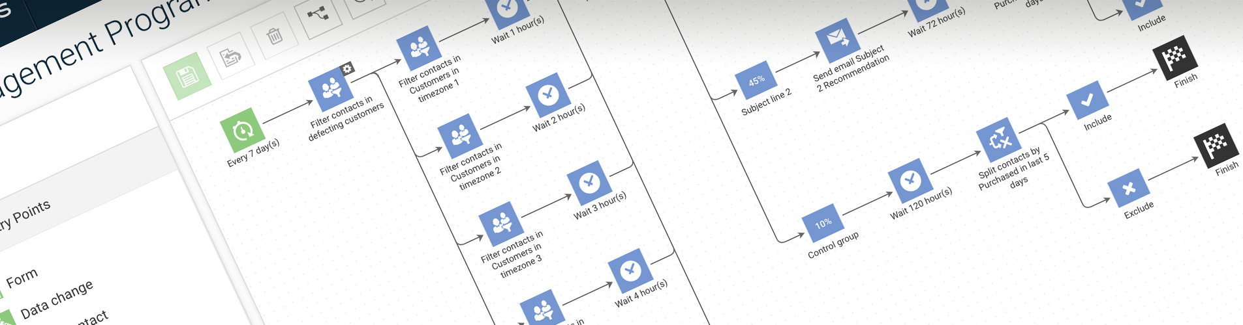
Arhitecture
01

Slide 5
Real time consumer data flow
Products collecting data
(Suite, Mobile SDK, Webextend, …)
Products consuming data
(Segmentation, Reporting, Domain rep., ...)
Execution Products creating treatment data
(Email sending, push sending, Personalisation, ...)
Behavior Data
Email
Web
Purchases
Push
Treatments Data
Mobile
Email - send, campaigns, content
Push – send, campaign, content
…
Notes:
Overview:
DP, - incoming data, real time enrichment through big table
AIP – heroku python, de kubernetes lesz a gépméret miatt.
Jenő Kubernetes – R on Kubernetes
Collecting level: If something wrong, no one really cares or not realize it
Consuming level: the decision is in the hand of the marketer whether it is good or not. She won’t realize 3% noise in the data
Execution level: these are generating the treatments. Tons of alerts and QA in the execution part,
but it was not a goal usually to store the whole treatment (content?)

Slide 6
Real time consumer data flow – AI Services
Products collecting data
(Suite, Mobile SDK, Webextend, …)
Products consuming data (Why)
(Segmentation, Reporting, Domain rep., ...)
Execution Products creating treatment data (How)
(Email sending, push sending, Personalisation, ...)
AI services creating AI data (Why)
Behavior Data
AI Data - WHY
Email
Geo – home location
Web
Buying probability
Purchases
Engagement score
Push
…
Treatments Data
Mobile
Email - send, campaigns, content
Push – send, campaign, content
…
Notes:
AI services add the next layer: these are on the top of the Behavior Data and help answering the WHY part.

Slide 7
Real time consumer data flow – AI Solutions
AI solutions
Connecting Behavior data + AI data with execution and creating Treatment data
Behavior Data
AI Data - Why
Treatments Data
Email - send, campaigns, content
Behavior Data
Push – send, campaign, content
Al Data
Incentive history
Recommended products
Sending timeslots
Buying Probability history (Why)
Notes:
AI Solutions: connecting the Behavior Data and AI Data with the Execution and
It is mandatory to store the treatments and answer for the Whom What, When, Why
An AI algorithm could work only in the case, when there is Behavior data, Treatments data which is accessible, and answers for the Who What, When, Why questions

Slide 8
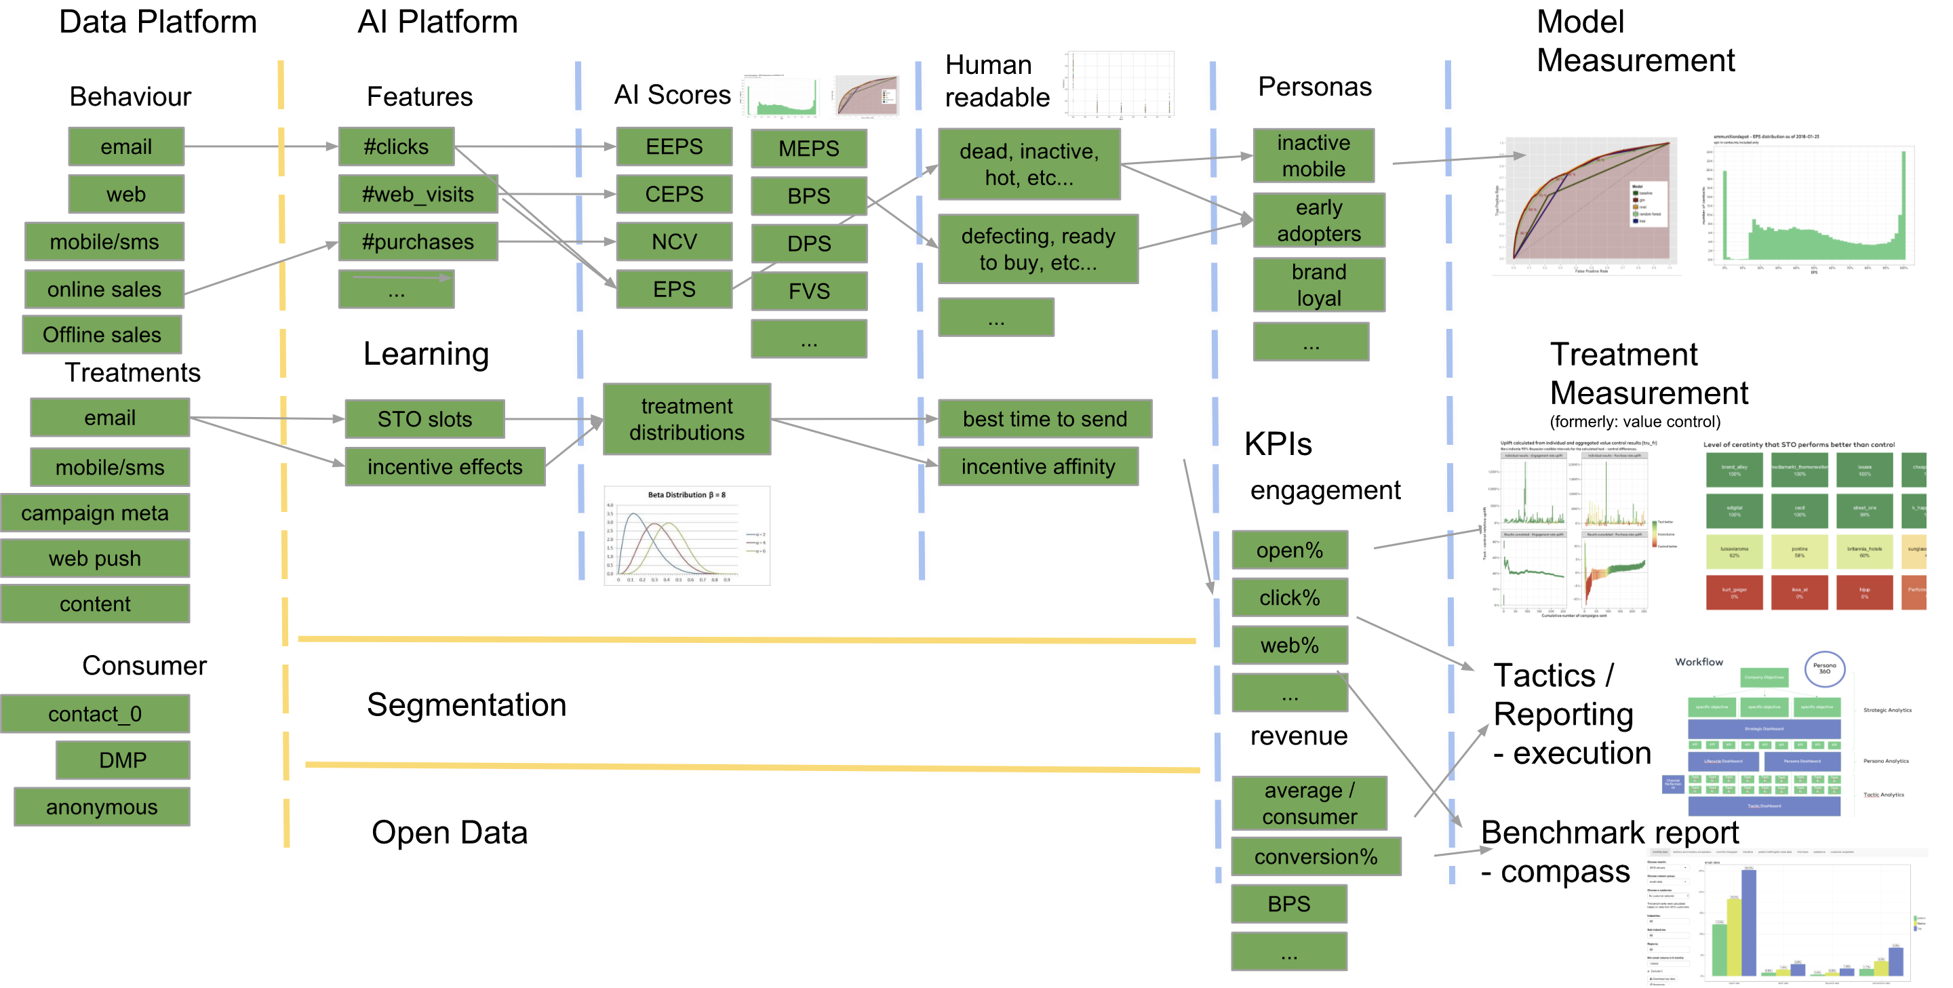
AI Platform over Data Platform

Slide 9
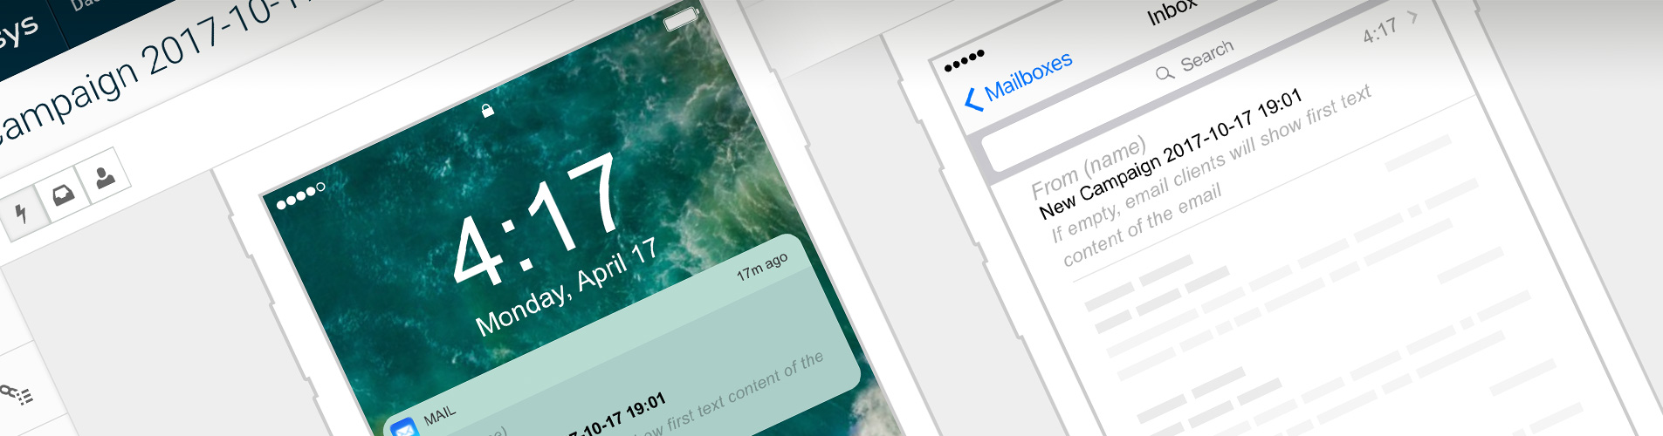
Why GCP?
02

Slide 10
Why GCP?
NO MORE CANCELLED PRODUCT
Because of the lack of data
I didn’t want to hear anymore
WE DON’T HAVE ENOUGH DISK
OR
We should increase the
MEMORY SPACE UNDER A DATABASE
Notes:
Én nem vagyok GCP partner, szóval kimondhatok olyan szavakat majd, hogy heroku, vagy aws.
1. Nincs több lefújt project, amiatt, h az adatok nem elérhetők, v nem skálázódik
2. Nem akartam hallani többet, h elfogyott a hely, v kell még diszket rendelni
3. Nem kell üzemeltetés – nem akarok sokkal többet azzal foglalkozni, h. mennyi memóriát kell akllokálni egy-egy db alá ahhoz, hogy lefusson egy-egy query.
4. Accountability – költségek terén
5. Furher products, such as tensor flow, vision api
Goals Summary:
Scalability
No operation
Accountability

Slide 11
Goals summary
Scalability
No operation
Accountability
Notes:
Goals Summary:
Scalability
No operation
Accountability

Slide 12
Experiences
03
Notes:
Elfér – a mi világunk nagyon pici a GCP-hez képest
Lehet rosszul használni – de tudja drive-olni is a developmentet
CI missing

Slide 13
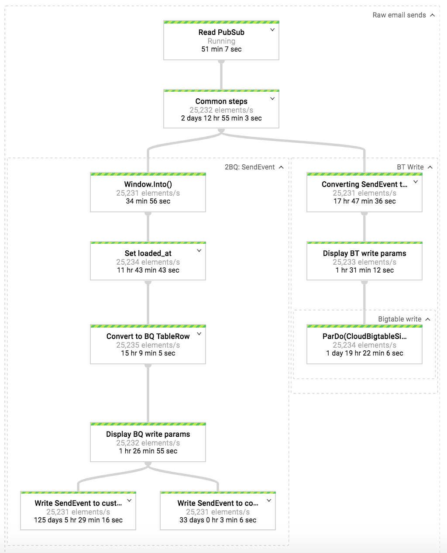
Example #1 – Data Flow and Data Migration
Migration experiences
#1 – w/o dataflow and partitioning 180K $
#2 – 1.5M parallel dataflow pipeline
#3 – 160Bx30B rows crossjoin in BigQuery
Notes:
Customerenként particiokba, költséghatékony
Migration 1: 180k $
Migration 2: 1.5M parallel open pipeline 5000*180*3
Migration: Send – open join: 7TB join 1TB open lefut 1 óra alatt.2 évnyi. 160B x 20B open

Slide 14
Example #2 – Data Flow and Enrichment (join)

Slide 15
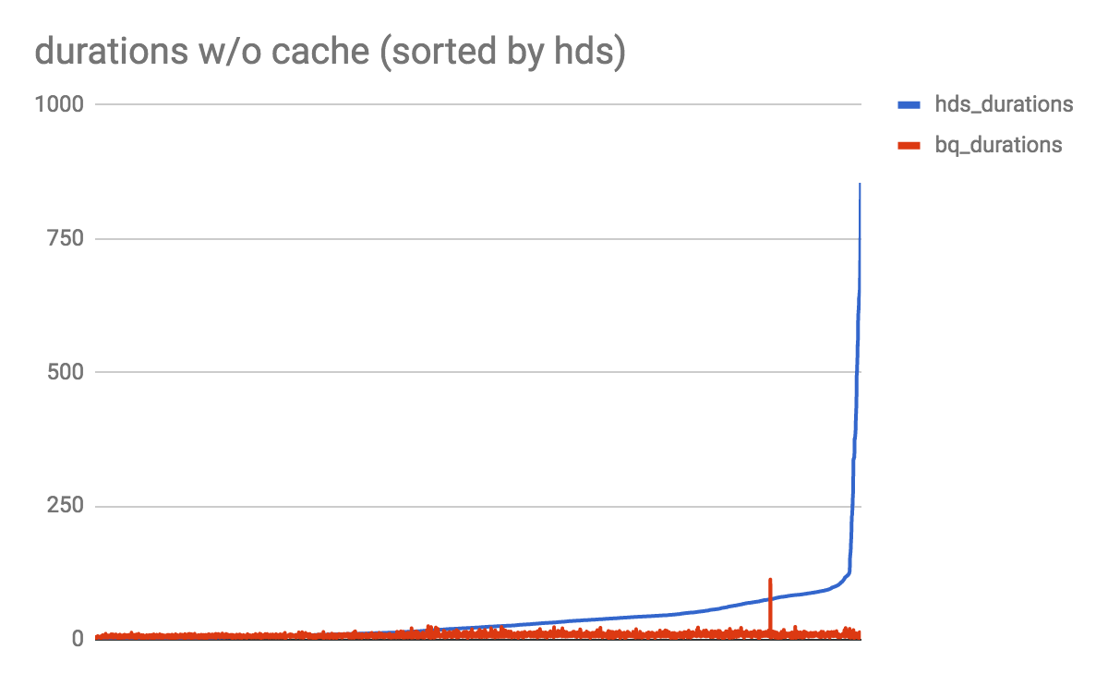
Example #3 – Segmentation over BigQuery
0.999 SLA
652 sec -> 25 sec
Notes:
Jó Példák:Jogosultságok, permissionok
Computation fuggetlenedik a storage-tól – Projects külön,

Slide 16
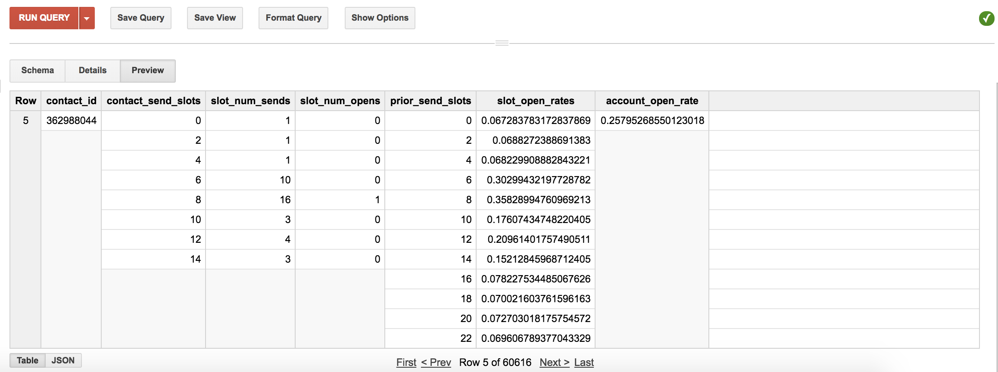
Example #4 – Bayesian Learning in BigQuery
Notes:
STO
UDF in BigQuery
And our Error with it

Slide 17
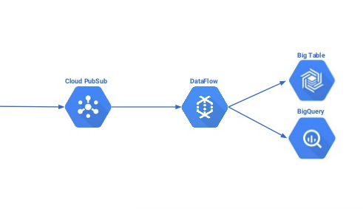
Example #5 – Duplicates
at least once
10⁻⁵
10⁻⁷
Notes:
Missing Alerting – pubsub megőrzi 1 hétig az eseményeket
Stackdriver megbízhatóság – 1 eseményre alert.
PubSub 10-5 at least once, Dataflow 10 perces uniq. Bigquery is 2perces időablakban uniqol, . 10-7 Teljesen sosem lesz
10_5 –ről 10_7 - Napi fél milliárdból lesz 50 dupla.

Slide 18
Conclusions
04
Notes:
Elfér – a mi világunk nagyon pici a GCP-hez képest
Lehet rosszul használni – de tudja drive-olni is a developmentet
CI missing

Slide 19
Conclusions
Unlimited space
Scalability
No operation
Accountability
Continuous Integration
Notes:
Outcome:
Elfér – a mi világunk nagyon pici a GCP-hez képest
Lehet rosszul használni – de tudja drive-olni is a developmentet
CI missing

