Slide 1
Jailbreak & Behind
Háló Zsolt @ Deloitte CRS

Slide 2
Why iOS is „secure” by design?
Filesystem
SOFTWARE
Kernel
Secure Enclave
Secure Element
HARDWARE
Crypto Engine
Device Key
Group Key
Apple Root Cert

Slide 3
Secure Enclave
Physically separate processor
Own independent boot sequence
Hardware based true random number generator
Crypto operations necessary for seamless en/decryption of data
Has the device ID fused into it @ manufacture time
TNO (Trust No One paradigm)

Slide 4
Code Signing
All apps must be signed by a signing cert that was issued by Apple
Must be distributed via the Apple App Store (with some exception)
Hash
Private Key
Signature
Code to be signed
Signing Certificate
Signed code

Slide 5
Privilege Separation
Process separation like in traditional UNIX file permission mechanism owner, user and group.
Apps run as user “mobile”
Critical stuff runs as “root”
Limiting exploit damage

Slide 6
Sandboxing
Further enforcing security than UNIX permissions
Cannot modify each other's data (permission required)
Can only access files in other sandbox via API-s

Slide 7
Jailbreaking
Actively circumventing code signature checks and other OS security controls
Tethered
Untethered
Can use all API-s
Removing sanboxing restrictions
You get a cool computer with a nice UI

Slide 8
Why should I care? Not my device/data ^^
Credential reuse of your users!
API keys
Connection strings/credentials
Full infrastructure reverse

Slide 9
Detection methods
File presence (Cydia.app, /bin/bash…)
File permissions (/root has write access)
Process forking (popen and fork returned pid)
System Properties (symlinks from the small partation)
dyld calls (dyld get image name, dyld image count) to check if certain dylibs are loaded
Privileged action (System call or write outside of sandbox)
SSH Loopback (if you can connect to 127.0.0.1:22)

Slide 10
Detection evasion
Binary patching
Dynamic hooking/instrumentation
Temporary disable jailbreak
xCon open source project, automagically hides the jailbroken status, usually ☺ (good to test against)

Slide 11
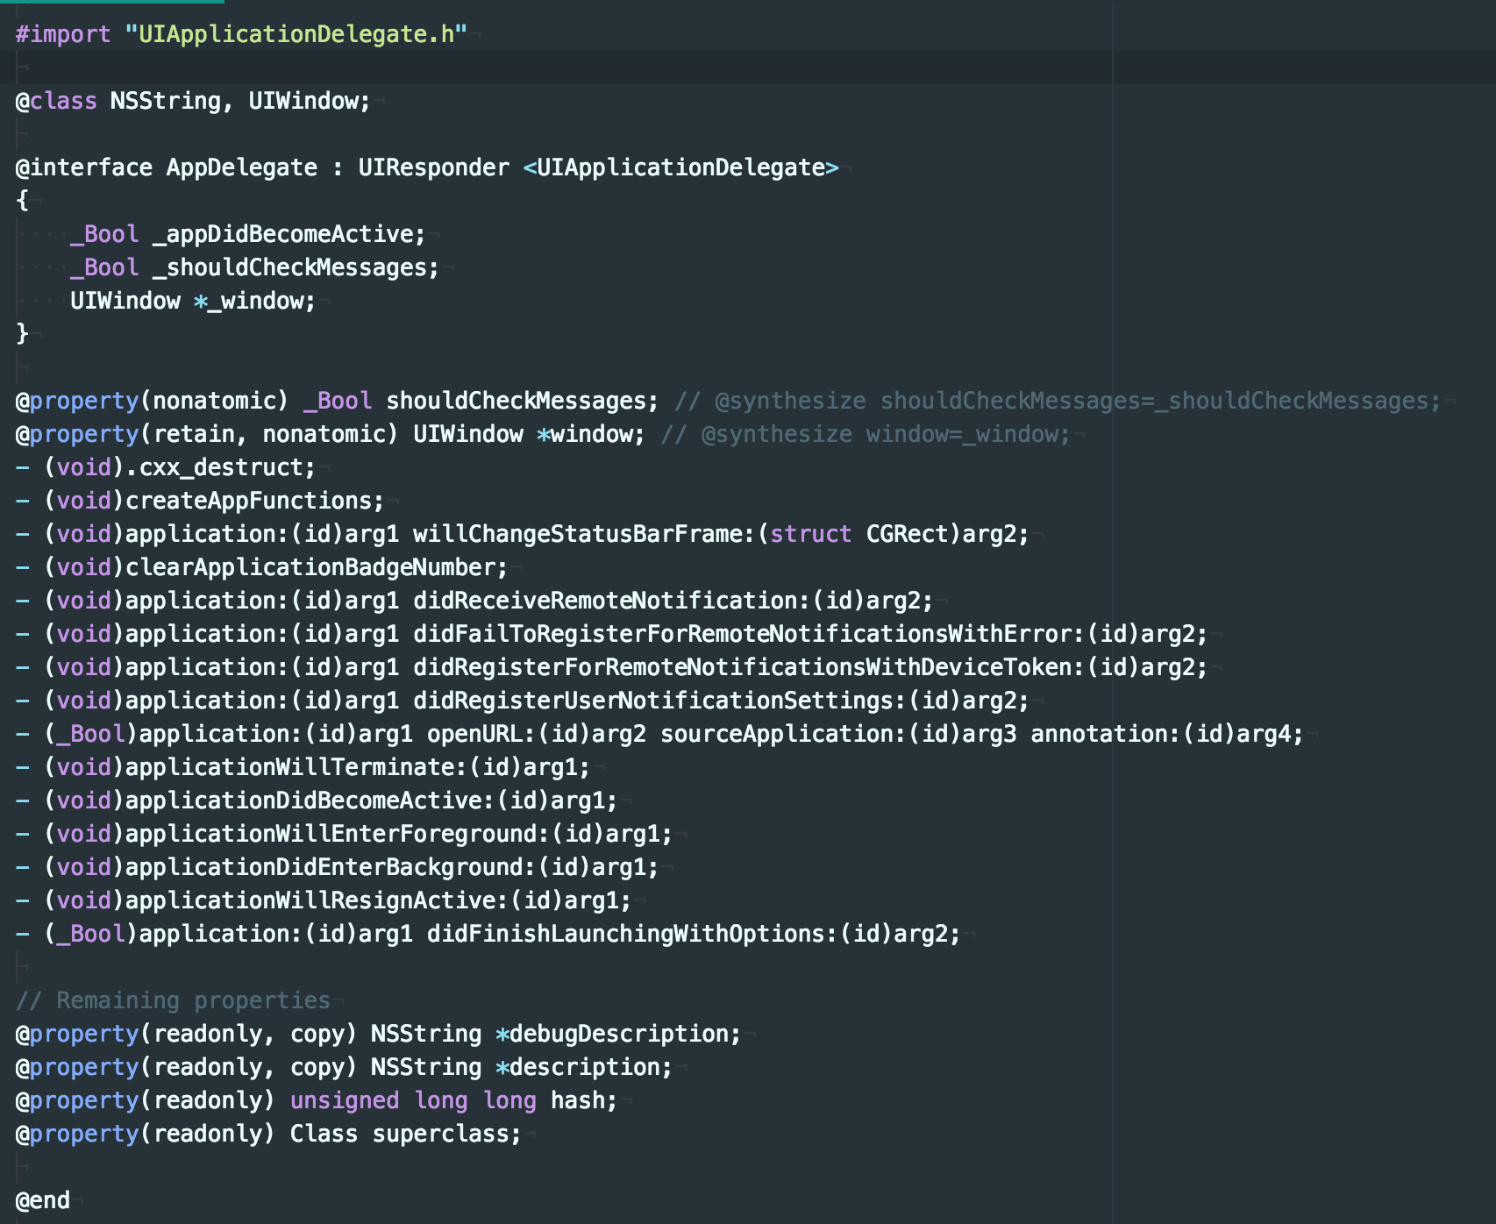
Frida
Ole André Vadla Ravnås
https://www.frida.re/
Classdump →

Slide 12
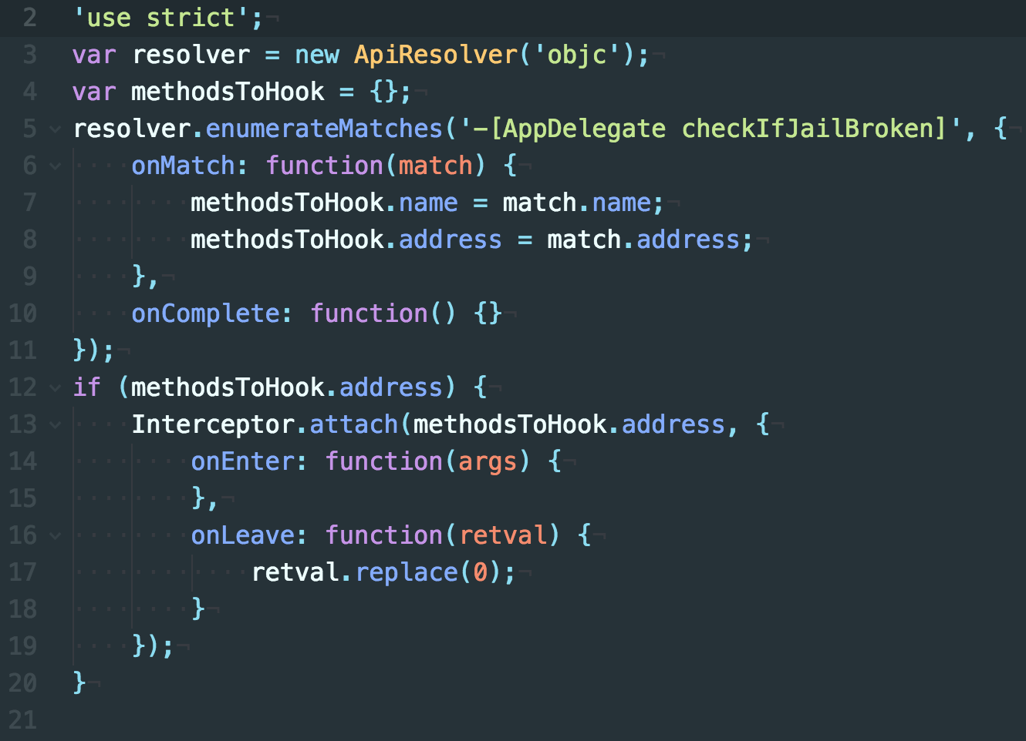
Frida
frida-trace -i "open*" -i "close*" Safari
frida-trace -U -f com.app.to.test -I "libcommonCrypto*„

Slide 13
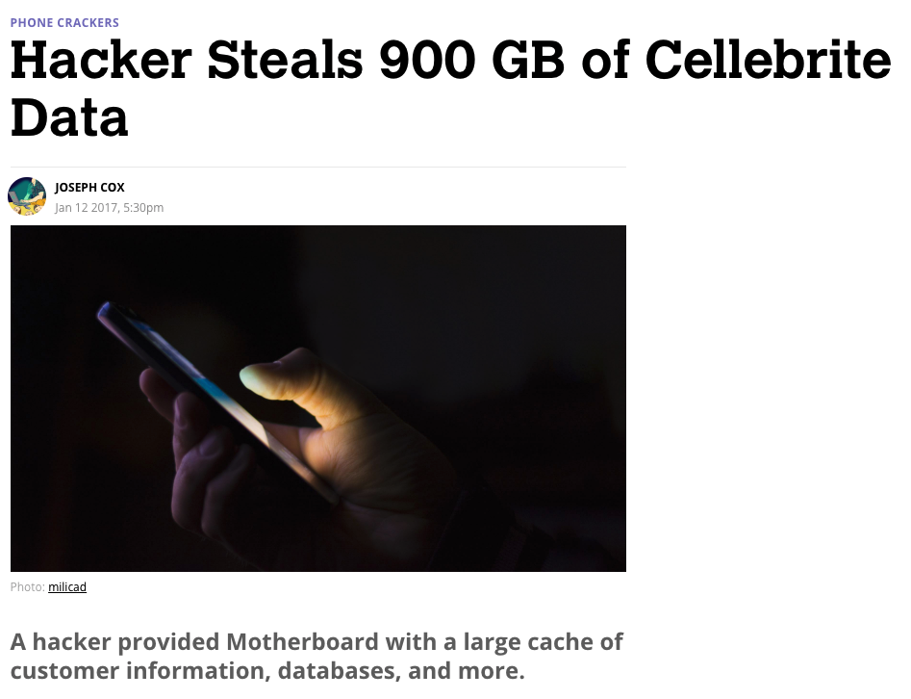

Slide 14
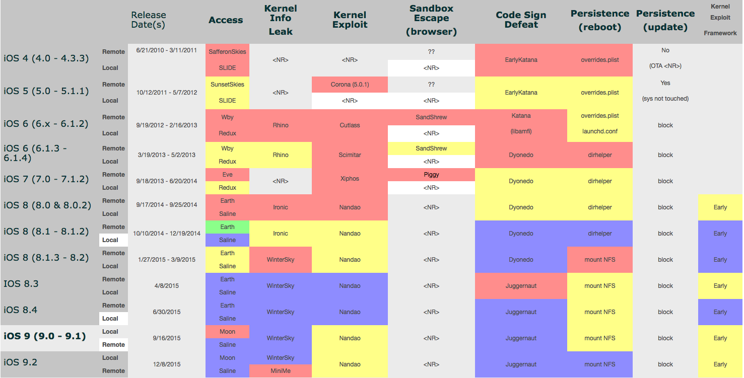

Slide 16
Suggestion
Tie to the application
Use separate lib a dependency for your app
Obfuscate C++/C code
Make it independent

Slide 17
Thanks
\O/

