Slide 1


FRAUD PREVENTION
SUPERCHARGED

Slide 2
Digital fraud is an immense problem with quickly increasing scale
Estimated value of fraudulent
online transactions, US$ B
19%
CAGR
’16-’20
Source: Juniper Research

Slide 3
Fraud impacts all kind of online businesses
Wide range
of fraud types
Wide range
of industries
Stolen Credit Cards
Account Takeover, Fake Account, Account Abuse
Card Testing
Friendly Fraud
Promo Abuse
Fake Goods & Listings
Etc.
E-commerce
Payment Providers, Banks
& Fintech
Airlines & Travel
Marketplaces
Online Gambling / Gaming
Dating & Adult Industry
Etc.

Slide 4




Fraud managers are presented with a wide range of options
Rely on
heavy use of
2FA solutions (e.g. 3-D Secure)
Implement integrated PSP fraud solutions
Use external
fraud management providers
Develop
in-house solution

Slide 5
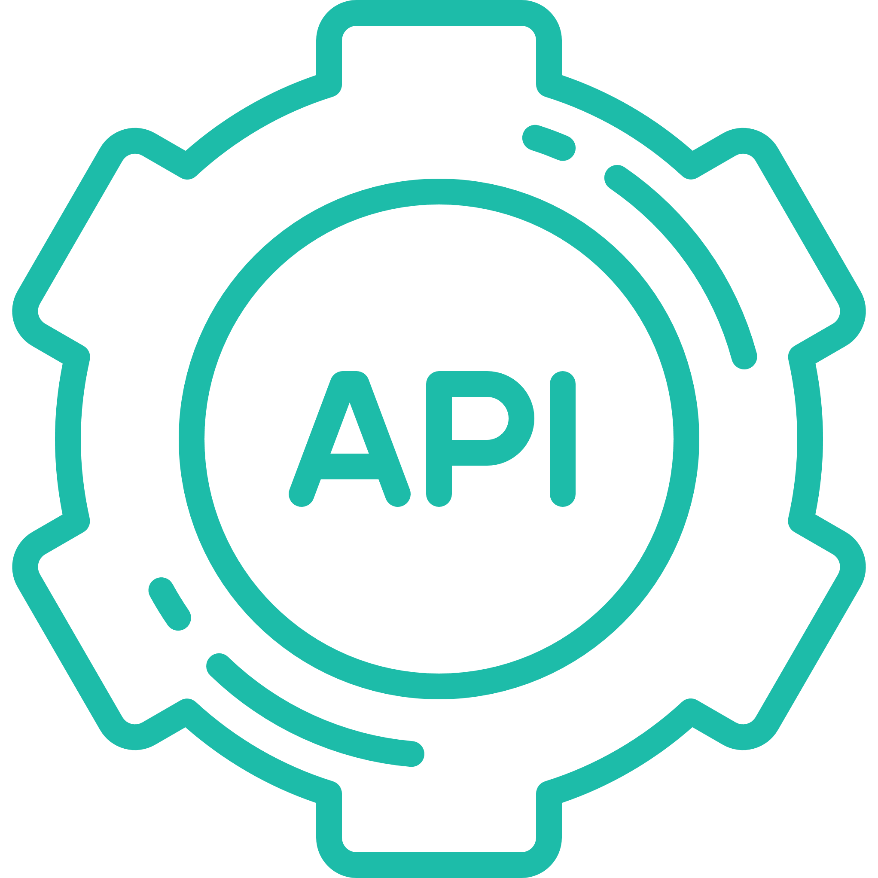





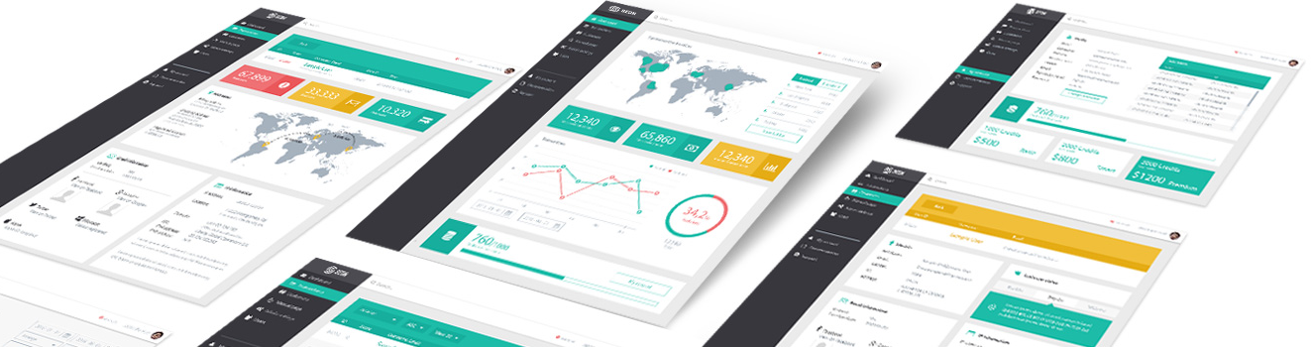
SEON offers a unique approach to help fraud managers be more effective
Simple REST
APIs
Fully modular integration
Radically improved
UI
In-depth coverage of relevant risk vectors
Big data analysis & dynamic, real-time scoring
Combination of AI & human intelligence

Slide 6
SEON’s APIs cover all relevant risk vectors
Fraud API
Receives and analyzes 62 datafields
Contains a graphical user interface (GUI) and a rule configurator module
Proxy API
Provides IP address related insight
Information such as VPN, proxy or TOR use is detected
Analyzes spam databases for any IP address related anomalies
Detects malwares, spywares and botnets
Email API
Highly effective tool for e-mail address investigation analyzing the domain related information of an e-mail address
Capable of analyzing whether any social media profiles are registered under the e- mail address
Device fingerprint API
Collects the relevant device related information through a Javascript snippet
This tool depicts a 360 degree view about the device of the user
Further APIs and mobile SDK in development pipeline

Slide 7
The SEON fraud prevention engine is highly effective and robust
API INTEGRATION & HISTORICAL DATA ANALYSIS FOR INITIAL SETTINGS
TRANSACTION DATA
SEON collects
all relevant
transaction data
from customer
DATA ENRICHMENT
SEON collects thousands of additional data points (e.g. IP&Geo Check, Device Fingerprint, Email Check)
SEON Engine
Our engine applies machine learning using big data to analyze collected data
i
In under one second,
SEON returns an accurate fraud score

Slide 8























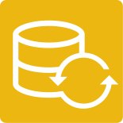


























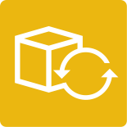
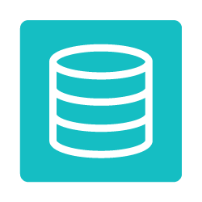




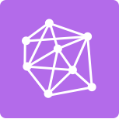






































AWS is the most robust, fully features technology infrastructure platform
TECHNICAL & BUSINESS SUPPORT
Account Management
Support
Professional
Services
Optimization Guidance
Partner
Ecosystem
Training & Certification
Solutions Management
Security & Billing Reports
Personalized Dashboard
MARKETPLACE
Business Apps
Business Intelligence
DevOps Tools
Security
Networking
Databases
Storage
ANALYTICS
DEV/OPS
MOBILE SERVICES
IoT
AI
ENTERPRISE APPS
HYBRID ARCHITECTURE
MIGRATION
Data Warehousing
Elasticsearch
One-click App Deployment
API Gateway
Rules Engine
Machine Learning
Virtual Desktops
Data Integration
Schema Conversion
Business Intelligence
Data Pipelines
Resource Templates
Single Integrated Console
Device Shadows
Image Recognition
Sharing & Collaboration
Integrated Networking
Exabyte-Scale
Data Migration
Hadoop/Spark
Interactive SQL
Queries
Build and Test
Identity
Device SDKs
Text to Speech
Corporate Email
Integrated Identity & Access
Application Migration
Streaming Data
Analysis
ETL
Application Lifecycle Management
Sync
Device Gateway
Conversational Interface
App Streaming
Integrated Resource & Deployment Management
Database Migration
Streaming Data
Collection
DevOps Resource Management
Mobile Analytics
Registry
Deep Learning Frameworks
Communications
Integrated Devices
& Edge Systems
Server Migration
APP SERVICES
Triggers
Mobile App Testing
Local Compute
Queuing & Notifications
Email
Containers
Targeted Push Notifications
Workflow
Transcoding
Analyze and Debug
Search
INFRASTRUCTURE
CORE SERVICES
SECURITY & COMPLIANCE
MANAGEMENT TOOLS
Regions
Storage
Object, Blocks, File, Archivals, Import/Export, Exabyte-scale data transfer
Databases
Relational, NoSQL, Caching, Migration, PostgreSQL compatible
Identity Management
Access Control
Monitoring & Logs
Assessment
& Reporting
Web Application Firewall
Manage Resources
Service Catalogue
Configuration Tracking
Availability Zones
Compute
VMs, Auto-scaling, Load Balancing, Containers, Virtual Private Servers, Batch Computing, Cloud Functions, Elastic GPUs, Edge Computing
Networking
VPC, DX, DNS
Configuration Compliance
Key Management
& Storage
Account Grouping
Resource & Usage Auditing
DDOS Protection
Monitoring
Server Management
Resource Templates
Points of Presence
CDN

Slide 9
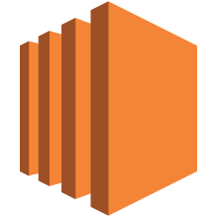



Compute
EC2
Auto Scaling
Lambda
Batch
EC2 Container Service
EC2 Container Registry
Elastic Beanstalk

Slide 10
Elastic Beanstalk
Elastic Beanstalk
Run and Manage Web Apps
Ideal for developers that simply want to upload their code and have the service manage the rest
Supports Docker, Java, .NET, Node.js, PHP, Python, Ruby, and Go
Automatically handles deployment, load balancing, auto-scaling, and application health monitoring
Retain full control over the AWS resources powering your application

Slide 11

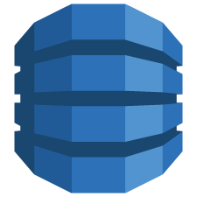
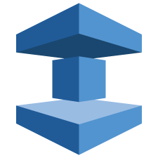

Database
RDS
DynamoDB
ElastiCache
Redshift
Aurora

Slide 12
RDS
Relational Database Service (RDS)
Managed Relational Databases
Resizable capacity
Handles time-consuming administration tasks
Choice of six popular data engines
High durability options
Automatic patching and backups

Slide 13
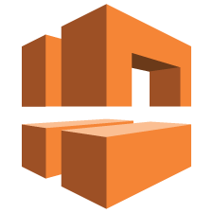



Networking
VPC
ELB
Route 53
Direct Connect

Slide 14
ELB
Elastic Load Balancing (ELB)
Application Load Balancing
Supports load balancing of HTTP, HTTPS and TCP traffic to EC2 instances
Detects and removes failing instances
Dynamically grows and shrinks based on traffic
Integrates with Auto Scaling

Slide 15
Route 53
Route 53
Scalable DNS and Domain Name Registration
Answers DNS queries with low latency by using a global network of DNS servers
Latency based routing to closest AWS endpoint
Integration with other AWS services
Register domain names

Slide 16






Administration & Security
Directory Service
IAM
Trusted Advisor
CloudTrail
Key Management Service
CloudWatch
AWS Config
Service Catalog
CloudHSM
Certificate Manager

Slide 17





Developer & Management
CodeDeploy
CodePipeline
CodeCommit
OpsWorks
CloudFormation
Application Discovery

Slide 18
OpsWorks
OpsWorks
Automate Operations with Chef
Automate operational tasks like code deployment, software configurations, package installations, database setups, and server scaling using Chef
Model the layers of your applications into stacks
Use Chef recipes and cookbooks
Supports Linux and Windows
Granular security control
Use it in AWS or on-premises

Slide 19
Artificial Intelligence
Machine Learning
Build Smart Applications Quickly and Easily
Fully-managed service built for developers
Create machine learning (ML) models without having to learn complex ML algorithms and technology.
Integrated with AWS data ecosystem
Find patterns in your data
Supports batch and real-time predictions

Slide 20

Tamás Kádár, CEO
tomkadar@seon.io

