Slide 1
Firebase a jégen
Firebase project tapasztalatok...
gabor.batori@itware.hu

Slide 2
Miről lesz szó?
mi az a „SUNBEARS-PROJECT”?
kezdeti ARCHITEktúra
Firebase bevezetése
Firebase architektúra
Összehasonlítás, tapasztalatok

Slide 3
SUNBEARS PROJECT
“ICE HOCKEY GAME RECORDING APPLICATION”
Record game events
Recorded events stored in database AT THE SERVER
SETUP DATA at the SERVER SIDE
Record data at the client side
Client is a tablet – Large (10’’) screen

Slide 4
RECORD
ANALYZE
CREATE
Create event templates
Record the events in the Android client
RECORDING ENGINE
TEMPLATE ENGINE
Analyze the results and make decisions
STATISTICS
ENGINE
PROCESS OVERVIEW

Slide 5
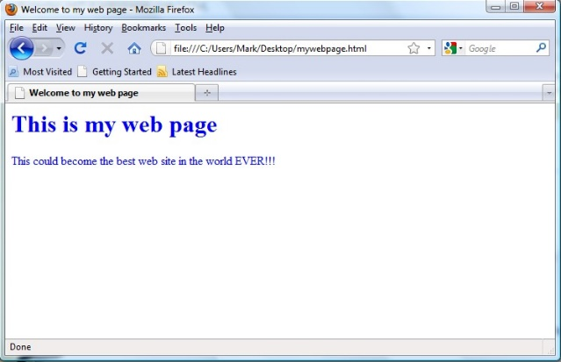
ARCHITECTURE
Admin Web UI
Statistics Web UI
$$$
Admin Backend
DATABASE
Admin Backend
Android Backend
Android UI

Slide 6
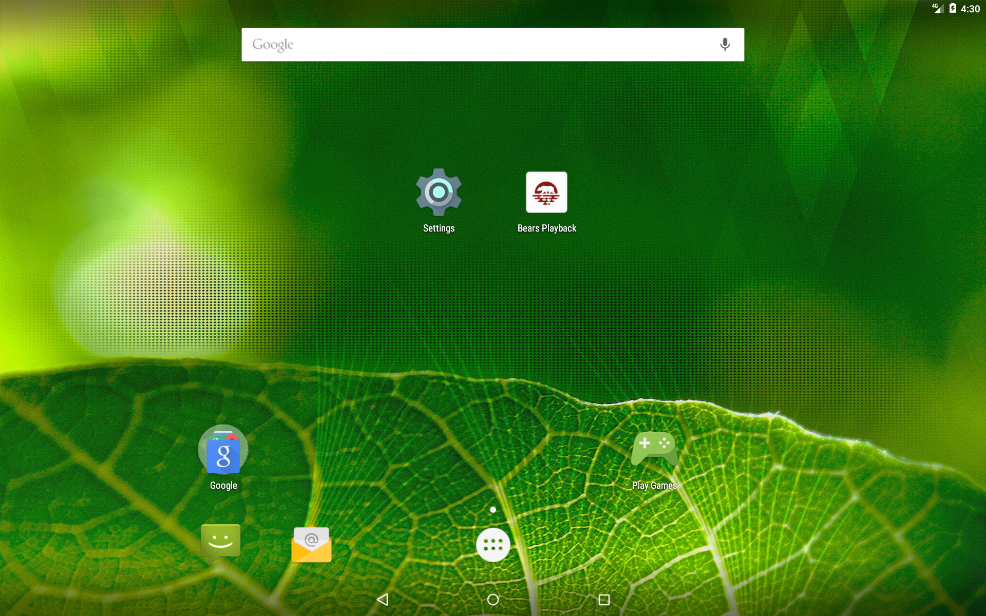

Slide 7
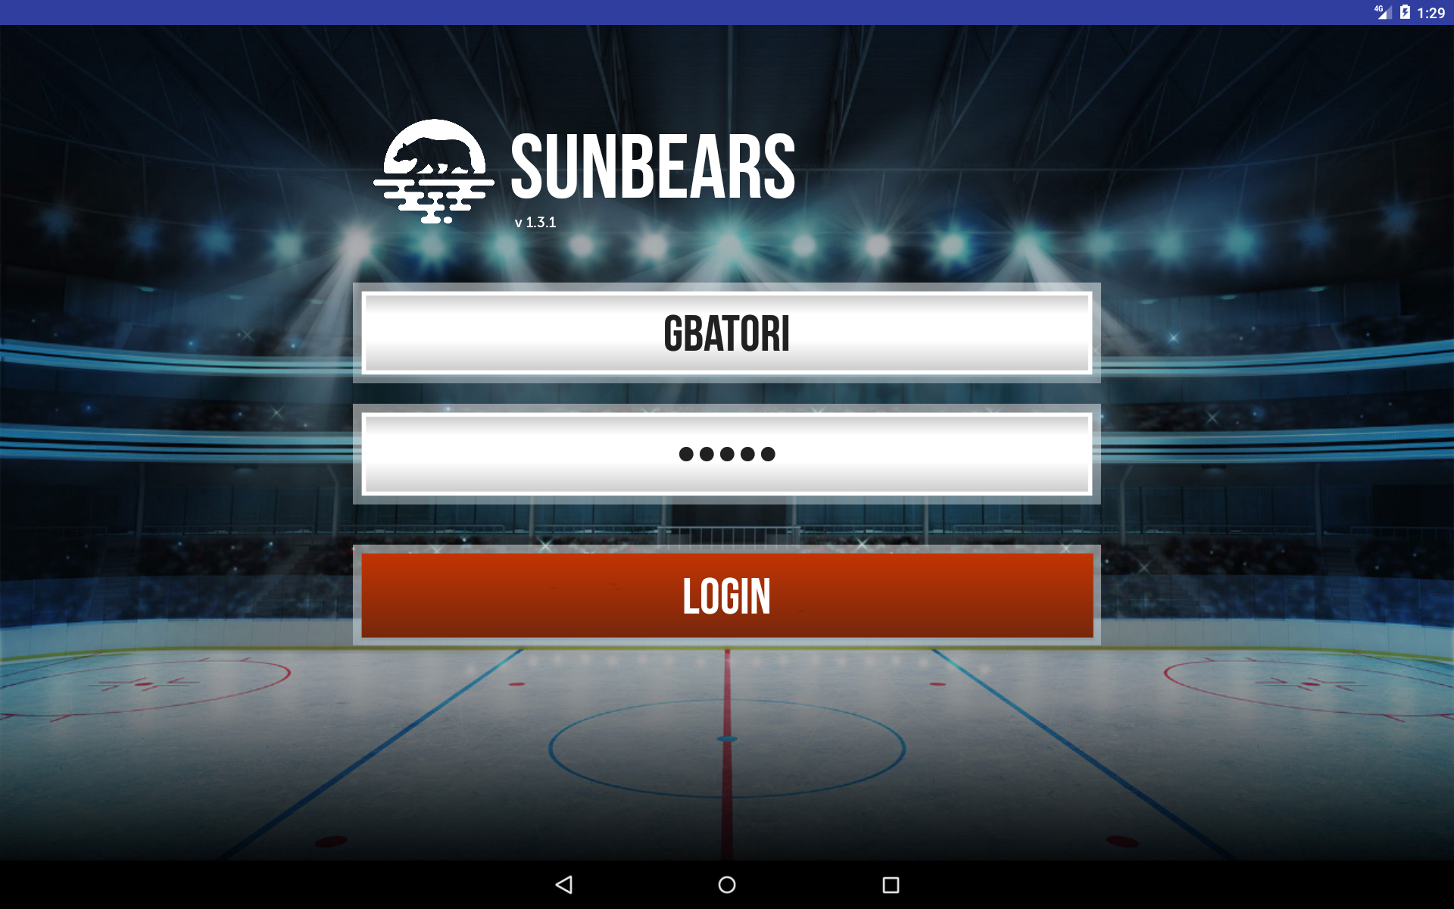

Slide 8
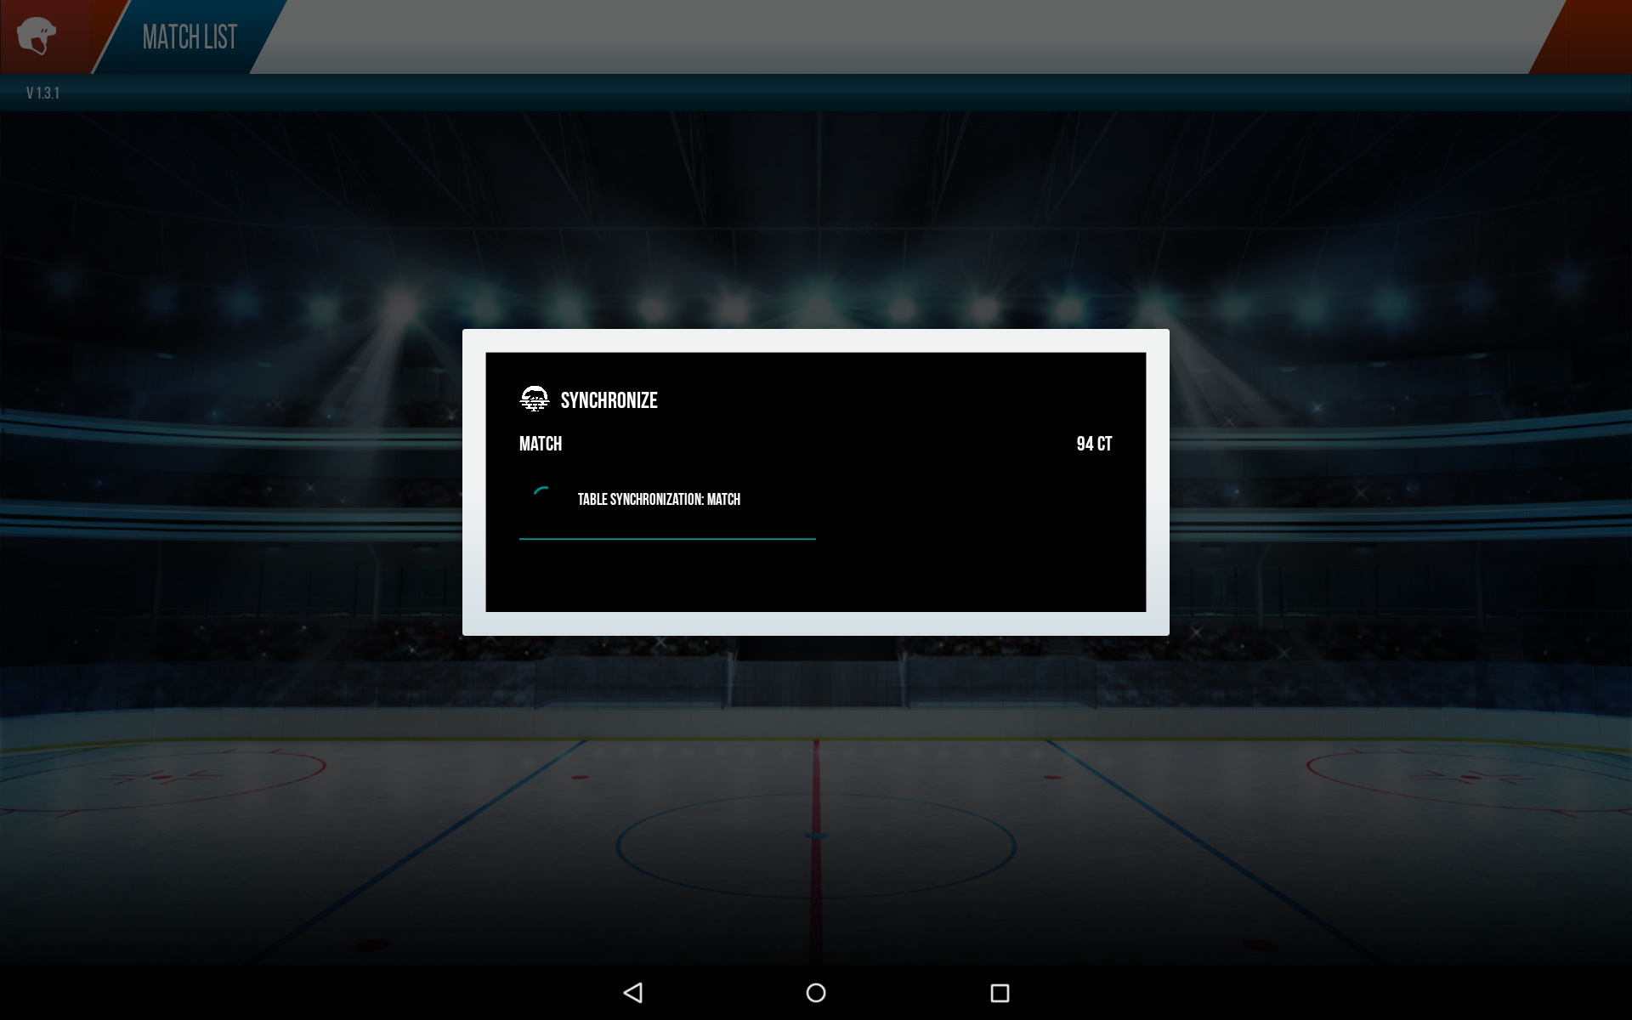

Slide 11
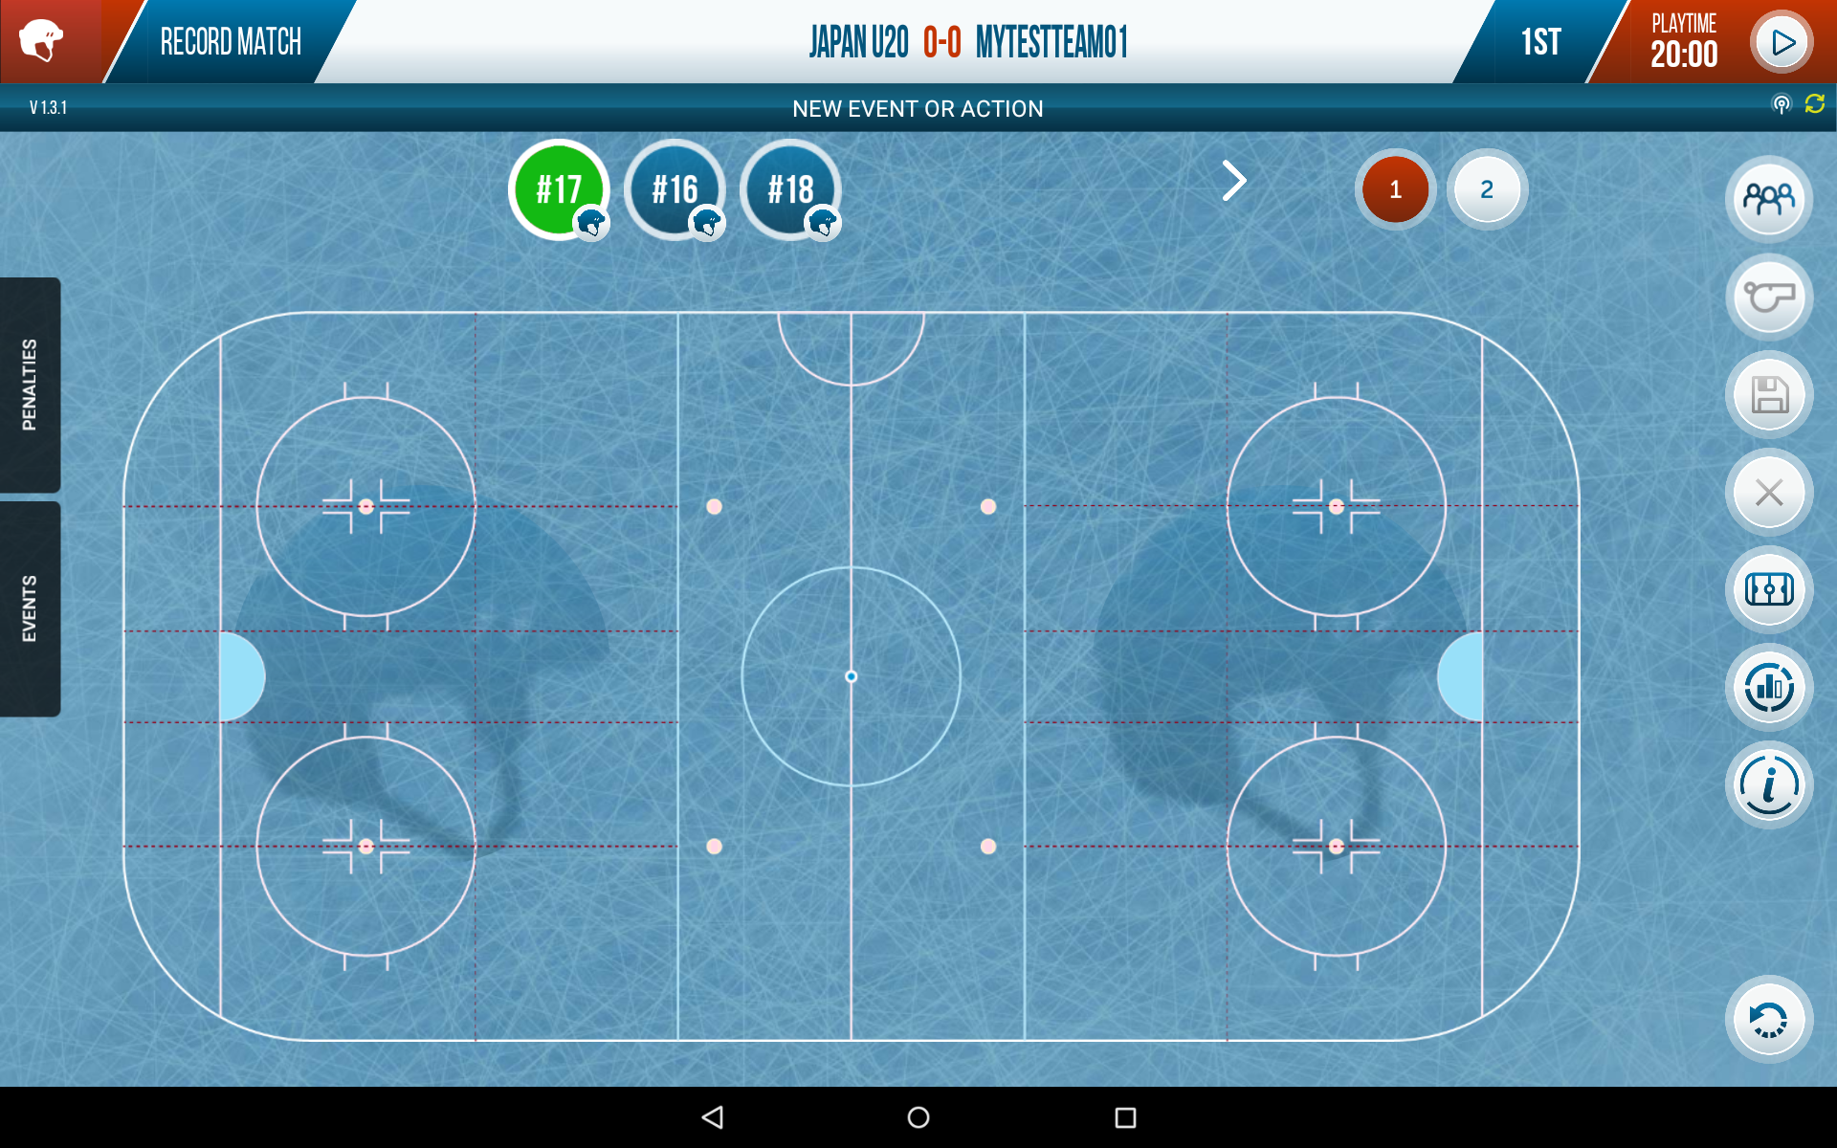

Slide 12
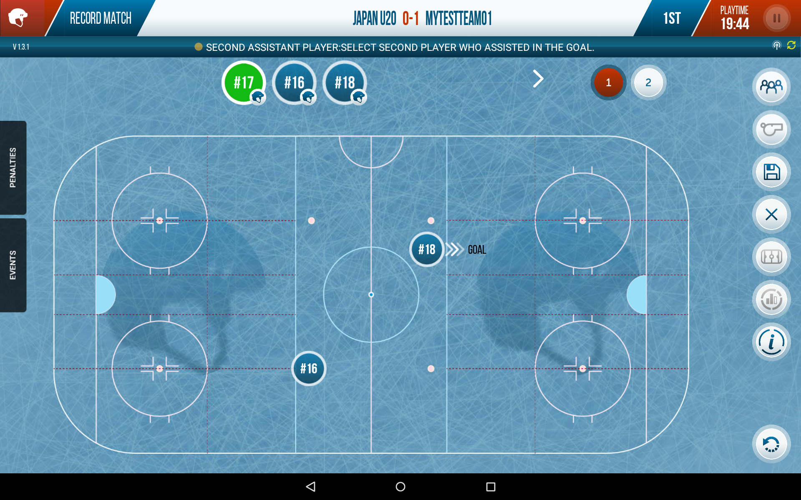
4
2
1
3

Slide 13
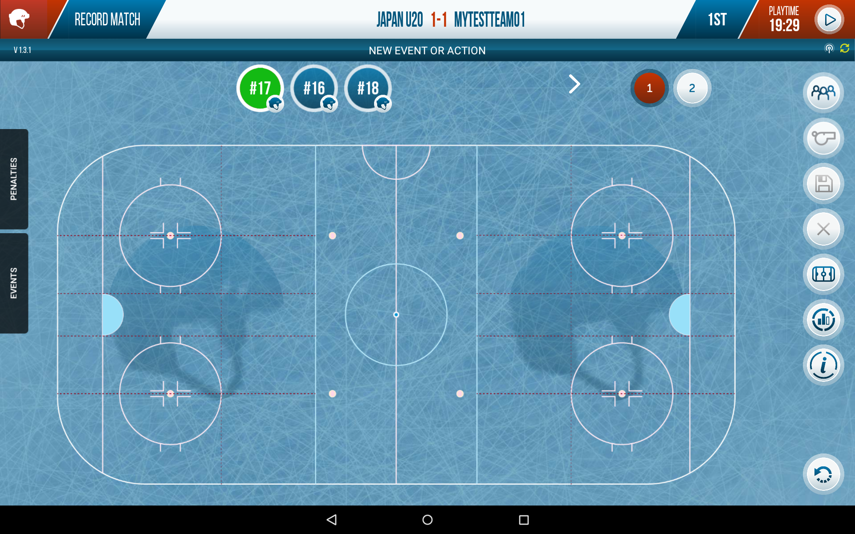

Slide 14
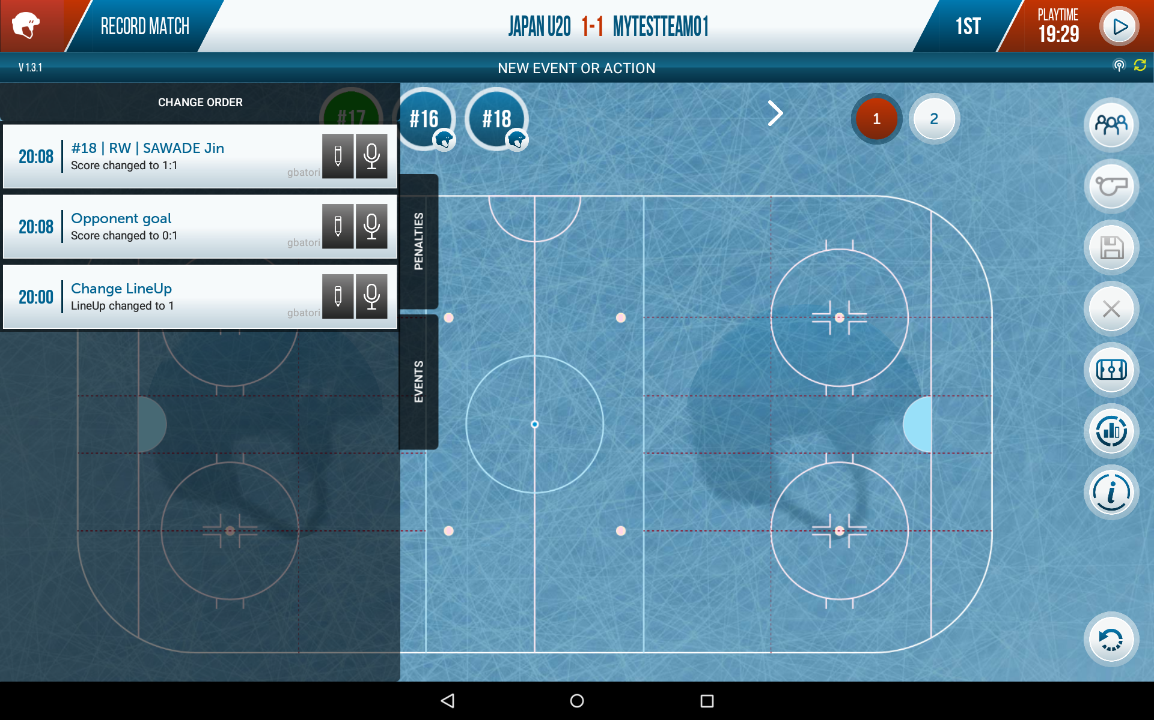

Slide 15
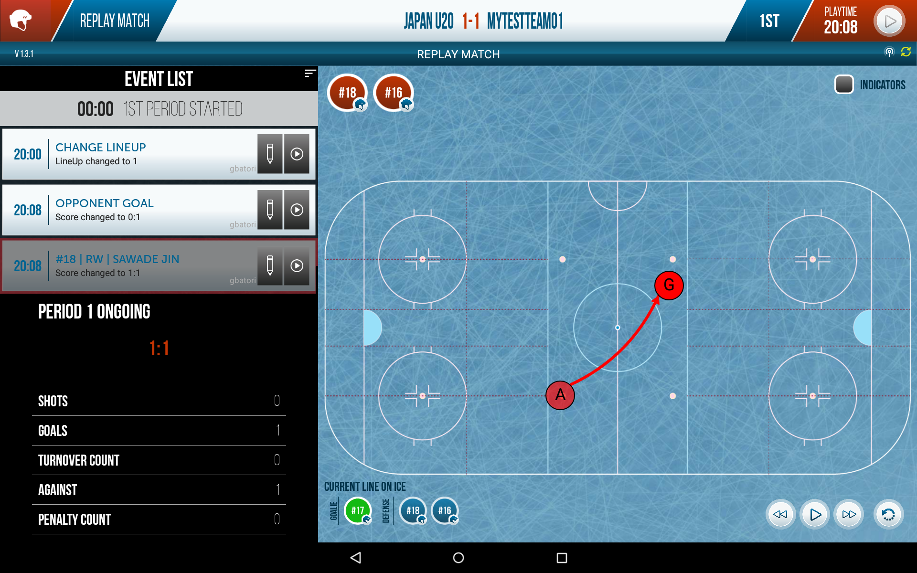

Slide 16
Original architecture
RECORDING EVENTS
USERS
TEAMS
MATCHES
STATISTICS
MATCHES
Data
MySQL
DB
STADIUMS
Files
LINEUPS
PLAYERS
METADATA
IMAGES
JPA, JAX-RS,JSON, DI
Android Backend
JPA, JAX-RS,JSON, DI
JAVA EE
Admin Backend
JAVA EE
Backend
JAVA EE
gzip, streaming, batch
Sync API
Web Components
SyncAdapter, CP
AngularJS
Android
Frontend
http://www.bears-admin.jp
SQLite

Slide 17
Firebase in SUNbears
Changing the underlying backend to Firebase

Slide 18
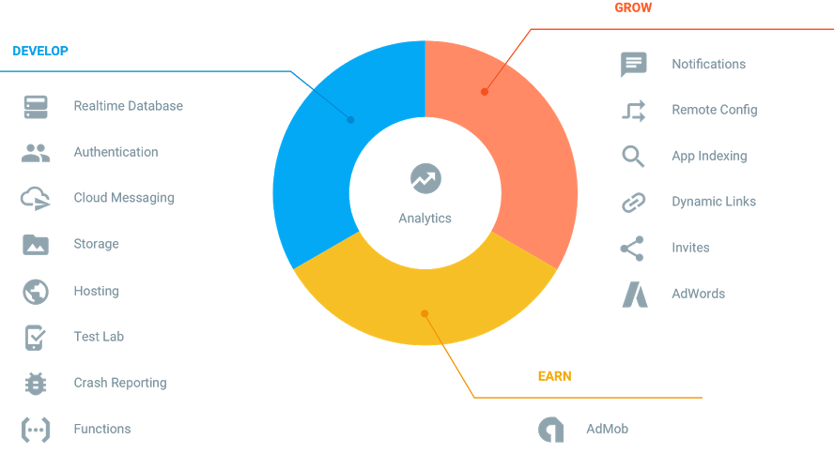
FIREBASE PLAtform

Slide 19
Firebase Database
“Realtime” synchronization between clients
NoSQL
Online/Offline
Storage in Cloud
Base on WebSockets
Only write Front-End code
FIREBASE
(BaaS)

Slide 20
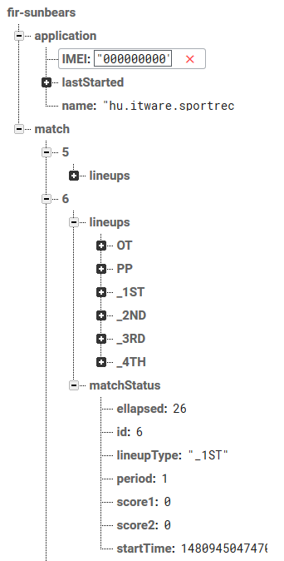
Data format and queries
Data is JSON
Denormalizing Data is normal
Support Queries
Swift, Objective-C, JAVA, Javascript, C++
Access by PATH.
database.getReference("match").child("6").child("matchStatus");

Slide 21
firebase „intro” architecture
PLAYERS
TEAMS
USERS
STADIUMS
METADATA
DB
MATCHES
STATISTICS
IMAGES
LINEUPS
Android Backend
Admin Backend
RECORDING EVENTS
Firebase
Sync API
Web Admin
RECORDING EVENTS
http://www.bears-admin.jp

Slide 22
1.
2.
3.
4.

Slide 23
FIREBASE PLAtform

Slide 24
Firebase architecture
TEAMS
Sunbears Cloud
MATCHES
STADIUMS
PLAYERS
USERS
+
IMAGES
+
STATISTICS
MATCHES
Firebase
METADATA
RECORDED EVENTS
LINEUPS
RECORDING EVENTS
Firebase
Authentication
Firebase
Storage
http://www.bears-admin.jp
Firebase
Functions

Slide 25
mit „adott” a firebase?!
Valós idejű szinkronizáció
felhasználói élmény
kooperáció
pontosabb rögzítés
azonnali Statisztika
edzői döntések
+RENGETEG ÚJ ÖTLET

Slide 26
development time
100 %
54 %

Slide 27
DEMO
some live demo: Android and Firebase

Slide 28
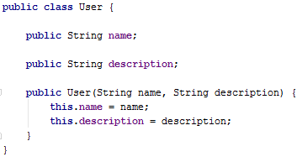
DEmo android application
Model:
User
Functions:
Create User
Delete User
List Users

Slide 29
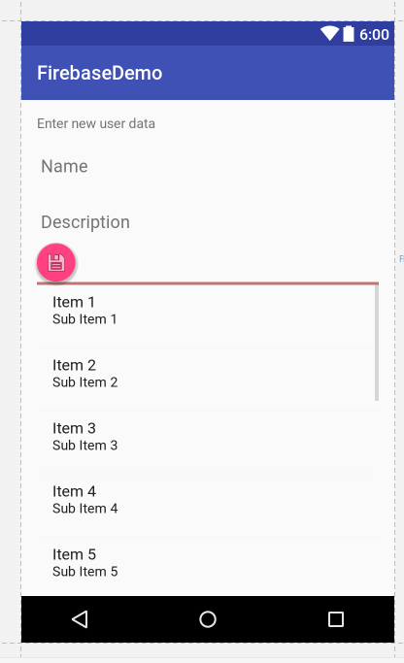
Demo application ui
User.name
User.description
ADD
List<User>
DEL
LIST

Slide 30
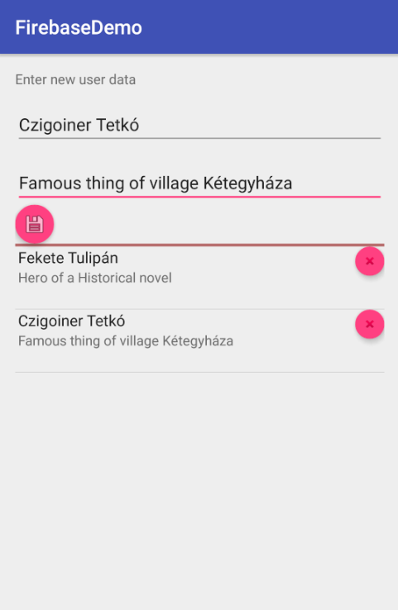
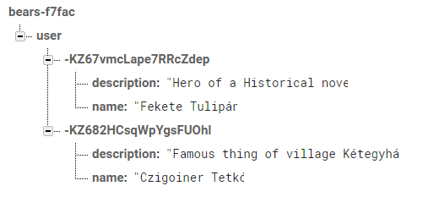
client
“Realtime” synchronization
firebase

Slide 31
Setup
build.gradle setup
compile 'com.firebaseui:firebase-ui:0.6.0' compile 'com.google.firebase:firebase-database:9.6.1'
apply plugin: 'com.google.gms.google-services'
get firebase instance
FirebaseDatabase database = FirebaseDatabase.getInstance();
access User list ref
DatabaseReference userRef = database.getReference("user");
create User
User user = new User(“gbatori“, “Description for gbatori");
String userId = userRef.push().getKey(); userRef.child(userId).setValue(user);

Slide 32
firebase ui
Firebase adapter
adapter = new FirebaseListAdapter<User>(this, User.class, R.layout.list_item, FirebaseDatabase.getInstance().getReference("user"))
Delete item
ImageButton delete = (ImageButton) v.findViewById(R.id.list_button_delete); delete.setOnClickListener(new View.OnClickListener() { @Override public void onClick(View view) { DatabaseReference dbRef = getRef(position); if (dbRef != null) { dbRef.removeValue(); } } });

Slide 33
end of part I…
Questions ?
thank you…

Slide 34
SYNC API ARCHITECTURE
The architecture of the Synchronization API in the Android client application
Android
Database
ORM
CRUD
SQLite
UI Screen
Datamodel
ITW
SYNC
API
Network
RESTful
Http
GSon
UI Screen
Sync
Service
Provider
UI Screen
Account
SQLITEDB
Auth
Android Framework
Utils
SyncAdapter
Http
SQLite
ContentProvider
Authentication

Slide 35
Synchronize ~1 million record…
~1.100.000
Server
(Wildfly)
Internet
<10 mins
4 hours
1 hour
Tablet
gzip
Database
(MySql)
streaming
batchSQL

