Slide 1
README.MD
For building the first purely digital mobile bank in Indonesia

Slide 2
We experiment, we move fast, we make it happen
At Supercharge we build high-impact mobile products making life easier for millions of users. Creating stunning experiences can only happen if you stretch yourself. To supercharge means to go that extra mile.

Slide 3
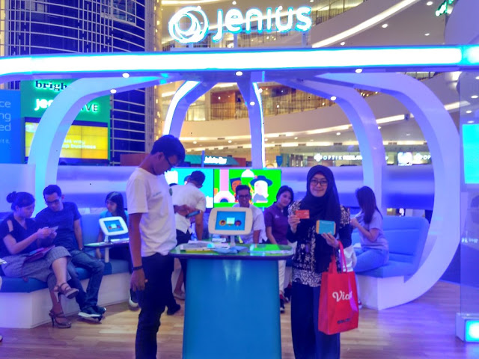

Slide 4
The beginning

Slide 5
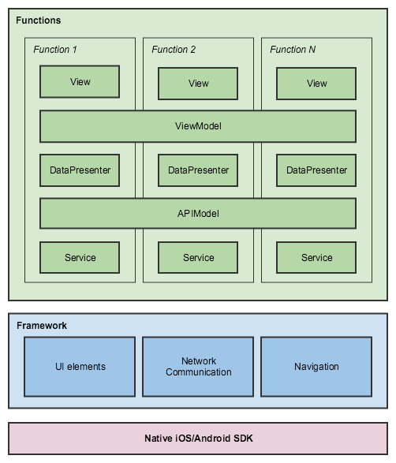
Architecture
Package by feature
SOLID
ViewModel != ApiModel

Slide 6
Architecture
Package by feature
SOLID
ViewModel != ApiModel
MockPresenter
https://github.com/slm/AndroidRandom
https://github.com/andygibson/datafactory

Slide 7
Architecture
sourceSets { mock.java.srcDirs += 'src/mock/java' mock.res.srcDirs += 'src/mock/res' staging.java.srcDirs += 'src/integration/java' staging.res.srcDirs += 'src/integration/res' }
NOT NEEDED IN MOCK

Slide 8
Architecture
sourceSets { mock.java.srcDirs += 'src/mock/java' mock.res.srcDirs += 'src/mock/res' staging.java.srcDirs += 'src/integration/java' staging.res.srcDirs += 'src/integration/res' }
configurations { integrationCompile stagingCompile.extendsFrom integrationCompile integrationAnnotationProcessor stagingAnnotationProcessor.extendsFrom integrationAnnotationProcessor }
NOT NEEDED IN MOCK

Slide 9
Architecture
sourceSets { mock.java.srcDirs += 'src/mock/java' mock.res.srcDirs += 'src/mock/res' staging.java.srcDirs += 'src/integration/java' staging.res.srcDirs += 'src/integration/res' }
configurations { integrationCompile stagingCompile.extendsFrom integrationCompile integrationAnnotationProcessor stagingAnnotationProcessor.extendsFrom integrationAnnotationProcessor }
networkDependencies.each { item -> integrationCompile item.value }
mockDependencies.each { item -> mockCompile item.value }
NOT NEEDED IN MOCK

Slide 10
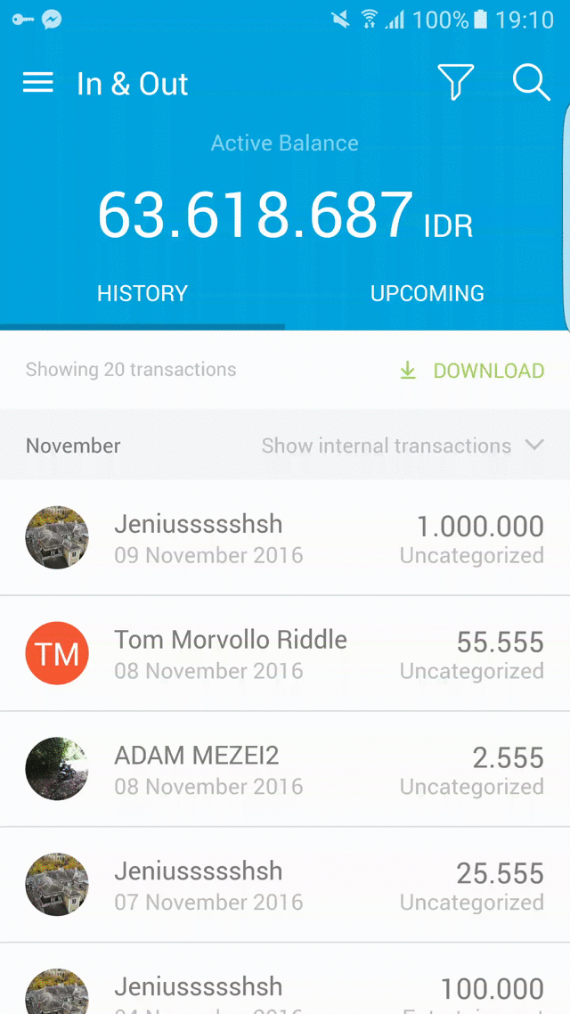
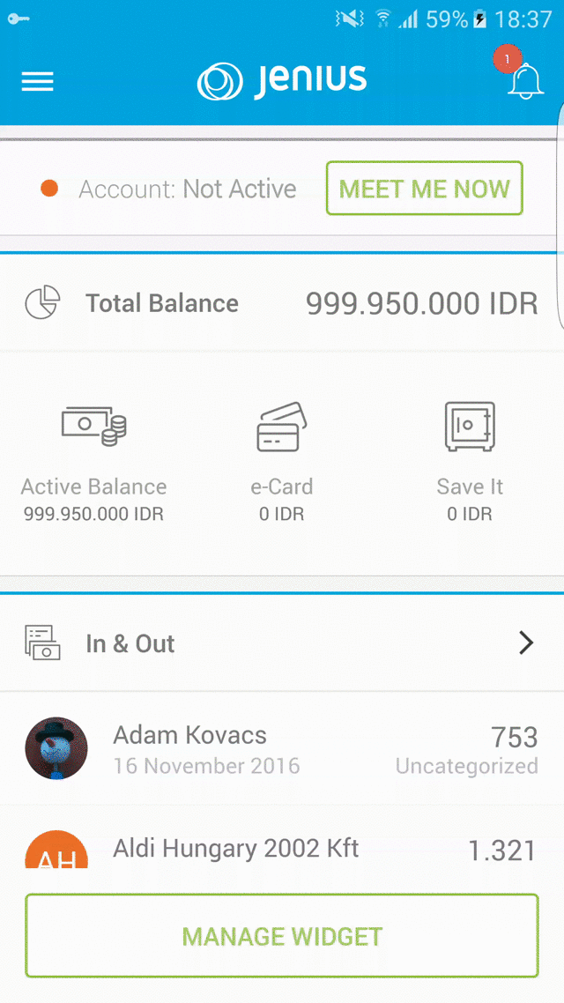
Architecture
Single Activity – Multiple Fragments
Easy to use
Centralized Navigation Management
Custom Backstack Handling
Presenter methods are Observables
Libraries first!

Slide 11
Daily RxJava

Slide 12
compile 'com.github.davidmoten:rxjava-extras:0.8.0.5’
compile 'com.trello.rxlifecycle:+’
observable.retryWhen(RetryWhen.retryWhenInstanceOf(CommunicationError.class) .delay(2L, TimeUnit.SECONDS) .maxRetries(1) .build())
.compose(bindToLifecycle()) .compose(RxUtils.androidSchedulers()) .doOnSubscribe(() -> appManager.showMultipleFullScreenprogress(true)) .doOnTerminate(() -> appManager.showMultipleFullScreenprogress(false)) .lift((Observable.Operator<T, T>) subscriber -> new Subscriber<T>(subscriber) { @Override public void onCompleted() { if (!subscriber.isUnsubscribed()) { subscriber.onCompleted(); } } @Override public void onError(Throwable e) { if (subscriber.isUnsubscribed()) { return; }
//TODO: handle error
subscriber.onError(e);
} @Override public void onNext(T t) { if (!subscriber.isUnsubscribed()) {
subscriber.onNext(t); } });

Slide 13
compile 'com.github.davidmoten:rxjava-extras:0.8.0.5’
compile 'com.trello.rxlifecycle:+’
observable.retryWhen(RetryWhen.retryWhenInstanceOf(CommunicationError.class) .delay(2L, TimeUnit.SECONDS) .maxRetries(1) .build())
.compose(bindToLifecycle()) .compose(RxUtils.androidSchedulers()) .doOnSubscribe(() -> appManager.showMultipleFullScreenprogress(true)) .doOnTerminate(() -> appManager.showMultipleFullScreenprogress(false)) .lift((Observable.Operator<T, T>) subscriber -> new Subscriber<T>(subscriber) { @Override public void onCompleted() { if (!subscriber.isUnsubscribed()) { subscriber.onCompleted(); } } @Override public void onError(Throwable e) { if (subscriber.isUnsubscribed()) { return; }
//TODO: handle error
subscriber.onError(e);
} @Override public void onNext(T t) { if (!subscriber.isUnsubscribed()) {
subscriber.onNext(t); } });

Slide 14
compile 'com.github.davidmoten:rxjava-extras:0.8.0.5’
compile 'com.trello:rxlifecycle:+’
observable.retryWhen(RetryWhen.retryWhenInstanceOf(CommunicationError.class) .delay(2L, TimeUnit.SECONDS) .maxRetries(1) .build())
.compose(bindToLifecycle()) .compose(RxUtils.androidSchedulers()) .doOnSubscribe(() -> appManager.showMultipleFullScreenprogress(true)) .doOnTerminate(() -> appManager.showMultipleFullScreenprogress(false)) .lift((Observable.Operator<T, T>) subscriber -> new Subscriber<T>(subscriber) { @Override public void onCompleted() { if (!subscriber.isUnsubscribed()) { subscriber.onCompleted(); } } @Override public void onError(Throwable e) { if (subscriber.isUnsubscribed()) { return; }
//TODO: handle error
subscriber.onError(e);
} @Override public void onNext(T t) { if (!subscriber.isUnsubscribed()) {
subscriber.onNext(t); } });

Slide 15
compile 'com.github.davidmoten:rxjava-extras:0.8.0.5’
compile 'com.trello.rxlifecycle:+’
observable.retryWhen(RetryWhen.retryWhenInstanceOf(CommunicationError.class) .delay(2L, TimeUnit.SECONDS) .maxRetries(1) .build())
.compose(bindToLifecycle()) .compose(RxUtils.androidSchedulers()) .doOnSubscribe(() -> appManager.showMultipleFullScreenprogress(true)) .doOnTerminate(() -> appManager.showMultipleFullScreenprogress(false)) .lift((Observable.Operator<T, T>) subscriber -> new Subscriber<T>(subscriber) { @Override public void onCompleted() { if (!subscriber.isUnsubscribed()) { subscriber.onCompleted(); } } @Override public void onError(Throwable e) { if (subscriber.isUnsubscribed()) { return; }
//TODO: handle error
subscriber.onError(e);
} @Override public void onNext(T t) { if (!subscriber.isUnsubscribed()) {
subscriber.onNext(t); } });

Slide 16
compile 'com.github.davidmoten:rxjava-extras:0.8.0.5’
compile 'com.trello.rxlifecycle:+’
observable.retryWhen(RetryWhen.retryWhenInstanceOf(CommunicationError.class) .delay(2L, TimeUnit.SECONDS) .maxRetries(1) .build())
.compose(bindToLifecycle()) .compose(RxUtils.androidSchedulers()) .doOnSubscribe(() -> appManager.showMultipleFullScreenprogress(true)) .doOnTerminate(() -> appManager.showMultipleFullScreenprogress(false)) .lift((Observable.Operator<T, T>) subscriber -> new Subscriber<T>(subscriber) { @Override public void onCompleted() { if (!subscriber.isUnsubscribed()) { subscriber.onCompleted(); } } @Override public void onError(Throwable e) { if (subscriber.isUnsubscribed()) { return; }
//TODO: handle error
subscriber.onError(e);
} @Override public void onNext(T t) { if (!subscriber.isUnsubscribed()) {
subscriber.onNext(t); } });

Slide 17
Debug & Test

Slide 18
Stetho
https://github.com/facebook/stetho

Slide 19
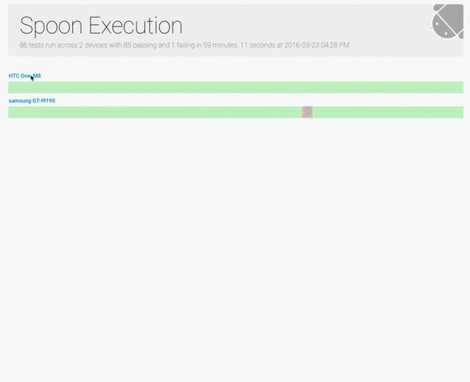
Espresso + Robotium + Spoon https://github.com/team-supercharge/android-test-util

Slide 20
Let’s integrate our work!

Slide 21
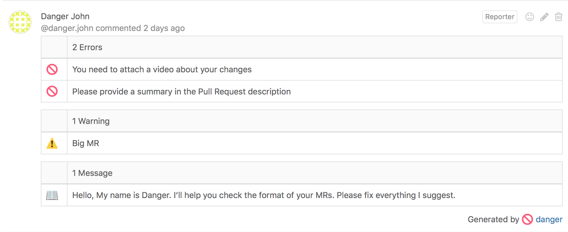
danger.systems

Slide 22
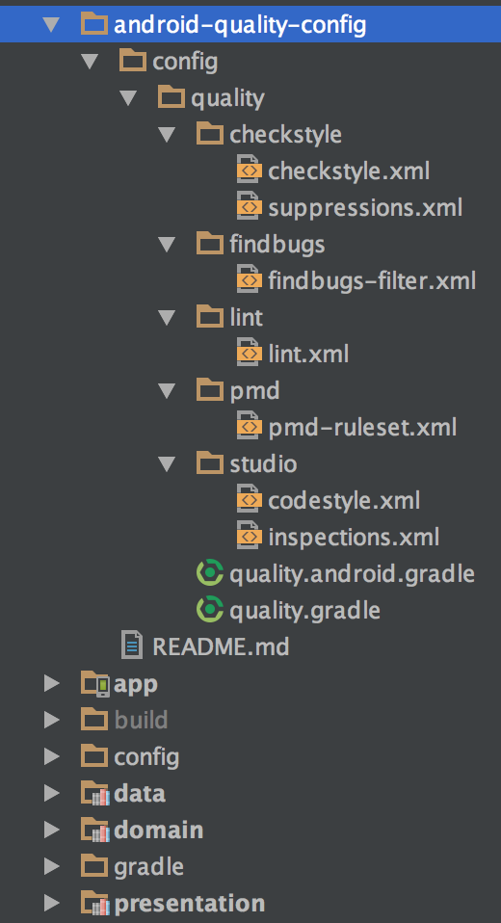
CI
Rebase feature branch
Build every MR
Run Checkstyle, Lint, PMD
Quality config as git submodule
Use WIP MR
Code review by 2
1 DEV
1 PM
Nightly Sonarqube analysis
Nightly proguard build

Slide 23
Fire the release!

Slide 24
ext.releseNotesPath = "build/tmp/crashlytics_release_notes.txt" def executeGitCommand(command) { def stdout = new ByteArrayOutputStream() exec { commandLine command standardOutput = stdout } stdout.toString().trim() } def getCommitCount() { executeGitCommand(['git', 'rev-list', 'HEAD', '--count']) }
def isCIMachine() { return project.hasProperty('versionName'); } if (isCIMachine()) { android.buildTypes.each { buildType -> buildType.ext.betaDistributionGroupAliases = "supercharge" buildType.ext.betaDistributionReleaseNotesFilePath = file(ext.releseNotesPath).absoluteFile.path } setupReleaseNotesFromCommitMessages() android.defaultConfig.versionName = versionName android.defaultConfig.versionCode = Integer.valueOf(getCommitCount()) }
./gradlew assembleProdRelease crashlyticsUploadDistributionProdRelease –PversionName=1.0.0

Slide 25
ext.releseNotesPath = "build/tmp/crashlytics_release_notes.txt" def executeGitCommand(command) { def stdout = new ByteArrayOutputStream() exec { commandLine command standardOutput = stdout } stdout.toString().trim() } def getCommitCount() { executeGitCommand(['git', 'rev-list', 'HEAD', '--count']) }
def isCIMachine() { return project.hasProperty('versionName'); } if (isCIMachine()) { android.buildTypes.each { buildType -> buildType.ext.betaDistributionGroupAliases = "supercharge" buildType.ext.betaDistributionReleaseNotesFilePath = file(ext.releseNotesPath).absoluteFile.path } setupReleaseNotesFromCommitMessages() android.defaultConfig.versionName = versionName android.defaultConfig.versionCode = Integer.valueOf(getCommitCount()) }
./gradlew assembleProdRelease crashlyticsUploadDistributionProdRelease –PversionName=1.0.0

Slide 26
ext.releseNotesPath = "build/tmp/crashlytics_release_notes.txt" def executeGitCommand(command) { def stdout = new ByteArrayOutputStream() exec { commandLine command standardOutput = stdout } stdout.toString().trim() } def getCommitCount() { executeGitCommand(['git', 'rev-list', 'HEAD', '--count']) }
def isCIMachine() { return project.hasProperty('versionName'); } if (isCIMachine()) { android.buildTypes.each { buildType -> buildType.ext.betaDistributionGroupAliases = "supercharge" buildType.ext.betaDistributionReleaseNotesFilePath = file(ext.releseNotesPath).absoluteFile.path } setupReleaseNotesFromCommitMessages() android.defaultConfig.versionName = versionName android.defaultConfig.versionCode = Integer.valueOf(getCommitCount()) }
./gradlew assembleProdRelease crashlyticsUploadDistributionProdRelease –PversionName=1.0.0

Slide 27
ext.releseNotesPath = "build/tmp/crashlytics_release_notes.txt" def executeGitCommand(command) { def stdout = new ByteArrayOutputStream() exec { commandLine command standardOutput = stdout } stdout.toString().trim() } def getCommitCount() { executeGitCommand(['git', 'rev-list', 'HEAD', '--count']) }
def isCIMachine() { return project.hasProperty('versionName'); } if (isCIMachine()) { android.buildTypes.each { buildType -> buildType.ext.betaDistributionGroupAliases = "supercharge" buildType.ext.betaDistributionReleaseNotesFilePath = file(ext.releseNotesPath).absoluteFile.path } setupReleaseNotesFromCommitMessages() android.defaultConfig.versionName = versionName android.defaultConfig.versionCode = Integer.valueOf(getCommitCount()) }
./gradlew assembleProdRelease crashlyticsUploadDistributionProdRelease –PversionName=1.0.0

Slide 28
Hi! Could u give me...

Slide 29
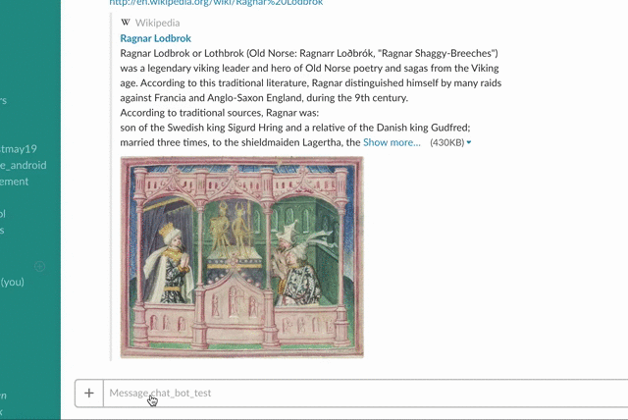

Slide 30
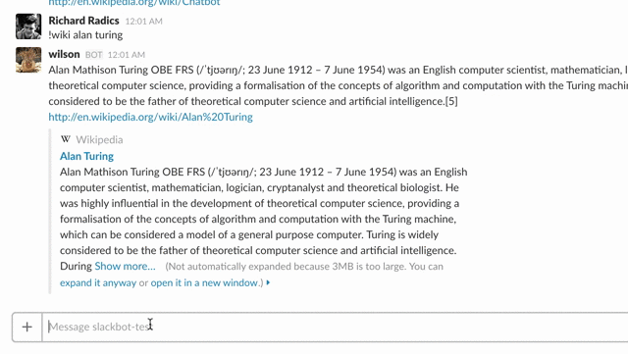

Slide 31
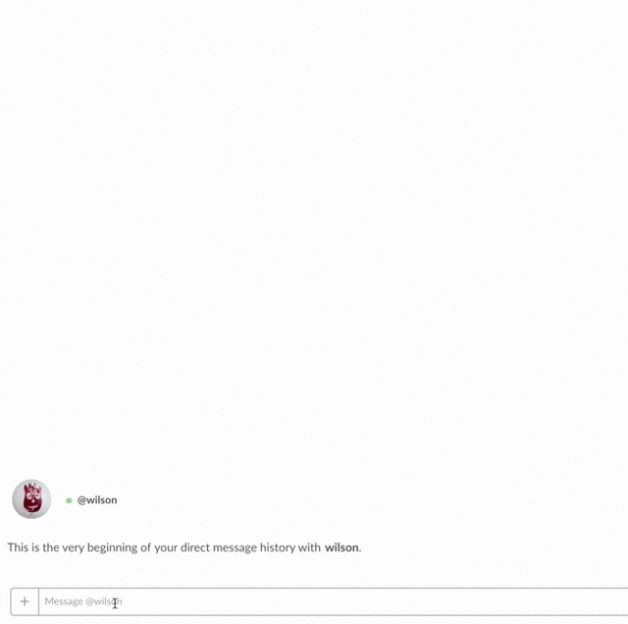

Slide 32
Improve every day!

Slide 33
Thank you!
We are hiring!
Richard Radics
Supercharge
Lead Android Developer
richard.radics@supercharge.io // www.supercharge.io

