Slide 1


Ipari IoT alkalmazás fejlesztés kihívásai és tapasztalatok
Czike Zsigmond | Üzletfejlesztési igazgató
Intelligent Network Energy Solutions™

Slide 2

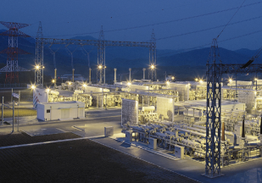
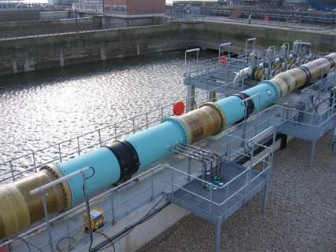


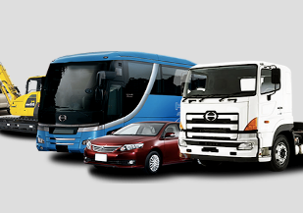
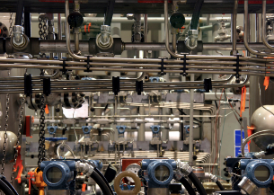










CASON Mérnöki Zrt.
Cason, established in 1992, is a leading provider of turnkey solutions in the field of industrial network communication and supervision primarily for the oil, gas, water and asset industries;
CASON Business Lines
Power
Water
Gas
Oil
Fleet & Object Tracking
Industrial
  AMR Advanced Meter Reading
  Natural Gas - Power - Water
  Cathodic Protection & Oil Leak Detection systems
  Multi-utility systems for Residential Water / Gas / Electricity
  Fleet and
  Workforce management
  IOT READY solutions
DIWICON Technology
Distributed Intelligence
Wireless Industrial Control

Slide 3


Digital Transformation
Marc Florette,
Chief Digital Officer (CDO)
Digital technologies can generate entirely new solutions to address the key essentials the utilities industry faces today and reveal additional business values;
Digital transformation is top of company agendas. Over 80 per cent of CEOs view key digital technologies such as data mining and mobile customer engagement as strategically important for their company.
Digital transformation is essential for gas utility sector in order to stay competitive in the future;
There are three focal points for digital transformation:
  Building new customer channels,
  The delivery of new services
  The role of digital in increasing efficiency and asset performance
„It’s a unique chance for digital transformation as we move to a much simpler organization and adjust to a more agile world where long-term capital expenditure is no longer the only major driver of value.
Three ‘Ds’ – de-carbonization, decentralization and digitization – are now key to our strategy”
Dr. Sascha Kreiskott,
Head of Digital Solutions at E.ON Energie
“We strongly believe some new services can only be introduced by digital because they have to be explained by way of content that can’t be done by a field force, at least not in the mass market

Slide 4
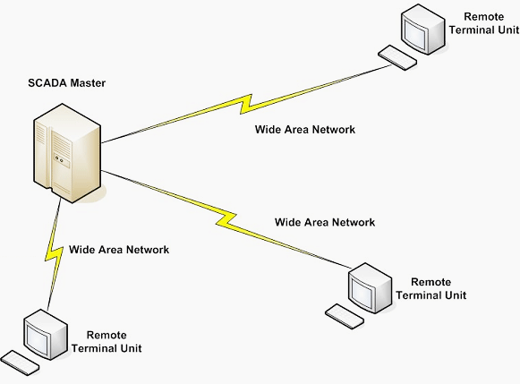
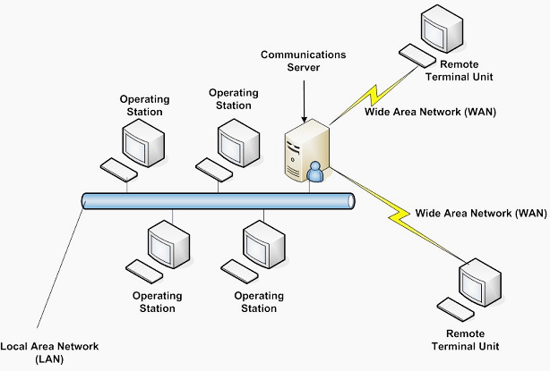
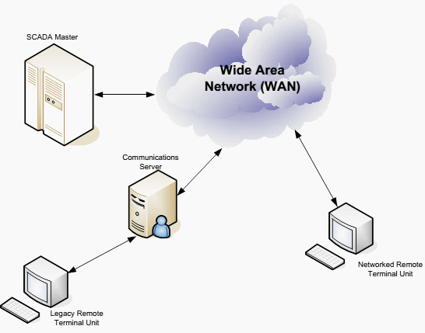
SCADA Evolution
Monolithic SCADA
Built around a Mainframe system
Stand alone „network”
Not really a network
Proprietary protocols by Vendors
Limited protocol functionality
No other communication
Hardwired connection on bus level
Primary/secondary master
Distributed SCADA
Multiple distributed stations
Dedicated functionality
Utilizes LAN protocol
Several LANs are connected
Protocols are still proprietary
Improved computing power
No other communication
Distributed redundancy
Networked SCADA
Master stations
Multiple networked systems
Sharing master functionality
Ethernet communication
Open system architecture
Standard open protocols
Introduction of WAN (IP) protocol
Significant improvement on reliability

Slide 5
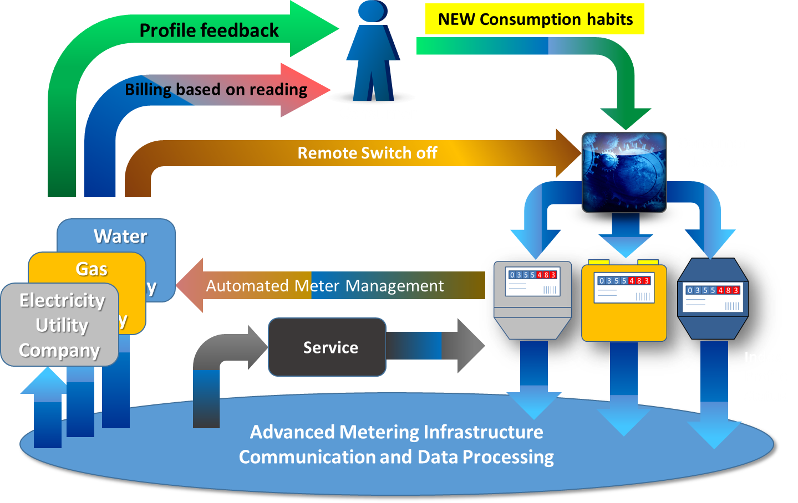
Smart Utility
Automatic Meter Reading
Advanced Metering Infrastructure
Advanced Metering Analytics
SMART Meter
SMART Grid

Slide 6
The Challenge
Autonomous operation
Wireless local connectivity
Data and communication encryption
IP67, ATEX Certification
Compact „Idiot-proof” design & installation
Maintenance free operation
Field Installation time less than 10 mins
Field level device intelligence
Favorable CAPEX
No or infinitesimal OPEX
CHEAP
RELIABLE
GUARANTEED

Slide 7
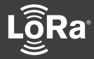

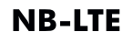


The Solution - Hardware
COMMUNICATION
GSM GPRS is „expensive”
Power output 2 Watts, (requires super caps)
Average consumption in milliamps
Huge battery capacity (70/140Ah)
Suitable Communication Technology
Power output in milliwatts range
Average consumption in microamps range
Communication for Installation
Local display or server side web-based app
Needs power and other resources
Low Energy Communication
BLE 4.x/5
Low power, long range
Tablet or Smart Phone
DEVICE
„Disposable” device design
Low consumption MCU
Single-chip (All-in) electronic architecture
Modular design, ready for future comm. protocols
Non-replaceable battery
10+ years lifetime
POWER
Simple, light-weight power management
Application of new battery types: Lithium Tionil Chlorid (LiSOCl₂) / Lithium Manganese Oxide (LiMn₂O₄)
Gyártás: 1000-es nagyságrend vs. 100.000-es nagyságrend

Slide 8
The Solution - Software
Open Industry Standard Communication Protocol
Data Process
Database
Big-Data Tools
Math
BI
Visualization & Reports,
Output for humans and machines
Data Analyzing
Predictive Algorithms,
Neural Networks, etc.
NoSQL
Workflow Based On-The-Fly
MQTT

Slide 9

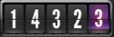
Encryption – the most secure way of data transfer
Devices
GATEWAY
Network
server
GRID Apps
1432.3
Sub GHz RF
IP
IP
CA039FDAB0
Encrypted Network Session Key
Application Session Key
CA039FDAB0
CA039FDAB0
DF09BBA02A
DF09BBA02A

Slide 10
Experiences and Consequences
OTA Firmware upgrade is not possible or limited
„Coulomb-Counting-Driven Hardware Design”
Carefully chosen device communication strategy
to avoid field communication channel collision
Stress testing on server side to avoid overload and data loss
End-to-end data and communication channel encryption
Thorough factory and field testing in real environment before mass rollout

Slide 11
Industrial IoT
Sensor Data Harvesting & Harnessing
Automation
Machine Learning
M2M Communication
Big Data
Cloud
Business Intelligence
Ultra Low Power Sensor
Low Power Network Technology
Wireless Connectivity
Autonomous Field Device
Open, Industry Standard Communication Protocol
Multilayer Encryption
Data Sharing

Slide 12



DW 256 ULX
XLP MCU

Slide 13

Köszönöm a figyelmet!
Czike Zsigmond
Üzletfejlesztési igazgató
zsigmond.czike@cason.hu
+36 70 934 0970
www.cason.hu
Intelligent Network Energy Solutions™

