Slide 1
Regulation and Digital Rights: The Big Picture
David Meyer a.k.a. @superglaze

Slide 2
Who Am I?
Journalist covering tech policy for 11+ years
Fortune, ZDNet, International Association of Privacy Professionals, Internet of Business, Privacy News Online
Connected Rights newsletter
Control Shift

Slide 3
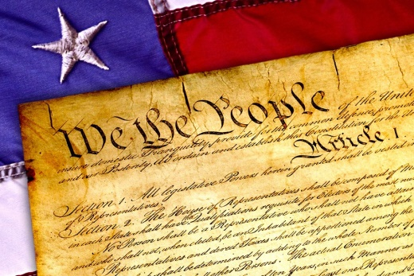
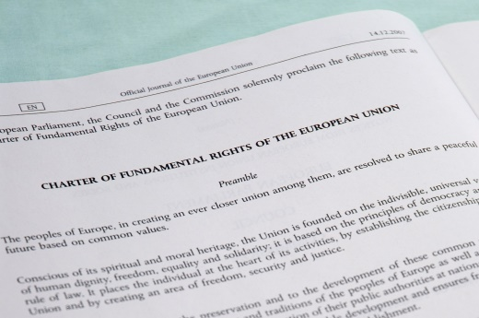
US vs EU
US Constitution
Freedom of expression
Search and seizure (not privacy)
EU Charter of Fundamental Rights
Privacy
Data protection
Expression and information
Notes:
Constitution – free speech 1st amendment, search and seizure 4th amendment
CFR – privacy article 7, data protection article 8, expression and info article 11

Slide 4
US vs EU
What surveillance is
Free expression vs privacy
Data control

Slide 5
Data transfers
Adequacy
Safe Harbour
Snowden and Schrems
Model contracts
Privacy Shield

Slide 6
GDPR
Regulation vs Directive
Fines
Personal data
Controllers
Processors
Consent
Contracts
Legitimate interests

Slide 7
GDPR
Restriction of processing
Access requests
Correction
Erasure
Portability
Profiling
Data breaches

Slide 8
ePrivacy Regulation
GDPR’s twin (in theory)
Do Not Track
Cookies
Consent (vs GDPR)

Slide 9
Filters and blocks
Copyright Directive
Consumer Protection Cooperation Regulation

Slide 10
Thank you!
@superglaze
david@dmeyer.eu
connectedrights.net
Control Shift: How
Technology Affects
You and Your Rights

