Slide 1
Gain Insights and Innovate with Location Services
Cisco Connected Mobile Experiences (CMX)
Fulajtár József, Cisco
2017 / 11 / 29
HWSW mobile!
Notes:
Hello, my name is (NAME) and I am (JOB TITLE) at Cisco.
I’m excited to meet with you to talk about Cisco Connected Mobile Experiences, or CMX. Before I get into the specific details about this solution and how it can help you, let’s take a look at the state of mobility today and where it’s headed.

Slide 2



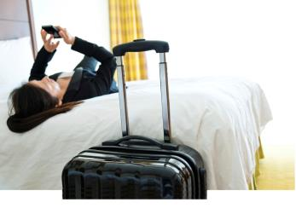

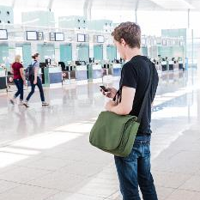
Healthcare
Retail
Education
Electronic Medical Records
Mobile Payments
Online Learning
Hospitality
Sports/Entertainment
Transportation
Self Check-in
Fan Experience
Reduced Wait Time
Digital business is creating the digital economy
The network is enabling digital business
Notes:
Organizations across industries are turning towards technology and innovations to more effectively drive business – this is creating positive business disruption
<<Click>>
We see it everywhere we go – The way we meet and collaborate, how we purchase goods and services how we interact with our environment – This makes the network the foundation for business disruption

Slide 3
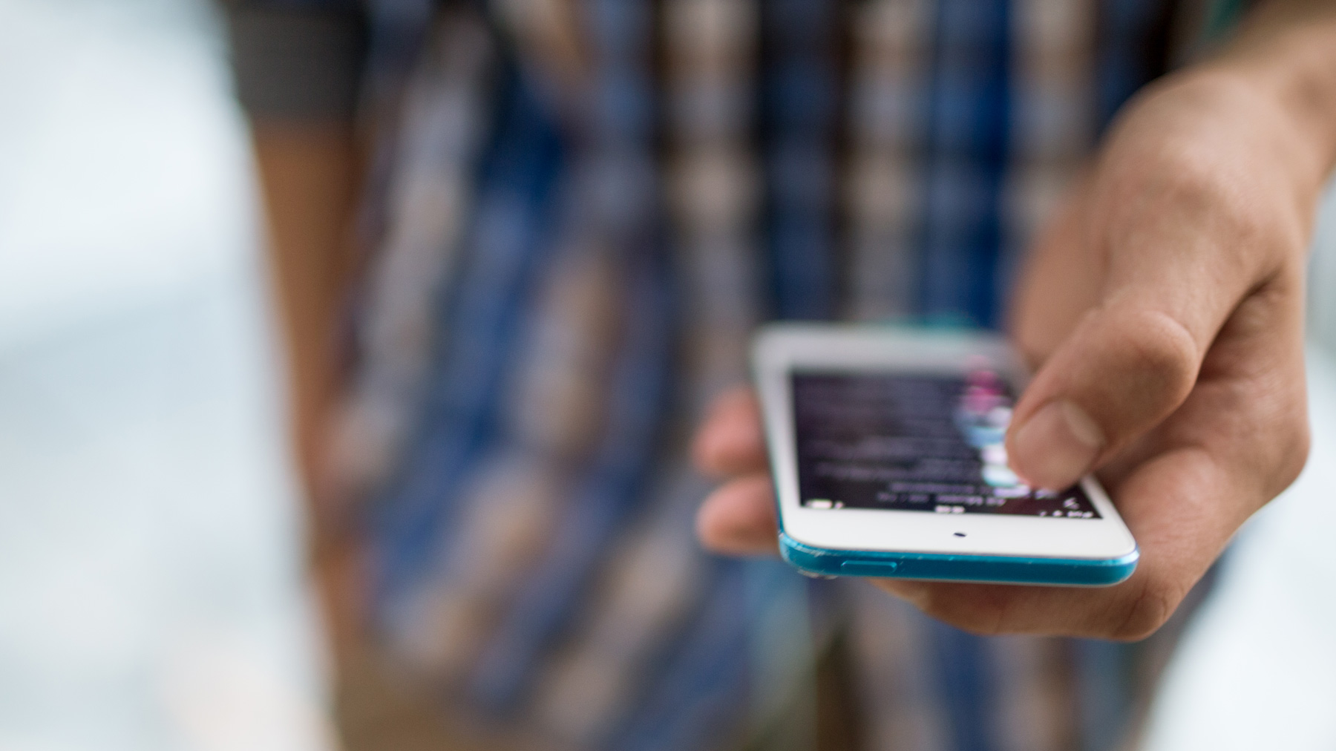
Customers Demand a Rich Mobile Experience
The Opportunity Is in Mobile
Shoppers want to look up online reviews and compare prices while browsing
56%
Of lines of business say mobile strategy is very or extremely important to their objectives¹
Hotel guests want free Wi-Fi and they want to see available services and amenities
Travelers want to find departure gates quickly and receive itinerary updates
“Consumers are not only keeping pace, they are in many cases leading the disruption.”²
Patients want location-enabled wayfinding apps
Students want to find their way around campus and receive safety alerts
¹ IDC Location Based Services: A Promising Customer-Centric Solution 2014
² IDC, Chief Digital Officers: Bridging the Innovation Gap Between the CIO and CMO, June 2015
Notes:
IT’s foot in the door is mobility.
56% of LoBs say that mobile strategy is very or extremely important to their objectives.
This is IT’s chance to collaborate as partners with LoB using its technology expertise. To make enterprise IT and marketing budgets come together to tackle bringing success to the business in the digital economy.

Slide 4


DNA—Transforming Business through the Network
Faster
Innovation
Reduce Cost
& Complexity
Lower Risk &
Meet Compliance
Insights & Experiences
Automation &
Assurance
Security
Visibility & analytics
CMX
Accelerated roll out
of services
Rapid threat detection
and mitigation
© 2015 Cisco and/or its affiliates. All rights reserved. Cisco Confidential
5
Notes:
How does the network need to evolve to enable growing business needs?
As we said before, the network connects all things digital. But let’s discuss how it needs to evolve to address IT priorities for digital.
The network needs to enable faster innovation by delivering Deep Insights on users behaviors, application performance, and threats. In order to Personalize Experiences it needs to deliver context relevant information like what users and devices are on the network and where. And this is possible when the network has visibility and can deliver the analytics, helping businesses make better decisions faster. For example, the network can tell a bank a VIP client has entered a store or what promotions are driving store front conversion or how well expensive real-estate is being utilized.
To sustain the increasing devices, apps and services, while reducing cost and complexity the network needs to deliver automation and service assurance. This will allow IT to get a branch office running quickly, or roll out new services and applications faster with efficiency and optimal experience.
The network needs to contain risk through integrated security services that rapidly detect and mitigate threats. Here the network – touching all things digital – can provide security everywhere so that it acts as both a sensor and enforcer all the way from the clients to the cloud.
However, while business leaders fully acknowledge the importance of the network in enabling digital, less than 10% of enterprises implementing digital business have very clear integration between their network and digital business strategies. (Source: Gartner)

Slide 5
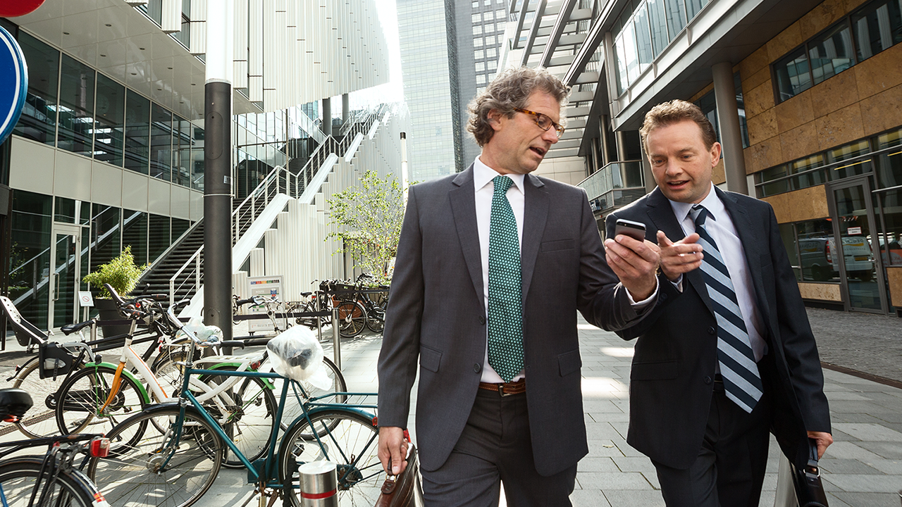


Imagine the Possibilities
Enhance customer
service and loyalty
Drive incremental
services and sales
Identify operational
bottlenecks
Provide venue
wayfinding
Foster interactive
experiences
Notes:
Until now, physical venues across industries have struggled to keep up with online counterparts and their vast amounts of data on customer behavior.
What if you could use your Wi-Fi network to gain insight into how, where, and when individuals move throughout your venue? And acquire real-time and historical analytics of the movement patterns of your customers?
What if you could enhance an individual's in-venue experience by providing information on nearby services such as location-specific marketing or promotions or indoor navigation?
Creating connected mobile experiences and services is a powerful differentiator that can set your organization apart from the competition. It can help increase revenue. And Cisco has a solution suite that helps you create that difference.

Slide 6
Introducing Cisco
Connected Mobile Experiences (CMX)

Slide 7


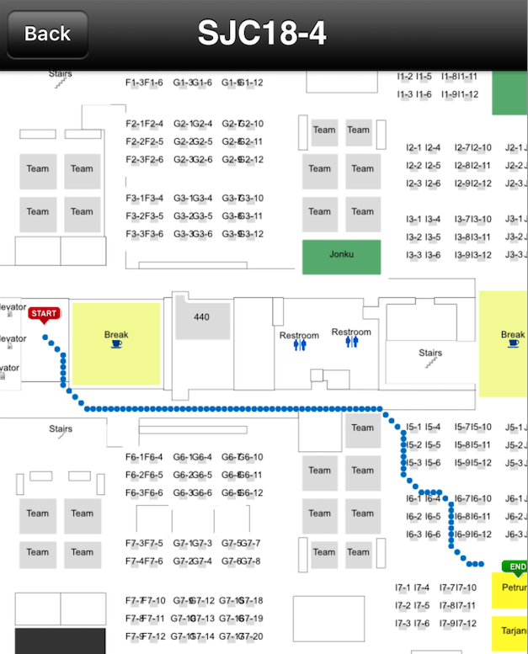

Drive Insights & Experiences with Cisco CMX
Detect
Connect
Engage
Presence and location detection
Visibility (Wi-Fi, BLE)
Easy Wi-Fi login, custom or social
Zone-based, custom
splash pages
App-based mobile engagement
Context-aware in-venue experiences
ANALYTICS
Presence
Location
Social
Notes:
Cisco Connected Mobile Experiences (or CMX) transforms your network into an experience engine. An experience engine that delivers dynamic, relevant content to mobile end-users. This connection between physical venue and user opens the door to improving user experiences and optimizing operations.
Cisco CMX is based on 3 primary activities: detect, connect, and engage.
First, as an end user carrying a mobile device approaches your venue, the network detects the presence and location of the device using visibility of Wi-Fi location, BLE, and video information.
After the end user receives notification of available Wi-Fi access and services, that individual can then connect to the network securely.
Once visitors have access, you can engage them with app-based mobile engagement by delivering context-aware experiences for the venue to develop a relationship
There’s an overarching activity across all three activities. That’s analytics, and it’s a key component of Cisco CMX. The solution sources location data from devices that have been detected and connected to the network, and it analyzes engagement opportunities from that data.

Slide 8
Indoor Location Accuracy Continuum
GOOD
BETTER
BEST
Greater Location Granularity
Increased Business Value
Notes:
We’ve shown how to easily deploy CMX and provide basic presence analytics in less than 30 minutes. Here, you can see that even this easy-to-deploy option provides investment protection with a clear migration path from presence analytics through hyperlocation.

Slide 9
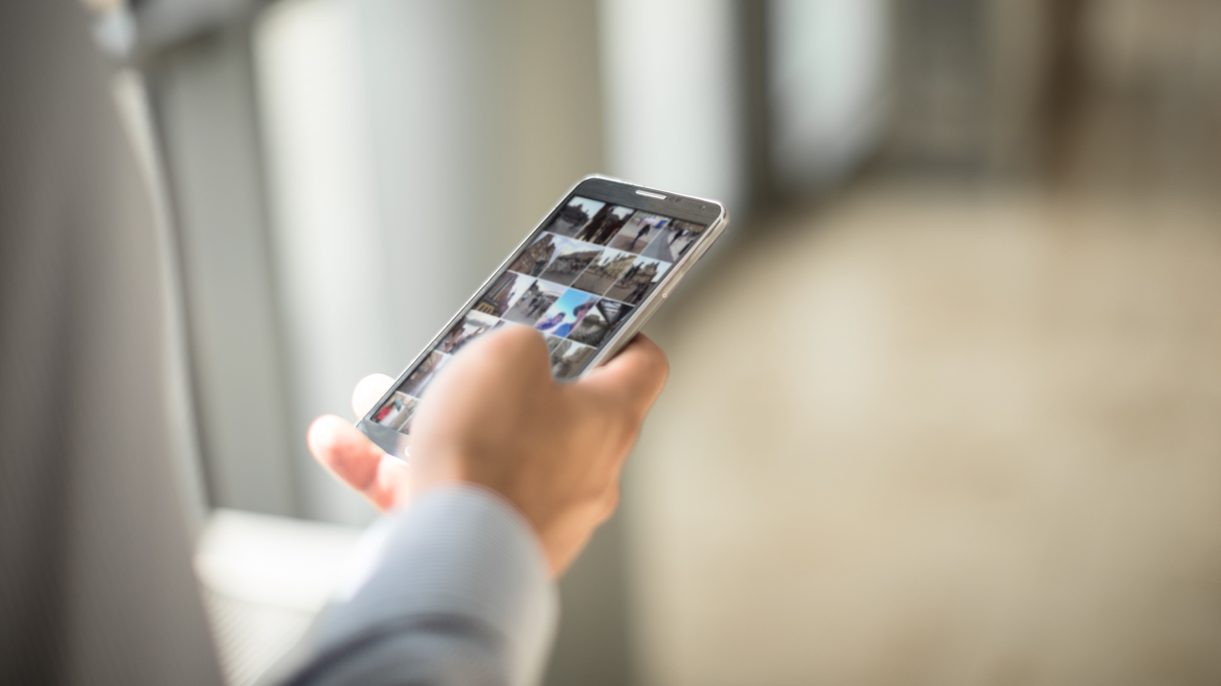

High Accuracy Location
Technology
Preferences
Use Case
Preferences
Wi-Fi
BLE
Closing the Gap
Navigation/Wayfinding
Proximity Marketing
Analytics
Space Utilization
© 2016 Cisco and/or its affiliates. All rights reserved. Cisco Confidential
9
Notes:
Today we are announcing the introduction of a BLE-based high accuracy location solution and a Wi-Fi-based high accuracy location. We are the only vendor that can provide this level of accuracy with both technologies. As a result, you don’t have to choose one technology over the other. And, because each technology is optimized for different use cases, you don’t have to compromise on location accuracy because of your desired use case. Cisco can deliver the optimal solution.
Let’s take a look at each of these new Cisco solutions.

Slide 10
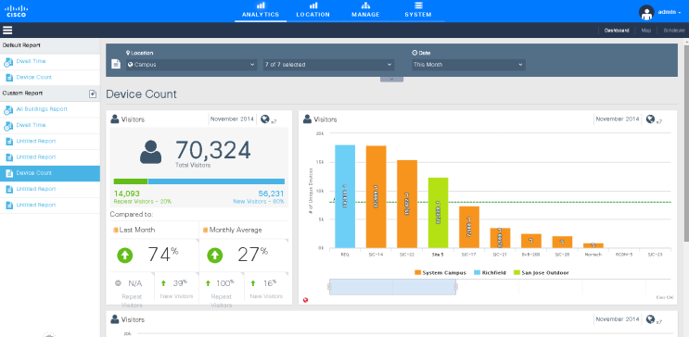
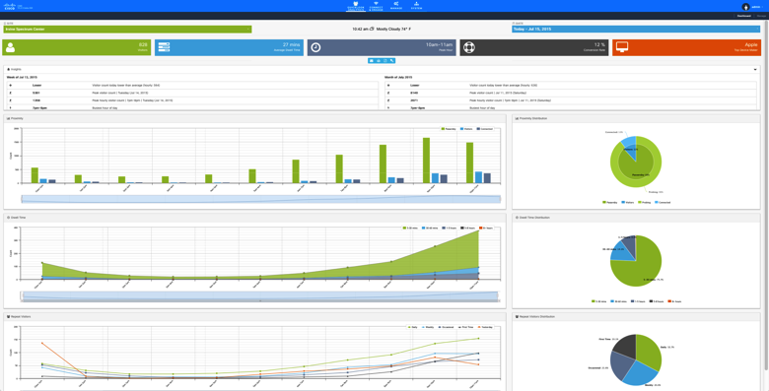
Understand How People Interact in the Location
Number of people by venue and zones
Peak time in venue
New compared to repeat visitors
Common traffic patterns
Where people spend time
DETECT
Notes:
Again, the first step in gaining control over your environment and fostering meaningful communication with customers and others is to detect who’s there, what they’re doing and how they spend their time. Only once the detection capabilities are in place can analytics happen.
Location analytics is the science of taking a series of data points and extracting value. That’s what CMX Analytics does. By providing both historical and real time analytics, you can know who’s where, what the traffic flows and patterns are, and which you can use to make operational changes for efficiencies. For example:
Analyze business performance to improve in-venue marketing
Optimize layouts to increase revenue per square foot
Increase customer satisfaction by understanding patterns and adjusting staffing
CMX Analytics achieves this by collecting millions of points of data, using them to calculate information, and translating this into actionable business intelligence—both real time and historical--that is relevant to the venue.
For example, CMX Analytics can show you:
Data: A particular Wi-Fi device was at a certain point for a given amount of time.
Information: On average, most visitors spent roughly 20 minutes at this location.
Knowledge: Due to inadequate staffing, visitors waited longer than they should for the delivery of goods/services.
The analytics engine presents the information to you through an intuitive interface.

Slide 11
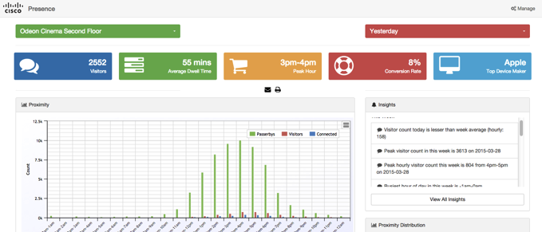
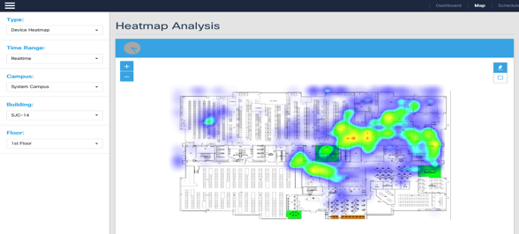
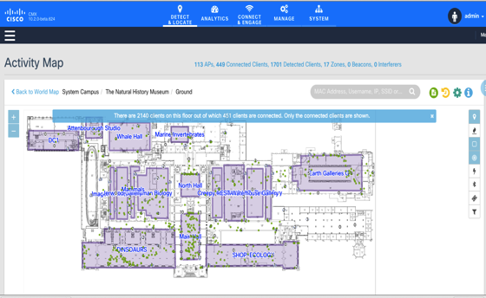
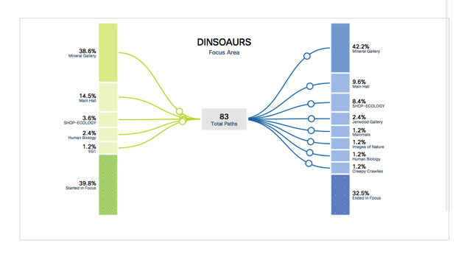
Gain Business Insights Through Analytics
Presence Analytics
Heat Maps
Correlation
Building/Floor
Timeframe
Parameters
Heat Map
Visitors vs. Passerbys
Repeat vs. New Visitors
Dwell Time
Busiest Hour, Day
Visitor Sentiment
Conversion Rate
Where do visitors spend time?
Which paths
did visitors take?
DETECT

Slide 12

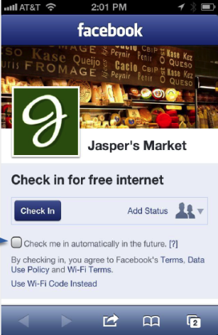
Enable Location-Specific Guest Access
Simplify access with user opt-in
Offer clear terms and conditions
Multiple access methods
Custom or social media
Customized access and promotion
Proximity-based landing pages
and video
Understand who is in your location
Enhanced analytics
CONNECT
Notes:
Of course, making sure users connect is an important step to getting your analytics. CMX Connect interacts with mobile devices by providing simple guest onboarding of devices with custom or social Wi-Fi access, depending on your organization’s requirements.
CMX Connect provides simple guest access to the local Wi-Fi network. Connections can be made using a zone-based captive portal or social login. This capability scales easily to thousands of users. You can customize your login page with graphics and ads. Using location data, Cisco CMX Connect can deliver welcoming experiences, depending on where customers are in the venue.
Cisco CMX for Facebook Wi-Fi is a derivative of CMX Connect. It lets visitors log onto the Wi-Fi network using their Facebook credentials and then takes users directly to the venue’s Facebook page.

Slide 13
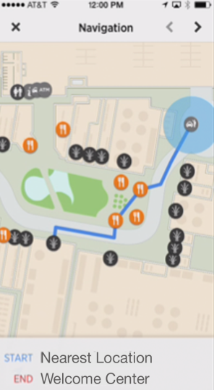
Engage Consumers Using Location Services
Work with Cisco and ecosystem
partners to align to business needs
Fully customizable applications with zone-based captive portals and enhanced advertising
Location-aware app for
personalized experience
Integrate with business systems
ENGAGE
Notes:
CMX Engage is the third activity for fostering customer relationships within your venue.
CMX Engage lets you enable two-way communication and build real-time relationships with visitors to truly add value to your mobile interactions.
You can personalize the in-venue experience by making context-aware apps that use data directly from your network. That data might be information about the visitor’s previous purchases, preferences, and so forth. Knowing a little something about the visitor means you can much better engage with the visitor on a meaningful and helpful basis.

Slide 14

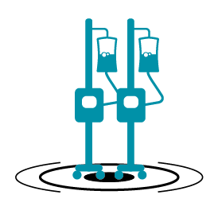


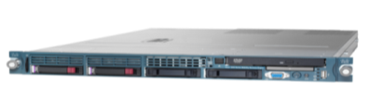




How the Connected Mobile Experience Works
Access Points
Northbound
clients
Cisco MSE
(Virtual/Physical)
Prime
Infrastructure
Analytics Data
Customer Engagement
Partner Mobile App Server/EMSP
Personalized Offers
Wayfinding
Notifications
Context
Data
Device App Built With CMX APIs
EMSP
CMX Analytics UI
(Location, behavior and demographic insights)
Generate Customer Insights
Increase Mobile Engagement
Boost Customer Satisfaction
Notes:
It starts with mobile device accessing wi-fi via an access point. The access points push data to the Cisco MSE, which can then push data to the CMX Analytics user interface where users can visualize customer flow patterns. The MSE also will push location data to partner mobile application servers, which power location enabled applications like way finding apps and personalized, location enabled promotions to customers in the venue.
DETECT: Again, the first step in gaining control over your environment and fostering meaningful communication with customers and others is to detect who’s there, what they’re doing and how they spend their time. Only once the detection capabilities are in place can analytics happen. Location analytics is the science of taking a series of data points and extracting value. That’s what CMX Analytics does. By providing both historical and real time analytics, you can know who’s where, what the traffic flows and patterns are, which you can use to make operational changes for efficiencies. For example:
Analyze business performance to improve in-venue marketing
Optimize layouts to increase revenue per square foot
Increase customer satisfaction by understanding patterns and adjusting staffing
CONNECT: Of course, making sure users connect is an important step to getting your analytics. CMX Connect interacts with mobile devices by providing simple guest onboarding of devices with custom or social Wi-Fi access, depending on your organization’s requirements.
ENGAGE: lets you enable two-way communication and build real-time relationships with visitors to truly add value to your mobile interactions. You can personalize the in-venue experience by making context-aware apps that use data directly from your network. That data might be information about the visitor’s previous purchases, preferences, and so forth. Knowing a little something about the visitor means you can much better engage with the visitor on a meaningful and helpful basis.

Slide 15
CMX Case Studies

Slide 16
Hospitality
Port Aventura
- Enhancing Customer Insight
The Challenge
 | Transform the visitor experience, improving attendance and loyalty
Digital Transformation
 | Created infrastructure to develop intimate understanding of park patrons – purchase habits, dwell time, crowding New information enables “situational” promotions and “perpetual” experiences
Business Outcomes
 | 15% of daily patrons using Wi-Fi prior to official service introduction With additional changes, expect to increase daily traffic by 25%
Mobility / CMX

Slide 17
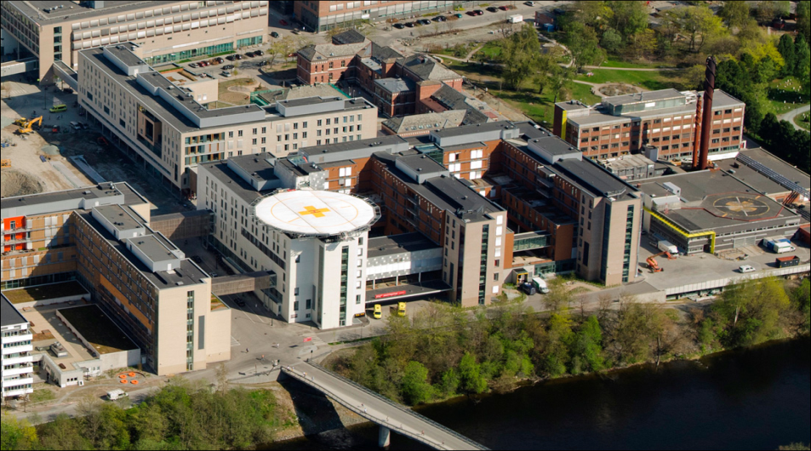
Healthcare
St. Olavs Hospital
- Advancing the Patient Experience
The Challenge
 | Transform the visitor / employee experience Improve operational efficiency
Digital Transformation
 | Indoor and outdoor navigation services Location-based information in smartphone application and patient-directed check-in terminals
Business Outcomes
 | 10,000 students, patients, staff, and doctors used the wayfinding solution within first three months of availability Reduced workload at information centers
Mobility / CMX

Slide 18
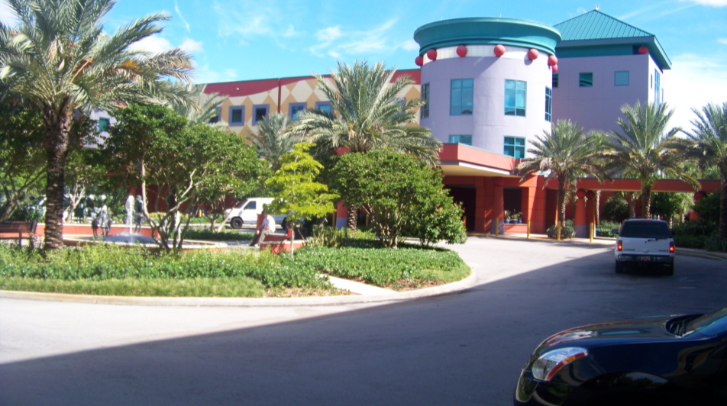
Healthcare
Miami Children’s Hospital
- Innovating Patient Care
The Challenge
 | Advance healthcare and empower patients by integrating transparency and information into all aspects of care
Digital Transformation
 | Enriched patient and family experience through Fit4KidsCare educational apps Enhanced healthcare by expanding clinician access to patient information
Business Outcomes
 | Anytime, anywhere EMR access Patient vitals recorded electronically Enriched patient and visitor experiences through wireless Fit4KidsCare application
Mobility / CMX

Slide 19
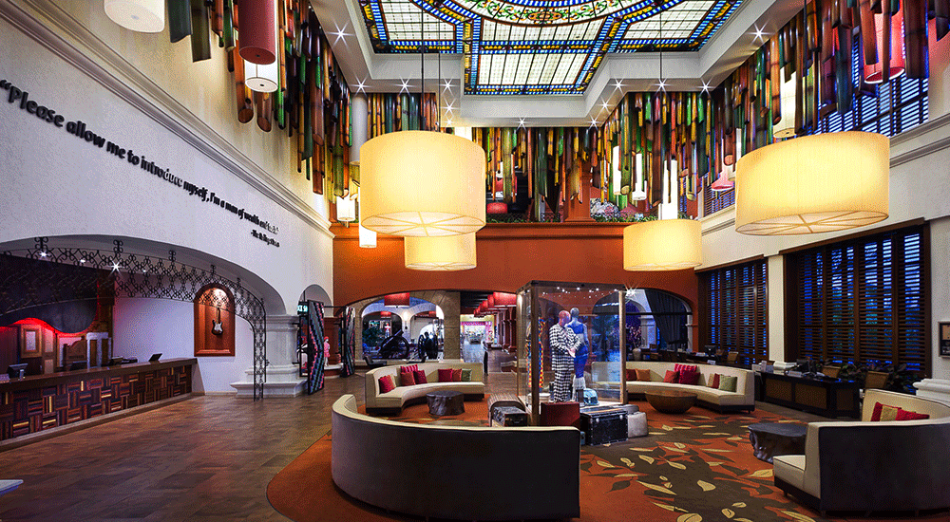
Retail
Riviera Shopping Center
Transforming the Retail Experience
The Challenge
 | Personalizing the customer retail experience for the new breed of shopper
Digital Transformation
 | Traffic flow and dwell time analytics to identify valued locations, underperforming stores Historical location-based analytics to improve effectiveness of marketing events
Business Outcomes
 | Instant, reliable and quantifiable marketing campaign feedback Cross-store shopping characteristics driving longer-term store “mix”
Mobility / CMX

Slide 20
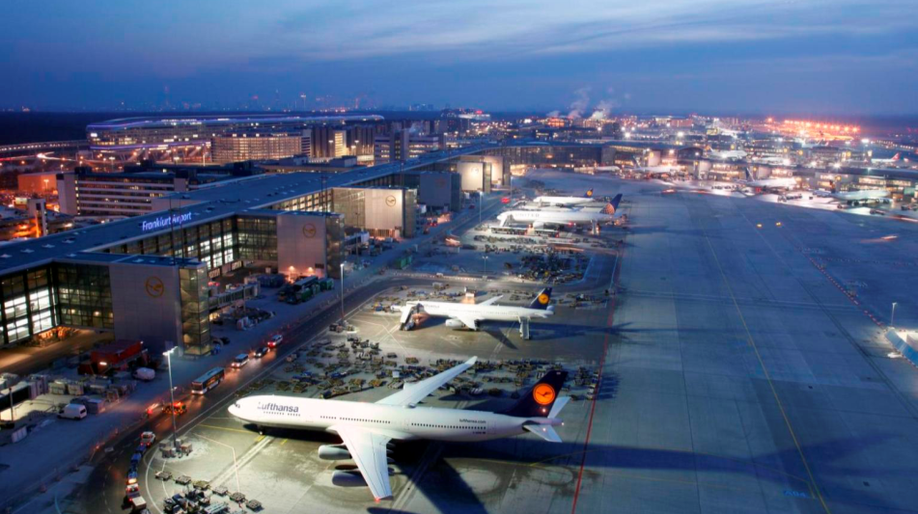
Transportation
Frankfurt Airport
- Open, Flexible, Communicative
The Challenge
 | Equip the new Frankfurt Airport headquarters with a flexible and collaborative working environment
Digital Transformation
 | Always-on wireless network offering file sharing, email, Internet, and IP telephony Location-based and context-aware customer services on Smart Phone app
Business Outcomes
 | Cable-free environment expected to generate more than €500,000 in savings over ten years Productivity and collaboration enhanced for 650 employees Innovative Wi-Fi services forecasted to deliver up to 40% revenue uplift
Mobility / CMX

Slide 21
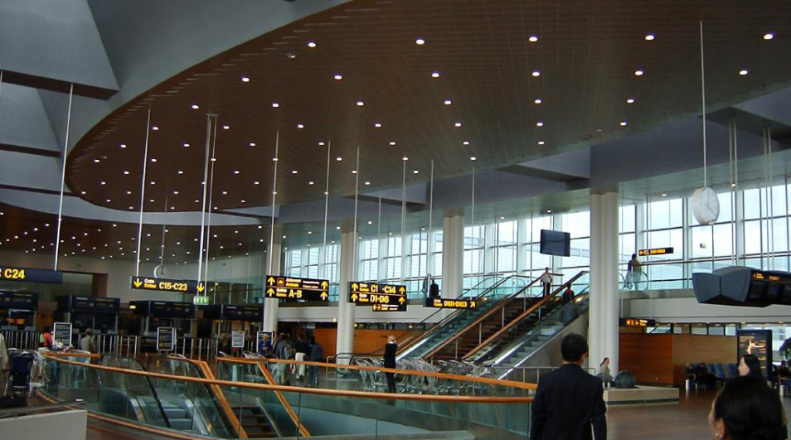
Transportation
Copenhagen Airport
- Transforming the Passenger Experience
The Challenge
 | Improving efficiency of airport operations to grow to 30 million passengers / year Enhancing the overall passenger experience
Digital Transformation
 | Wayfinding app with directions to stores, restaurants, check-in desks, gates Analytics to identify passenger choke points and reduce overall wait times
Business Outcomes
 | Virtually eliminated costly, manual surveys Generated 2,000 downloads a week of Airport application Operational improvements will enable throughput of 30M passengers / year

Slide 22
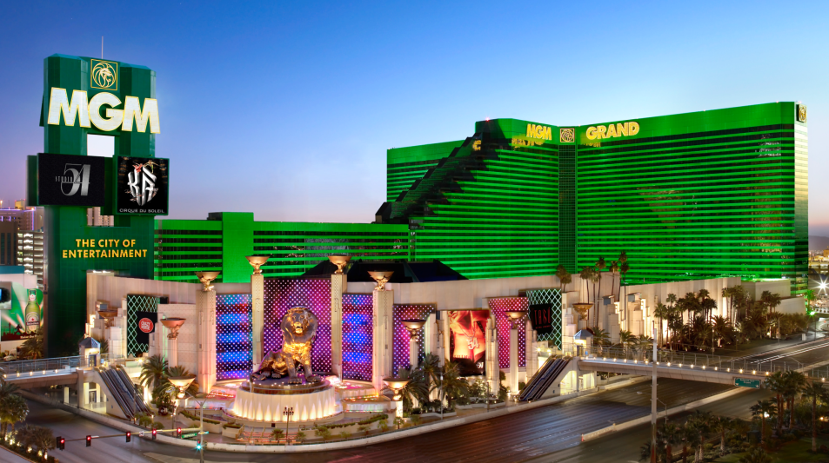
Hospitality
MGM Resorts International
- Personalized Real-time Marketing
The Challenge
 | Engage, entertain and inspire guests Enhance the resort experience by providing personalized mobile services
Digital Transformation
 | High-performance, tiered Wi-Fi for customer satisfaction and revenue Personalized, location-based content through Bellagio wayfinding application
Business Outcomes
 | Tiered Wi-Fi driving customer satisfaction and increased service revenue Increased business opportunities with innovative customer interactions
Mobility / CMX

Slide 23
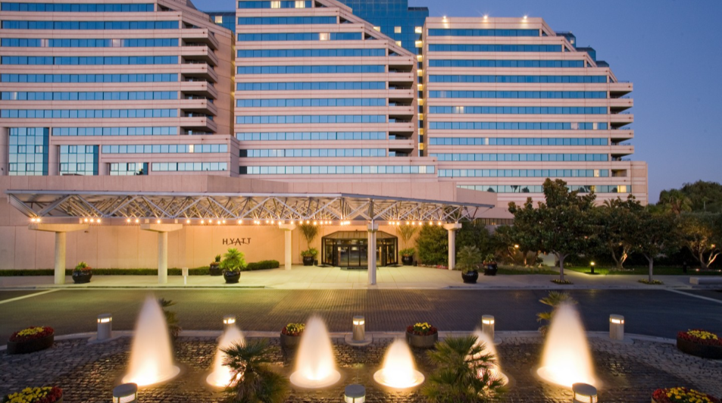
Hospitality
Santa Clara Hyatt
Driving Business Intelligence
The Challenge
 | Limited Wi-Fi coverage not designed for the for the modern, mobile digital guest
Digital Transformation
 | Wayfinding and location-based services for 1:1 guest advertising Location and dwell-time analytics for enhanced service delivery and revenue growth
Business Outcomes
 | 15-20% increase in non-room revenue 65-point increase in customer satisfaction – raised property from bottom 5% to top 5% 25% to 40% increase in lobby bar spend by offering free Wi-Fi access Increase of 37% of Net Promoter Score one year after implementation

Slide 24
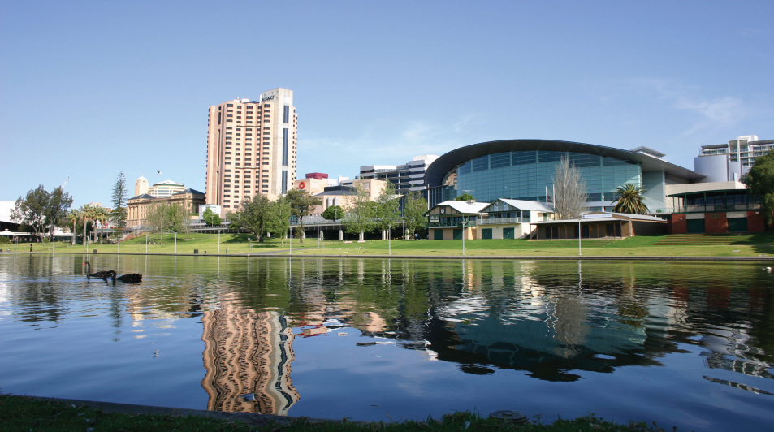
Public Sector
City of Adelaide
- Revitalizing the City Center
The Challenge
 | Facilitate collaboration for residents, tourists, and businesses Decrease cost of cellular connectivity Enhance public safety and improve infrastructure
Digital Transformation
 | Free wi-fi for residents and tourists to draw and maintain visitors Identification of usage and traffic patterns to more appropriately define city services
Business Outcomes
 | 30,000 unique users connect to the network each day Savings from public employee cellular data use redirected to public safety Higher efficiency from mobile city workers due to “always on” connection
Mobility / CMX

Slide 25
HWSW
Thank you!

