Slide 1
VR Design Software
For
Product and Character Creation, Presentation and Training
Zoltan Karpati
Co-founder
ZOLI@leopoly.com

Slide 2
To reach 50 million people
75 yrs
38 yrs
13 yrs
4 yrs
35 days
Notes:
Mi z mit még ki lehet olvasni ebből azon kívül hgoy gyorsan növekednek a dolgok.
Hwre fokuszálnununk. Szoftveren kell legyen a hangsuly???
hazánkaban B2C piacon ne vágjunk bele Hwbe annyira szabaon mint Swbe, körültekintőbbnek:
HW gyártás jobban centralizálódik mint SW
Itthonról nehéz ugrani a kicsi piac miatt -
Nagságrendekkel nagyobb finanszirozási igény ami itthon korlátoztoo
Ezt a sebsseéget összeraktuk azzal hogy van új világtrend. Next slide

Slide 3
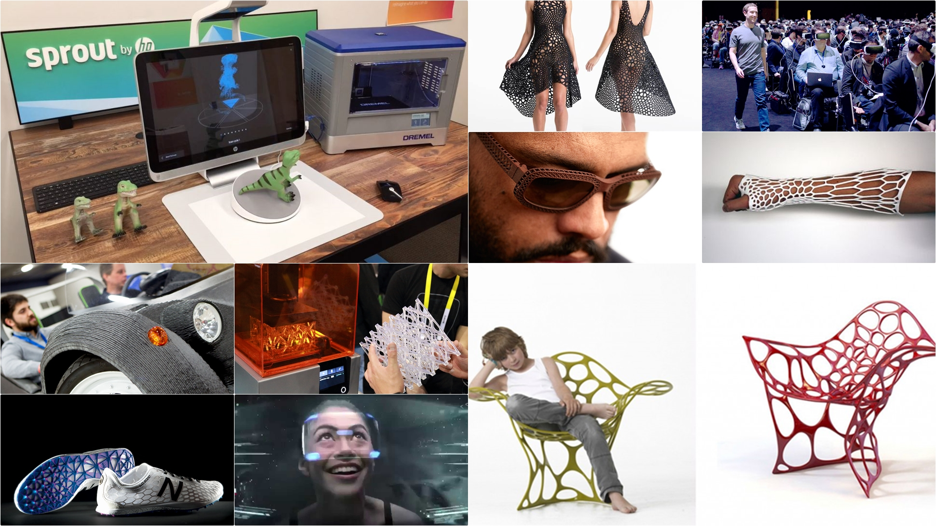
Notes:
In a few years time we will have shoes, eyewear, furniture, prostethics perfectly fitting our body shape and personal tastes.
To help you understand, let me tell you a story.
I needed to replace the doorknob in my daughter’s room. I wanted to do something special, and because of Leopoly, I was able to go online, customize the shape, color, and material for a new knob, and even engrave a personal message, all in seconds. It was 3d printed and delivered in 2 days, providing delight for my daughter and to be honest even more to her mother.
This is just a doorknob but this is the future for most products.
This is the new era of digital manufacturing and mass customization.

Slide 4
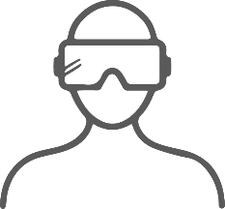
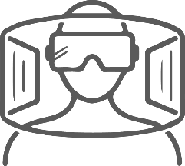
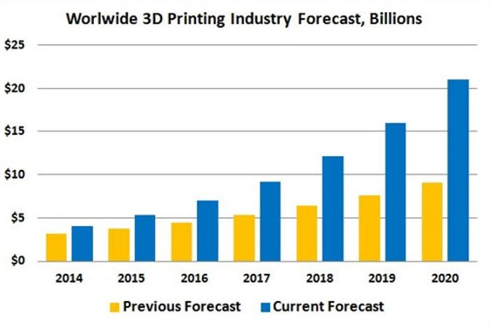
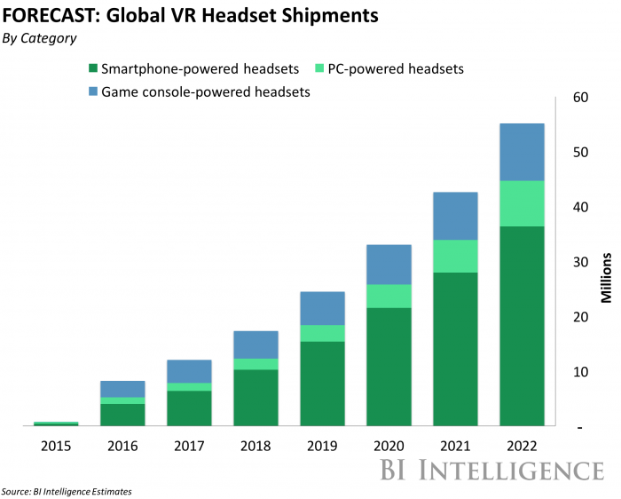
Technology trends - 3D digitization
DRIVEN BY
3D, AR & VR TECHNOLOGIES
3D print
3D scan
VR
AR
Notes:
And this new wave of digitization is led by 3D technologies, scanning for digitization, printing for manufacturing, AR and VR for visualization and other reasons.
There are two technology trends transforming our digital landscape.

Slide 5
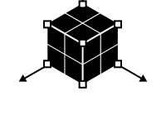
Advantages of vr
AR/VR provides added value when:
True physical objects or situations are needed, but can’t be presented.
3D visualization is crucial to understand
Spatial thinking and interactions can speed up processes
Immersion means better, more engaging experience or more effective communication
Big amounts of data has to be structured in a consistent and transparent way
Fields of impact
Entertainment
Games
Movies
3D Modeling
Product design
Character design
Education
School edu
Corporate Training
Communication
Private
Corporate
Notes:
AR/VR has the most significant added value in the following cases or situations where
True physical objects or situations are needed, but can’t be presented. Presenting certain real-life objects would be: expensive, dangerous, impossible
3D visualization is crucial to achieve effective knowledge transfer
Spatial thinking and interactions can speed up processes or improve user experiences or enhance workflows or boost collaborations
Immersion means better, more engaging experience or more effective communication
Big amounts of data has to be structured in a consistent and transparent way
********************************************************************************************
Entertainment (Gaming, Movies)
VR gaming compared to flat screen gaming is like “being part of the virtual world” versus “observing the virtual world through a window”.
A well-polished VR game allows users to actually feel the true size of the objects and the significance of the actions performed by the characters.
It broadens the audience’s perspective and provides the ability to observe anything from any angle at any moment.
Thanks to the progressively evolving motion tracking systems and input solutions, in a foreseeable future, game interactions can be close to realistic.
Advantages of VR in 3D modeling
BŐVEBBEN A KÖVETKEZŐ SLIDEON
3D input devices, while having the ability to
change their perspective at any time, just like if they were working in the real world.
They can manipulate the object freely in the desired direction with optimal intensity and ease.
Advantages of VR in general training and education
Visualization and experience are the essence of effective knowledge transfer. -> AR/VR technologies are capable of visualizing and simulating procedures, objects, situations in a realistic way.
This is a great advantage when experiencing or viewing/observing something is expensive, problematic, dangerous, or impossible.
Examples: simulations in safety critical industries, surgery simulation and training in AR/VR, learning about anatomy or chemistry, user manuals etc.
Advantages of VR in general communication, presentation These technologies enable people to experience products, services, environments anywhere any time for an affordable cost. This can come in handy in the following fields:
Fashion: AR changing room, visualizing wearables on customers
Product design: Presenting prototypes and ideas in AR/VR
Tourism: Experiencing locations, available programs
Sales/Marketing: Immersive advertisements, user behavior analysis (eye tracking and recognizing facial expressions), experiencing products and services
Remote support: pointing/highlighting physical objects and placing information, annotation, instructions etc. at the right physical place (car/household/IT repair etc.) with the help of augmented reality
Personal chatting with your loved ones

Slide 6
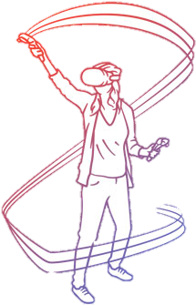
VR & 3D Design
Unintuitive Human – Machine Interactions
Realistic, Intuitive Creation Experience
Change their perspective at any time
Easy to navigate and locate points
Manipulate in the desired direction with optimal intensity and ease
Avoid Errors: Simple to check out results in any perspective
Multiple users at the same time
Compare size, design variation intuitively
Virtual designs instead of physical prototypes and mock-ups
Notes:
Advantages of VR in 3D modeling
1.,2.:AR/VR enables 3D designers, sculptors, animators and artists to work on 3D objects, in environments with 3D input devices, while having the ability to change their perspective at any time, just like if they were working in the real world.
3.:_They can manipulate the object freely in the desired direction with optimal intensity and ease.
4.:Virtual reality is a game changer for design because it offers an actual experience rather than a sketching tool. The errors associated with distorted representations can be reduced since the experience is always three dimensional, interactive, and rendered in real time.
5:Advances in augmented- and virtual reality have also opened the door for multiple users, designers, decision-makers to simultaneously observe and work on the same design or concept.
6.:Testing the designs, comparing variations (size/colors etc.), rearranging complex structures will be easier than ever.
7.: Building physical prototypes and mock-ups, when possessing these technologies, will make no sense after a while.

Slide 7
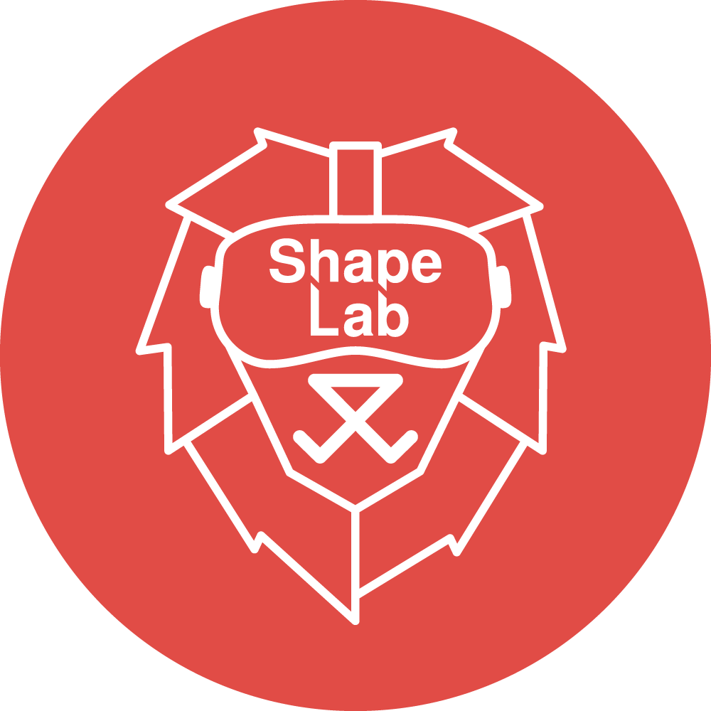
Polygon control
Adjustable Painting Resolution
Adjustable Sculpting
Sculpt in the Air: Add material anywhere
Multi-player: Collaborate in real
Object Mix and Scene Handling
Multiplatform
Notes:
Polygon control: Users will be able to optimize their advanced polygon count
Adjustable Painting Resolution: You are free to set your own painting resolution.
Adjustable Sculpting: More freedom for the users
Sculpt in the Air: Add material anywhere and everywhere
Multi-player: Collaborate in real time in your own virtual space
Object Mix and Scene Handling
Multiplatform

Slide 8
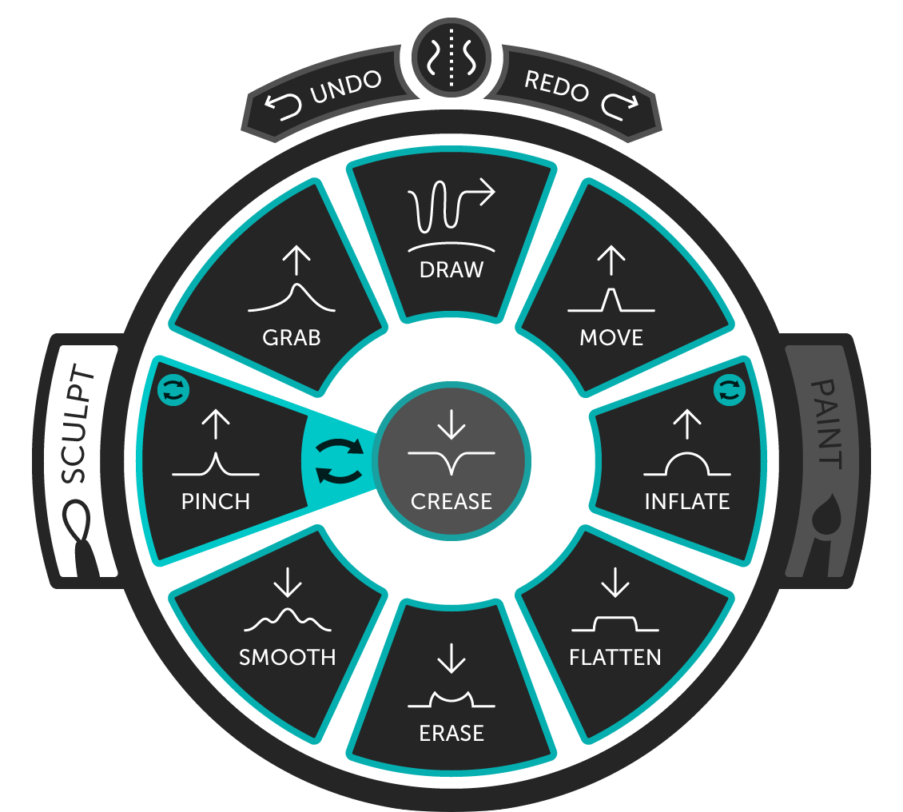
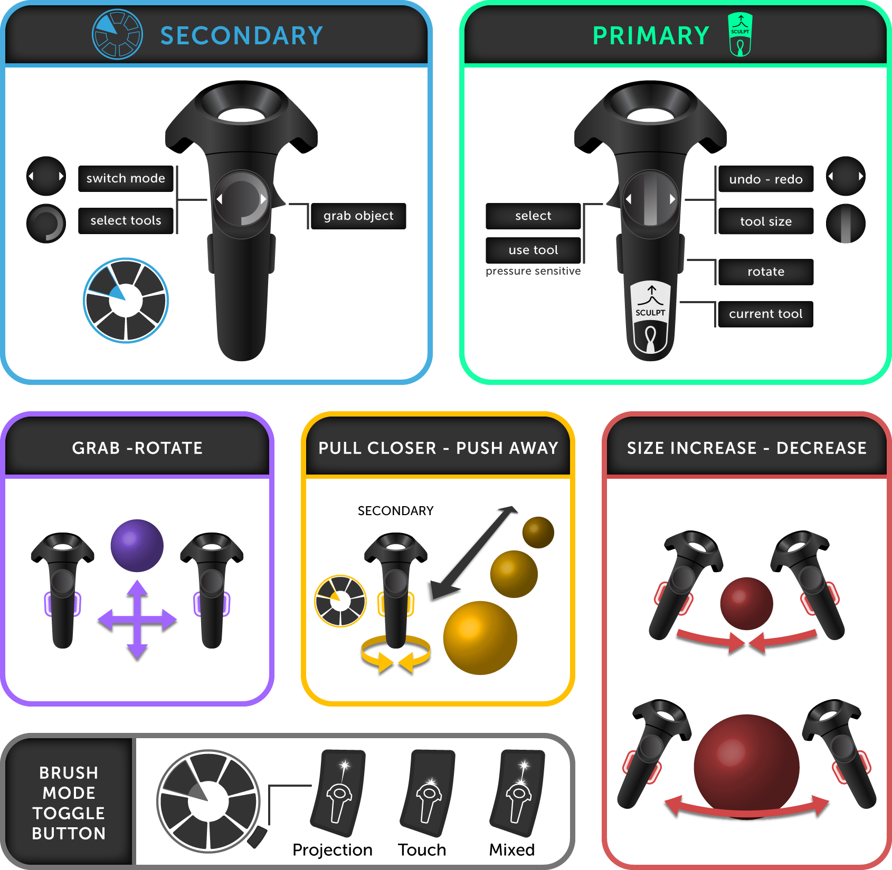
ShapeLab - UX in VR
Challenges
Lack of VR UX/UI Standards and Conventions
Completely different input devices
Variety of input devices
Ensure that user stay immersed
Ensure that user is not bothered by anything
Take care of the whole environment and atmosphere
Completely new but still familiar way of selecting tools and options
Completely new but still familiar way interacting with objects
Solutions
Using the logic of touchscreen gestures
Console-like weapon chooser radial UI
Cozy, neutral and optional environments
User is never forced to be watch any of the UI elements
Utilizing pressure sensitivity
Trying to simulate real-life interactions

Slide 9
ShapeLab - Engine
Leopoly Engine C++ UI (buttons, sliders, etc.) Input handling (implement and support all HW) Sounds Render 3rd party modules (12+ different): Json, XML, open JL, open SDL, CURL, OpenVR |  |  | 3rd party + Leopoly Engines Evaluation: Unreal vs. Unity Licencing method, experiences, market penetration, target platforms, performance, script language, graphics, SculptLib: Packaged all of our key competencies, features Plug-in module, native dll Platform: windows, webGL, web ASM
Pro | Contra |  | Pro | Contra
Everything on your hands No boundaries | Slower implementation More, wider competencies, HR resource needed Tool development needed Maintenance |  | Faster implementation Less HR resource needed Faster respond for the market requirements, implementations Test process (HW + platform) Team work, processes | Dependency form a 3rd party engine Support, implementation for the niche markets

Slide 10
Thank you!
Zoltan Karpati
Co-founder
ZOLI@leopoly.com

Slide 11
ShapeLab - Engine
Leopoly Engine
C++
UI (buttons, sliders, etc.)
Input handling (implement and support all HW)
Sounds
Render
3rd party modules (12+ different): Json, XML, open JL, open SDL, CURL, OpenVR
3rd party + Leopoly Engines
Evaluation:
Unreal vs. Unity
Licencing method, experiences, market penetration, target platforms, performance, script language, graphics,
SculptLib:
Packaged all of our key competencies, features
Plug-in module, native dll
Platform: windows, webGL, web ASM
Pro/Contra
Everything on your hands
No boundaries
Slower implementation
More, wider competencies, HR resource needed
Tool development needed
Maintenance
Faster implementation
Less HR resource needed
Faster respond for the market requirements
Test process (HW + platform)
Team work, processes
Dependency form a 3rd party engine
Support, implementation for the niche markets

