Slide 2
„Ultralight” IoT hardware ipari környezetben 2017.11.29 – HWSW mobile! 2017

Slide 3
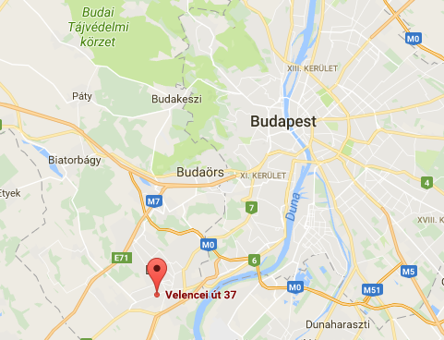
CASON in a Nutshell
CASON Engineering was established in 1992
80 employees in Hungary and Romania
TQM, Certified ISO 9001, 14001, 27001, 28001, 50001
Start
System Integration
Crude Oil/Product Pipeline Leak Detection System
Remote Data Acquisition & Control
Short Range Wireless AMR Solutions
LPWA Based IoT-Ready Devices
Energy Harvesting Sensors and Ultralight AMR
1992
1999
2017
2018
2019
Hydrocarbon Refinery Laboratory Equipment Distribution, Development and Service
Industrial Automation
GPRS Based Fleet & Workforce Management
Multi-utility AMR/AMI Solutions
CASON ULX Core Development
Chip-Scale
ULX Core

Slide 4
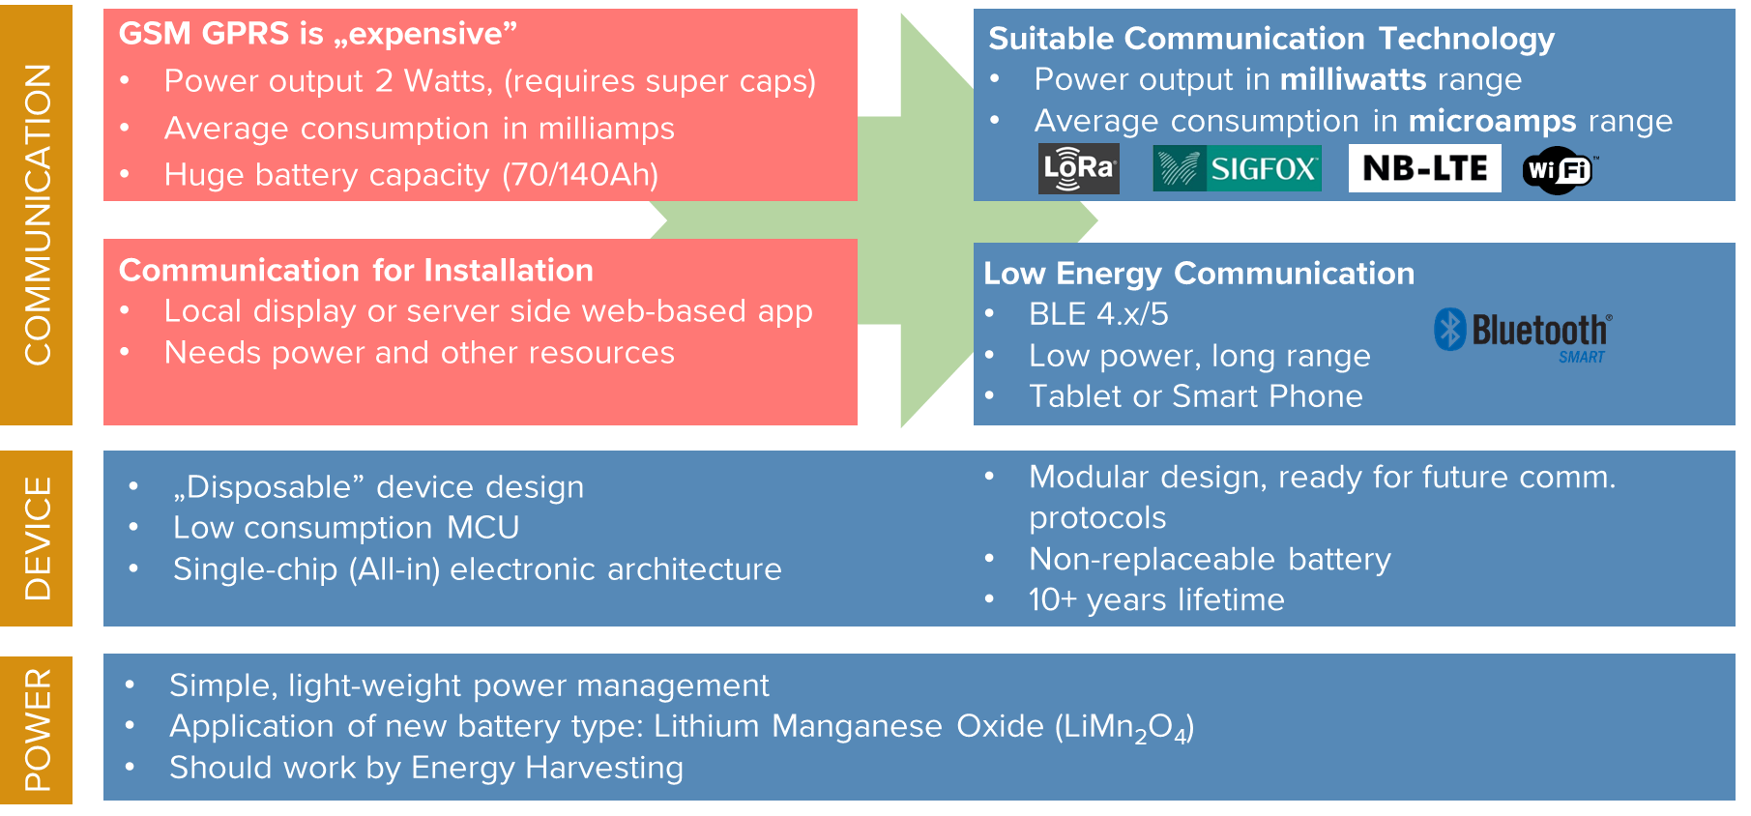
Previously on mobile! 2016
EU Regulation on Liberalized Energy Markets
First Smart Metering Boom is over
Spread is gone from traded Power/Gas
Decreasing natural gas consumption
Decommissioning of infrastructure
ULP Massive IoT-like electronics parts available
Booming LPWA radio technology and services
Digitalization – Industry 4.0 Everywhere
Asset Optimization is the main focus for the operators
Major projects, tenders are on the market

Slide 5
We Had a Concept
Modular Design
Ultra Low Power Parts
Variable Communication
Long-life Battery Pack
Variable Battery Capacity
Variable I/O Modules
Long Term Availability
Future Proof Design
Further Development Possibilities

Slide 6
Development Cycle
IoT Core
Battery
Mechanical Design
Business Adaptation
Piloting Experiences
Radio
Product
Essential Components
Skilled Engineers
Business Domain Knowledge
Open Minded Customers
Piloting Opportunity in Real Operating Conditions
Good Sense of Future
Divination

Slide 7
IoT Core Design – Phase 1 Conceptual Design
Main Design Drivers
10 years of operating lifetime
Data security
Sufficient computing capacity for end-point AI
I/O flexibility
Communication flexibility
Direct device management
Small device size
Maintainable firmware code
Certifiable – CE, UL, EMC, ATEX
Industrial grade
Maintenance free operation
Self Diagnostic
Lifetime data logging to flash memory
Premium Parts
ULP ARM MCU
MUST BE CHEAP
Cryptographic Proc.
LiMNO2 Battery
Internal Antenna
Bluetooth 4 LE/LR
Various Sensors

Slide 8
IoT Core Design – Phase 2 Basic Engineering
Op. temp: -40 to +85 °C
Components
ARM MCU
Flash Memory
Motion sensor
Temperature sensor
BLE
RTC
Quartz
Cryptographic coprocessor
Op. voltage: 1,8 – 3,0 V
Sleeping current < 15 uA
UV and moisture resistant
Max. size 50 x 70 mm
Portable FW code
Secured communication
Firmware upgrade (BLE)

Slide 9
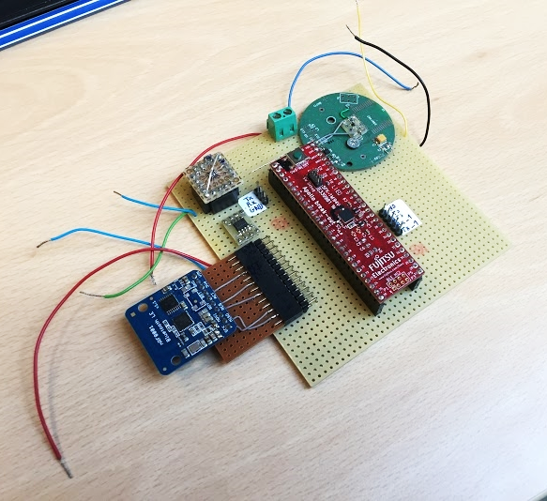
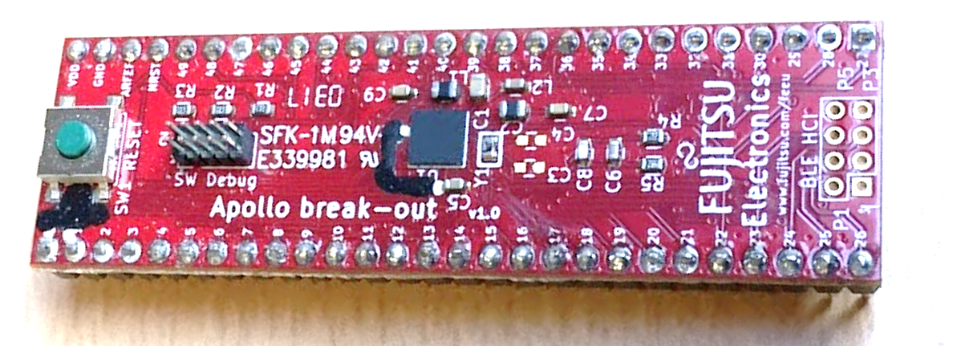
IoT Core Design – Phase 3 Prototyping
3 engineers
2 months designing and testing POC
Final revision reached in 4 revisions
Several parts were tested
MCU was tested on Exploration Kit
Sensors were recommended by Fujitsu

Slide 10
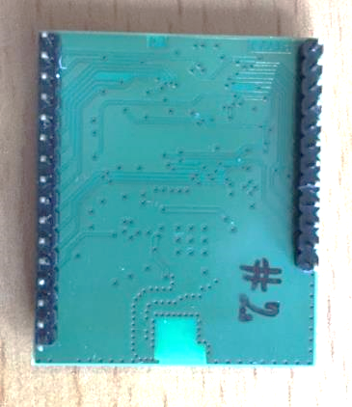
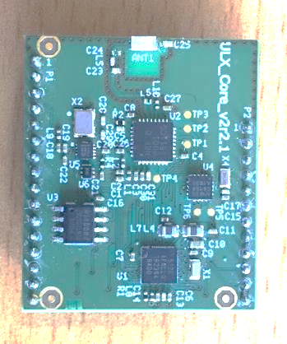
IoT Core Design – Phase 4 Cooperation with Fujitsu
Teamed up with Fujitsu Electronics
Gerber files, blue prints were sent back and forth
In 1 month we reached the final version
The ULX Core was ready for production
Last minute changes…

Slide 11
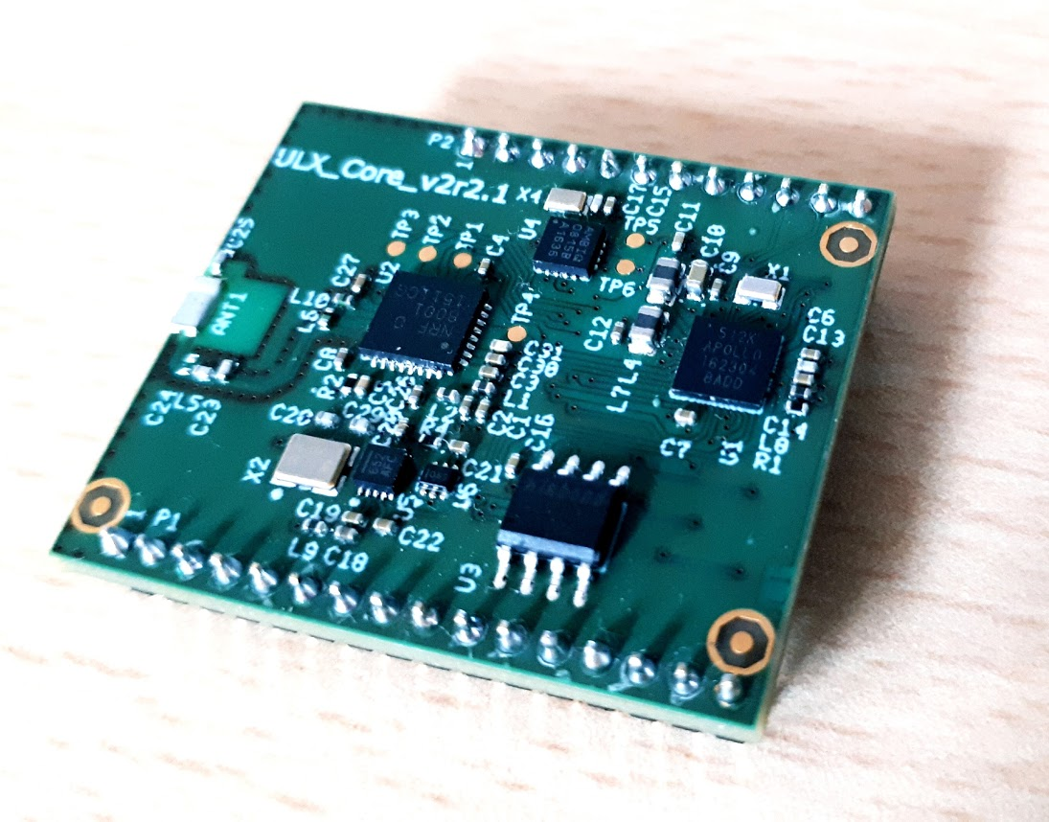
IoT Core Design – Phase 5 First Production Batch
First 1000 units was manufactured in 4 weeks.
AOI Testing procedure in the factory
Randomly selected samples were tested
No issues were detected
Product is ready for massive IoT rollouts

Slide 12
IoT Core Design – Phase 6 Battery Design
Functional Requirements
10 years operating lifetime
15 minutes LPWA communication
1 + 1 + 10 years battery lifetime
100% power capacity utilization
1.8 - 3,0 V
95% of lifetime at 3,0 V

Slide 13
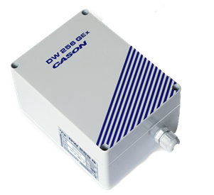
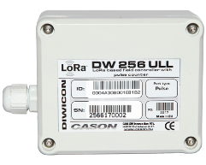
Impact of ULX IoT Core
1480 g
1728 cm³
120 mm
160 mm
New Ultralight AMR devices
Existing AMR portfolio redesign
Significant development cost reduction
BOM cost lower → competitive pricing
Mass production became available
ULX device 88% lighter
ULX device 83% smaller
Functionality and lifetime remained the same
90 mm
90 mm
45 mm
185 g
304 cm³
75 mm

Slide 14
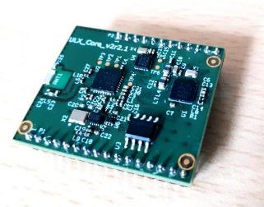
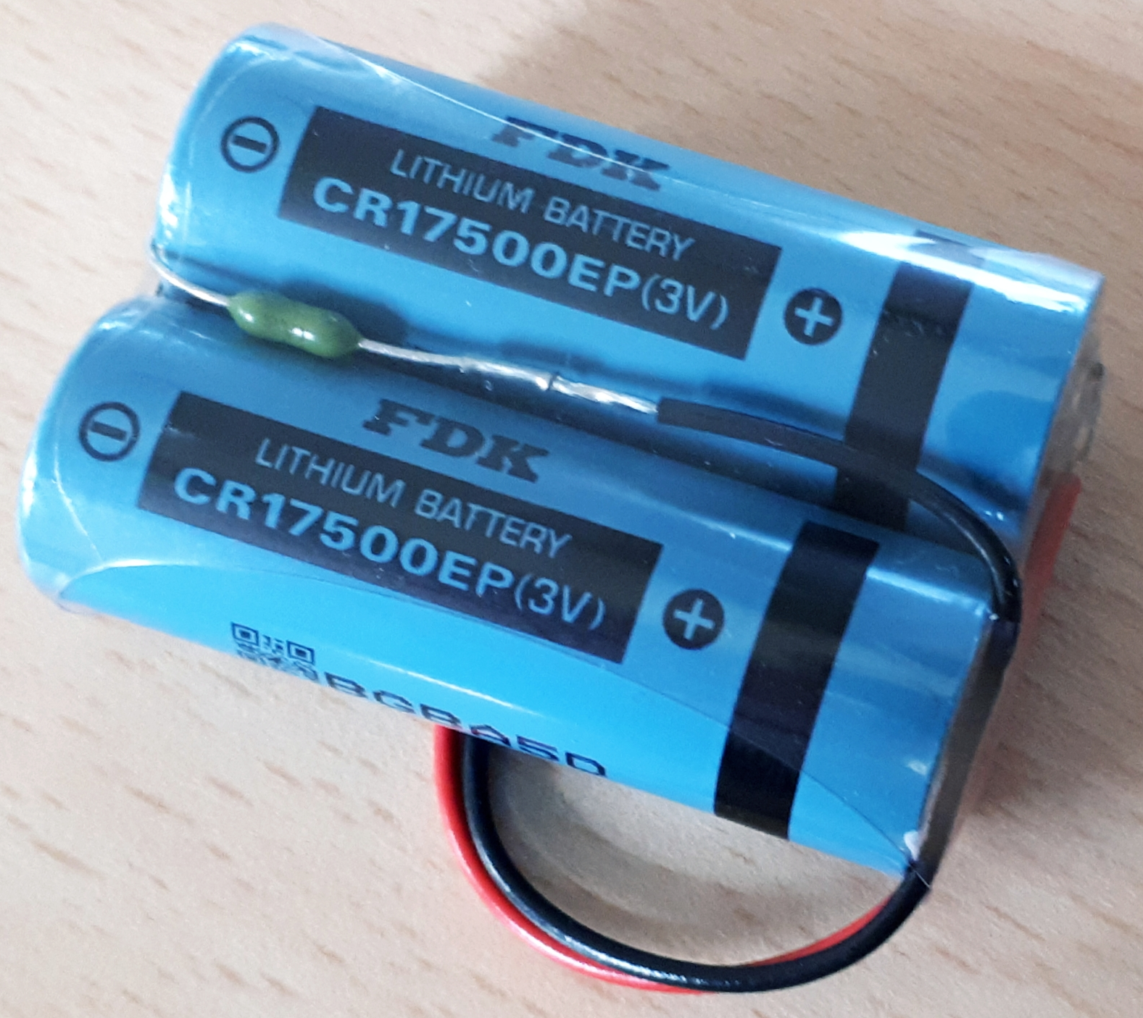
CASON IoT System Architecture
Digital input
RS232 / RS485
Analogue input
Digital output
Analogue output
-m
Features
Compact size: 30 x 35 [mm]
Ultra-low power design (< 15µA)
Long-life operation (> 10 years)
Real-time clock (high precision)
History (logs, events and alarms)
Fast installation procedure (over the air)
Monitoring functions (battery, temperature, …)
Controlling functions (customizable Outputs)
FDK
CR17500EP
6Ah 3,0V
Lifetime
1 year CASON stock period
1 year customer stock period
10 years working period

Slide 15
Challenges
Financial investment into the project
Reliable, quick reacting engineering partner
Mainly uplink communications
Limited downlink
Firmware upgrade questions
Availability of parts and lead times
Li battery lead times
Increasing number of e-automobiles
Adaptation to business domains
Water, Power, Gas, etc.
Big data, central data processing
What type of data to store
NO SQL + RDBMS
Data processing performance question
„Public Enemy no.1.”

Slide 16
Working out the Real Value
End point intelligence
Pre-processed data at end points
Big data, central data processing
What type of data to store
Performance questions
Utilization of data
How to make information from data?
What is useful for the user?
Wow-effect whet data is interpreted first time in high granularity
Is the end user ready to understand what they see?
What is valuable for the user and operators?
Etc.
How to make money out of it?
Next year… ☺

Slide 17
Experiences and Consequences
Not the wafer is expensive but the packaging!
Power management (sleeping Current) is the key of Massive IoT Devices
Data Security is even more important than ever before
End point intelligence will be key in data processing and BI
Mainly uplink possibilities → Firmware must be bullet proof
Without in piloting real conditions and testing mass production should not be started

Slide 18
Thank you for your kind attention!
Zsigmond Czike
Chief Sales and Business Development Officer
e-mail: zsigmond.czike@cason.hu
mobile: +36 70 934 0970

