Slide 1

The 5G responses for the IoT challenges
5G
Presenter:
Bendek Kovács, PhD
(Senior Specialist, Network Performance, Ericsson)
Notes:
11/28/20172012-02-03
1
2012-02-03
1

Slide 2
Circuit switched fallback:
LTE Data, CS voice
Authentication,
Security,
Connectivity,
Mobility
Circuit
switched
CORE
GSM
GSM
Telephony services
3G
Authentication,
Security,
Connectivity,
Mobility
HSPA
WCDMA
Packet
Core
No CS
Support!
INTERNET, VPN, ETC.
LTE
LTE
Data Services
Wi-Fi

Slide 3
VoICE OVER LTE and Ims Centralized services
CS Voice
Centralized
telephony
services
Circuit
switched
CORE
GSM
GSM
PS Voice
IMS
Telephony
3G
Data
HSPA
WCDMA
Authentication,
Security,
Connectivity,
Mobility
Packet
Core
Data, Internet APN
LTE
INTERNET
or VIRTUAL
PRIVATE NETWORK
LTE
Data, Enterprise APN
Data
Data Services
Wi-Fi

Slide 4


Ericsson Paving the way to 5G
1
Gbps
600
Mbps
300
Mbps
150
Mbps
Ericsson Lean Carrier
Cat-1
Power Saving Mode
Extended Coverage
Narrowband-IoT

Slide 5
3GPP access technologies for massive ioT communications
Bandwidth
Coverage
Battery life
Throughput (peak)
Security
Mobility
Deployment
Cat-M1
1.4MHz
160dB (+15dB)
10+ Year
0.8/1 Mbps full duplex
Connected & idle mode mobility
SW
NB-IoT
200kHz
164dB (+20dB)
10+ Year
227/250kbps multi-tone UL
Idle mode mobility
SW
EC-GSM-IoT
600kHz
164dB (+20dB)
10+ Year
473/473kbps
Idle mode mobility
SW

Slide 6
5G networks…
Application service
IoT
Services
5G NR
PS Voice
IMS
Telephony
Netflix
IPTV
NB-IoT
Data
Packet
Core
Media
APP,
Data
LTE
INTERNET
or
PRIVATE NETWORK
LTE
Data
Wi-Fi calling
Wi-Fi

Slide 7
Ecosystem around the Massive IoT Infrastructure

Slide 8
The massive iot challenge…

Slide 9

connected park
Connected park services:
- From guessing to knowing,
measure the health of the park
- An intelligent maintenance system,
an AR enabled worker
- Vibration reports on tools
- Remote operation
- Customer services developed on
popular common Platforms
Requirements:
- Totally different traffic model (low and high bw, massive number of devices, rare communication)
- Cheap device is required, low Operator ARPU
- Low power devices are required
- Heavily customized application
- Security?, Positioning?, Zero touch management?, etc.
Notes:
Supporting a sustainable future for people, nature and businesses
Create value for people, the city, and businesses
Leveraging on the global and/or local eco systems of possible partners and data flows
https://www.youtube.com/watch?v=RZiyWAV4MW4

Slide 10

IoT: Wide Range of Requirements
Massive Machine Type
Communication
Critical Machine
Type Communication
SMART BUILDING
LOGISTICS, TRACKING AND FLEET MANAGEMENT
REMOTE HEALTH CARE
TRAFFIC SAFETY & CONTROL
REMOTE
MANUFACTURING,
TRAINING, SURGERY
SMART METER
SMART
AGRICULTURE
CAPILLARY NETWORKS
INDUSTRIAL APPLICATION
& CONTROL
LOW COST, LOW ENERGY
SMALL DATA VOLUMES
MASSIVE NUMBERS
ULTRA RELIABLE
VERY LOW LATENCY
VERY HIGH AVAILABILITY
Notes:
So when we think about the Internet of Things it’s easy to think of it as a single entity – but of course it’s not. It’s an enabler for a very wide variety of use cases and not unsurprisingly those use cases have differing requirements that need to be met to make them viable.
Two main classes of cases we talk about are these – massive machine type communication and critical machine type communication. In the first it’s all about cases that will roll out in high volume – quite possibly embedded with no access to on-grid power. In the second there’s more focus on safety, security and integrity. These are applications where trust in the system is essential – remote surgery could be an example– or automated braking in your car for instance. Many different MTC use cases with varying requirements for connectivity exist in between the two ends of the MTC scale.
We can see that there is a range of requirements that underpin these use cases – that are more or less relevant in each case. For the IoT to reach it’s potential we need to be able to deliver connectivity that meets these needs for reliability, for scale, for low energy use and low cost.
Cellular is the technology that can address maybe not all, but most of these needs and it has some specific properties that makes it attractive for a wide range of opportunities.
235 words - 2:10
Notes:
The requirements of machine-type communication (MTC) vary considerably. At one end of the scale lies massive MTC, with critical MTC services at the other end.
Examples that fall into this Massive MTC use-case category include the monitoring and automation of buildings and infrastructure, smart agriculture, logistics, tracking and fleet management. The requirements for massive MTC include: > architecturally simple devices that use a low-complexity transmission mode > devices that can run on battery power for many years > long transmission ranges for devices in remote locations > scalable networks that can connect either a large or a small number of M2M devices
In the Critical MTC type of communication, monitoring and control occur in real-time, E2E latency requirements are very low – at millisecond levels – and the need for reliability is high.
---------------------------------------------
Prepared for : IoT Launch 2015
Best Before: Jan 2016
Author : Shanqing Ullerstig & Paul Cowling – BURA Marketing & Communications
Source: Adjust slide from GF Research
-------------------------------------------------

Slide 11
5G networks…
Application service
IoT
Services
5G NR
PS Voice
IMS
Telephony
Netflix
IPTV
NB-IoT
Data
Packet
Core
Media
APP,
Data
LTE
INTERNET
or
PRIVATE NETWORK
LTE
Data
Wi-Fi calling
Wi-Fi

Slide 12
5G networks…
Application service
C-IoT
Services
M-IoT
Services
5G NR
PS Voice
IMS
Telephony
Netflix
IPTV
NB-IoT
Data
Packet
Core
Media
APP,
Data
LTE
INTERNET
or
PRIVATE NETWORK
LTE
Data
Wi-Fi calling
Wi-Fi

Slide 13
Network slicing
Ability to distinguish between fundamentally different services

Slide 14
Example of Network slice types
Massive MTC
Enterprise and Industry
Massive MTC
Enhanced MBB
Enterprise and Industry
Critical Communication and MTC
Low cost
Low energy
Massive numbers
Wide area coverage
Internet access
Operator services
High availability
High reliability
Low latency
Very high availability
Very high reliability
Very low latency

Slide 15
5G networks…
Application service
C-IoT
Services
M-IoT
Services
5G NR
PS Voice
IMS
Telephony
Netflix
IPTV
NB-IoT
Data
Packet
Core
Media
APP,
Data
LTE
INTERNET
or
PRIVATE NETWORK
LTE
Data
Wi-Fi calling
Wi-Fi

Slide 16
5G network SLICING
Sensor
IOT Packet
Core
IoT
Services
5G NR
Netflix
IPTV
INDUSTRY
Packet
Core
ROBOT
COntrol
Media
APP,
PS Voice
NB-IoT
Data
TELECOM
Packet
Core
IMS
Telephony
Data
LTE
INTERNET
or
PRIVATE NETWORK
LTE
Data
Wi-Fi calling
Wi-Fi

Slide 17
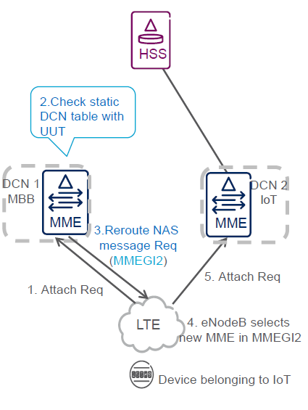
Cor network selection and deployment options
Network slices are network sharing common functions and / or infrastructure but built for a specific service or purpose
Core Network Selection
  PLMN ID based
  APN based
  Dedicated Core Network Selection
  enhanced Décor (eDecor)
  5G Core network selection

Slide 18
Communication in the M-MTC Slice

Slide 19
Short Message System (SMS)
SMS is a well-established method for simple device configuration and communication with simpler devices. SMS support is mandatory functionality for all IoT access types (EC-GSM, NB-IoT, Cat-M1)
SMS over SGs
Due to the available alternatives for cost efficient transport of data over the control plane (DoNAS), the main intention for using SMS in Massive IoT Infrastructure solution is to configure eUICC devices

Slide 20
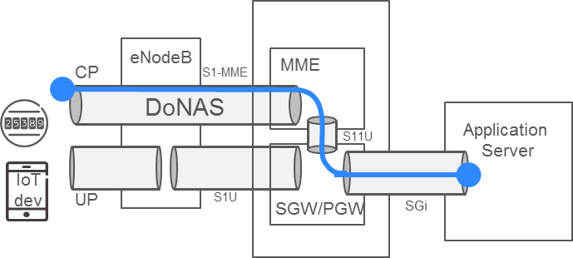
IP based communication over NAS (DoNAS)
DoNAS enables transport of non-time critical, small volumes of data between the UE and the application server, resulting in reduced signaling.
Encapsulating the data in NAS PDUs avoiding full cycle of connection procedures
Traffic model “infrequent small data”
Mandatory feature for NB-IoT devices
Control plane vs Data plane
Data plane is originally designed for voice, media, high bw, etc. while control plane is designed for short messages.

Slide 21
Power saving

Slide 22
Power Saving mode (PSM)
GOAL: to reduce the UE signaling both functionally and frequency
Power Saving Mode (PSM)
  A UE in PSM is not immediately reachable for mobile terminating services
  similar to power-off, but the UE remains registered with the network and there is no need to re-attach or re-establish PDN connections
Network Synchronized High Latency Communication
  SGW buffers the downlink data towards the device
Discontinuous reception (DRX) cycle
  UE specific time interval between monitoring downlink channels for paging messages like SMS, can be enlarged
Low Complexity UE Support
  The MME stores the UE Radio Capability for Paging information and notifies the eNodeB of this information in the Paging message

Slide 23
Developer's view

Slide 24
Application Lifecycle developer’s sketch…
Develop applications using OpenSource and existing IoT Platform developer ecosystems
Installation: installing 100 000+ sensors
  Plug and Produce (Industry 4.0)
Update/Upgrade and load application for the devices
Operate applications
The developer does not need to know 3GPP details

Slide 25
5G system architecture
3GPP TS 23.501 V1.0.0 (2017-06)
The 5G architecture is defined as service-based and the interaction between network functions is represented in two ways. Network functions within the 5GC Control Plane shall only use service-based interfaces for their interactions.
Reference point representation.
shows the interaction that exist between the NF services in the network functions described by point-to-point reference point (e.g. N11) between any two network functions (e.g. AMF and SMF).
Service-based representation,
where network functions (e.g. AMF) within the control plane enables other authorized network functions to access their services
Authentication Server Function (AUSF)
Core Access and Mobility Management Function (AMF)
Data network (DN), e.g. operator services, Internet access or 3rd party services
Network Exposure Function (NEF)
NF Repository Function (NRF)
Policy Control function (PCF)
Session Management Function (SMF)
Unified Data Management (UDM)
User plane Function (UPF)
Application Function (AF)
User Equipment (UE)
Notes:
A split between Access and Mobility Management (AMF) and Session Management (SMF) has been introduced in the architecture.

Slide 26
Service-based interface in 5GC
Services and Operations
Common control protocol using e.g. HTTP based API, replacing protocols like e.g. Diameter
Enabling the integration with IoT Platforms (e.g. Azure, AWS, etc…)
NF A
Service Based Interface (SBI)
NF B
Request
NF Service A1
Producer
NF Service A1
Consumer
Reply
NF Service B1
Consumer
Subscribe
NF Service B1
Producer
Notify
NF Service Operation

Slide 27

Key Takeaways
The evolution of networks is motivated by new services and cost reduction
Network slicing, parts of the network are purpose optimized
Data over signaling channels for power saving and efficient communication
Saving on signaling messages for IoT devices for power saving
Network exposure, programmability, simplification, “easy” user interface

Slide 29
references
TR 23.799 Study on Architecture for Next Generation System
TR 28.801 Study on management and orchestration of network slicing for next generation network.
TS 23.501 System Architecture for the 5G System
TS 23.502 Procedures for the 5G System

