Slide 1
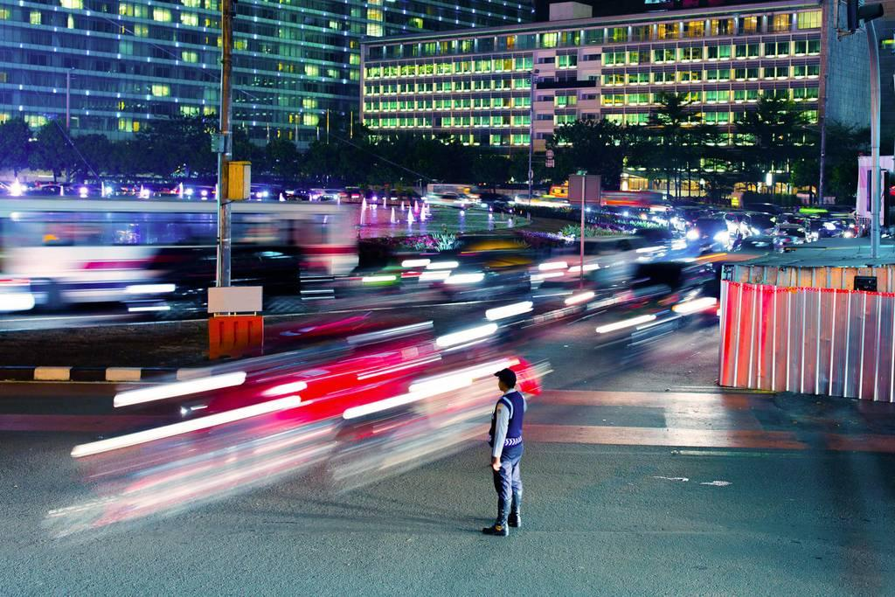
Payments at scale
Uber’s next generation payments system
Gergely Orosz, Engineering Manager, Uber, Amsterdam
29 Nov 2017

Slide 2
➜
Motivation Why?
Primitives What?
Architecture How?

Slide 3
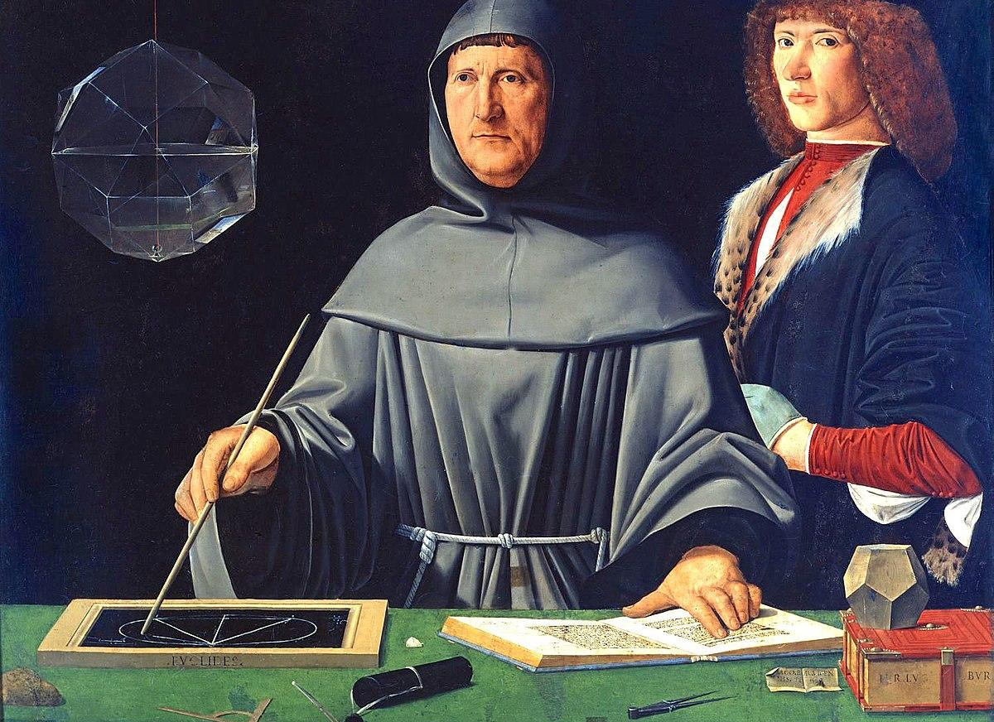
Motivation
Section title
Luca Pacioli
“The Father of Accounting and Bookkeeping"
Notes:
He was the first to document it

Slide 4
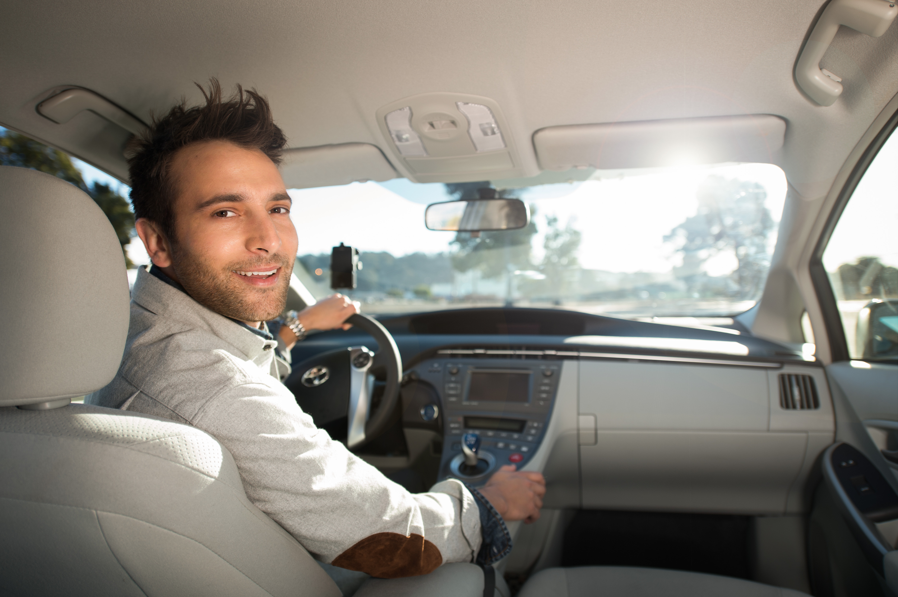
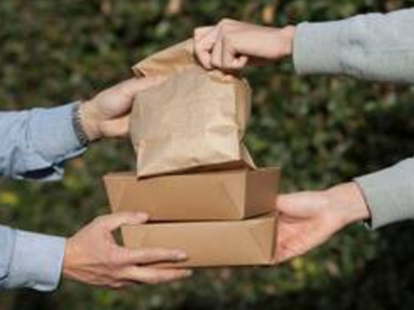
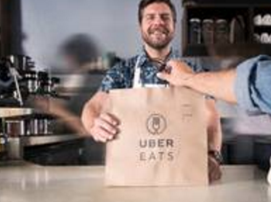
Payments at Uber, previously
Section title
Source of truth?
Riders
Drivers
$€¥
Rider payments store
+
$€¥
EATS
Driver payments store
Couriers & Restaurants

Slide 5
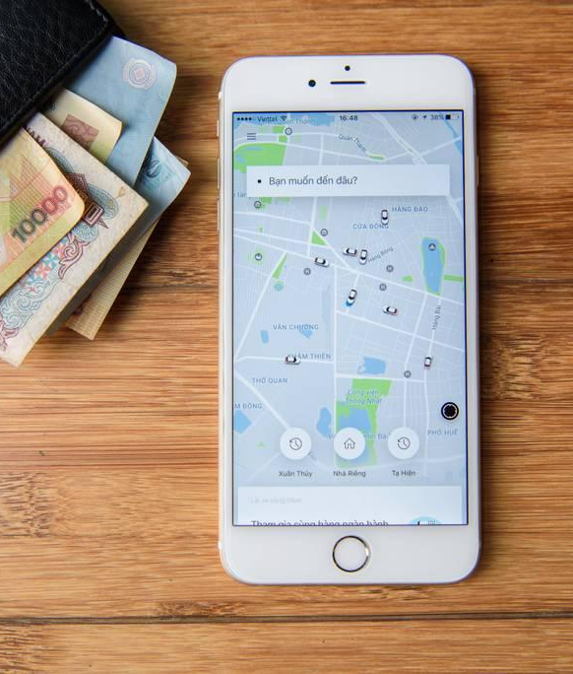
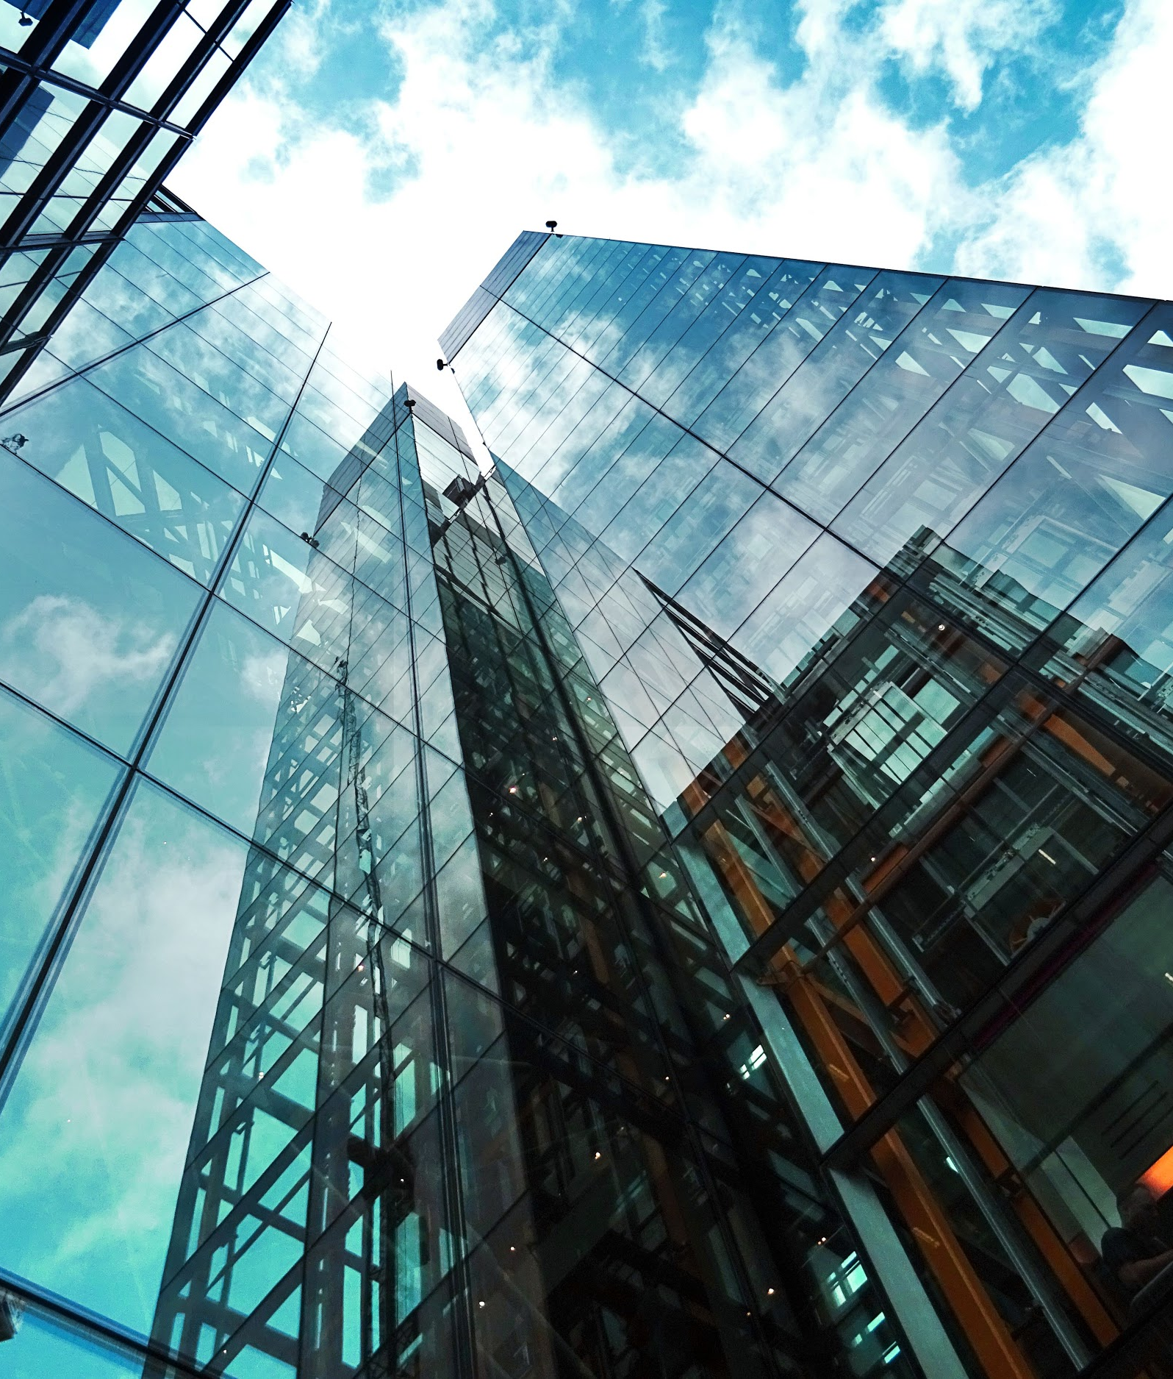
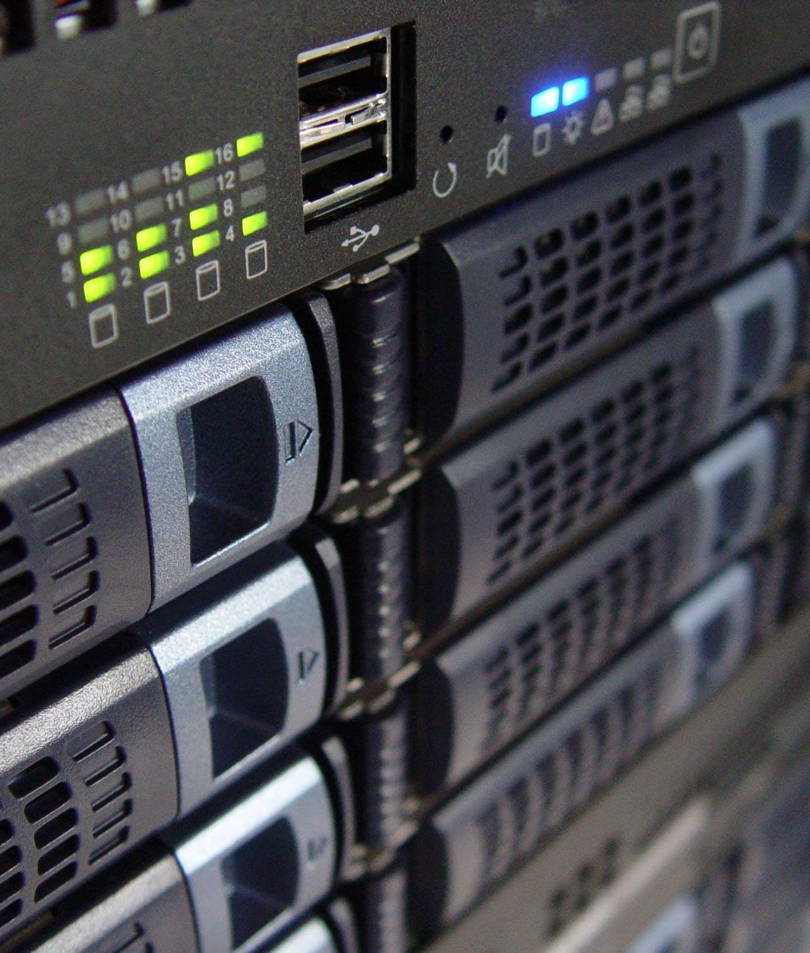
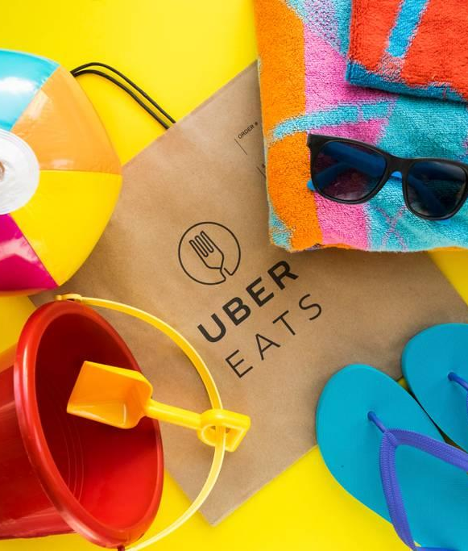
Motivation
Why build a payments system from scratch?
Single payments system
Pay out & collect from the same system. Follow double entry accounting principles.
SOX Compliance
Uber’s regulatory responsibility as a company.
Multi-Zone Active Active
99.99% SLA for all payment processing.
Support new businesses
Not everything is a trip.

Slide 6
Motivation Why?
➜
Primitives What?
Architecture How?

Slide 7
Model basics
Section title
Account
Entry
Order
balance
+amount -amount
sum(Entry.amount)=balance
sum(Entry.amount)=0
1
*
*
1
Rider, driver, business, etc.
A single money movement: a debit or credit
Money movements associated with a business event
Example
-$8
Rider: Gergely
-$8 (billed)
-$4 (promotion)
Driver: Tom
+$10
+$2 (base fare)
Trip Completed Order
+$8 (distance & time)
Sum: $0
-$2 (commission)
Uber
+$2 (commission)
-$2

Slide 8
Motivation Why?
Primitives What?
➜
Architecture How?

Slide 9
Architecture Requirements
It should grow as Uber grows
Vertically scalable architecture (just add more boxes)
Data should never be lost
Durable data storage
Loosely coupled architecture
Messaging based communication
Messages should not get lost
Lossless message queue
Notes:
Isolation & testability - Changes in one should have little to no affect with another. Developer productivity -

Slide 10
Payments Architecture
“Update the order status”
“Update accounts”
“Initiate the async payment collection process”
“Move the money: update the transaction”
Account store
Order Processing
Payment collections
Storage with frequent updates
“Update accounts”
“Publish the order to consumers”
Reporting
Order
Order Insertion
Order Stream
Order Lookup & Store
“Store orders in an immutable way”
Document store
Messaging
Insert-only storage

Slide 11
Messaging Requirements
Durable message production and consumption
After a box comes back online, previous messages should be received.
Kafka
Kafka offers strong durability out of the box. At-least-once delivery (lossless) cluster set up at Uber.
Lossless pipes
Messages should not be dropped.
De-duplicate messages
Use idempotent UUIDs to de-duplicate messages
Notes:
Isolation & testability - Changes in one should have little to no affect with another. Developer productivity -

Slide 12
Storage Requirements
Partitioned data store
Support storing >1,000TB of data with sharding
Strong consistency
Use optimistic locking to manage concurrent updates on an account, to reflect its balance at all times.
Multi-zone, fault tolerant datastore
If a box or datastore is down, data should still be available
Cassandra
Cassandra provides durability out of the box & supports multi data center operations.
Using Lightweight Transactions for strong consistency.
Durable data store
Writes will survive permanently, even if the server crashes or loses power
Notes:
Isolation & testability - Changes in one should have little to no affect with another. Developer productivity -

Slide 13
Payments Architecture
“Update the order, noting that we have started collection”
Properly under the hood
“Let’s collect the money from the rider”
“Send a message that the money is moved.”
Account store
Order Processing
Payment collections
Java service
Python / Go service
“Create or update accounts like rider, driver, Uber”
Cassandra
“The trip has completed order”
“Publish a Trip Completed Order with its entries”
Reporting
Order Insertion
Order Stream
Order Lookup & Store
“Expose trip history”
“Store orders in an immutable way”
Java service
Java services
Document store
“Generate, store & send a receipt”
Lossless Kafka
HDFS / Hadoop MapReduce

Slide 14
Extending Orders
Section title
Order Insertion Service
Business Event Processors
Decompose business events into desired money movements
Update account balances, place holds
Business Event Orders
Trip Complete
Eats Complete
Fare Adjustments
Chargebacks
Money Movement Orders
Collection initiated/response
Payout initiated/response
Refund initiated/response
External Money Movements
Contact payment services
Handle responses
Place holds, update account balances
Order Processing Service

Slide 15
Summary
We needed to build a new payments system
We had a lot of motivation.
Account, Entry, Order
The 3 primitives we built our system on.
Widely available technologies
Built on top of Kafka (messaging), Cassandra (storage), Java8 (language). It could have been other technologies that met our requirements. Only not-so-common part: lossless message delivery cluster.
Notes:
Isolation & testability - Changes in one should have little to no affect with another. Developer productivity -

Slide 16
Show me the numbers
$20B+
Money to be processed every year (and growing)
99.99%+
Target availability of the system (52 minutes / year downtime)
10,000 Q/sec
Expected load that we need to support for parts of the system
Notes:
Isolation & testability - Changes in one should have little to no affect with another. Developer productivity -

Slide 17
Thank you
Gergely Orosz
Engineering Manager, Payments, Uber Amsterdam
@GergelyOrosz uber.github.com eng.uber.com

