Slide 1
SOFŐR HELYETT KÓDOK
Szabó Tamás, NNG

Slide 2
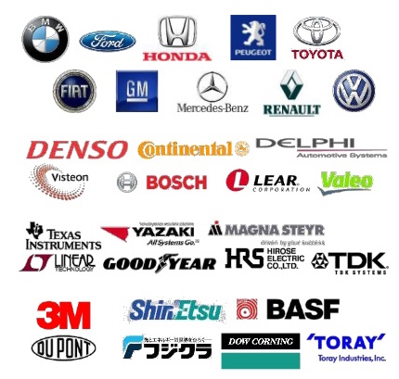
AUTOMOTIVE VALUE CHAIN
OEM
Tier1
Tier2
Tier3

Slide 3
# LINES OF CODE
400k
14M
100M
Total infotainment market 15B$, growth rate 12%
Notes:
Space-shuttle 400k, Boeing 787 14M, S-Class 100M
Source: http://www.informationisbeautiful.net/visualizations/million-lines-of-code/
Total market 15B$, growth rate 12%

Slide 4
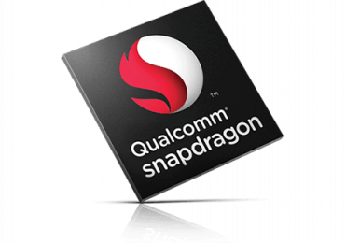
Infotainment system development
SW
OS
HW

Slide 5
LIFECYCLE
Planning
Prototyping
Verification
Tooling
Launch
Production
Drawing to driving:
3 – 4 years!

Slide 6
NNG Vehicle UI/UX Development Process
User Research
Interaction Studies
Customer Engagement
Customization
Wireframing
Prototyping
Customer Review
Scripting
Validation
Start of Production
Research and Development
Advanced Conceptualization
Production Engineering
Automotive Development Timeline

Slide 7
BUT THIS IS ALL ABOUT TO CHANGE

Slide 8
RELEVANT MARKET TRENDS
Mobile / UX
EV
TaaS/MaaS
Autonomous

Slide 9
NEXT …

Slide 10
PLATFORMS
Android Auto (Android, many OEM’s)
Apple Car (iOS, many OEM’s)
SDL (Ford, Toyota)
Abalta Weblink (iOS, Android)
MirrorLink (Samsung, Sony, HTC / VW)
Android Automotive (FCA)
INRIX OpenCar
Genivi Alliance

Slide 11
See you on the head unit!

