Slide 1
YOUR MOBILE DEVELOPMENT TEAM
React Native Why choose?
Notes:
Hey everyone, nice to see so many people who are interested in React Native.
React Native is a hot topic these days.
I am trying to tell you some information about it and share our 2 years of experience.
It could be helpful for agencies, companies, development teams or even freelancers to decide when and why to consider React Native as a technology to use for your next mobile product.

Slide 2
About Me
Adam Bene
CTO & Founder @ Bene Studio
My main interests:
JavaScript, React Native, Mobile Development, React, Cloud, Java, Web Node.js PHP, C++, OpenGL, Shaders...
Notes:
My name is Adam Bene and I am a co-founder and CTO of Bene Studio.
My main interests are mobile and web development, especially JavaScript, React Native and technologies around this world. I have some experience with several other web technologies such as JSP, PHP, Express SSR, CSS3, HTLM5, C++, etc.
I love working with awesome people to evolve together and move the world forward.
We have been using React Native for more then 2 years now.
We built several MVPs and a large scale application with all of its components and cloud solutions.

Slide 3
BeneStudio.co
We help enterprises, startups and agencies to build the best mobile products
Product Design
Cloud Architecting
React Native Development
Knowledge Transfer
Notes:
At Bene Studio we help enterprises, startups and agencies to build the best mobile products in Hungary, Germany and all over the world.
We do product design, cloud architecting and React Native development.
So we do full stack solutions.
We can also transfer the knowledge at the end of a development phase, which can be really valuable especially for a startup.
We also have trainings in React Native.

Slide 4
What is React Native?
“Learn once, write anywhere”
“Build native mobile apps using JavaScript and React”
Cross platform technology
Performant
Open source & free
Notes:
What is React Native? React Native is a cross platform mobile technology developed by Facebook.
“Learn once, write anywhere” - as FB says.
“Build native mobile apps using JavaScript and React”
Officially supported platforms are iOS and Android by Facebook
and UWP and WPF by the official Microsoft fork
and macOS - it is an experimental fork.
React Native is really performant, we’ll see 2 slides later how this is achieved.
It is totally open source & free and will be.
There were some issues around the React and React Native license which is resolved for now as it is under MIT and BSD licenses.

Slide 5
What is NOT React Native?
not
✘ it’s not a hybrid mobile framework
✘ it doesn’t run in browser or webview
Notes:
it’s not a hybrid mobile framework as phoneGap or ionic
because basically React Native doesn’t run in webview or browser.

Slide 6
Who’s using React Native?
Facebook
Instagram
Skype
Airbnb
UberEATS
SoundCloud Pulse
Notes:
React Native is developed by Facebook, that’s why Facebook is one of its first users.
Instagram is also using it - they migrated partly and gradually over time, feature by feature to React Native.
You may have noticed that lately Skype had a completely new version which was rewritten in React Native. And it is a Microsoft product.
Airbnb is also written in RN and it is one of the largest contributors of the RN ecosystem.
UberEATS and SoundCloud is also using RN as well as many other applications - you can check them on the official site of RN.

Slide 7
React Native vs. native?
80% cross platform JavaScript code → save development time
20% native code
Code in latest JavaScript
CodePush
Code & knowledge sharing with web
Notes:
Suppose that you have a RN app targeting iOS and Android. In this case you can have about 80% of the same code on both platforms in JavaScript and React.
Only about 20% native code is needed for a project like this - of course if you have some special inhouse native code then it might be more.
You can code in the latest JS and React.
With CodePush you can update your users’ apps in almost real time avoiding the possibly painful Apple or Android store review - and it is completely legal as far as you don’t change the purpose of the app.
It is also possible to share code between web and mobile since RN uses the same React that can be used on the web.

Slide 8
Team Competences
JavaScript
React Native
React
Redux
...
Android native
?
iOS native
?
Notes:
In RN development most of the code is written in JS. But the app has to compile both for iOS and Android so the team should have knowledge about the native build, release and store deploment processes.
You can have JS developers who know some native mobile development or have these competencies in separate developers.

Slide 9
How React Native works?
You have a native project for each platform
Native components
React Native bridge
Batch native calls
Callbacks or emitting events
JavaScriptCore (WebKit engine)
ReactJS: “virtual DOM” reconciliation, rendering
Notes:
You have a native project for each platform. For example an XCode workspace for iOS and a gradle project for Android.
RN has a lot of native components implemented and bridged to make it possible to use them from JS.
For performance reasons RN does batch native calls and reuses components where possible.
From the JS code callbacks are registered and events are emitted - that’s how the native and the JS part communicate.
The JS code runs in JavaScriptCore which is the WebKit engine.
In RN we use React with JSX to describe our UI declaratively.

Slide 10
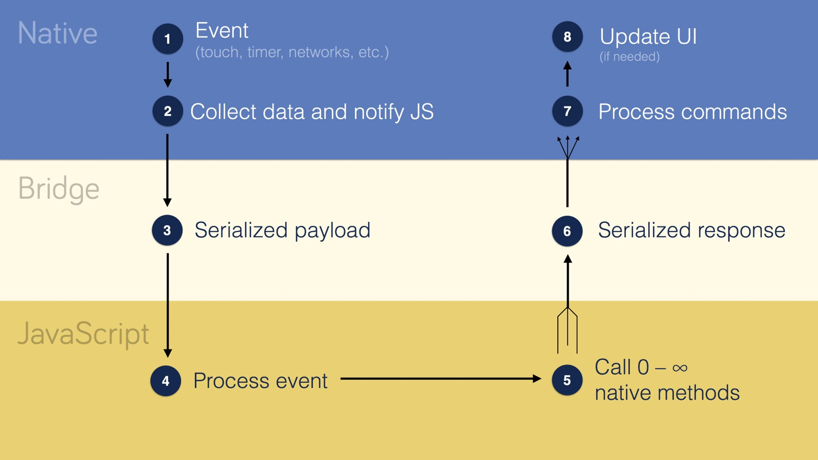
How React Native works?
source: https://tadeuzagallo.com/blog/react-native-bridge/
Notes:
In the blue (native) layer at #1 an event is emitted.
It notifies the JS throught the bridge (light yellow).
The JS code (yellow) processes the event and it can send back commands.
The commands are serialized and sent throught the bridge.
After that the native part of RN processes the commands and performs them.

Slide 11
Developer experience in React Native
Latest JavaScript (ES6/7/8)
JSX, declarative UI
Hot reloading
React Native Debugger, React Developer Tools
Inspector
Vibrant community
Notes:
Latest JS: async/await, object spread operator, even optional chaining operator with Babel
You can write the UI in a declarative way using JSX - the same you use on the web React.
Hot reloading: don’t have to recompile the app, you can check the changes immediately
Professional debugger, react dev tools.
Inspector: as it is familiar from the web dev tools
Contributors: Facebook, AirBnB, Microsoft

Slide 12
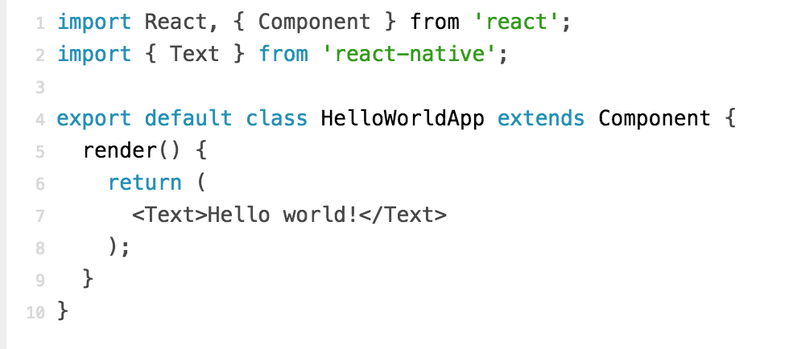
Hello World in React Native
Notes:
Have a glimpse at the RN hello words.
As you can see it is the same as the React on the web just using RN components.
On the line 7 there is a JSX expression which will be transpiled to a React.createElement expression.

Slide 13
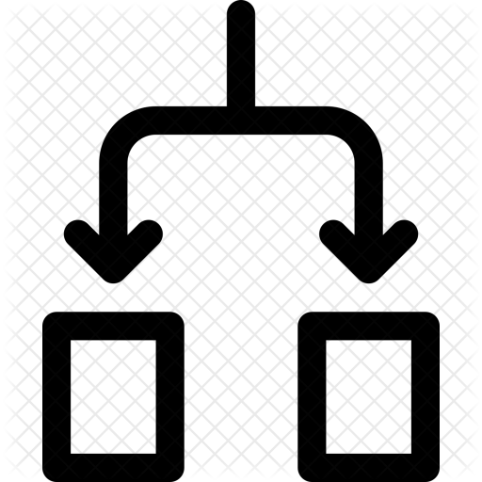
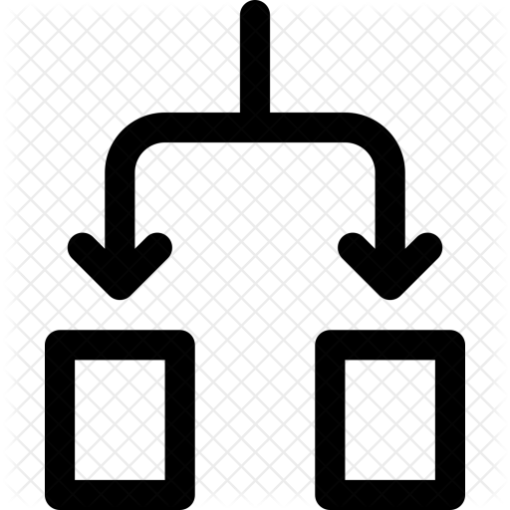
Continuous Delivery
CodePush
Build JS
Run tests
Distribute immediately to the users phone
Notes:
One more speciality of RN is that you can deliver app versions on the fly, continuously.
Since the business logic is transpiled and built into a single bundle, it can be transferred to each production mobile devices.
That’s what CodePush does.
In the Continuous Delivery pipeline you can have the usuas steps as running tests, static analysis and so on.
Of course, if some native change is needed then you have to release native mobile apps.
These changes can be native dependency upgrades, icon changes or new features.

Slide 14
Why choose React Native?
Have a common code base in latest JavaScript
Have one mobile team
Build performant cross platform apps
Use React
CD with CodePush
Ability to implement anything in native
Notes:
Using RN you can develop and maintain most of the code in latest JS.
You can focus on developing only one mobile app with some native specialities such as different search inputs or deep linking processes.
The app you build in RN will be as performant as a native app, because the components themselves are native ones.
RN allows you implement real CD so you have the control over your product.

Slide 15
Contacts
BLOG blog.benestudio.co
TWITTER @adam_bene
PERSONAL BLOG medium.com/@adambene
EMAIL adam@benestudio.co
Notes:
Feel free to contact me if you are interested in RN development.
You can follow me on social media, we have a blog at blog.benestudio.co and I am available after the talk.
Thank you for your attention!

