Slide 1
A quick introduction

Slide 2
About me
Adam Arold
I work at IBM Budapest Lab (Ustream)
My favourite language was Clojure
Until I started working with Kotlin

Slide 3
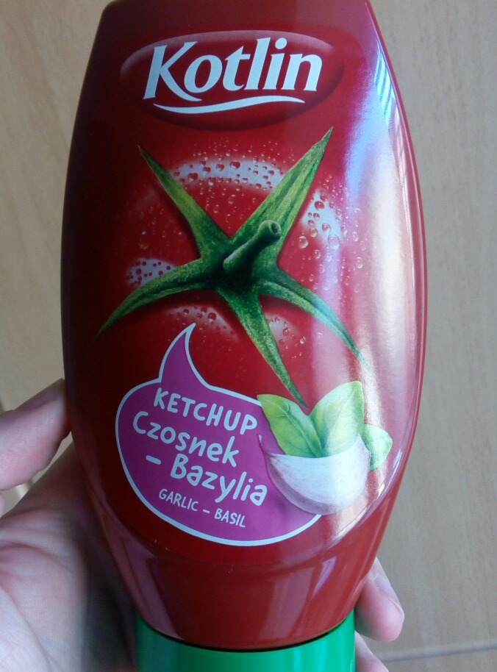
What Kotlin is Not

Slide 4
What is Kotlin?
A JetBrains home-grown programming language which…
Is a simple and flexible alternative to Java
Which interoperates well with existing Java code
Compiles to Java bytecode
Runs on the JVM
(And can also compile to Javascript)

Slide 5
Kotlin promises to…
let you achieve more with less code
solve a lot of problems in Java
help you keep using the Java ecosystem
let you write your front-end and back-end code in the same language
give you 100% Java interoperability
do it well compared to the alternatives (Clojure, Scala)
add only a thin layer of complexity on top of Java

Slide 6
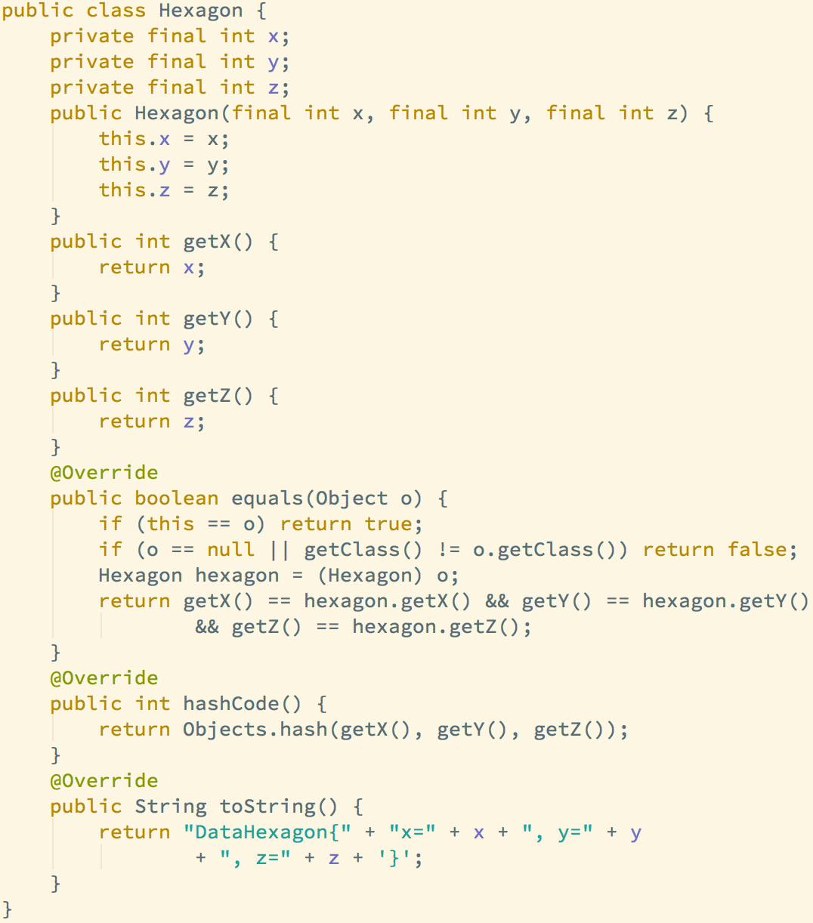
Value objects vs Data classes

Slide 7
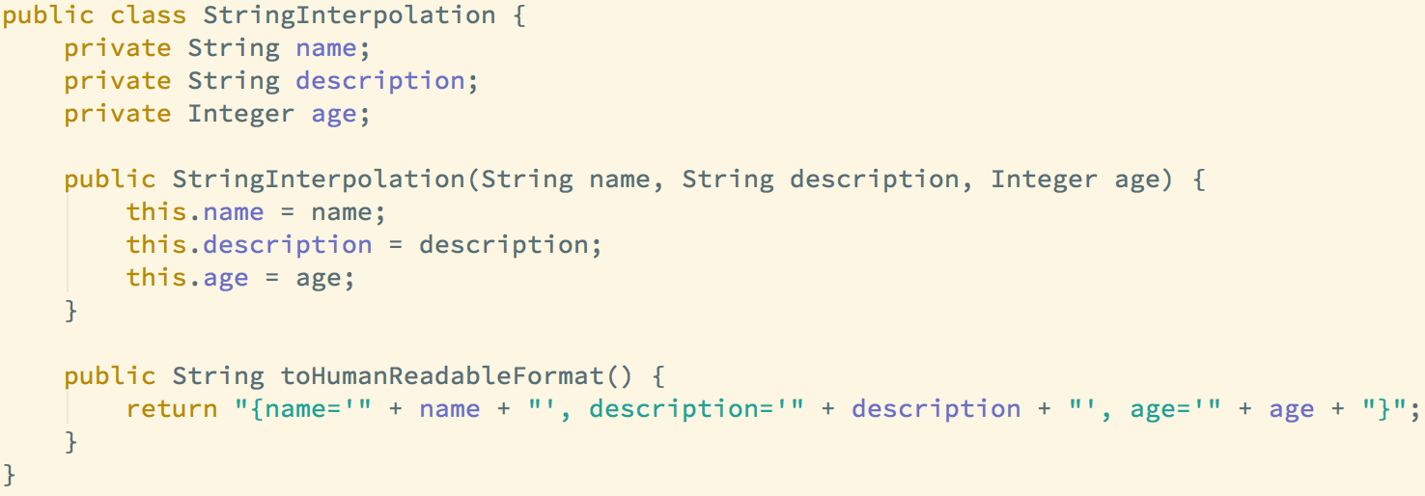
String interpolation

Slide 8
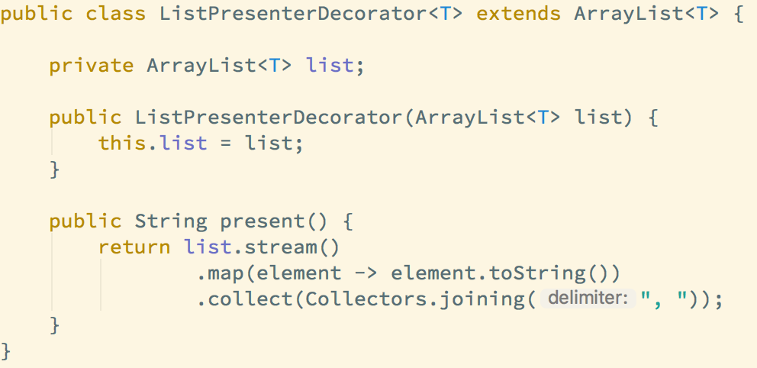
Extension functions

Slide 9
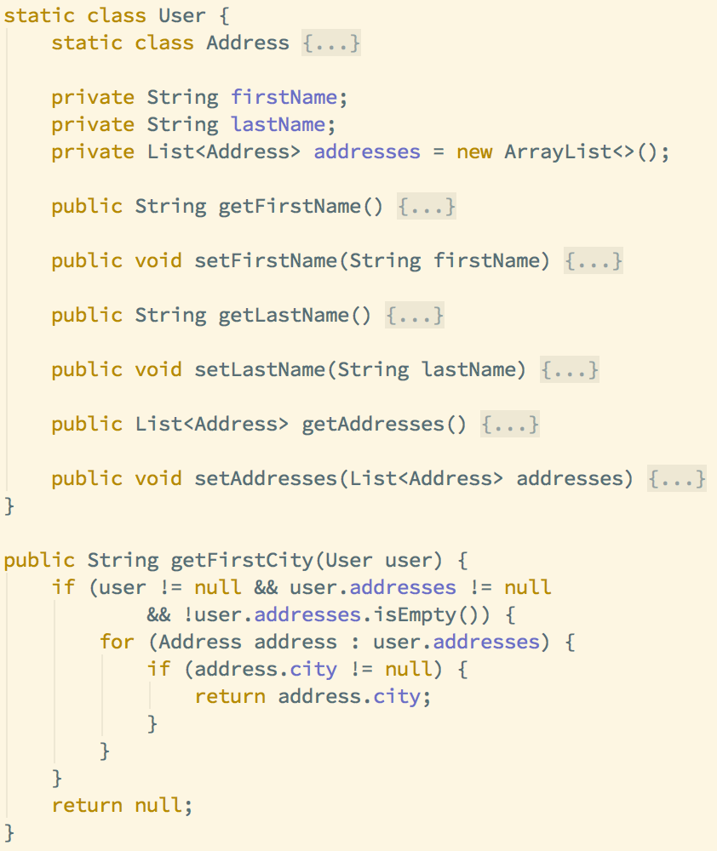
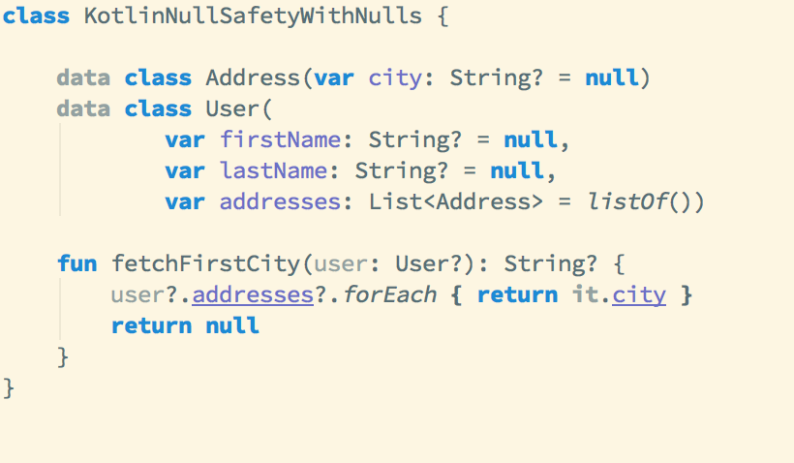
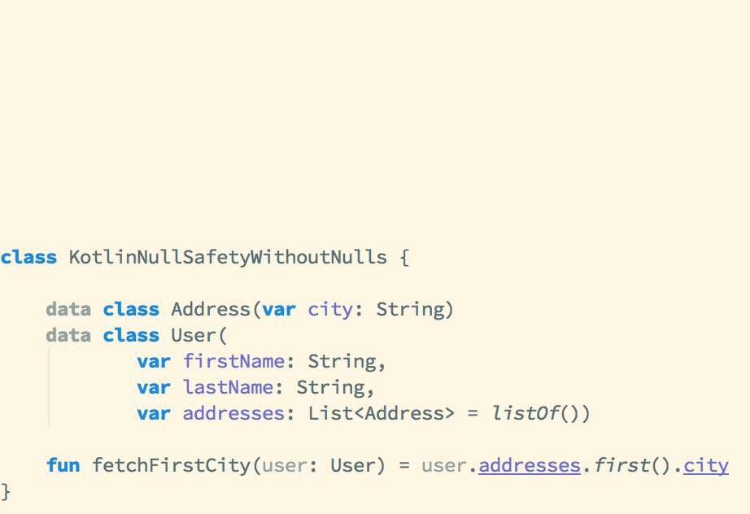
Null Safety

Slide 10
Type Inference

Slide 11
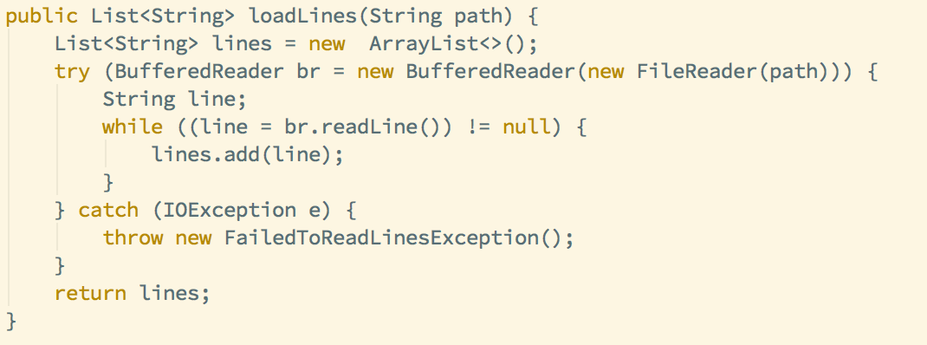
No Checked Exceptions

Slide 12
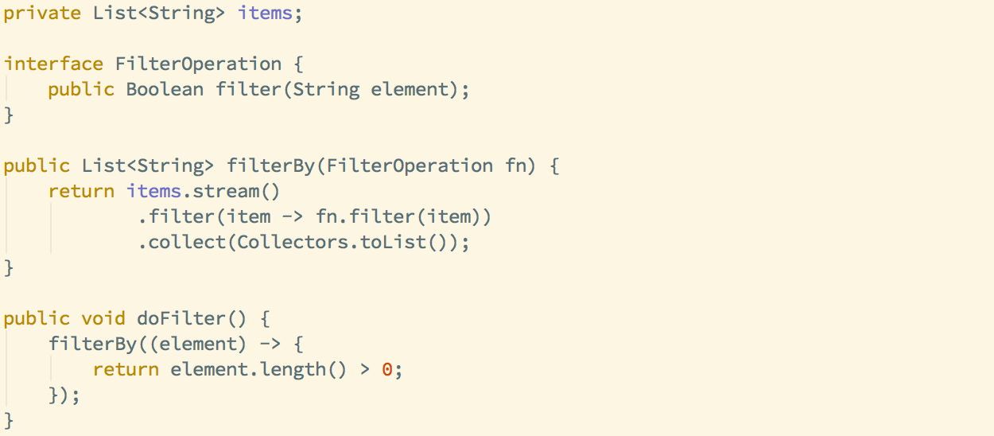
Lambdas

Slide 13
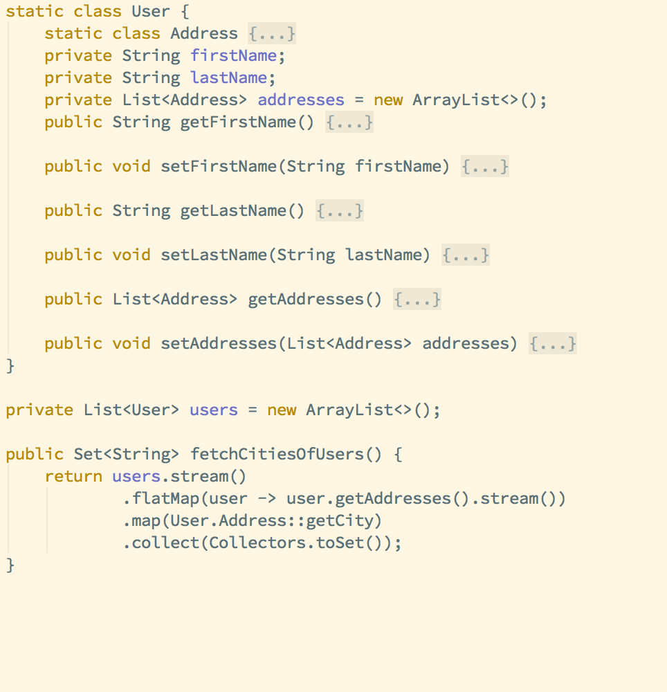
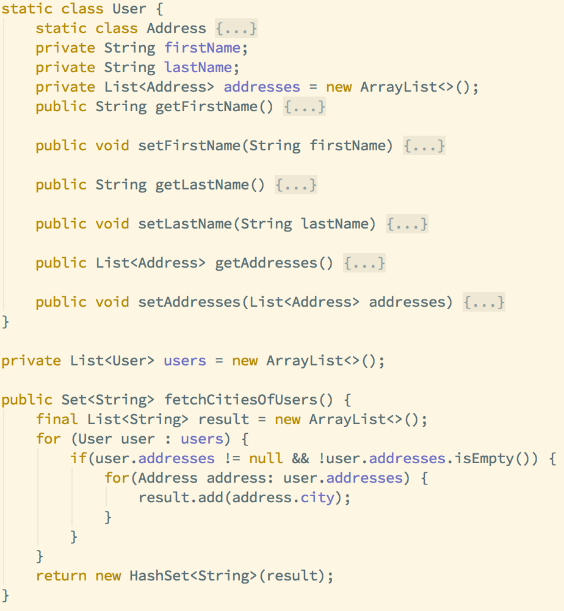
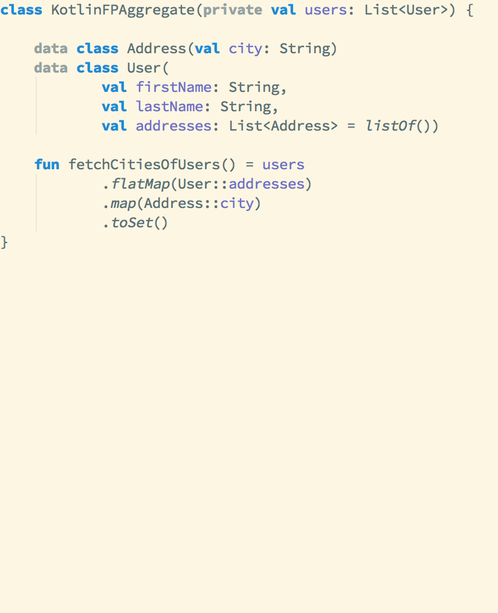
Functional programming support

Slide 14
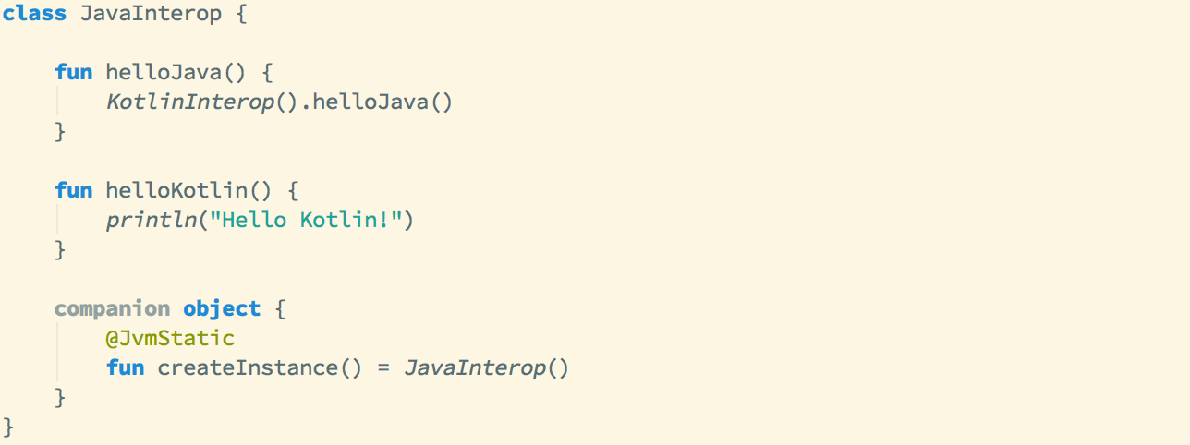
Kotlin / Java interoperability

Slide 15
Things to tell your Boss
Kotlin comes from industry, not academia. It solves problems faced by working programmers today.
It is free and Open Source
Comes with a useful Java to Kotlin converter tool
You can mix Kotlin with Java with 0 effort
Can use all existing java tools/frameworks
Supported by the best IDE on the market (with free version)
Easy to read, even non-Kotlin programmers can review your code
You don’t need to commit your project to Kotlin: you can start by writing your tests in it
JetBrains is not likely to abandon Kotlin because it drives their sales

Slide 16
Does it live up to the hype?
Only You can tell

Slide 17
WHERE TO START?
https://kotlinlang.org/docs/tutorials/
https://www.reddit.com/r/Kotlin/
https://kotlinlang.org/docs/tutorials/koans.html
https://blog.jetbrains.com/kotlin/
https://github.com/KotlinBy/awesome-kotlin

