Slide 1
android architecture components with mvvm
Angeli Róbert
Senior Android Developer
Tresorit

Slide 2
evolution of patterns

Slide 3
evolution of patterns
2010 – classic android
mCounterText = (TextView) findViewById(R.id.tv_clicks);
mCounterIncrementButton = (Button) findViewById(R.id.btn_increment);
mCounterIncrementButton.setOnClickListener(new View.OnClickListener() {
public void onClick(View v) {
mClicks++;
mCounterText.setText(""+mClicks);
}
});

Slide 4
evolution of patterns
2013 – butterknife and retrolambda
@Bind(R.id.tv_clicks) mCounterText;
@OnClick(R.id.btn_increment)
public void onSubmitClicked(View v) {
mClicks++;
mCounterText.setText(""+mClicks);
}

Slide 5
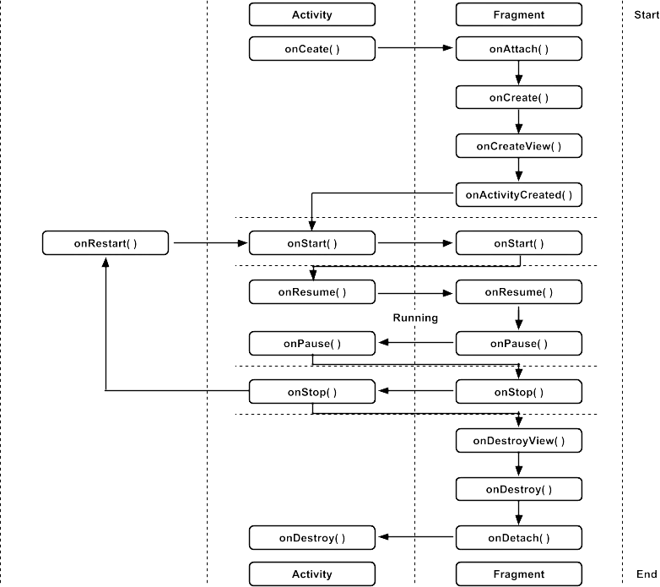
evolution of patterns
2014
avoid fragments
flow and mortar
mvp
react

Slide 6
evolution of patterns
2015 – data binding library - mvvm
<layout xmlns:android="http://schemas.android.com/apk/res/android">
<data>
<variable name="counter" type="com.example.Counter"/>
<variable name="handler" type="com.example.ClickHandler"/>
</data>
<LinearLayout
android:orientation="vertical"
android:layout_width="match_parent"
android:layout_height="match_parent">
<TextView android:layout_width="wrap_content"
android:layout_height="wrap_content"
android:text="@{counter.value}"/>
<Button android:layout_width="wrap_content"
android:layout_height="wrap_content"
android:onClick="@{handler.clickHandle}"/>
</LinearLayout>
</layout>

Slide 7
mvvm vs mvp
View
View
data
binding
update
UI
user
actions
View Model
Presenter
Model
Model

Slide 8
databinding
pro
door to mvvm
less boilerplate code
binding class generation at compile time
contra
hard to debug
different layout, different screen size

Slide 9
architecture components
new library by Google
help us design applications that are “robust, testable, and maintainable”
viewmodel
livedata
room

Slide 10
lifecycle
lifecycle
abstract class
can be observed
events from lifecycle change
lifecycleowner
interface
implemented by lifecycle aware components

Slide 11
lifecycle

Slide 12
viewmodel
store and manage UI-related data
lifecycle conscious
survive configuration changes
restore data
asynchronous call delegation

Slide 13
viewmodel restore data
old way:
onsaveinstancestate()
fragment instance
retaininstancestate()
handling configuration changes by yourself
new way:
viewmodelprovider
store for viewmodels

Slide 14
viewmodel provider
val profileViewModel = ViewModelProviders.of(this).get(SomeViewModel::class.java)

Slide 15
viewmodel
class SignUpViewModel @Inject constructor() : ViewModelBase() { val email = ObservableField("") val firstName = ObservableField("") val lastName = ObservableField("")
...
override fun onCreateView(inflater: LayoutInflater, container: ViewGroup?, savedInstanceState: Bundle?): View { return super.onCreateView(inflater, container, savedInstanceState).also { binding?.viewmodel = obtainViewModel<SignUpViewModel>().apply {
... lifecycle.addObserver(this) } } }

Slide 16
viewmodel
must never reference a view, lifecycle, or any class that may hold a reference to the activity context
modularity
leak safety
testability

Slide 17
viewmodel
problem: viewmodel without any android dependency (resources)
androidviewmodel allows applicaion context
solution: binding adapter

Slide 18
viewmodel binding adapter
@BindingAdapter("text") @JvmStatic fun set(view: TextView, resId: Int) = if (resId == 0) view.text = "" else view.setText(resId)
@BindingAdapter("src") @JvmStatic fun set(view: ImageView, resId: Int) = view.setImageResource(resId)
@BindingAdapter("textColor") @JvmStatic fun set(view: TextView, resId: Int) = view.setTextColor(view.resources.getColor(if (resId == 0) R.color.transparent else resId))

Slide 19
viewmodel
problem: communication between fragments
solution: common viewmodel
master-detail fragment
activity does not know anything about this communication
fragments do not need to know about each other

Slide 20
livedata
observable data holder
lifecycle-aware
no memory leaks
no crashes due to stopped activities
no more manual lifecycle handling
always up to date data

Slide 21
livedata
class SignUpViewModel @Inject constructor() : ViewModelBase() { ... val showProgress = LiveData<Boolean>()
override fun onCreateView(inflater: LayoutInflater, container: ViewGroup?, savedInstanceState: Bundle?): View { return super.onCreateView(inflater, container, savedInstanceState).also { binding?.viewmodel = obtainViewModel<SignUpViewModel>().apply { showProgress.observe(this@SignUpFragment, Observer { showProgress(it) }) ... } } }

Slide 22
livedata
problem: leak viewmodel
model (e. g. repository) is holding a reference to a callback in the viewmodel, the viewmodel will be temporarily leaked

Slide 23
livedata leak viewmodel
LiveData
Local Data Source
View
observes
ViewModel
Model
user actions
Local Data Source

Slide 24
livedata leak viewmodel
LiveData
Local Data Source
View
ViewModel
Model
Local Data Source

Slide 25
livedata leak viewmodel
solution:
drop callback on onclear
in model use weakreference or eventbus
use livedata between viewmodel and model

Slide 26
livedata leak viewmodel
LiveData
Local Data Source
View
observes
ViewModel
observes
Model
user actions
data
Local Data Source

Slide 27
livedata leak viewmodel
LiveData
Local Data Source
View
ViewModel
Model
Local Data Source

Slide 28
livedata
problem: livedata between viewmodel and model
subscribe from the viewmodel if you do not have access to the lifecycleowner
solution: using transformation

Slide 29
livedata transformation
map()
make changes to the LiveData value before dispatching it
switchMap()
return a different LiveData instance based on the value of another one.

Slide 30
livedata
problem: handle context-dependent operations from viewmodel
solution: event from viewmodel to view (singleliveevent)
show dialog
start activity
show fragment
show snackbar
show toast
...

Slide 31
livedata singleliveevent
no event-triggering during configuration change
events only after subscription
contra:
only one observer can be notified

Slide 32
livedata singleliveevent
class SingleLiveEvent<T> : MutableLiveData<T>() { private val pending = AtomicBoolean(false) @MainThread override fun observe(owner: LifecycleOwner, observer: Observer<T>) { super.observe(owner, Observer<T> { t -> if (pending.compareAndSet(true, false)) { observer.onChanged(t) } }) } @MainThread override fun setValue(t: T?) { pending.set(true) super.setValue(t) } }

Slide 33
livedata singleliveevent
viewmodel
val snackbarText = SingleLiveEvent<Int>()
view
snackbarText.observe(activity, { showMessage(it) })

Slide 34
thank you!
Angeli Róbert
Senior Android Developer
Tresorit

