Slide 1
Application protection
Why should we?
What to protect [against]?
How to do it?
Háló Zsolt
iOS Dev
Security Consultant
Pentester

Slide 2
TOC
Basics – why?
What to protect?
Potential attack vectors
Tools & Advices

Slide 3
Why?
We have 0 control* over the environment
Can’t be sure who / why downloads our product [Tesla / OnStar]
What impact might it have?
CIA – Confidentiality – Integrity – Availability
Brand damage
Loss of revenue / users / anything the service interacts with

Slide 4
What to protect?
Depends on:
What data are we operating with?
What attackers could do with it if they obtain it (always assume they will)
How much does it worth for you/company to stay out of headlines?
Personal data ( [user]name, birth, mail, PASSWORD etc. )
Financial information ( cards, account numbers, statements etc. )
Technical information ( API-keys, URLs, hardcoded credentials etc. )

Slide 5
What to protect against? (attack vectors)
Network sniffing
Data theft
User impersonation
Unauthorized usage of intellectual property
Analytics flood
Reversing
Application impersonation (tampering)

Slide 6
How to protect?
Proper usage of platform tools ( Touch ID – keychain, face auth^^ )
Unbroken(yet) crypto
Hashing + salting
Device enrollment
Proper root / jail detection
Certificate pinning
? THIRD PARTY SOLUTIONS ?

Slide 7
Third Party Tools
Debug protection
Tamper detection
Root / Jail detection
String encryption
Obfuscation
Control flow
Arithmetic
Types

Slide 8
String Encryption

Slide 9
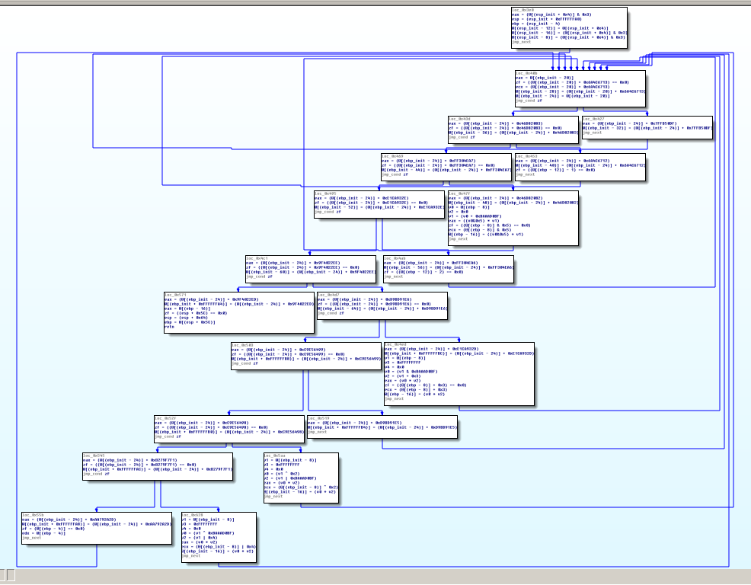
Control Flow Obfuscation

Slide 10
Type Obfuscation

Slide 11
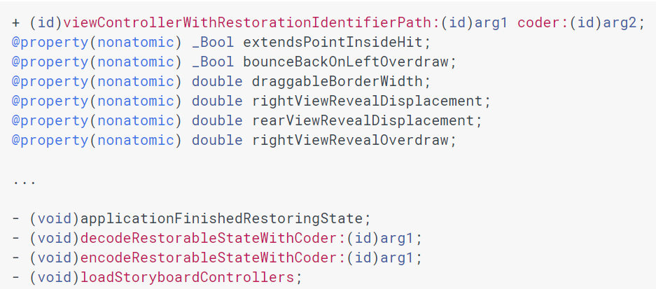

Slide 12
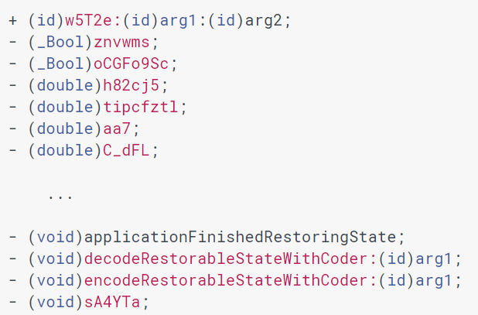

Slide 13
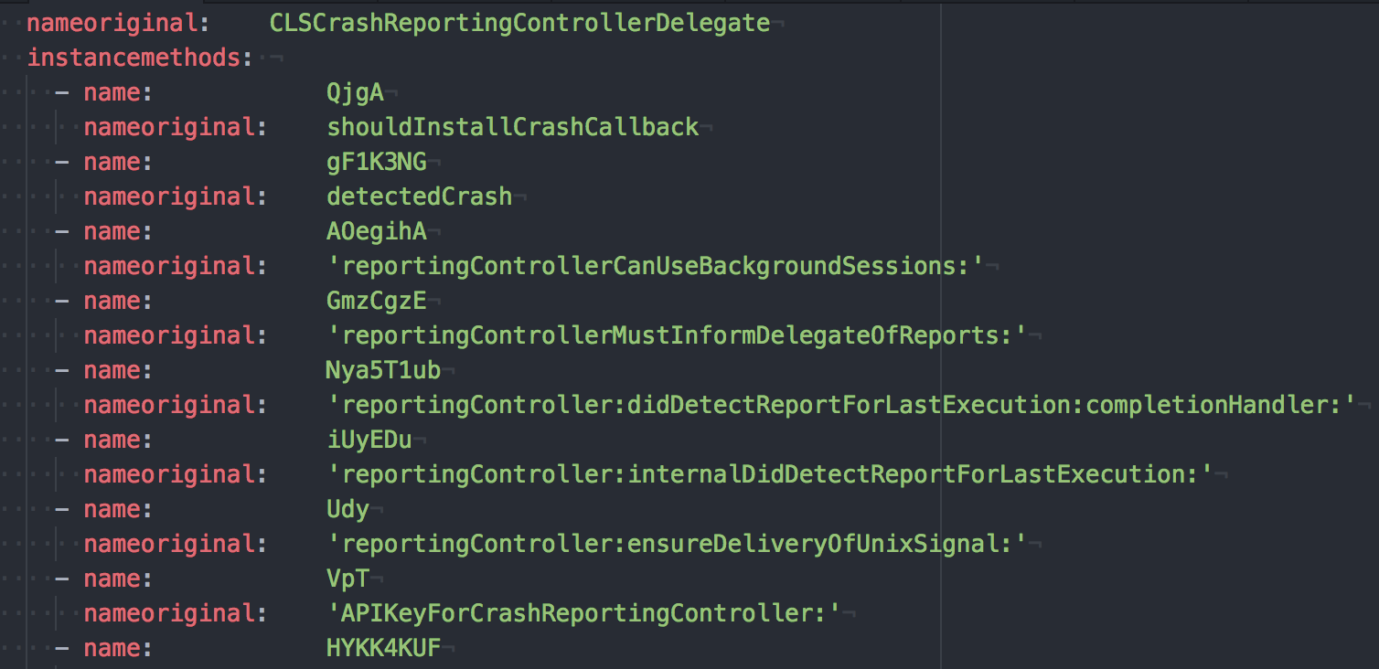

Slide 14
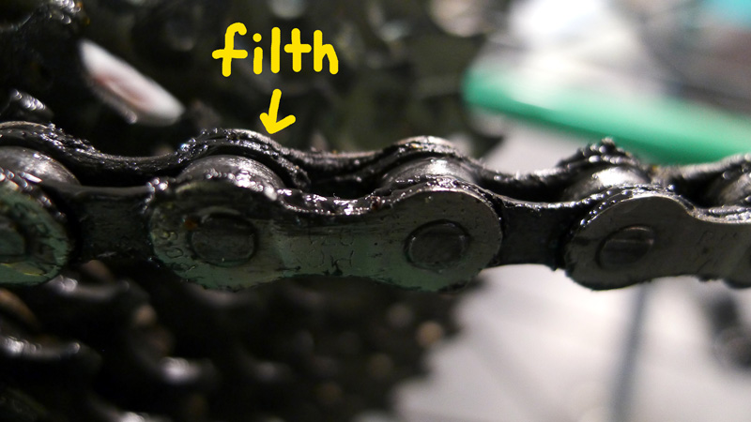
Certificate Pinning
THE DIRTY CHAIN

Slide 15
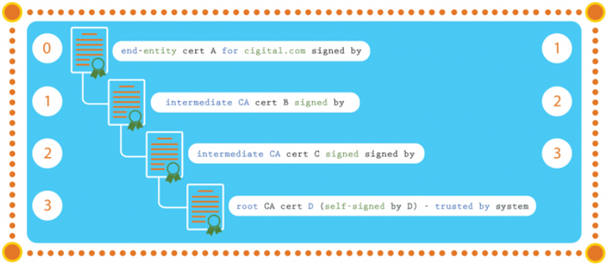
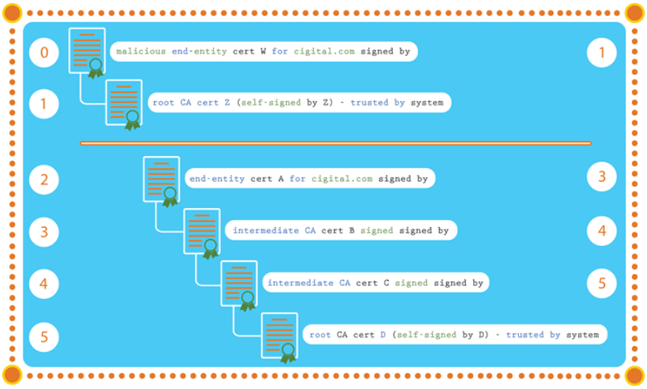
The Dirty Chain Problem
www.synopsys.com/blogs/software-security/ineffective-certificate-pinning-implementations

Slide 16
The Dirty Chain Problem
www.synopsys.com/blogs/software-security/ineffective-certificate-pinning-implementations

Slide 17
