Slide 1
5G is coming soon
Zoltán Turányi
5G Expert, Ericsson Research

Slide 2

5G capabilities
1000x
Mobile Data
Volumes
10x-100x
5x
Connected Devices
Lower Latency
10x-100x
End-user Data Rates
5G
10 years
3G
4G
2G
Battery Life for Low Power Devices

Slide 3
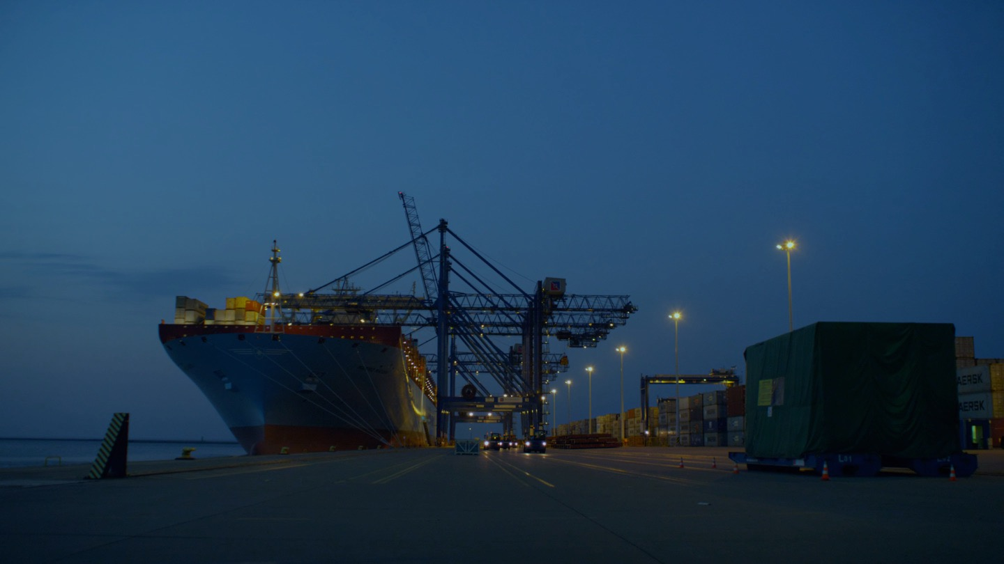
SENSORS
EVERYWHERE
BROADBAND AND MEDIA EVERYWHERE
5g
SMART VEHICLES,
TRANSPORT
INFRASTRUCTURE, MONITOR
AND CONTROL
USE CASES
CRITICAL CONTROL
OF REMOTE DEVICES
INTERACTION
HUMAN-IOT
Notes:
The development of 5G is a perfect example of how development is now driven by the applications. You will hear plenty more about this across IP, cloud and radio today!

Slide 4
Massive bandwidth
1
Really a lot of bandwidth
  Dense urban and indoor deployment
  10+ Gbit/s per user device
Examples
  Drone views
  Football game streamed up
  Live remote control
  AR/VR

Slide 5
Business innovation
2
Currently mobile operators
  License spectrum
  Own and operate a network
  Offer value-added services
  Engage customers and sport brands
Examples
  Shared networks/Networks owned by site owner
  Private networks
  Networks with no customer relations
  Horizontalization

Slide 6
Physical apps
3
Today’s apps
  Software only
  Mobile phones and tablets
  Typically bound to a few devices
Next wave of apps
  Come with a device
  Many forms and shapes
  A fleet of them
“Everything that benefits from being connected will be connected”

Slide 7
Bult-in Compute
4
Most new 5G use cases require
  Massive bandwidth; and/or
  Low latency
Add computation to the mix
  Distributed Cloud
  Edge Computing
Offered as a combination of services
A platform for innovation

Slide 8
New ui
5
“The most profound technologies are those that disappear. They weave themselves into the fabric of everyday life until they are indistinguishable from it.”
Mark Weiser: The Computer for the 21st Century, 1991
Buzzwords
  Connected everything
  Augmented Reality
  Machine intelligence
Examples
  Control everything
  Safety at the construction site
  Fix your own washing machine

Slide 9


