Slide 1
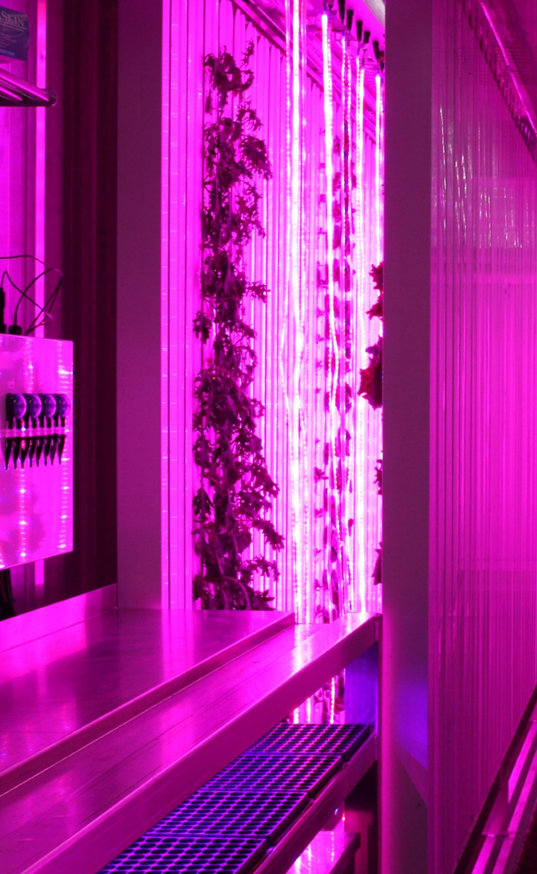
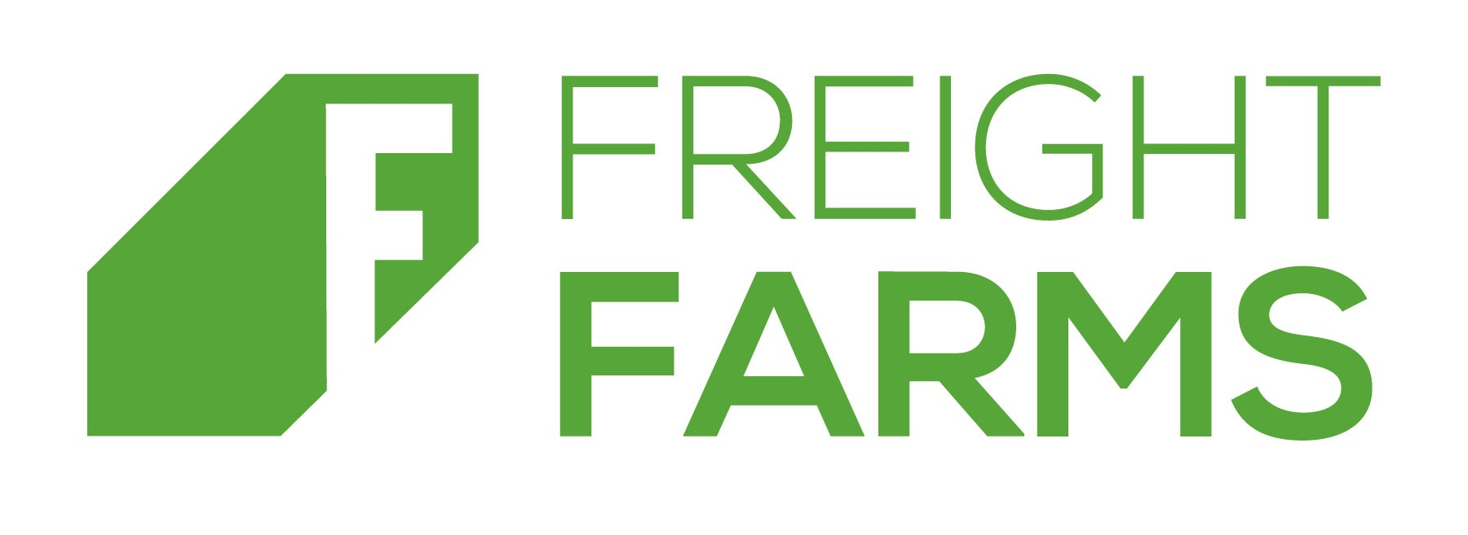
Kyle Seaman
HWSW Mobile
November 23

Slide 2
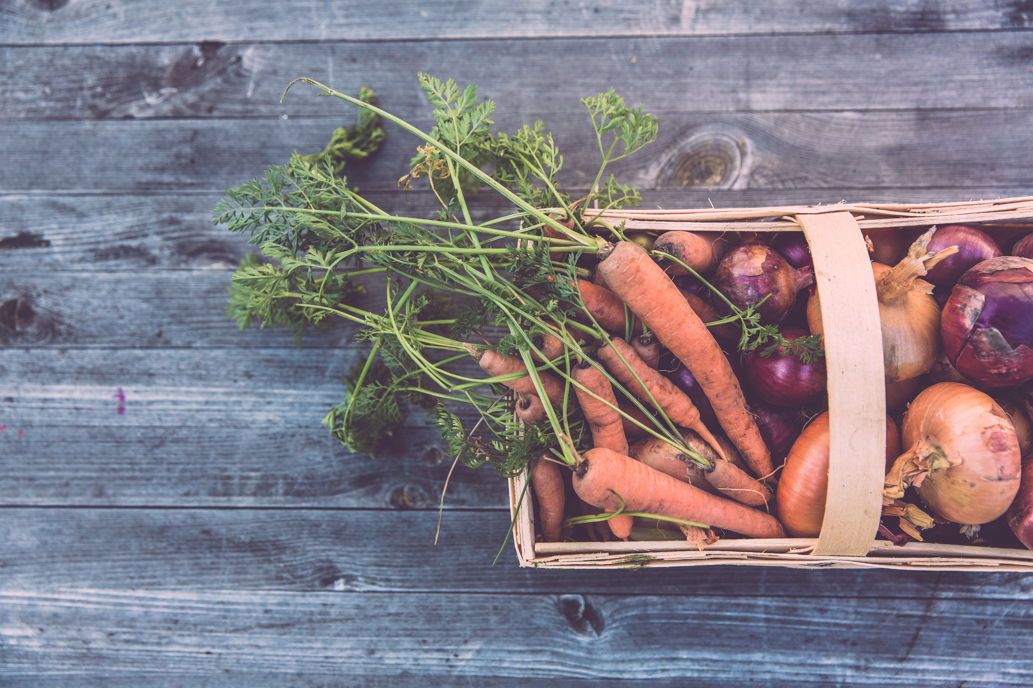
MAKING LOCAL FOOD GLOBALLY POSSIBLE

Slide 3
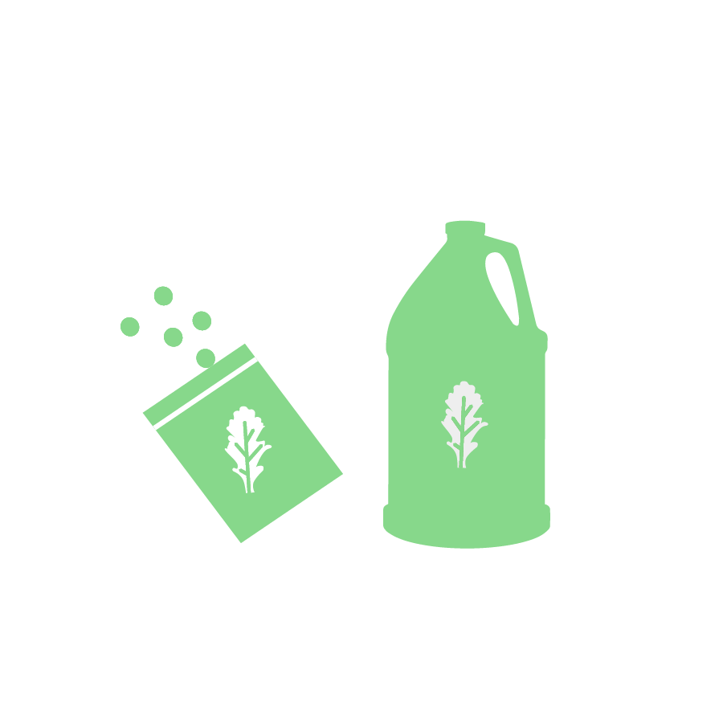
LIGHT
AIR
WATER
FOOD
Notes:
We packed up the farmland and put it in a container that we can take anywhere! With the Leafy Green Machine, we hope to help change the way people grow their food so that fresh food is close to you anytime, any place.
Inside the container plants are safe from whatever weather is happening outside.

Slide 4
LIGHT
128 LED light strips
Mimics sunlight
Notes:
Light
Plants need light to grow. They use a process called photosynthesis to turn light into energy that they can use to grow. Outside plants get this light from the sun! Inside we use LED lights.

Slide 5
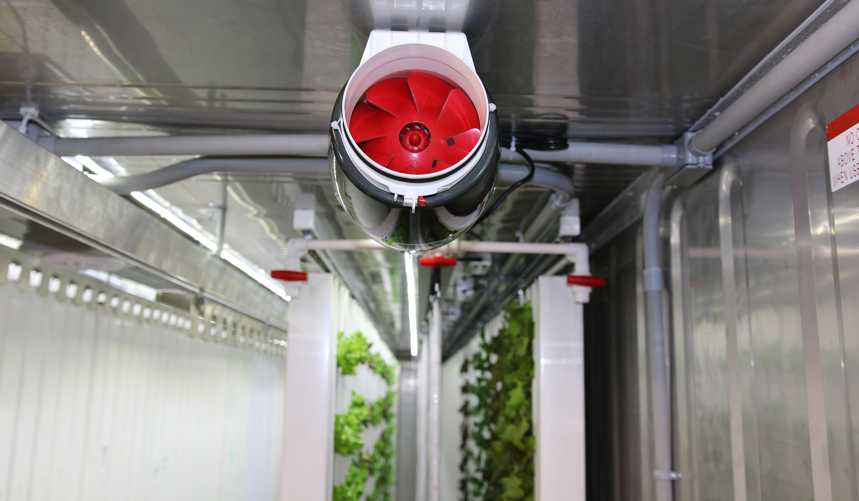
AIR
Temperature
CO2

Slide 6
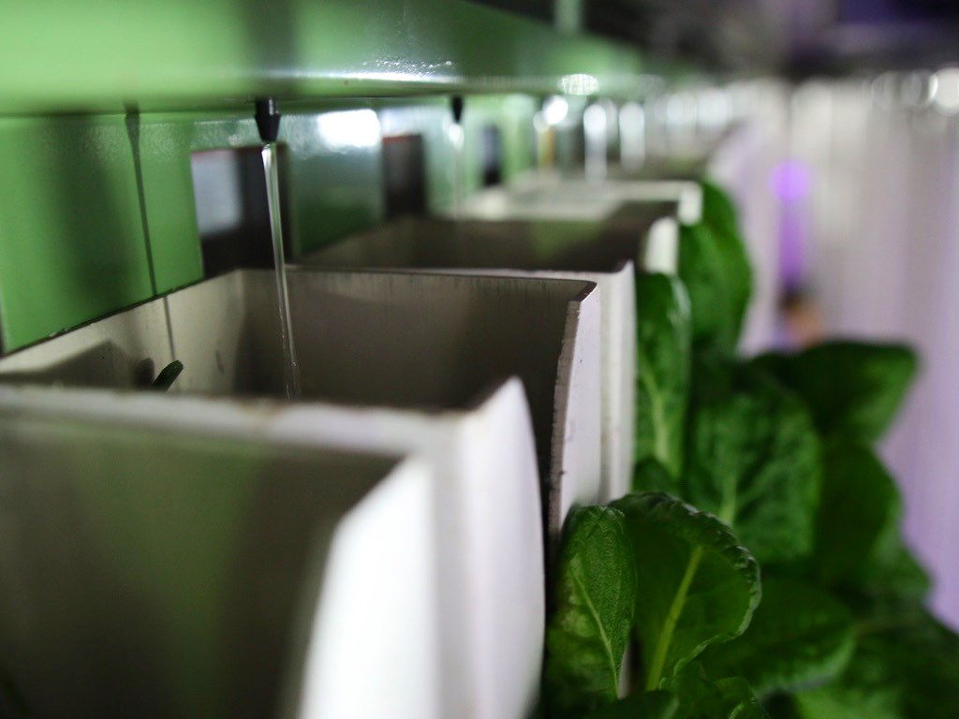
WATER
Drip irrigation
Closed-loop system

Slide 7
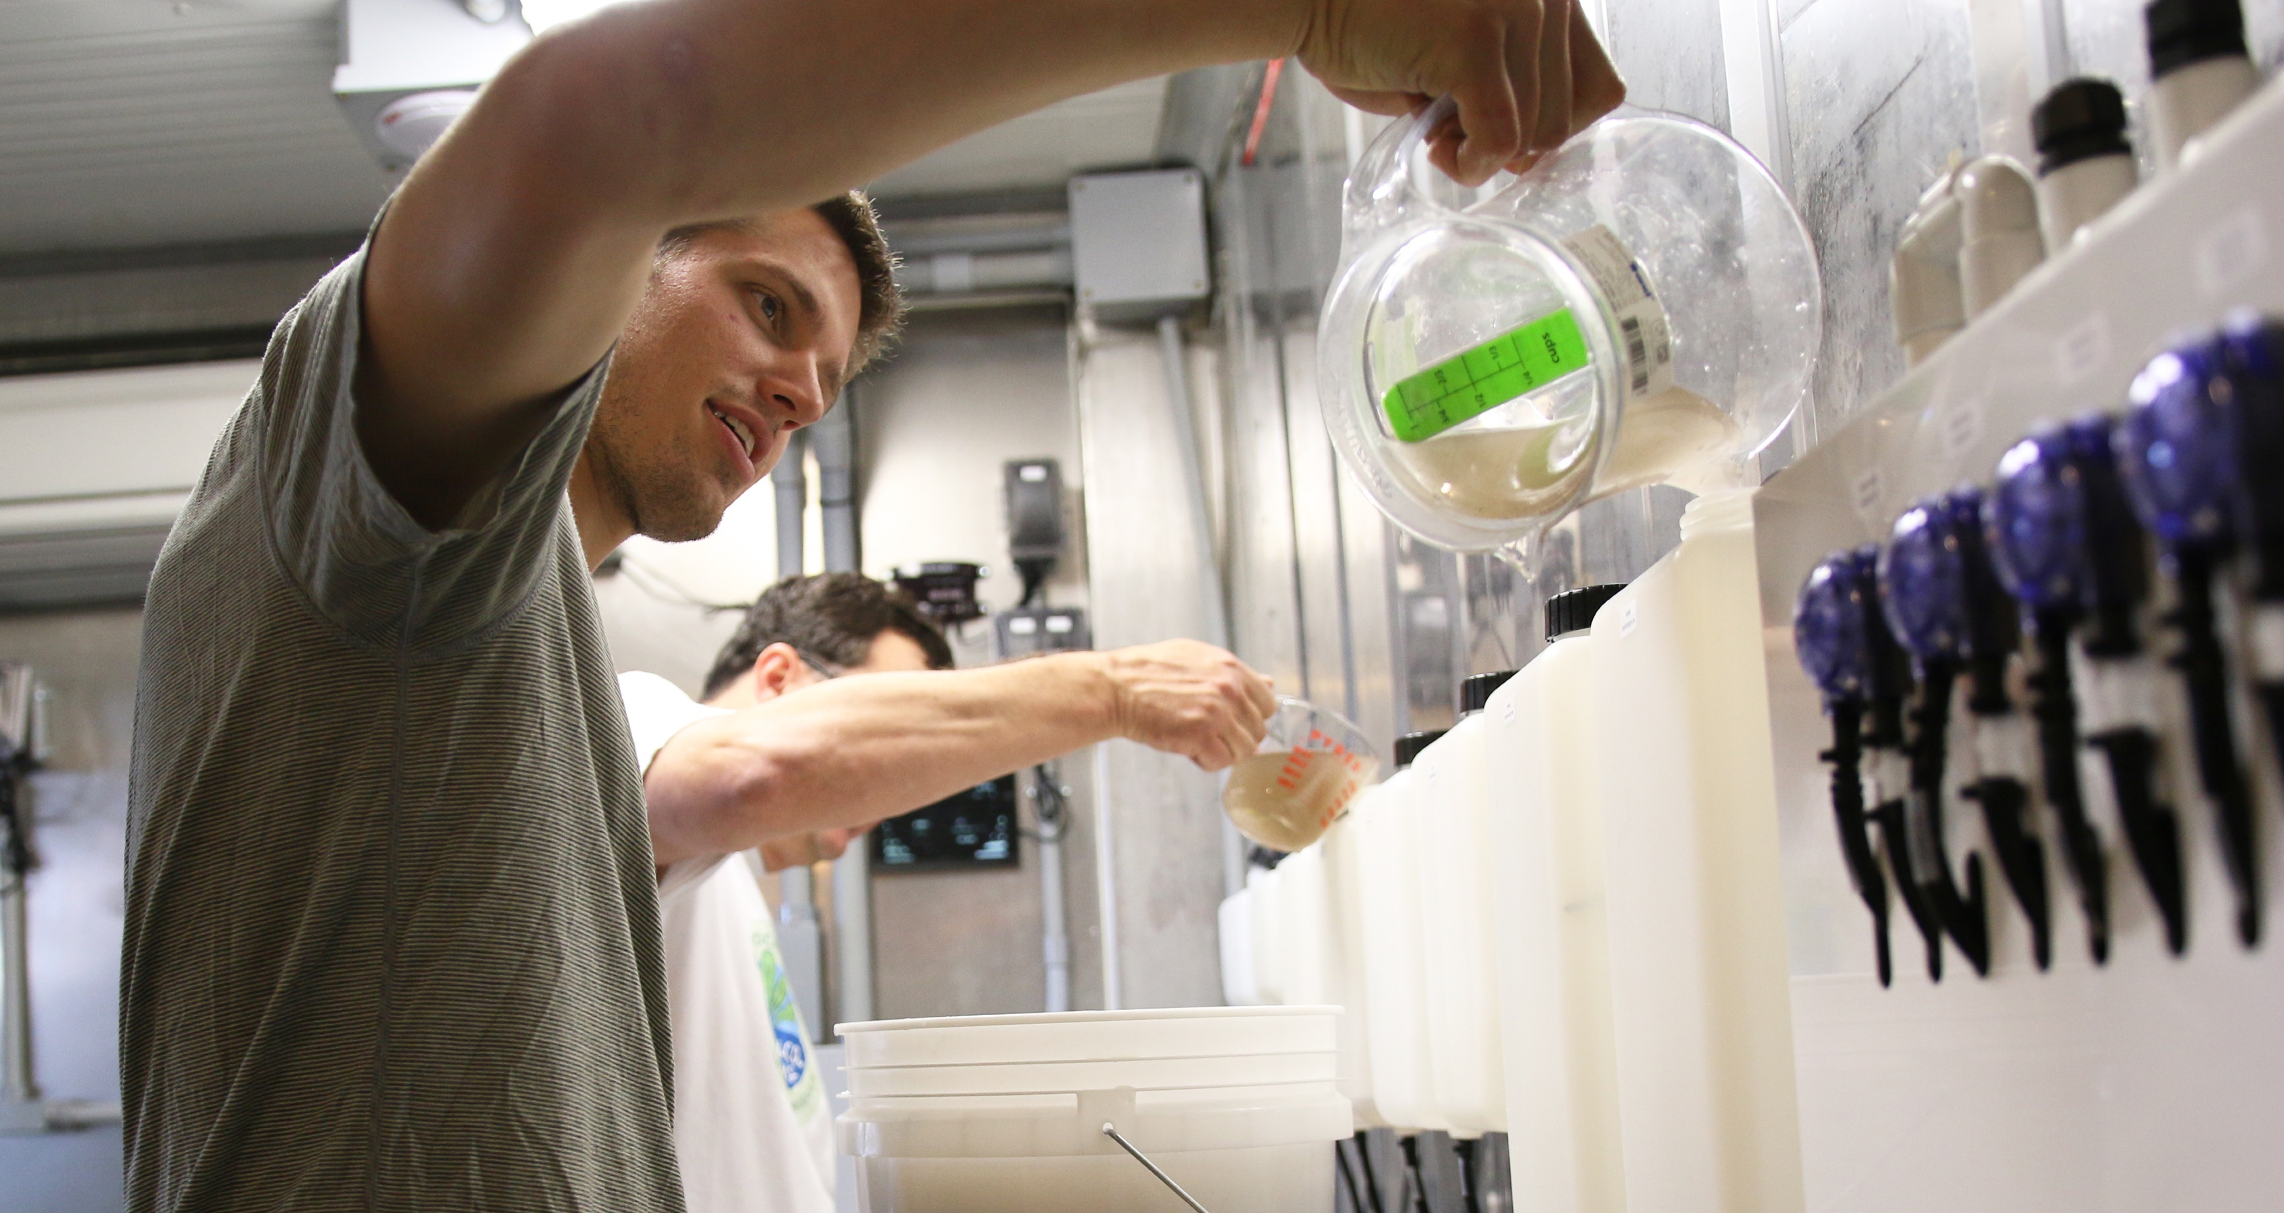
FOOD
Liquid Nutrients
pH Balance
Notes:
Food
Traditionally plants get their food from fertilizers or nutrients in soil
We took all the plant food out of the soil and dissolved it into the water, so when the plants get the water they also get the food they need!
Our water is like a smoothie

Slide 8
SEEDLING
STATION
3,600 plants
Notes:
Nursery area for baby plants. When they’re about 3 weeks old, we move them to our grow towers.

Slide 9
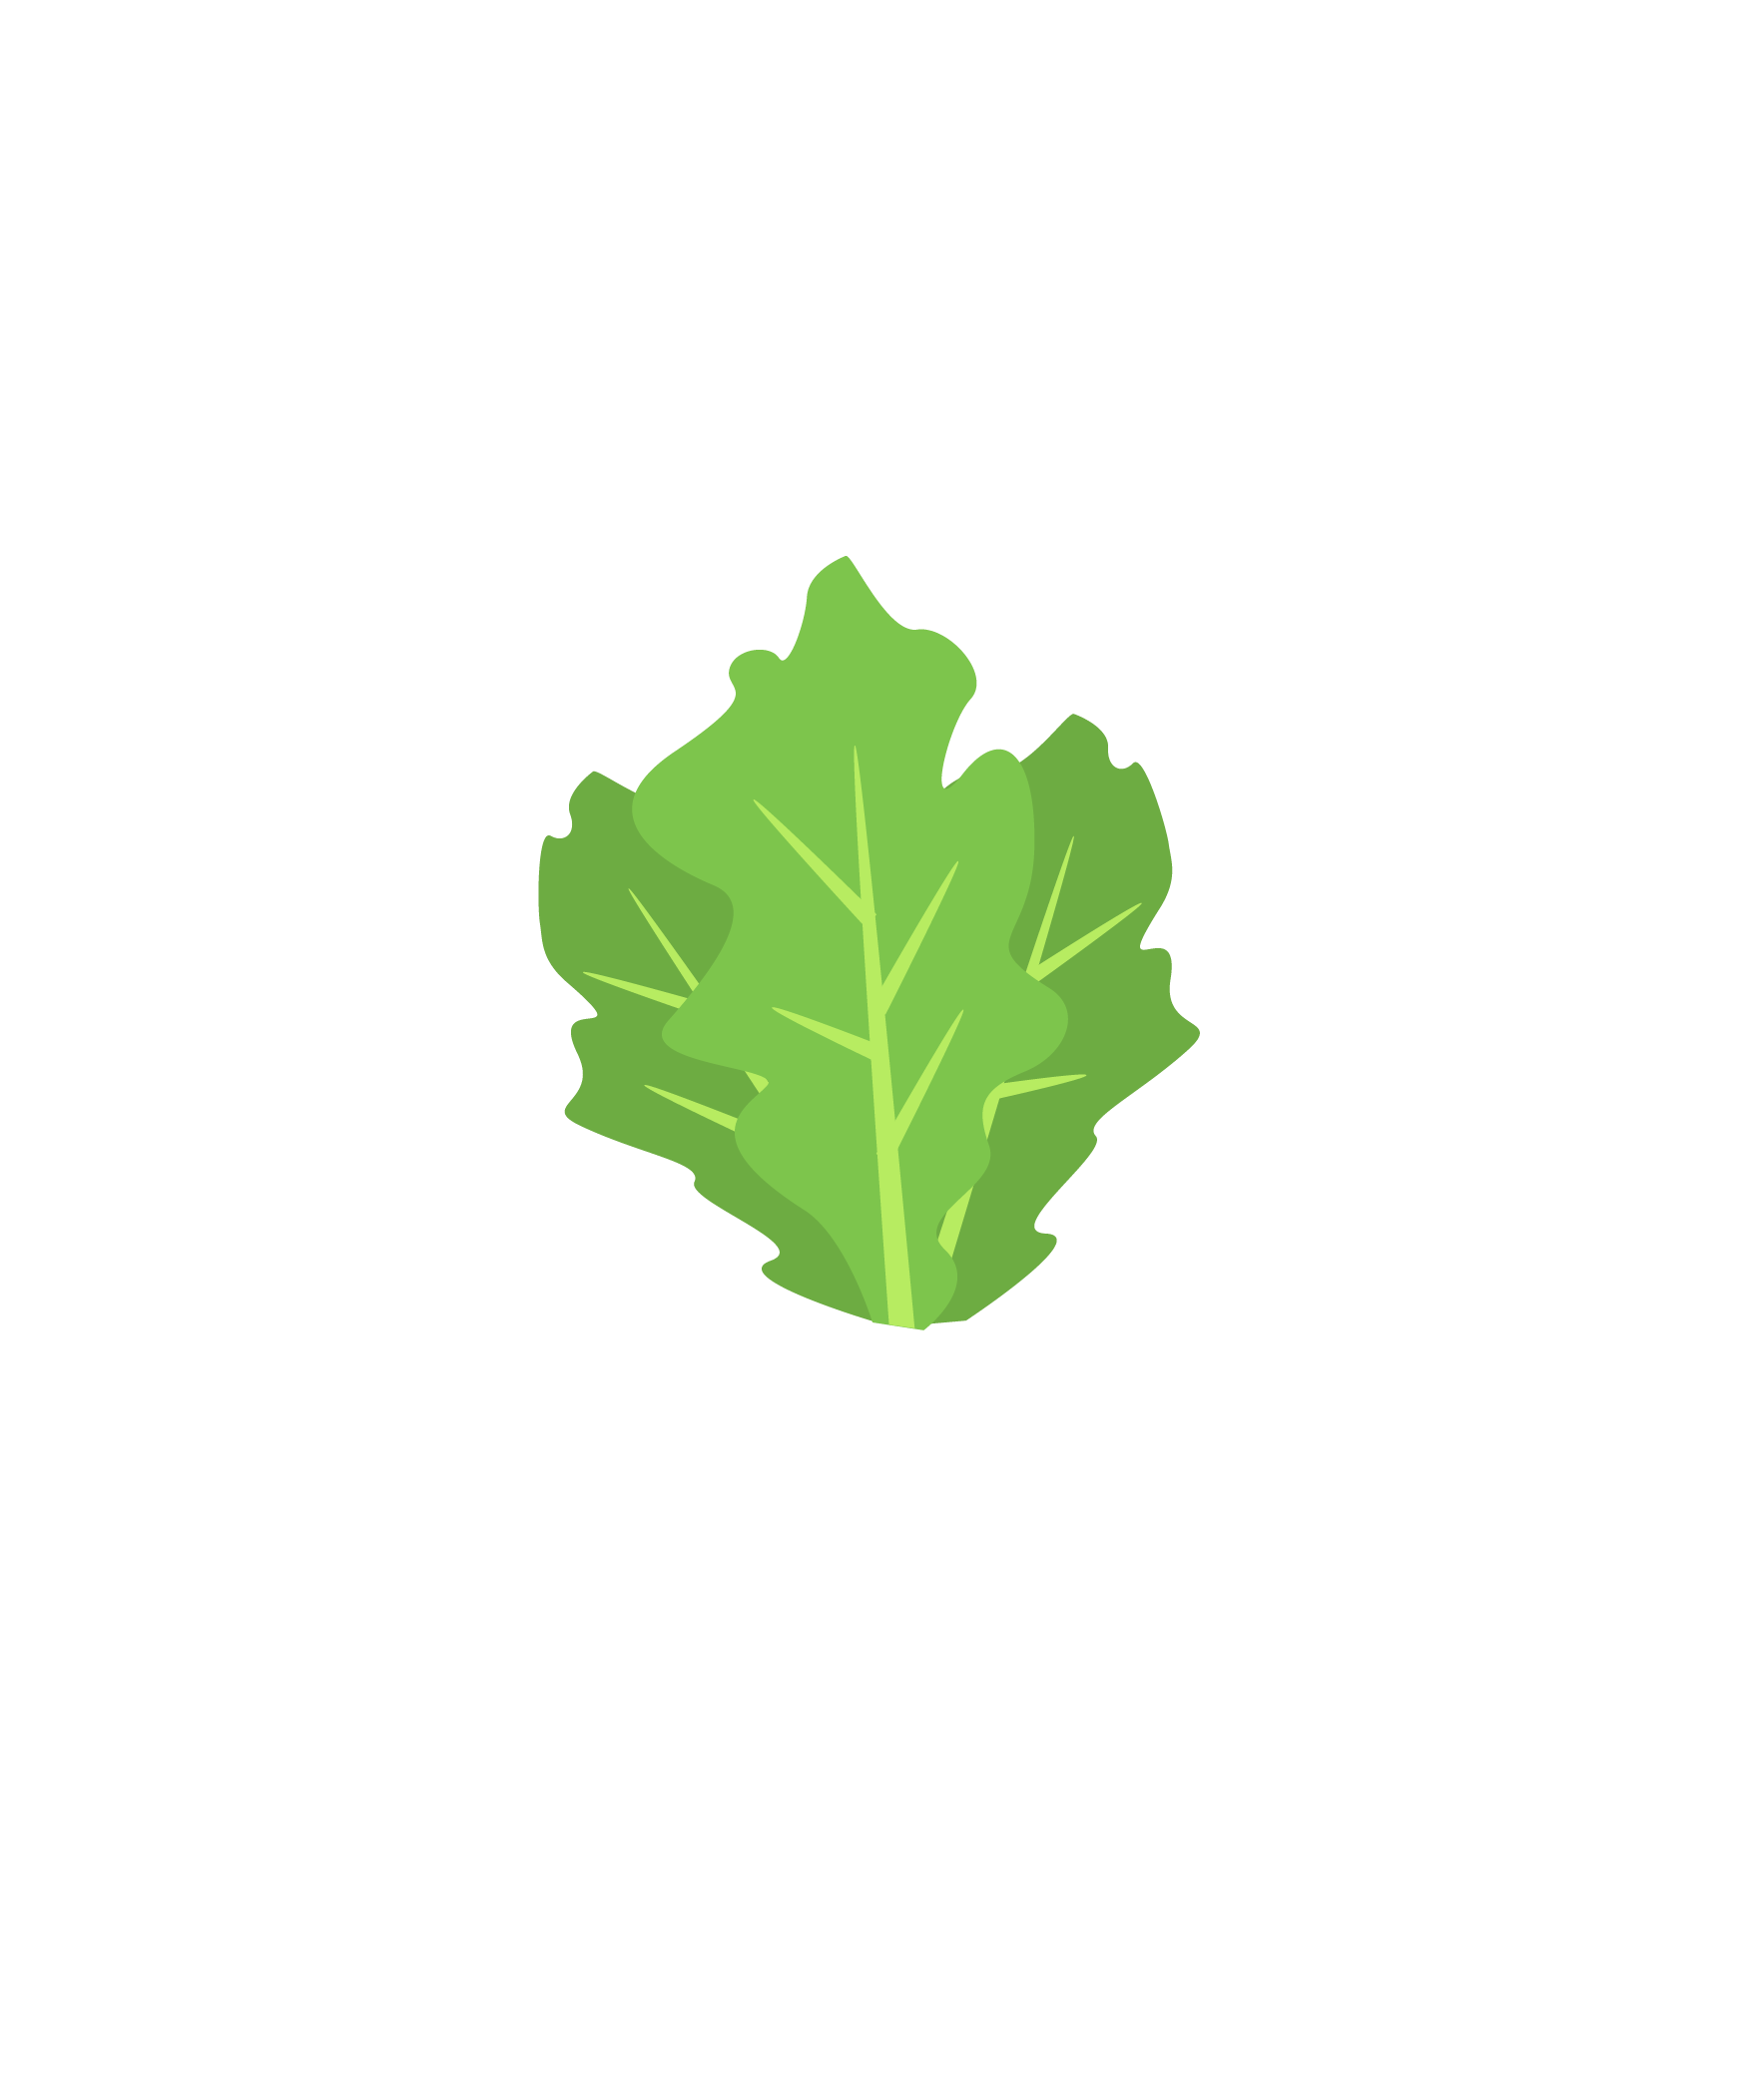
MATURE
PLANTS
4,500 plants
Notes:
Nursery area for baby plants. When they’re about 3 weeks old, we move them to our grow towers.

Slide 10
AUTOMATION &
CONNECTIVITY
Environmental Controls
Remote Monitoring
Notes:
But this was just the start. We realized early on that the farms economics would be directly driven by how well we could streamline workflows and minimize actual time in the farm. Automation was our first step, and now connectivity.
At Freight Farms, we believe that making farming accessible to more people is good for our health, our communities, and our dinner plates.
We automated our farm so that more people can start farming no matter where they are or what they do for work. Many people who want to farm are in cities, where they have a full time job and there’s not a lot of space, but there are a LOT of people who want fresh food.
The automation in the Leafy Green Machine helps these people grow food for their communities.
To do that, they need to make the most out of the little space they have inside the container.

Slide 11
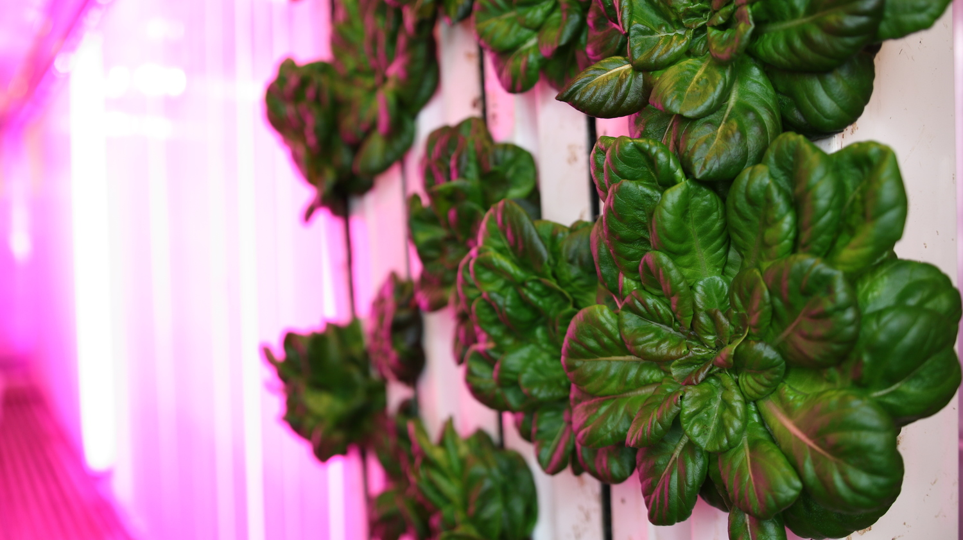

Slide 12
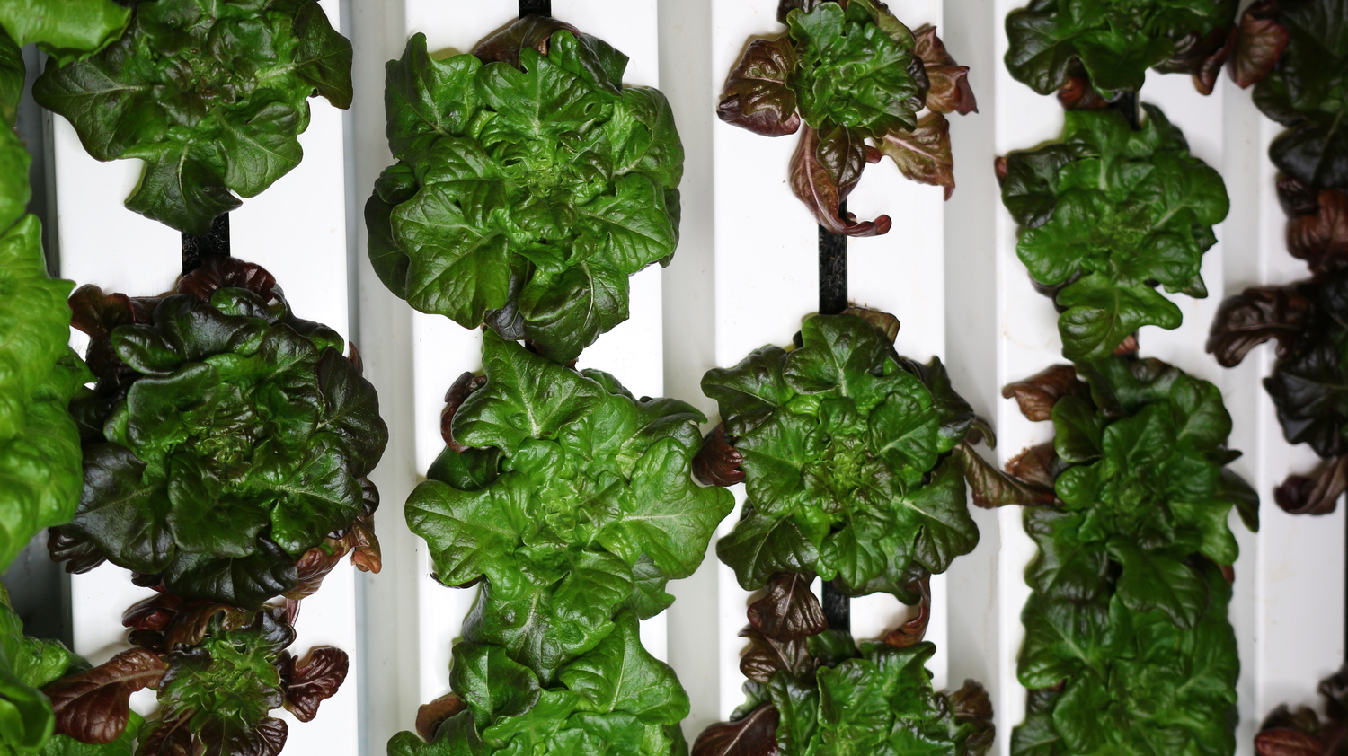

Slide 13
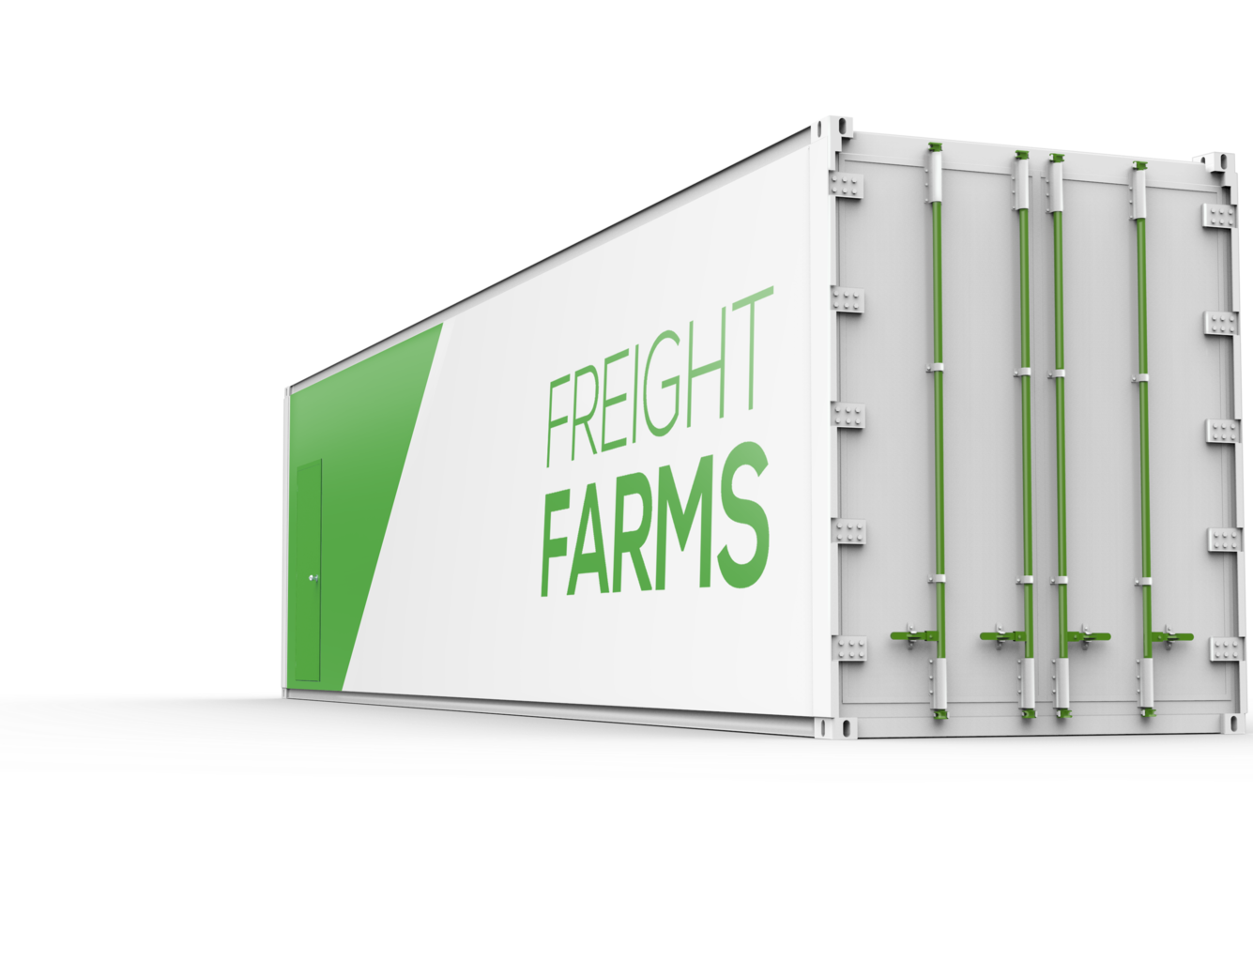
THE LEAFY GREEN MACHINE
a complete hydroponic growing system built inside a shipping container capable of producing a variety of lettuces, herbs and hearty greens.
365 day growing season
90% less water usage than traditional agriculture
6000 sq. meters of production
Notes:
Why did we put the farm inside a shipping container?
Well, we noticed that wherever we went, we saw some kind of shipping container - they’re everywhere! Back of trucks, on ships, on top of buildings, in backyards or parking lots...So we decided to take insulated shipping containers that no one wants anymore and turn them into farms that can go anywhere a shipping container, just like a normal container.

Slide 14
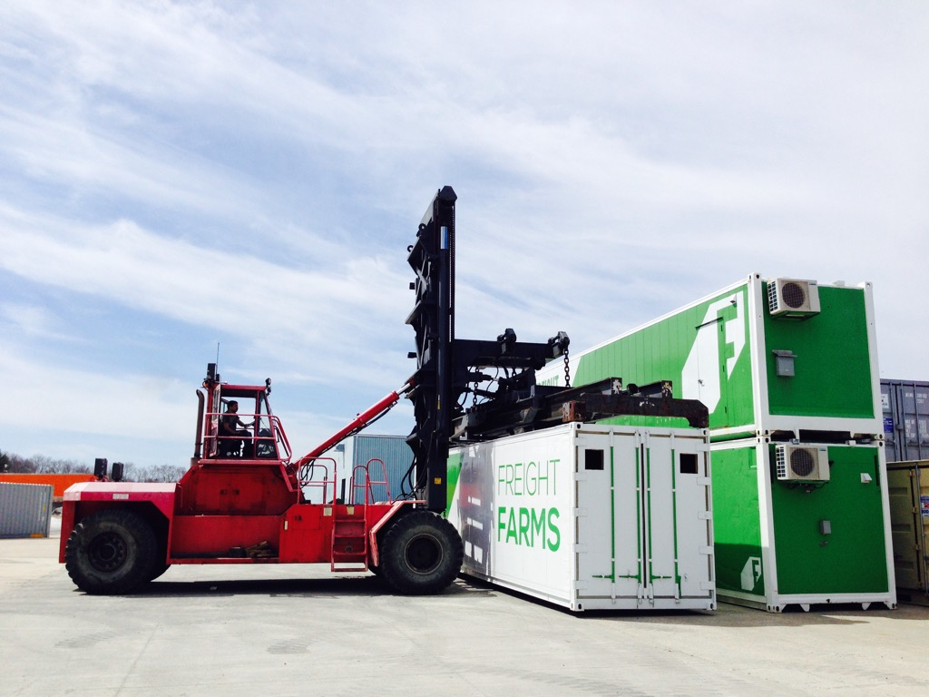
Turning anyone
into a farmer
De-risking production
Activating Urban Ag
Delivering a platform and network
Notes:
Why did we put the farm inside a shipping container?
Well, we noticed that wherever we went, we saw some kind of shipping container - they’re everywhere! Back of trucks, on ships, on top of buildings, in backyards or parking lots...So we decided to take insulated shipping containers that no one wants anymore and turn them into farms that can go anywhere a shipping container, just like a normal container.

Slide 15
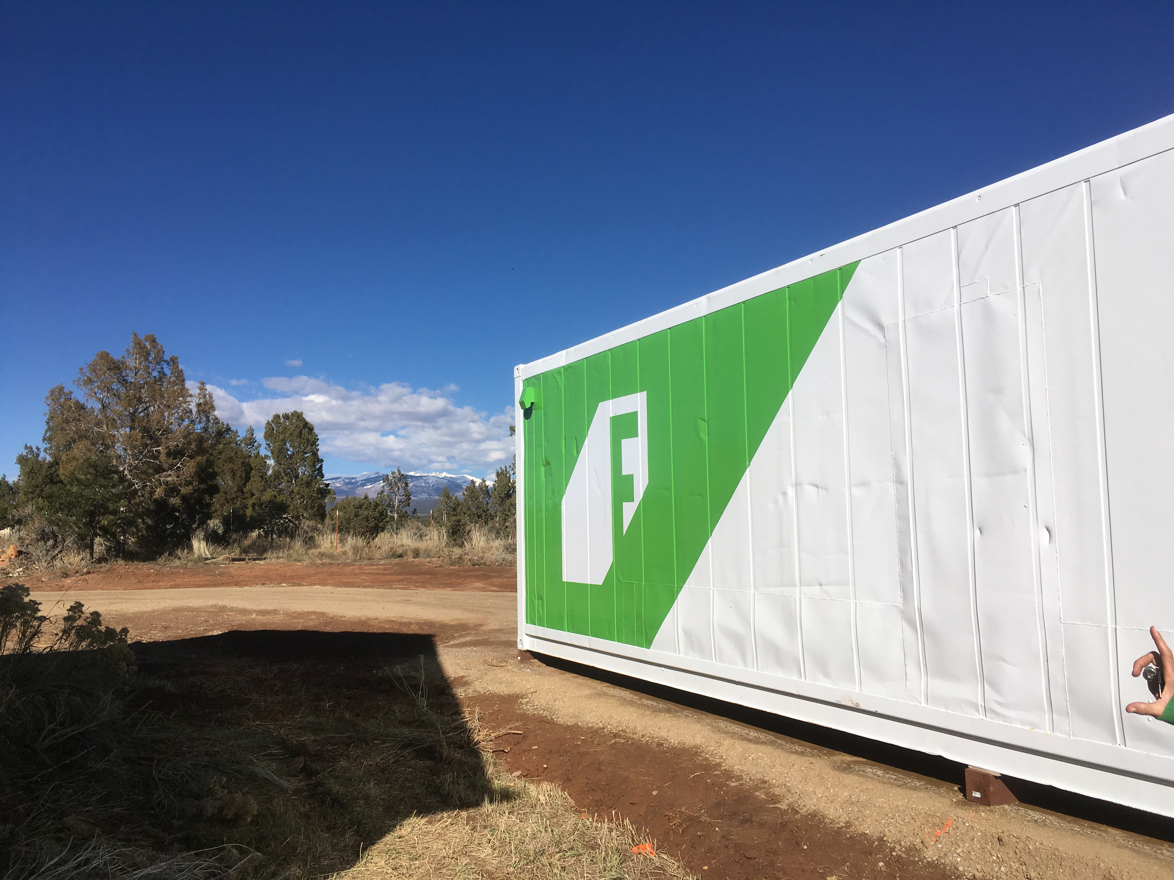
BECOMING A CONNECTED FARM AND COMPANY
BUILDING A CONNECTED FARM AND COMPANY
Notes:
We may be unique in that we aren’t building IoT technology as much as we are implementing the functionality to drive better customer experiences of our product.
But for those of your out there not building the low level tech, I bet we are VERY similar to you. And I’d like to take you through our process and what we’ve learned in becoming a connected product company (while focusing on the value add / customer layer).
We embraced IoT as a core piece of our product for two main reasons — many of which I’m sure will resonate with you all here. First, our top priority is delivering the best customer experience. For us specifically this means….

Slide 16
DELIVERING THE BEST CUSTOMER EXPERIENCE
Scaling support & being proactive
Farm economics
“Self-driving” farm
Notes:
we want to be delivering the best customer experience, and in our case this means scaling support

Slide 17
PRODUCT ENABLEMENT
Real world analytics
Crop & workflow optimization
Network of farms
Notes:
This simply extends our goal of delivering the best customer experience, which we are now able to do because of product functionality that would never have existed with connectivity.

Slide 18
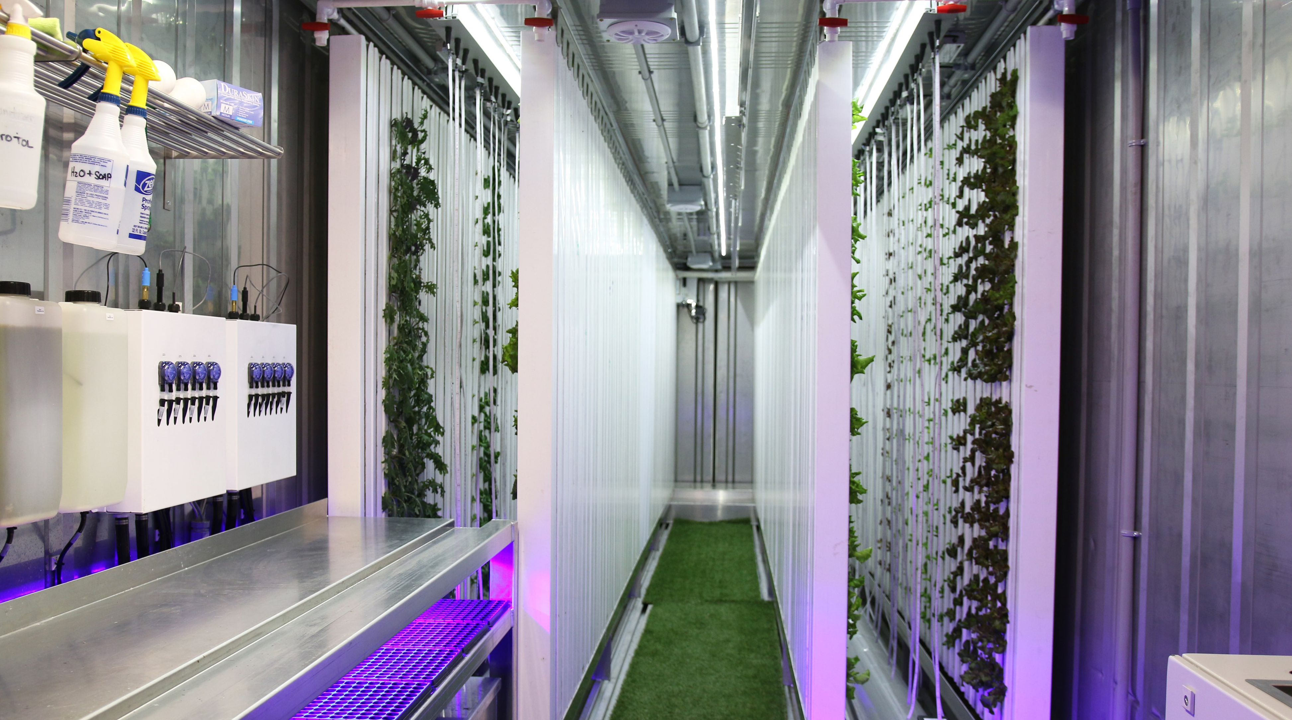
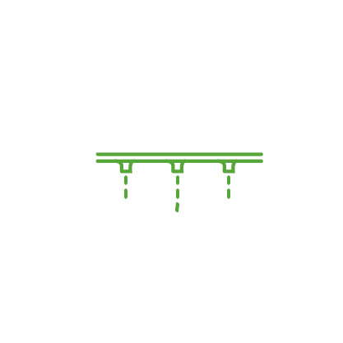
A CONNECTED FARM
CLIMATE & HYDRO
EQUIPMENT
YIELD
20 MILLION READINGS PER YEAR
Notes:
At Freight Farms, we believe that making farming accessible to more people is good for our health, our communities, and our dinner plates.
We automated our farm so that more people can start farming no matter where they are or what they do for work. Many people who want to farm are in cities, where they have a full time job and there’s not a lot of space, but there are a LOT of people who want fresh food.
The automation in the Leafy Green Machine helps these people grow food for their communities.
To do that, they need to make the most out of the little space they have inside the container.

Slide 19
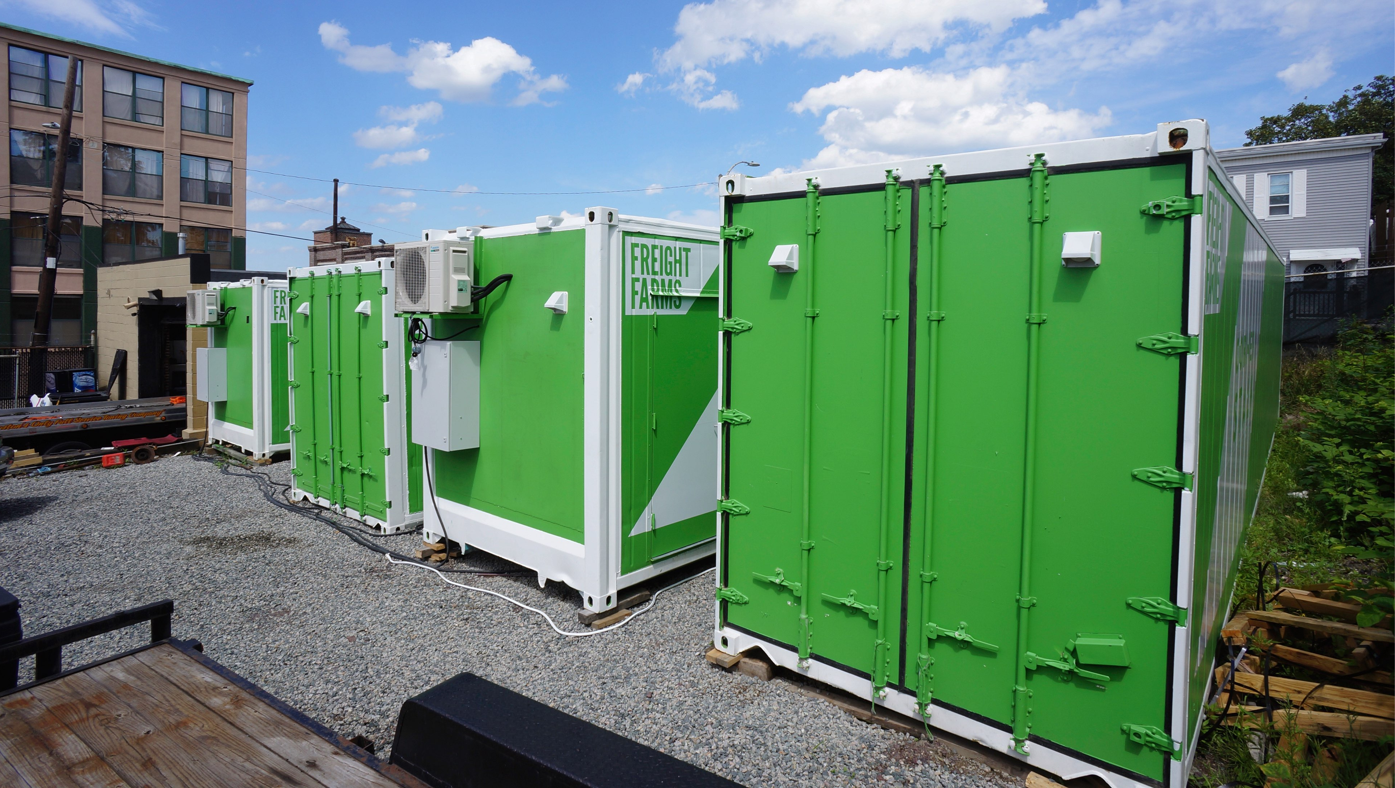
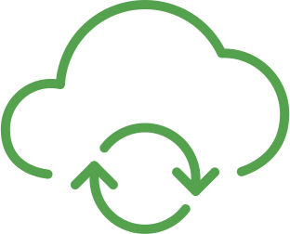
A NETWORK OF FARMS
Notes:
At Freight Farms, we believe that making farming accessible to more people is good for our health, our communities, and our dinner plates.
We automated our farm so that more people can start farming no matter where they are or what they do for work. Many people who want to farm are in cities, where they have a full time job and there’s not a lot of space, but there are a LOT of people who want fresh food.
The automation in the Leafy Green Machine helps these people grow food for their communities.
To do that, they need to make the most out of the little space they have inside the container.

Slide 20
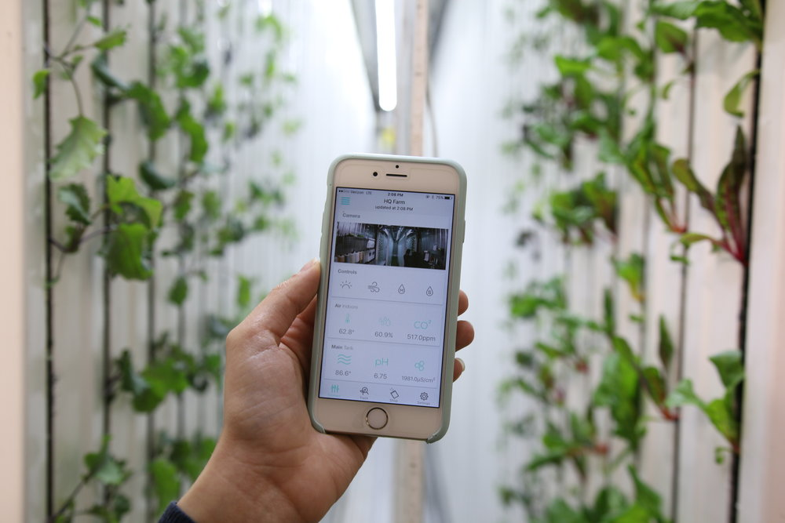
Your digital farming assistant
Notes:
Where growing seasons are usually really short.

Slide 21
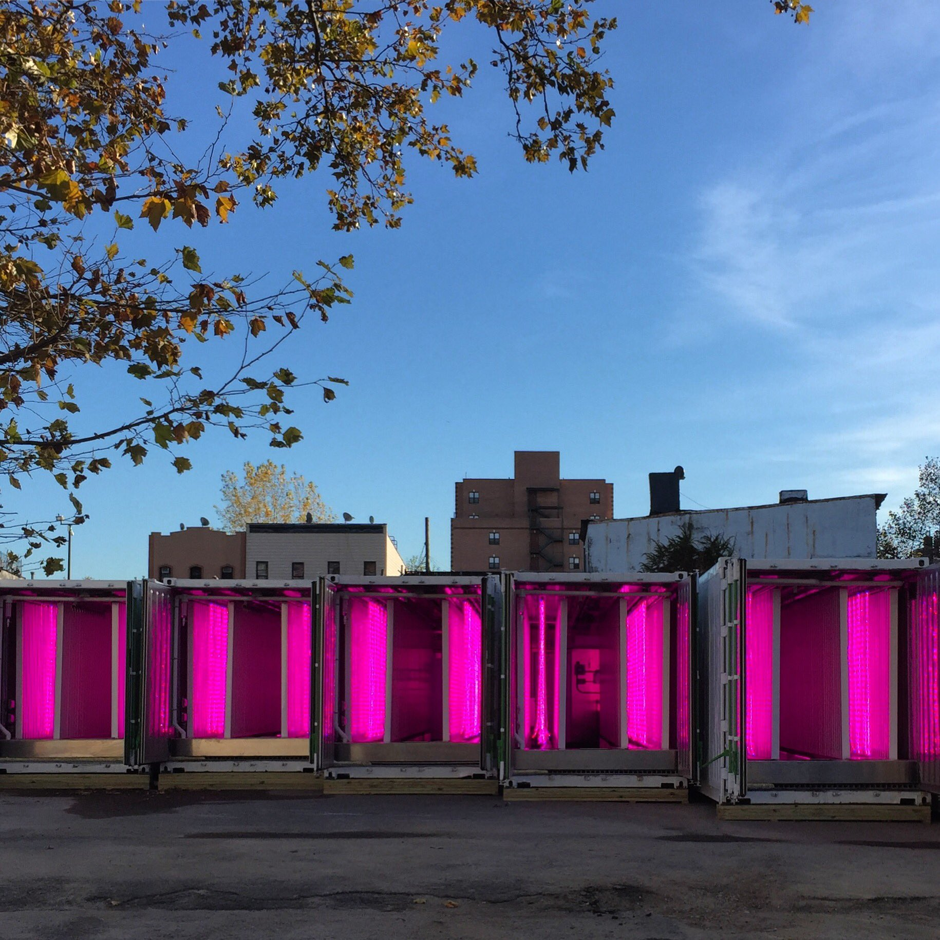
TECH ARCHITECTURE
source Square Roots Grow
Notes:
As I’ve mentioned, we leaving at the application layer of a lot of core technologies (databases, servers, protocols) and I’ll take you through some of the ways in which we are architecting our systems and building our applications to really get the most out of these.

Slide 22
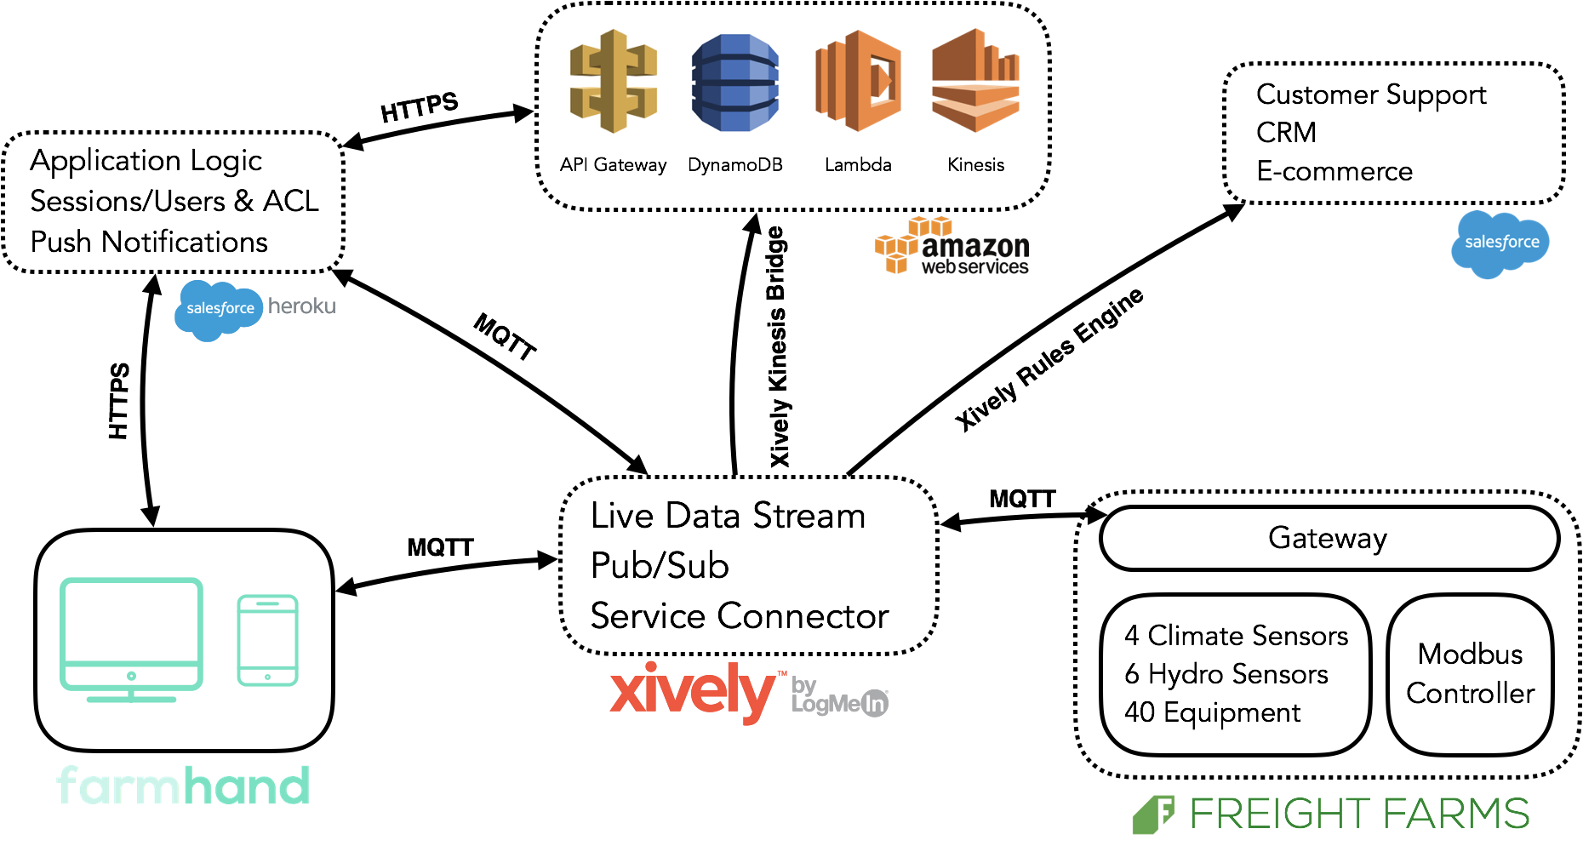

Slide 23
MQTT
Lightweight low bandwidth
TCP/IP protocol
Pub/Sub with a broker
Notes:
As you can see Xively is a core piece

Slide 24
EXTENDING MQTT AT THE BROKER LEVEL
Organization rules
Devices and clients are defined
Channel Templates
Notes:
As you can see Xively is a core piece

Slide 25
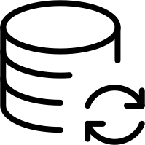
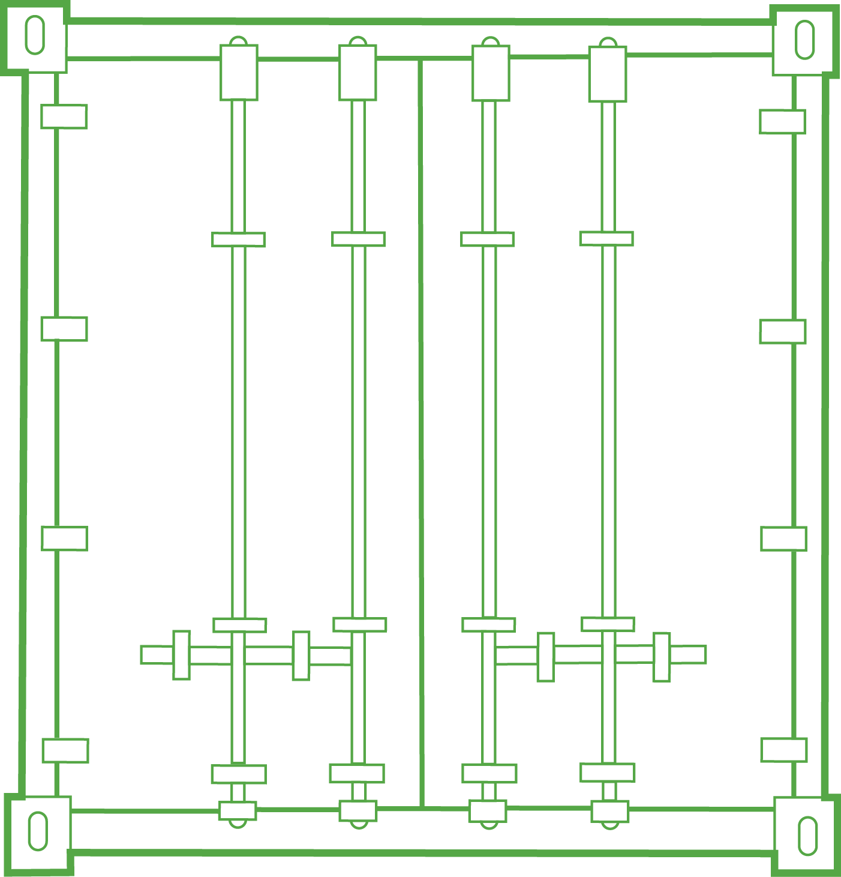
Pub/Sub Advantage
Kinesis
One data point to N number of consumers
Notes:
-this probably seems obvious, especially since we are talking about a pub/sub system, however, I under appreciated the 1 to many (many being VERY different subscribers).
-Bandwidth constraints.
-future flexibility, we just migrated from our mongo database to AWS’s dynamos
put as much expensive processing on the cloud (such as network requests/routing)

Slide 26
A NORMAL CLIENT SERVER RELATIONSHIP
REQUSET
RESPONSE
In IoT, this doesn’t really fit
Notes:
Where growing seasons are usually really short.
Rarely is the client directly interacting with the device. For some tasks, sure, but for we try to limit this, to keep bandwidth down
… NEW WORKFLOWS & DESIGN PATTERNS

Slide 27
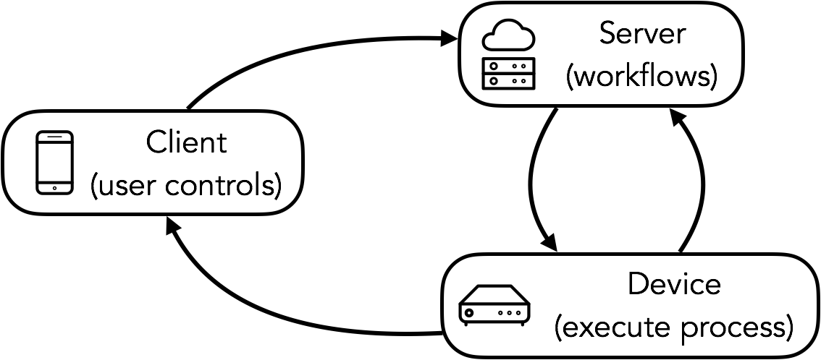
MULTI PARTY PROCESS DESIGN PATTERN
Notes:
Where growing seasons are usually really short.
… NEW WORKFLOWS & DESIGN PATTERNS
-Workflows for us are anything defined action a user wants to take on the farm. This could simply be turning the lights on, or a more complicated task such as calibrating the sensors… Calibrating is actually a set of nested processes and especially when dealing with
-Too long of a process for HTTP, risk timeouts
-Many processes are important and a client disconnect could be problematic
-We don’t want the error handling / workflow logic living on the client… in many ways this allows the client to be blind to the actual device
-enables continuous updates to the workflows (and new workflows) without needing the client to update
-client also includes the server in this case, for logs and other storage

Slide 28
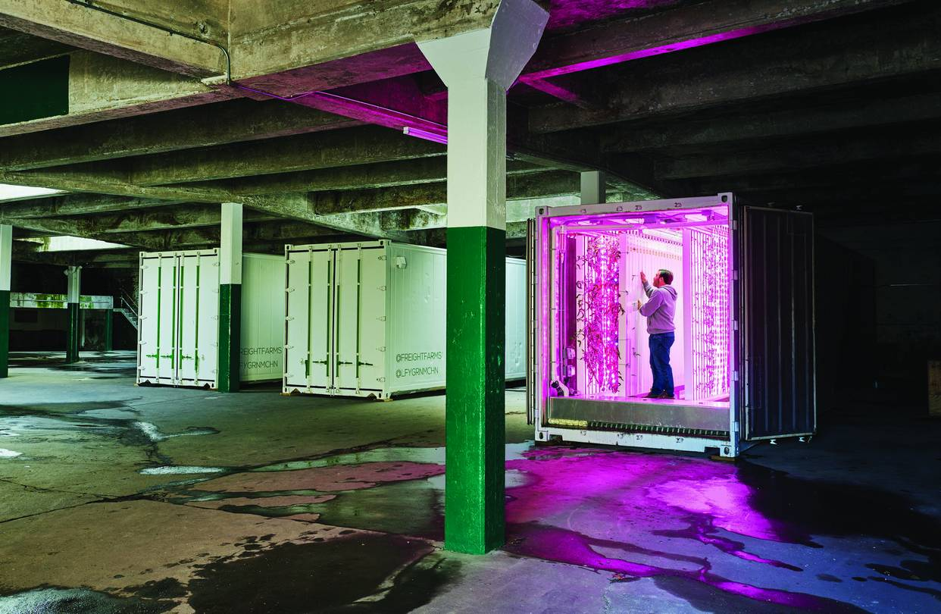
LESSONS LEARNED
source Wall Street Journal
Notes:
In the past 2 years, from 10 disparate container farms, to over 100 fully connected farms. and in the process have learned a few things. the first.

Slide 29
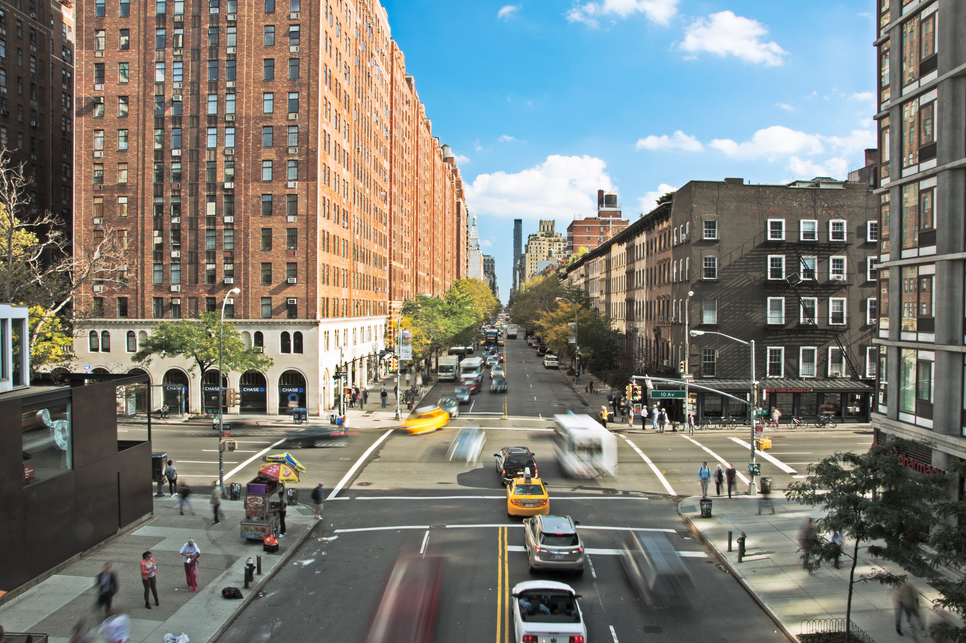
OWN THE LAST MILE
source https://unsplash.com/@zachinglis
Notes:
What I mean by this, is that everyone here is building IoT products should look a lot of like right up until the data is being consumed by your user with the specific contexts of your product being added.
We wasted a lot of time trying to build our own MQTT broker…
As attempting as it is to get into the stack and start reinventing things, don’t. Focus on what you do best, building a great user experience for your product.
Data deliverability and storage should be the last of your worries. This would be like us deciding to build our own AC unit, instead of using the best in class.
DON’T REINVENT TECH
KNOW WHAT SEPARATES YOU
https://unsplash.com/@zachinglis

Slide 30
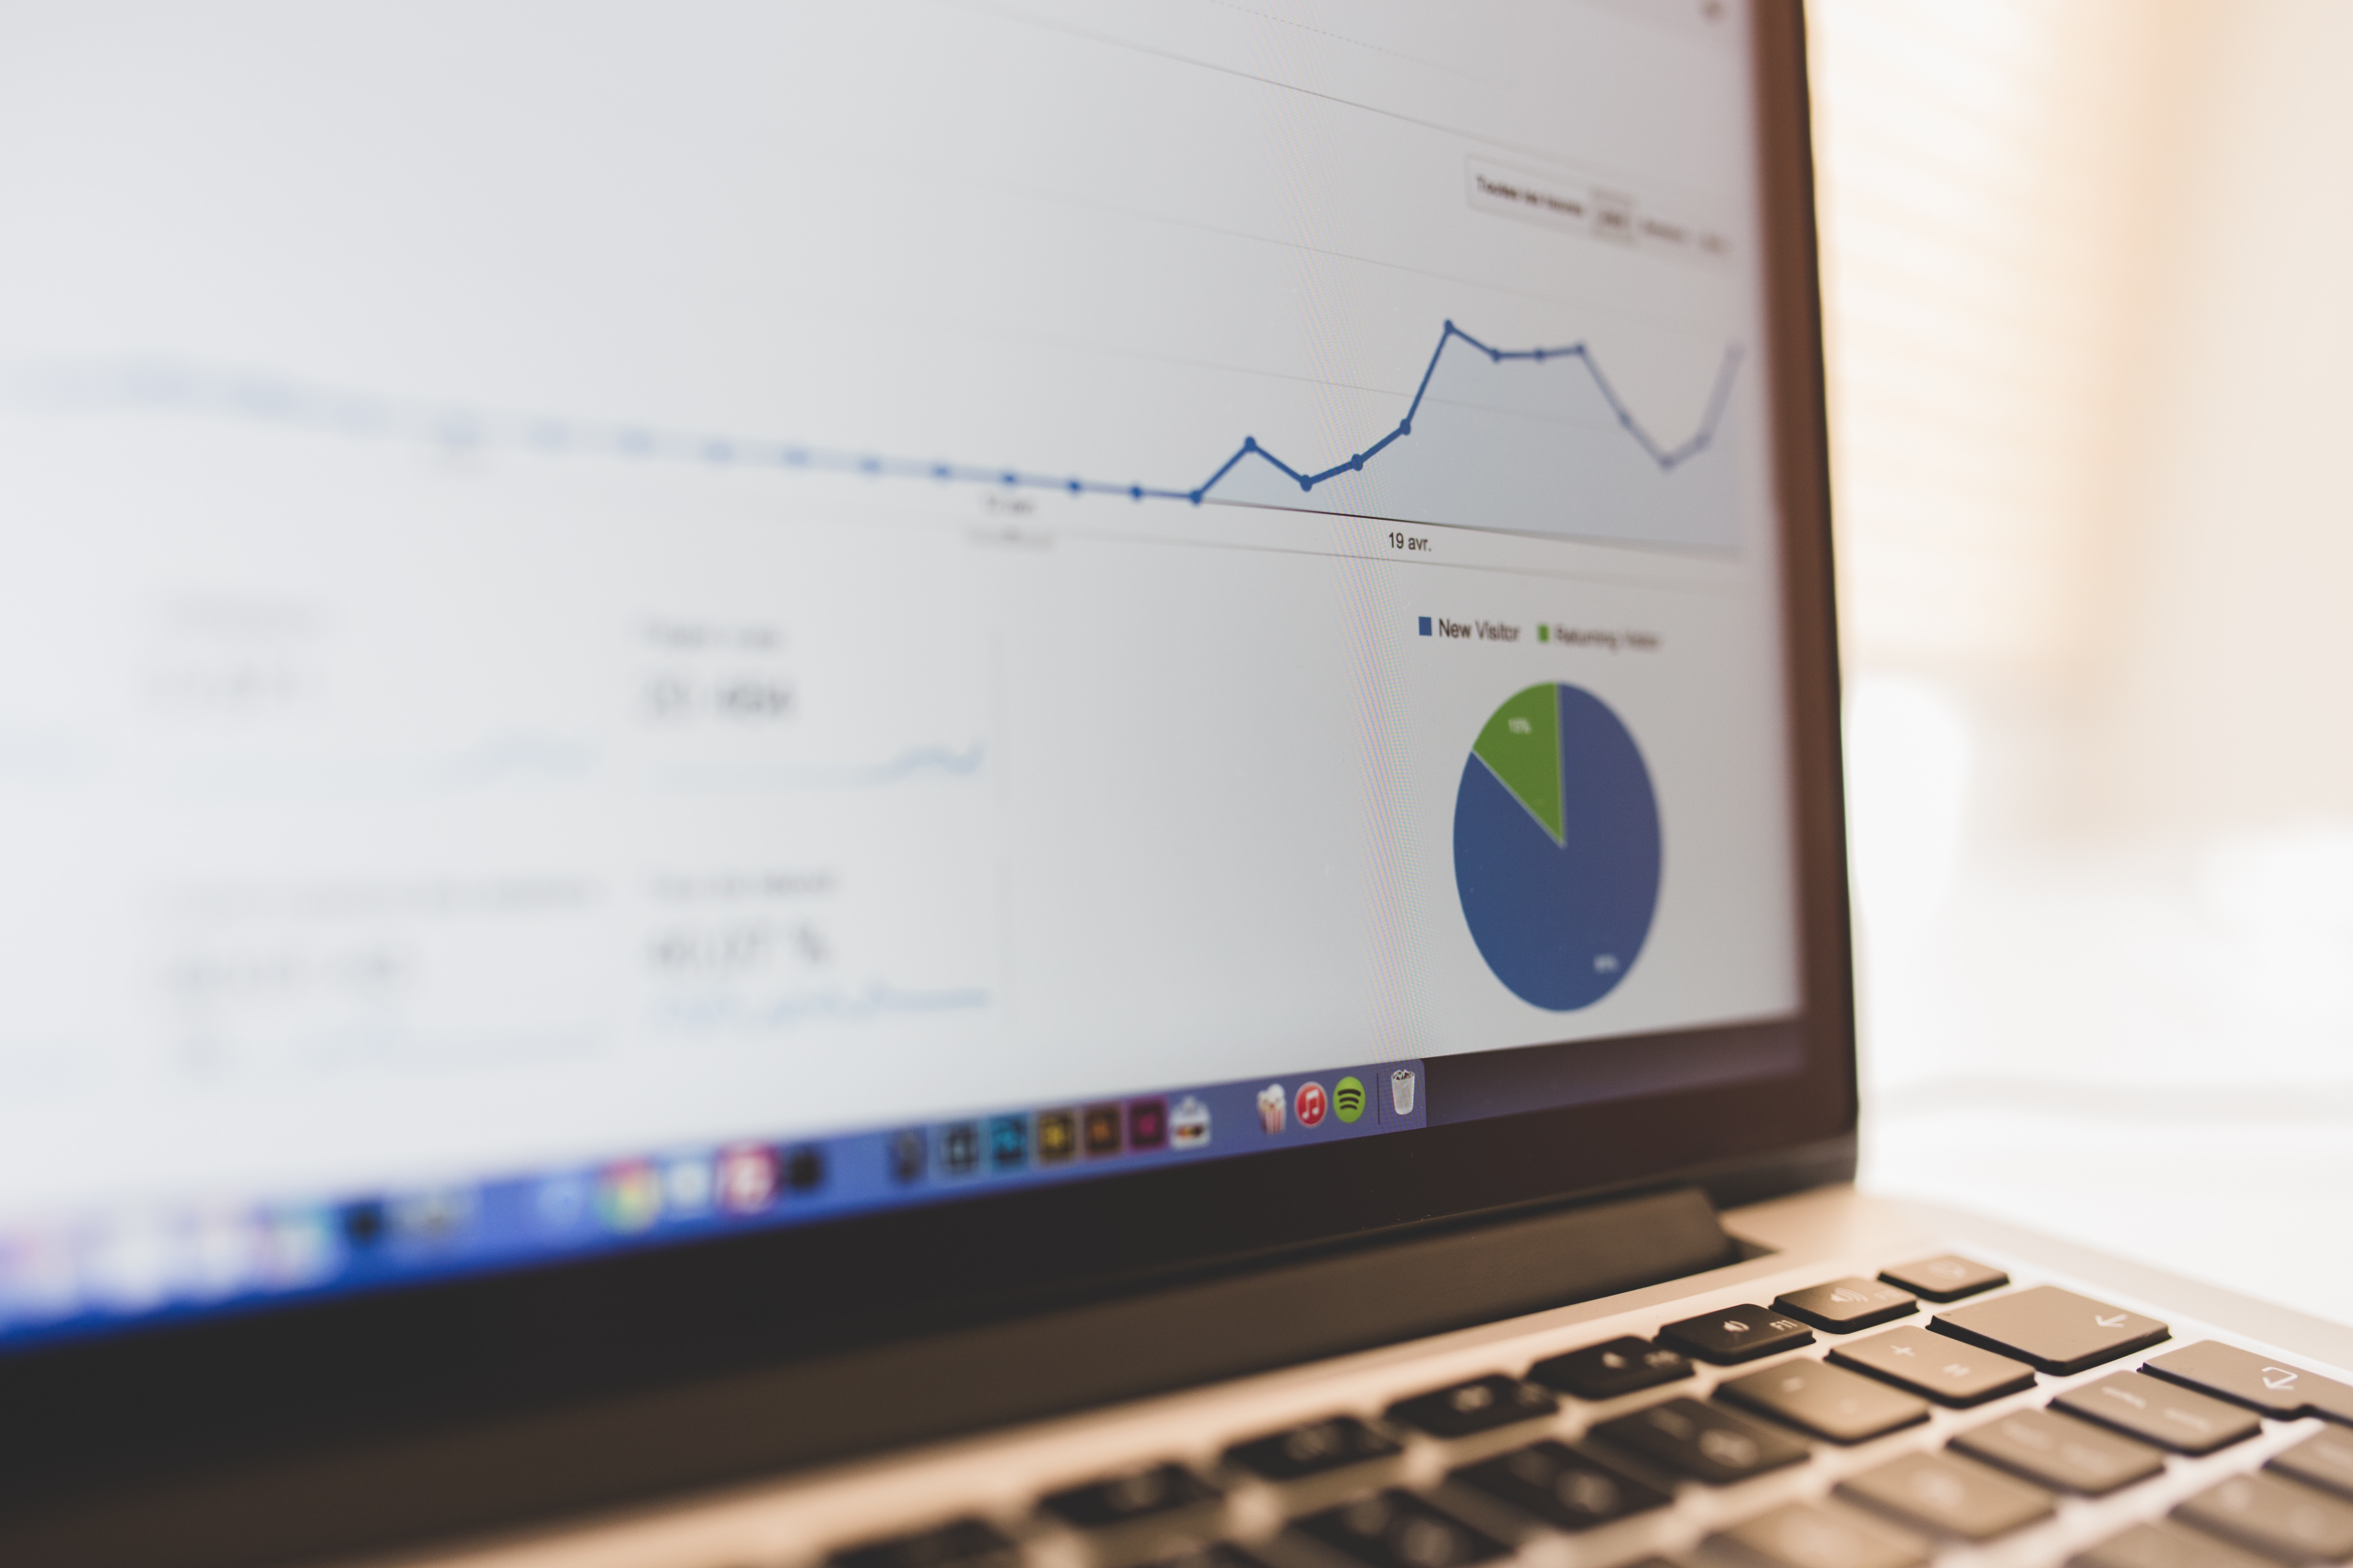
ALL DATA IS MULTIPURPOSE
source https://unsplash.com/@albertosaure
Notes:
This has been the most interesting piece for us.
• something as a simple as a temperature reading
• for the crop you’re currently growing the automation controller cares about the current temp in time
• the overall recipe cares about the trend line
• us as freight farms care about the aggregate
•
The opportunity here is enabling a wide range of applications with a relatively simple and naturally generated data set
• and this can apply across your organization whether it be hardware and software Product development, customer support, and especially the unknowns
• for example our sales team asked for a report on how many farms we had operating in 100 degree F (MAKE THIS CELSIUS)… as we had a new lead who was skeptical on our warm weather performance. we were able to highlight farms across the US that mapped to this new climate
•
• Thoughts
• Store data in a standard way, making it easy to reference a later date when it’s needed
https://unsplash.com/@albertosaure

Slide 31
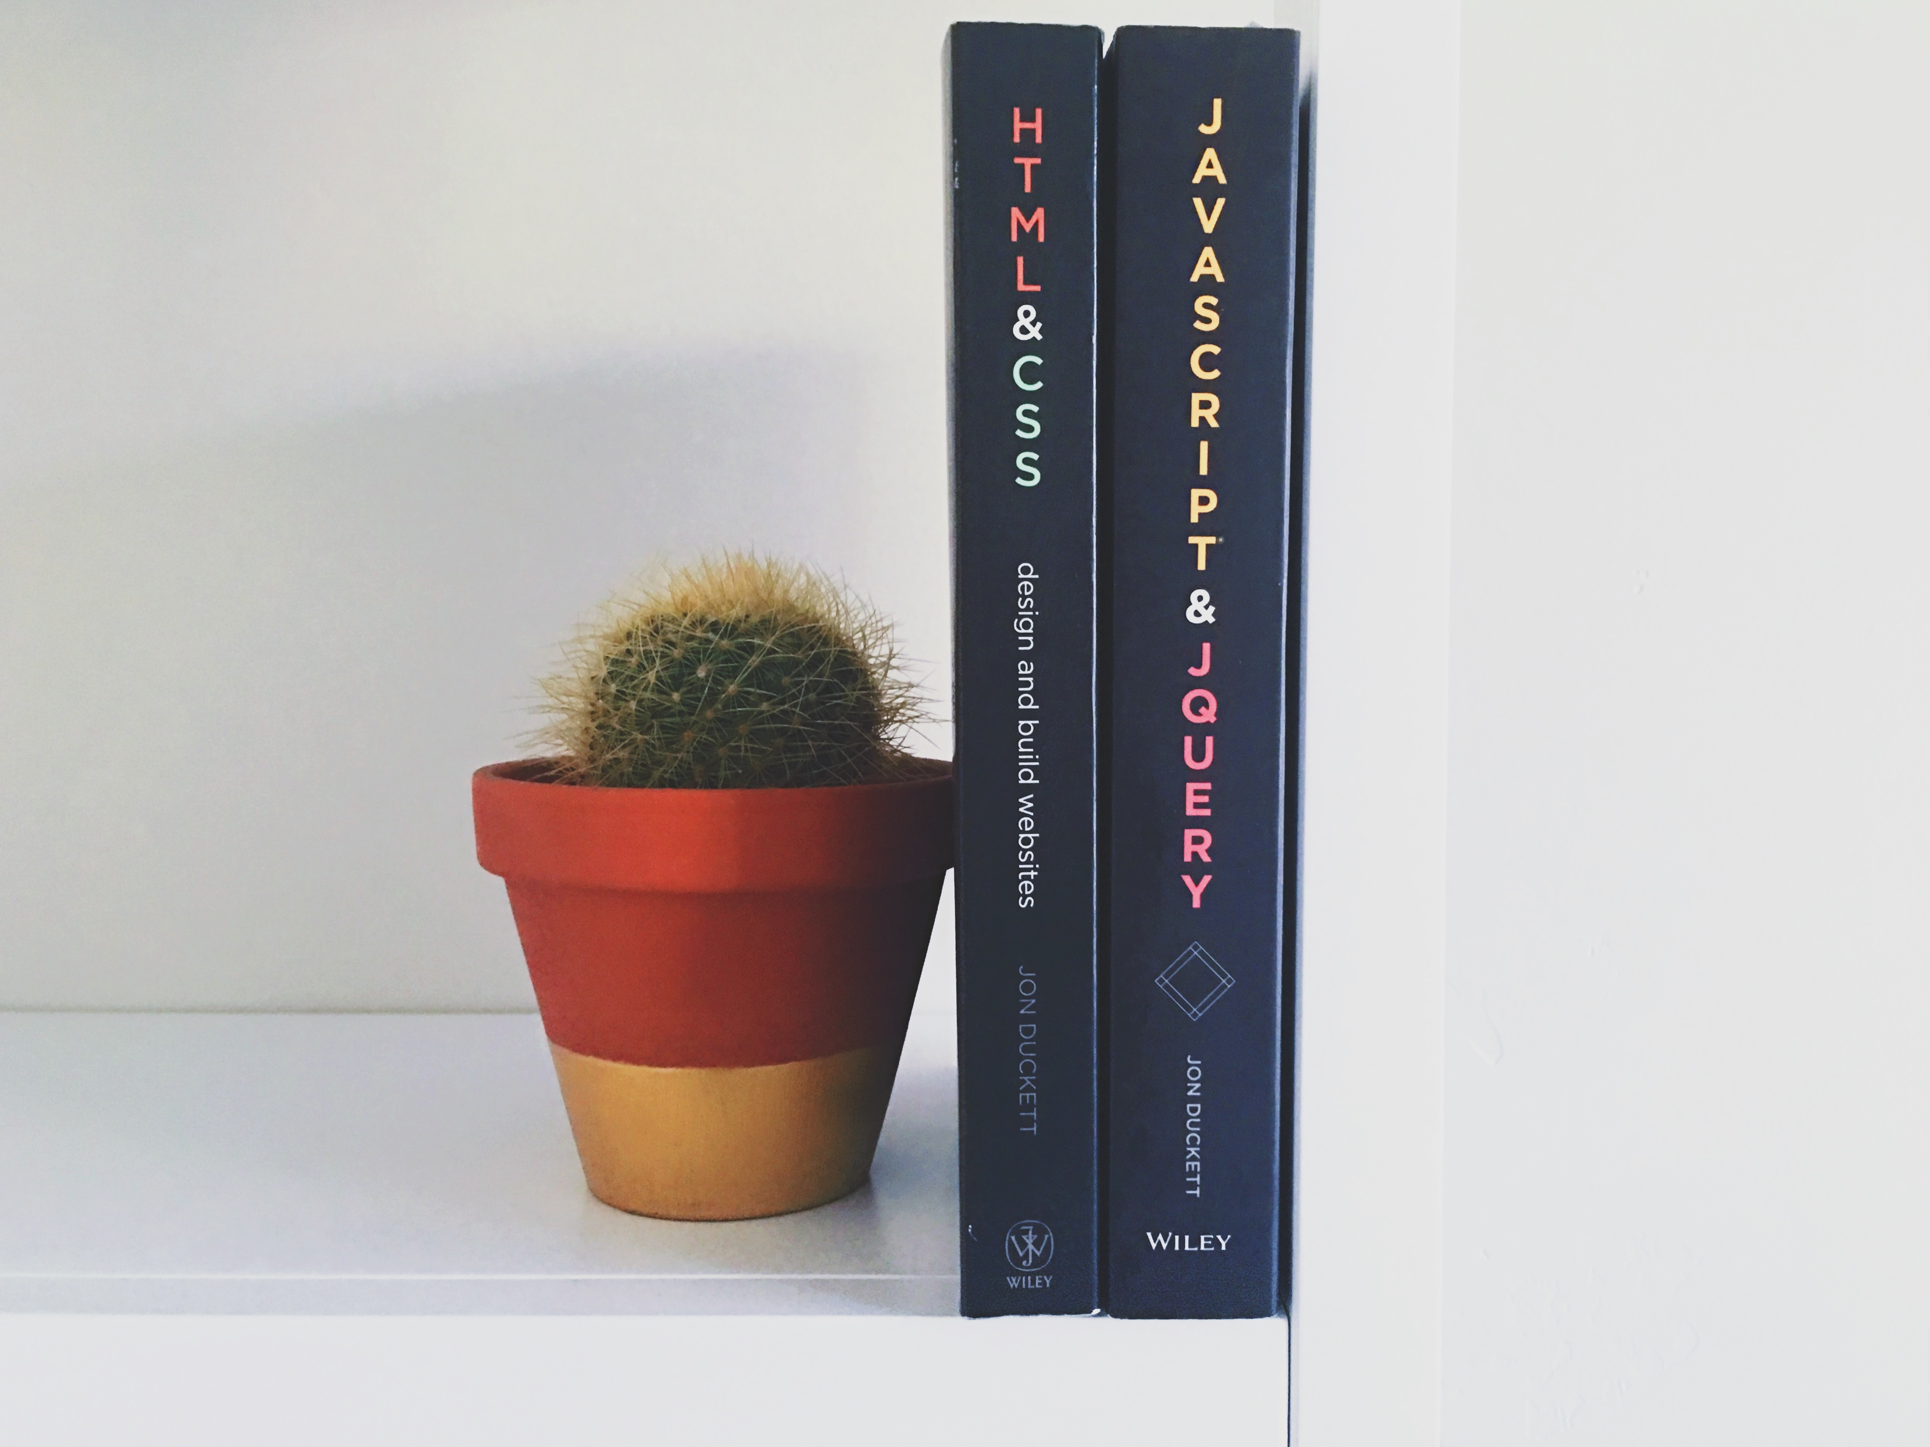
EMBRACE STANDARDS
source https://unsplash.com/@grakozy
Notes:
Where growing seasons are usually really short.
IoT is still young and in-flight. Things are changing fast, the best way to hedge against these changes it to embraces standards. Just like web standards, there are some great IoT standards emerging… this gives you the benefit of evolving your products vs. rebuilding as these standards improve.
Most importantly, it enables portability, and avoids vendor lock in. Especially while things are so young, it’s important to hedge.
https://unsplash.com/@grakozy

Slide 32
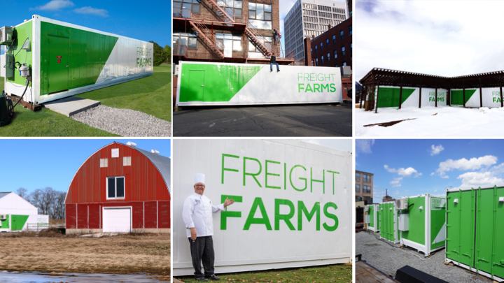
Notes:
By following these best practices, we’ve been enable to create over 60 small businesses this year alone, with a small team in Boston supporting over 100 farms across North America and now Europe.
The COOLEST thing about them is that they used to be teachers, veterans, engineers, etc. and all decided to become farmers….Because we’ve made farming easy and accessible.

Slide 33
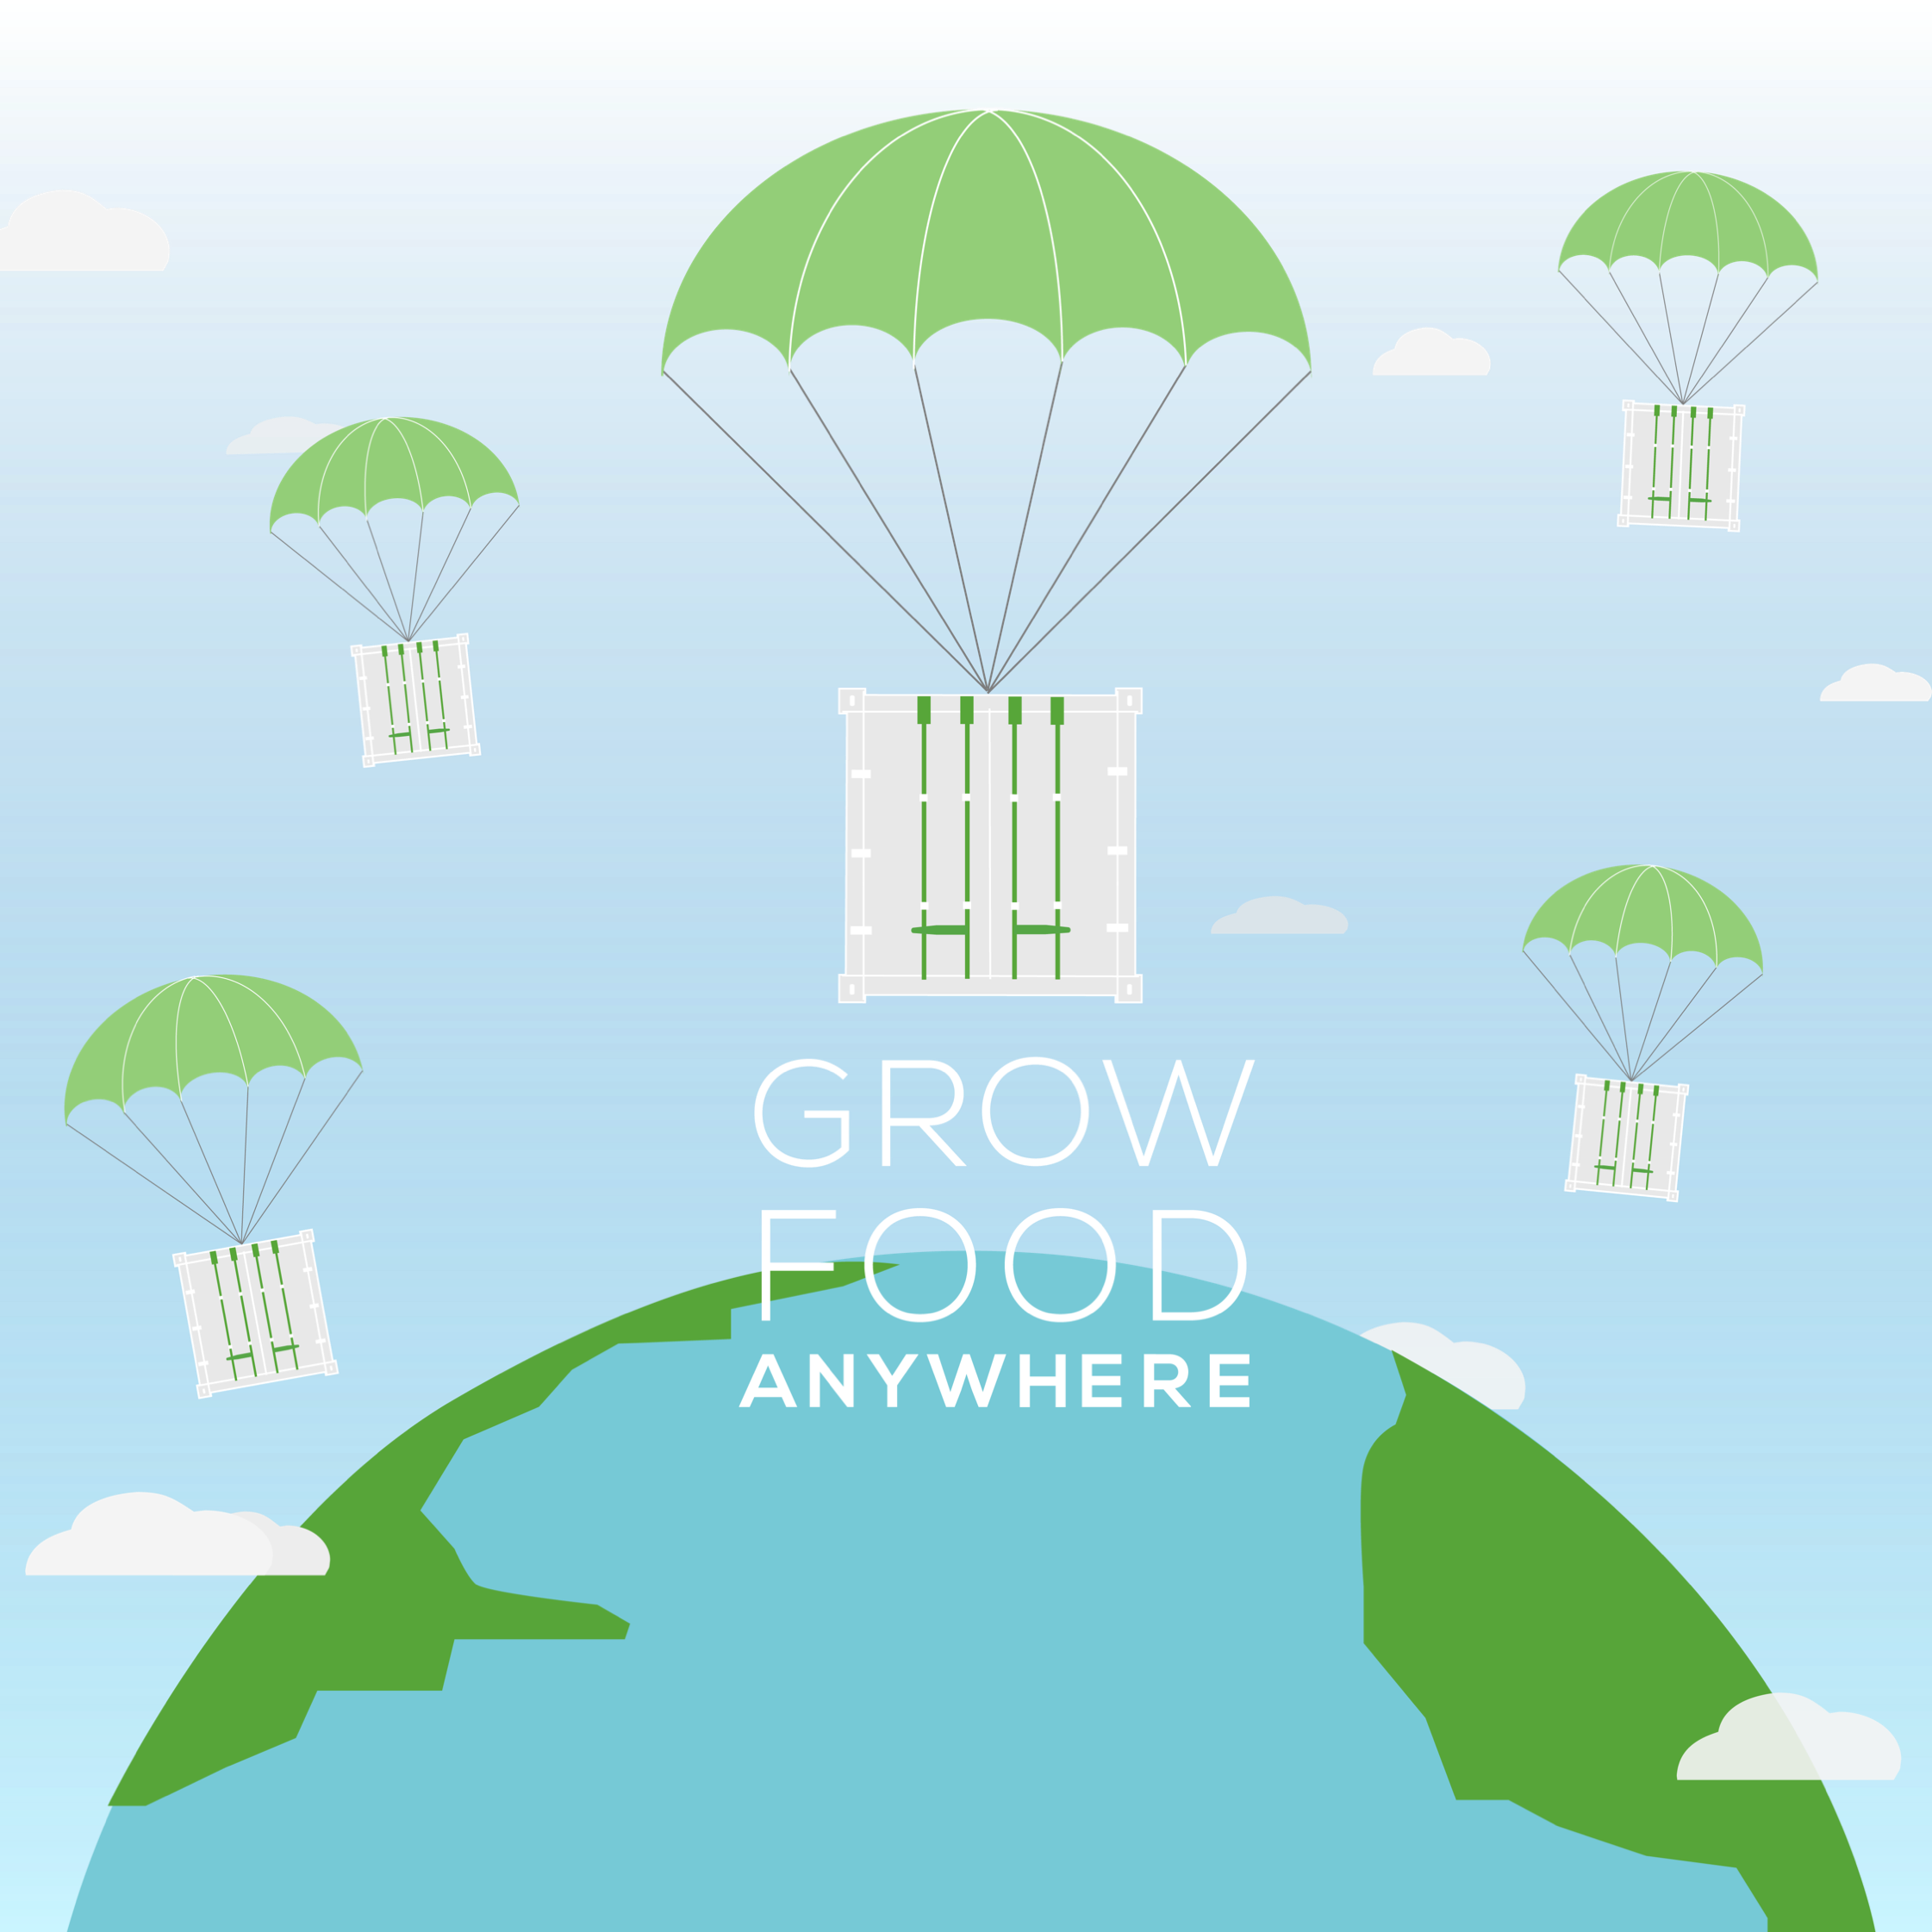
Notes:
Local food a global reality

