Slide 1
eAndon Mobile Application
Notes:
Introduce myself

Slide 2
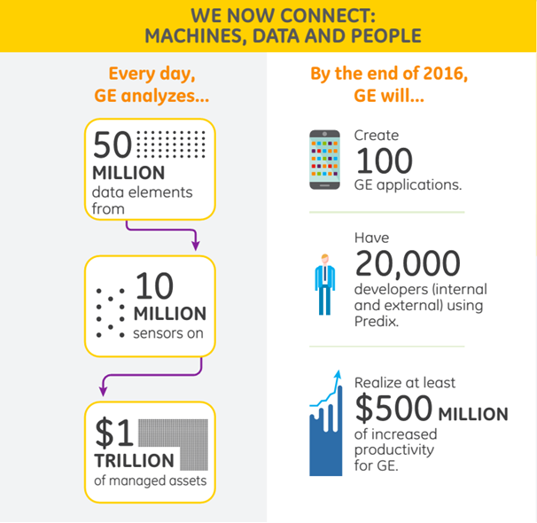
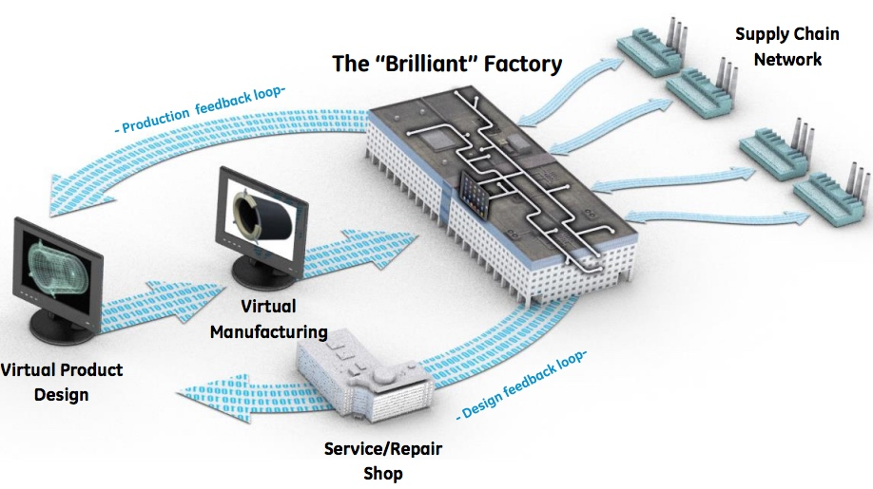
Notes:
1- GE HC around the world. 65 Plants, Medical equipment (Xray, CT, MR, Ultrasound, surgery and diagnosis, Cuffs), Lifesciences
120 years old
2- Like for all GE, transforming from a traditional industrial company toward a Digital Industrial company.
Many data that can be collected and used within GE and sold material
Need to use it to optimize, create value, and keep leadership position
→ become Digital company with many Dev and Sw Dev projects
IoT is about to make things smarter... Our products, CT etc... But not only our products, also our organization engineering, services and factories
3- The data flow is from Engineering to Client site. My team working on the Factory part… Brilliant factory = Lean+Digital ➔ Optimize, better quality
4- get connected, get insight, get Optimized

Slide 3
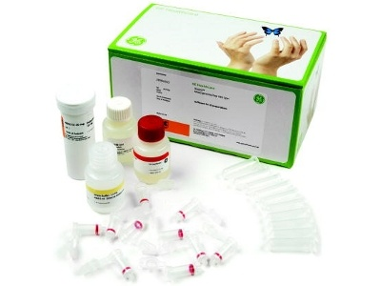
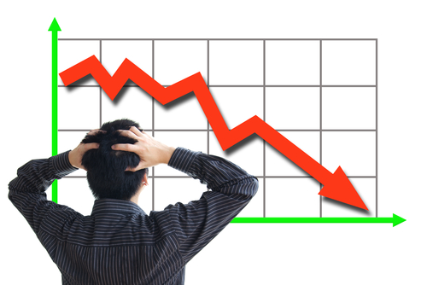
Our Challenge
Minimize the STOP of production lines
Minimize stop time
Notes:
Our Challenge we wanna face with that SW
A line stopped/problem
is loss of production and/or quality
Loss of money
Possible loss of client statisfaction if not delievred on time
Even more with Build to Order methodology
And can have worse consequence: example of Arlington heights, US:
At Arlington Heights, we produce a pharmaceutical product with a 13-hour half-life, requiring reliable and consistent out-time.
Produce to be consumed the next day. No Stock, no place for failure
Already performant but every single method than allow them to decrease unproductivity time is crucial
Our Challenge is then to make sure that those Problem are detected and addressed as fast as possible. No loss of any time for resolution.

Slide 4
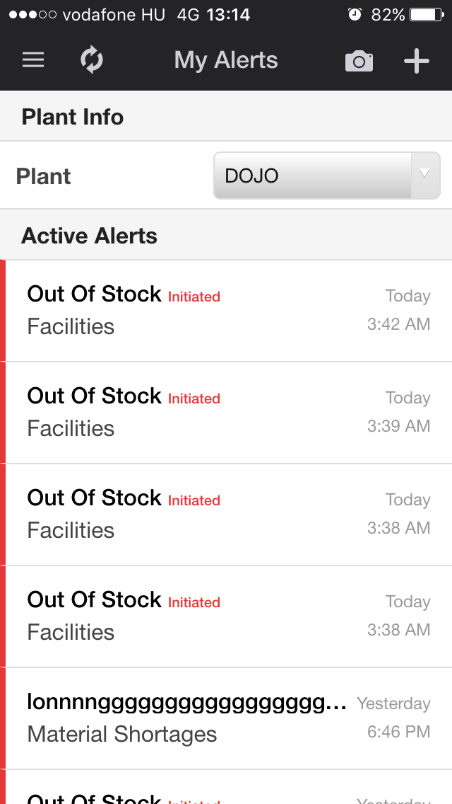
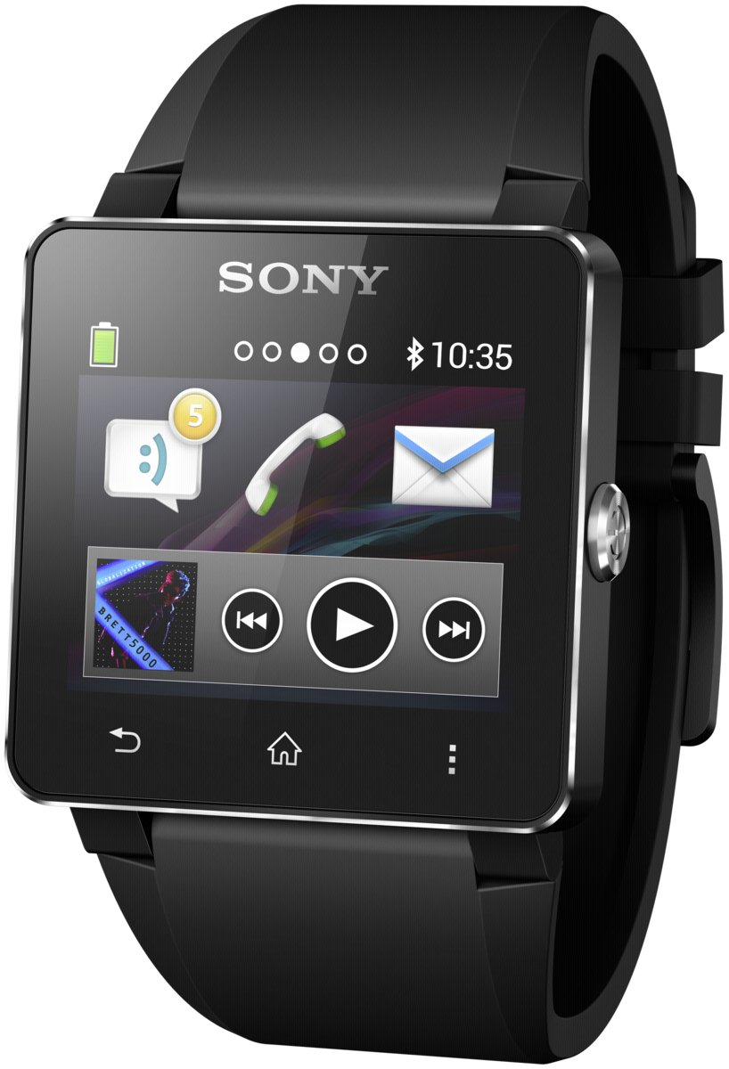
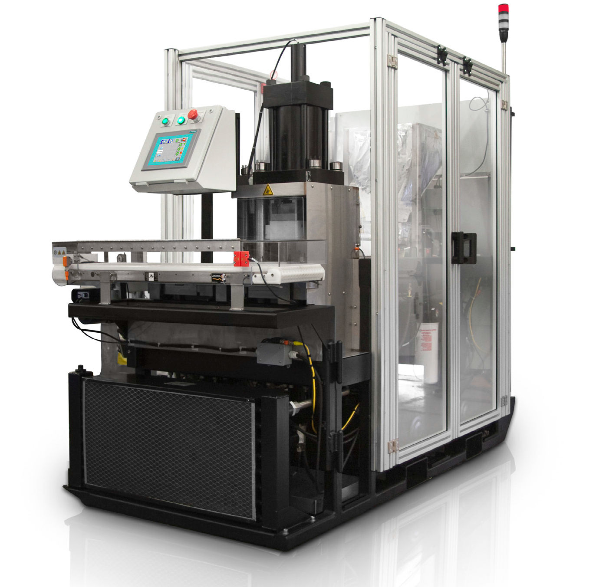
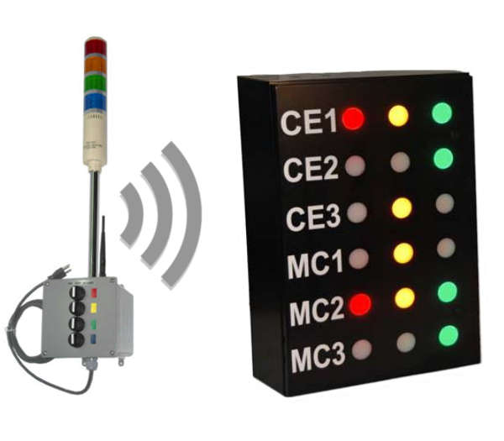
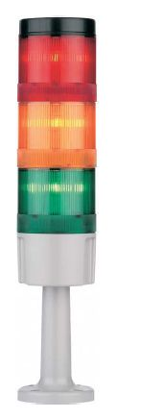
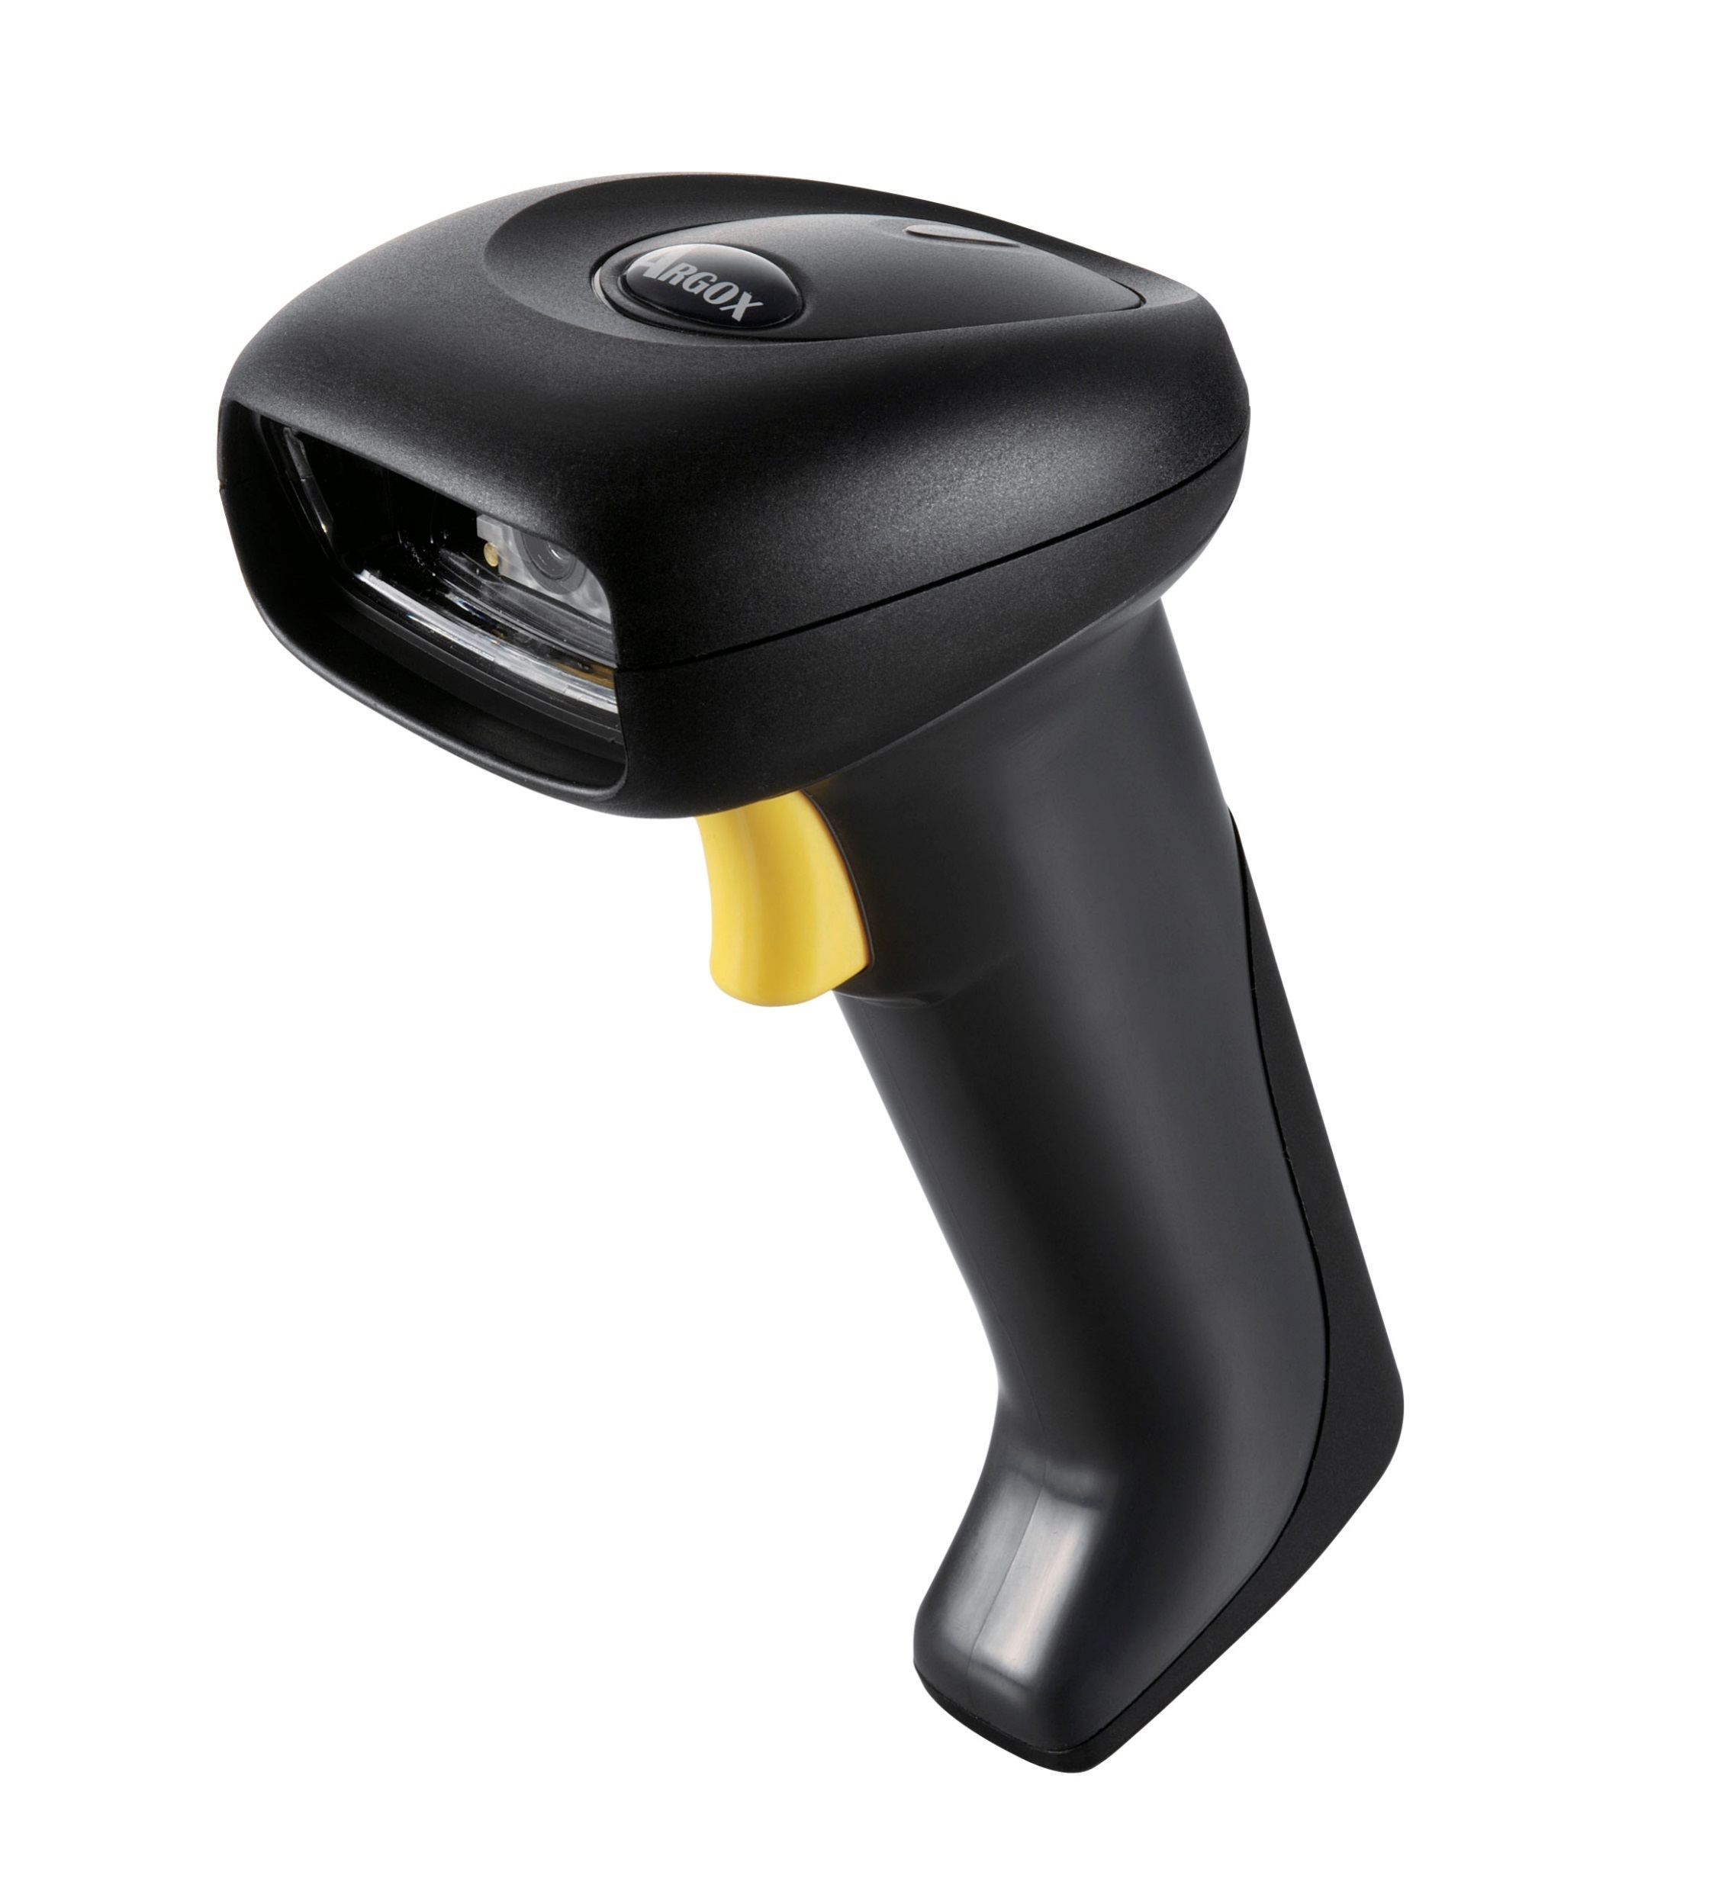
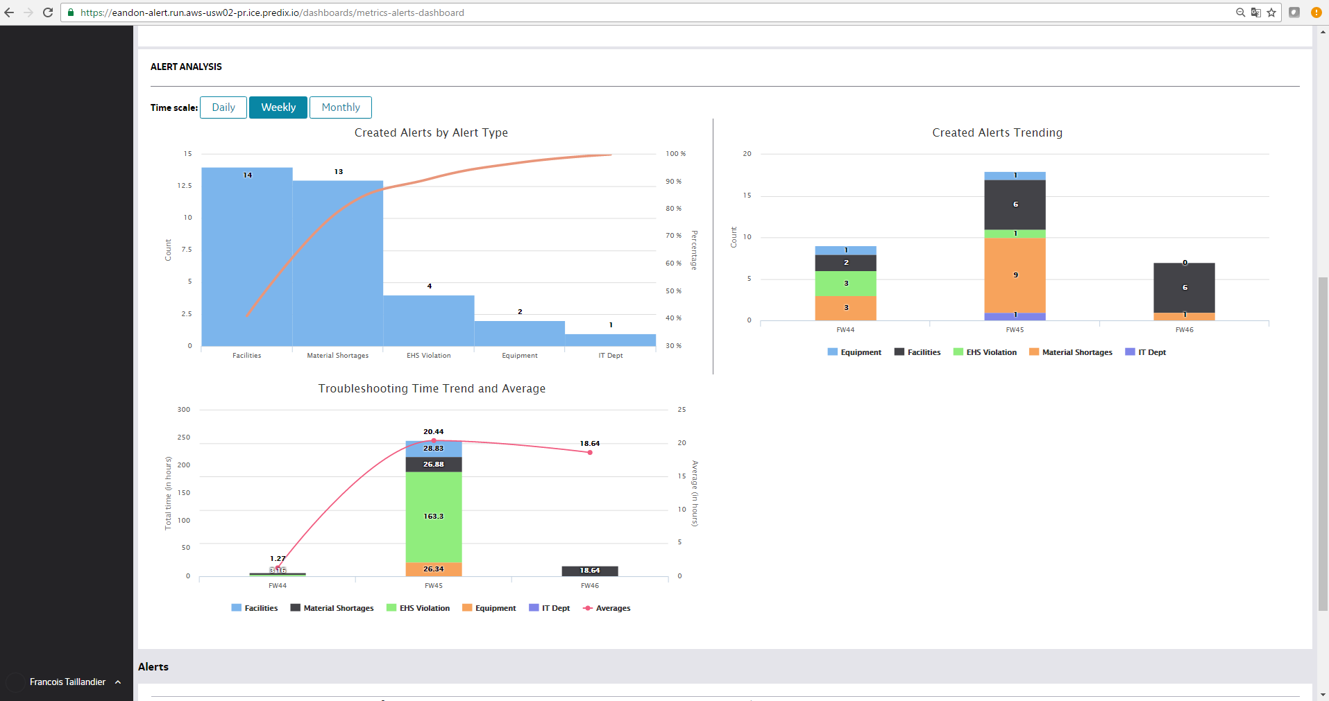
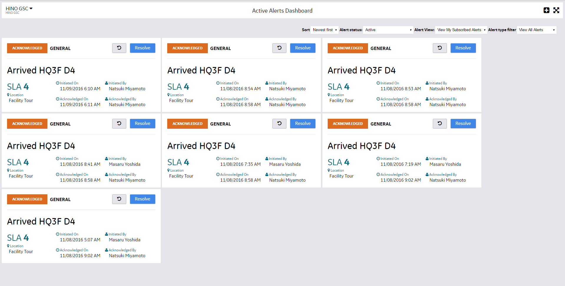
Andon to eAndon
From Physical to Digital
eAndon on
Notes:
1- Andon is a physical system base don lights, activated manually
→ Not optimal to notify people, not visible from everywhere, specific teams might not be on the locations, leadership wanna know as well
2- it can be linked to Dashboard, Sound system, and sometimes machine
But still not the best
Some plants do not have any system… and if they want to implement they would prefer something more Digital… they all have mobile on them, they wanna take advantage of it
3- eAndon
On Predix, GE industrial platform, we connect all our products to the cloud, from all GE
All app logic and data on Predix
Mobile dev on Cordoba+Ionic
Input manual (mobile, desktop, barcode), or from machines through an API
Input by barcode is really important in a factory, cause it is faster, and less error
Alert management mobile, desktop… and by machine
Dashboard on mobile and screen
Notifications by email, sms and push notif

Slide 5
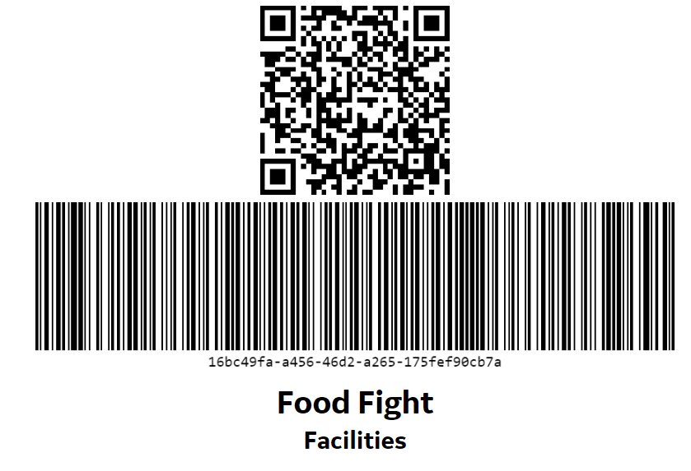
eAndon
Demo of the Mobile App
Notes:
Demo.
Show the Mobile App, and the scanning possibility
Create an Alert from QR code
Acknowledge it, comment and Resolve
Check email

Slide 6
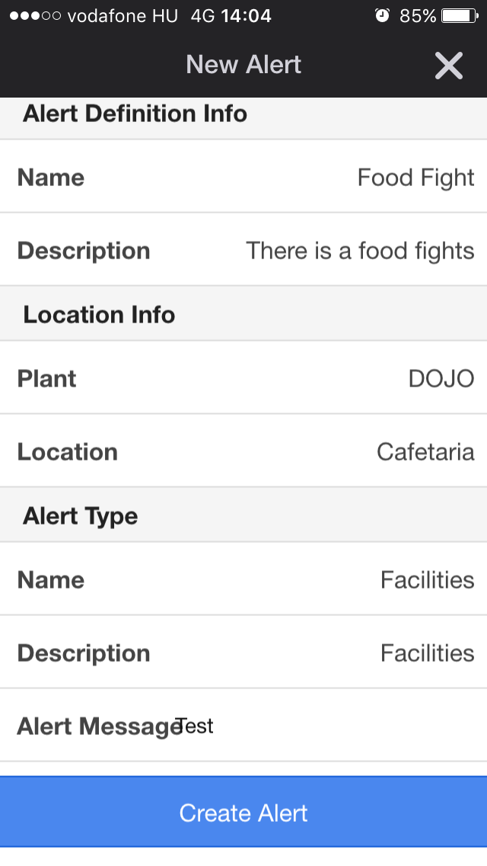
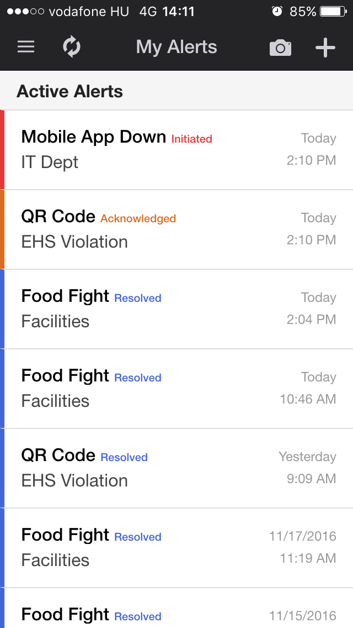
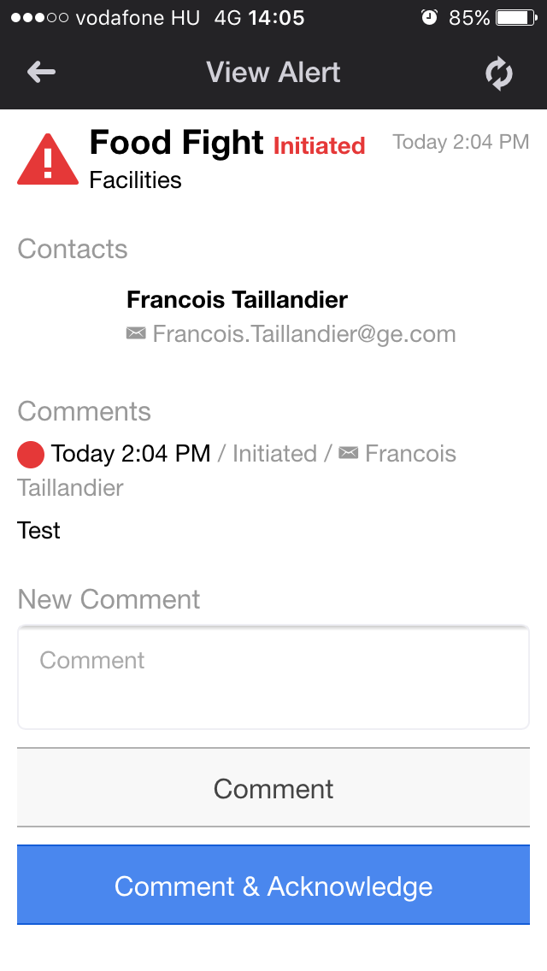
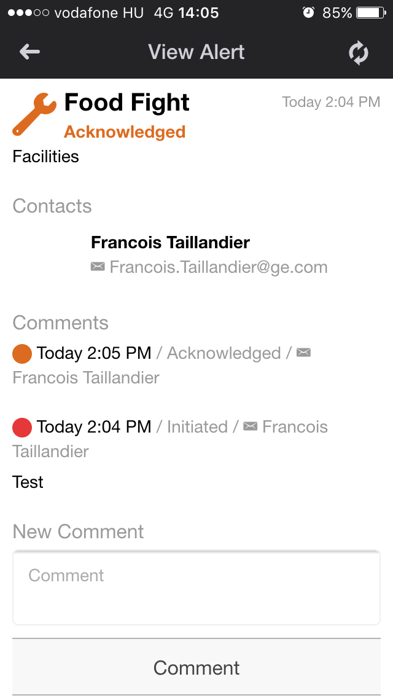
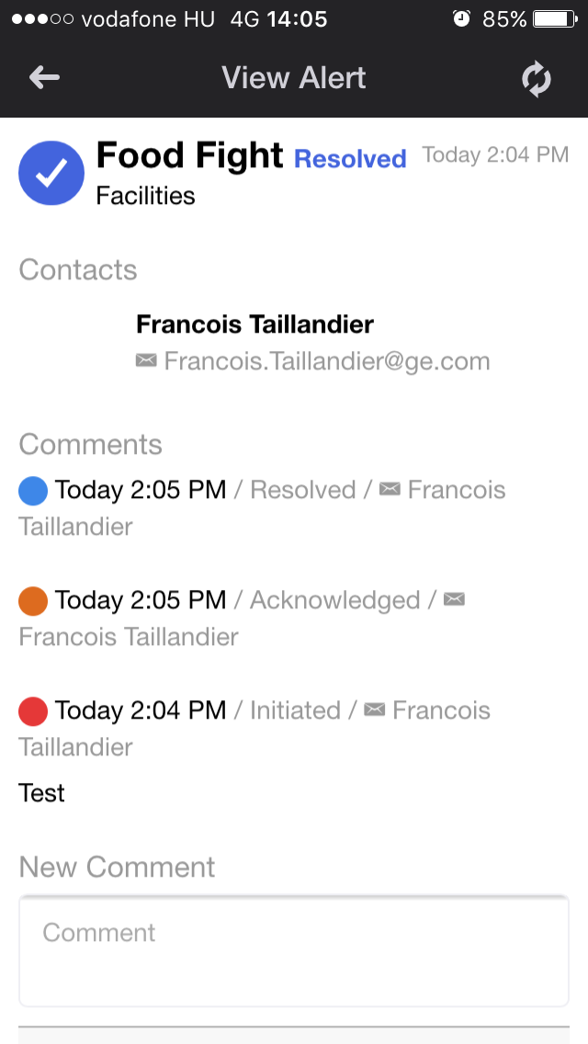
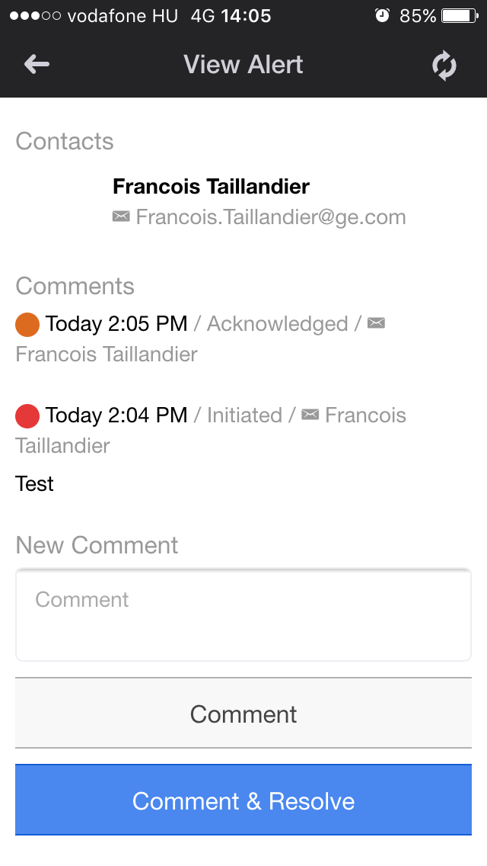
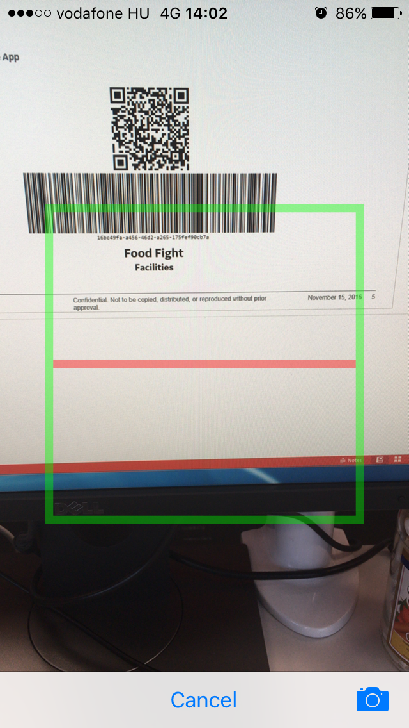

Slide 7
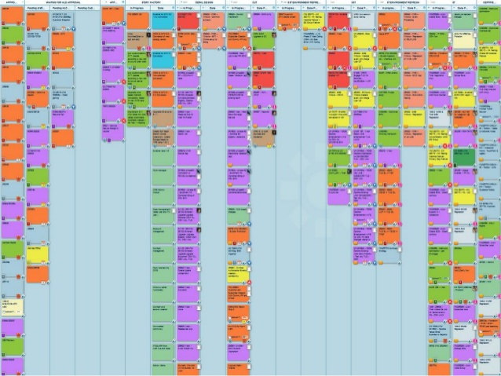
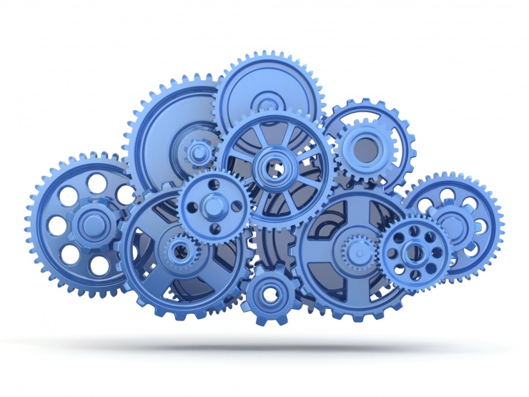
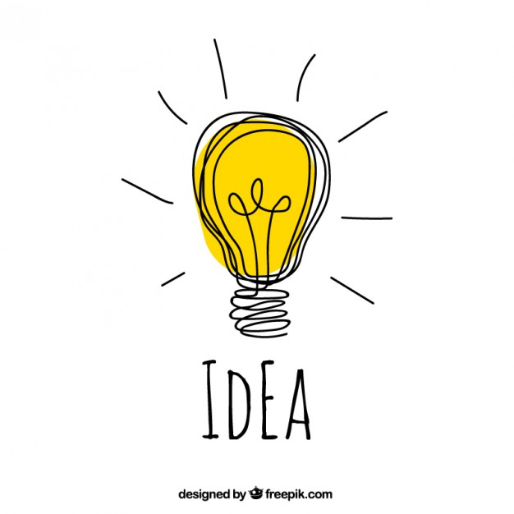
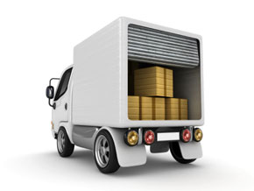
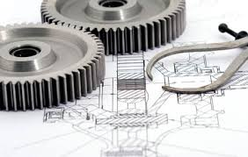
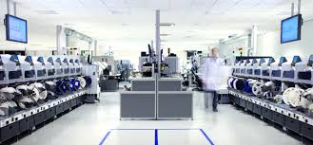
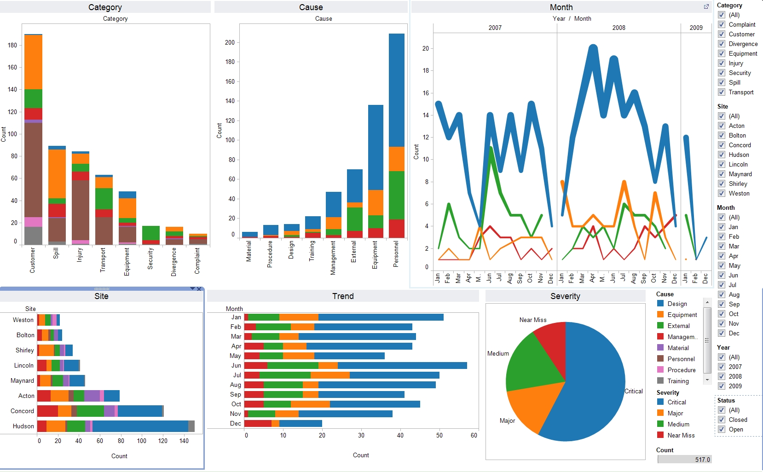
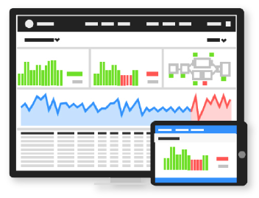
What’s next
Engineering
Services
Designed for rapid consumption within Supply Chain
MBd/MBe
Advanced field support through analytics and Brilliant Factory
Services 2.0
Notes:
1- More applications and integration with Machine datas (directly or through existing tool like Oracle, Rockwell, InforEAM)
2- Not only Brilliant Factory: Service and Engineering also big request in GE... Especially Service for Mobile app
3- Not just GEHC… All GE… and in Budapest a big increase of GE Digital (0 early 2016, eoy 20, 2017 50)

