Slide 1
What is the “phase 2”?
a.k.a.
How do you sell IoT products effectively?

Slide 2
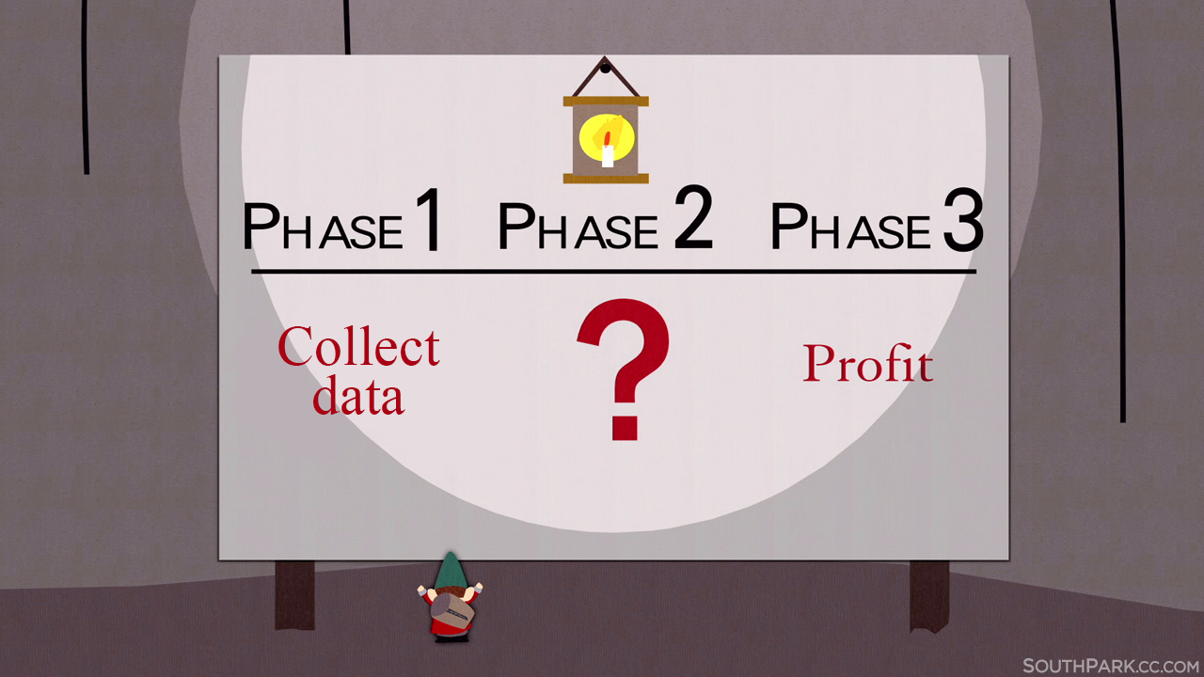

Slide 3
What is the “phase 2”? a.k.a.
How do you sell IoT products effectively?
Who is Energomonitor?
We are an IoT startup.
Customer feedback is not our best friend.
Punks don't sell, be professional.
Can you serve the global market by yourself?
Be a sales network builder.

Slide 4
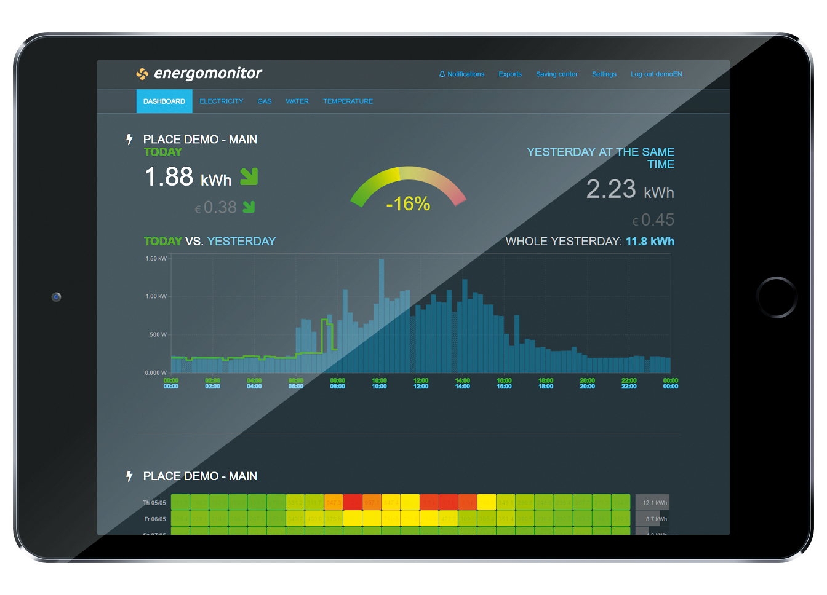
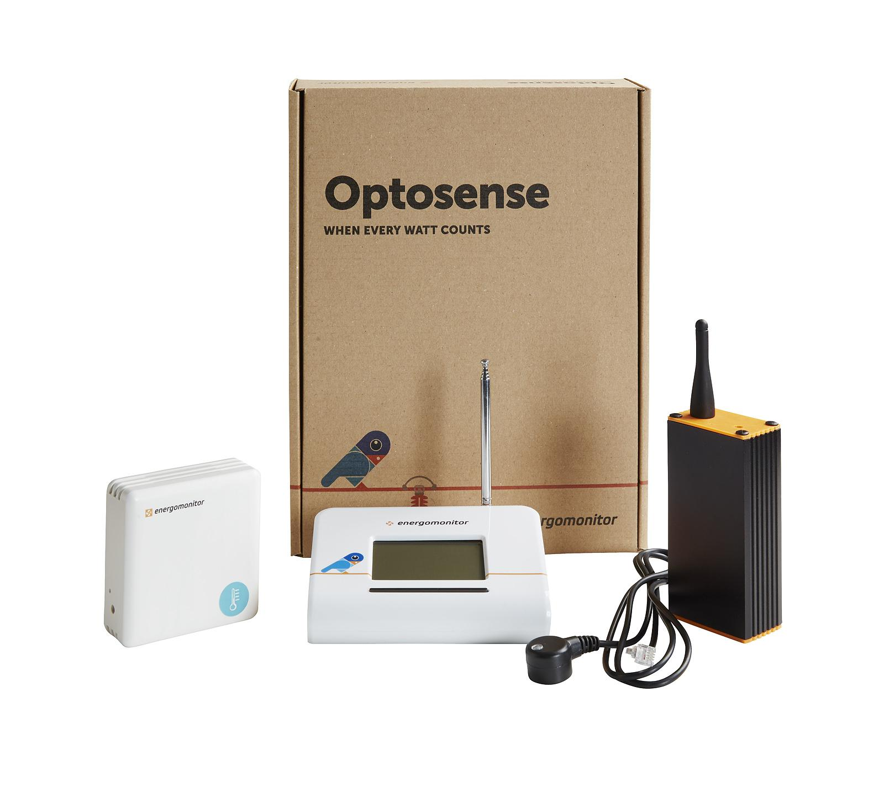
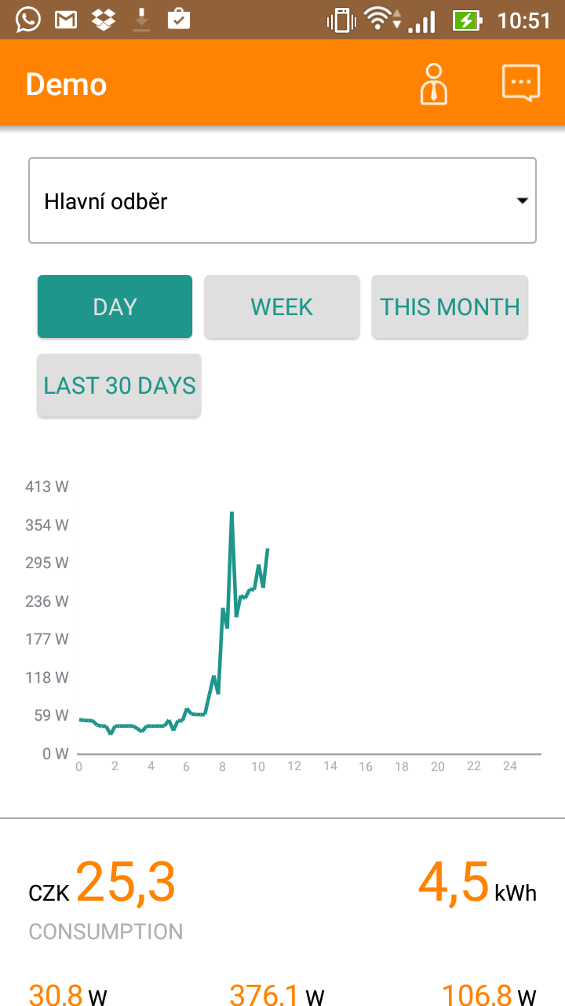
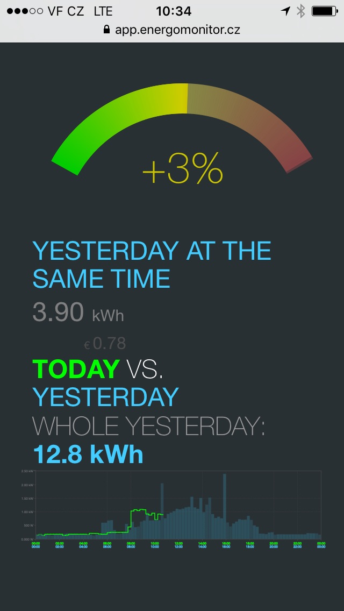
Insight into
your house

Slide 5
We are an IoT startup -
what do they keep telling us to do?
Do everything the punk way. No legal, no processes, no structure.
Follow the lean development. Test massively on real people.
Develop SW only and HW from a 3rd party.
Startup coaching and special trainings for startups by “professional managers”

Slide 6
Customer feedback is not our best friend
Product consists of SW and HW, there's no easy and cheap way to spread it, our product is literally physical.
Feedback from a very narrow group of special customers
Low sales = low feedback to support further development
Customers are employees, their friends, engineering and IoT enthusiasts
Lack of strategic development
No obvious value for the customers
How to get to the massive number of customers?

Slide 8
Punks don't sell, be professional
Outside your start-up bubble nobody cares about start-ups.
The whole world is not waiting for your cool IoT product.
The advice from outside the customer base is useless.
Get an international feedback, compete & cooperate with the best.
Combine the innovation with a standard approach!

Slide 9
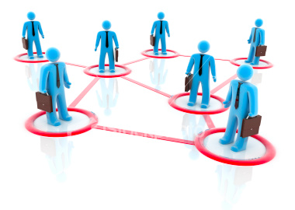
Can you serve the global market by yourself?
First step is getting out of borders.
Different conditions at european markets.
Continuous presence needed for good cooperation.
Logistics and customer & tech support world-wide.
The marketing does not reach far from the Czech borders.

Slide 10
Be a sales network builder
It is necessary to build an intermediary point at each market.
Connected points with your company in the center.
Instead of multichannel communication one narrow channel.
A functioning network is the answer to the stable and consistent approach to CX.
Think outside the borders and act on it!
Consistent and reliable approach to customers!

Slide 11
Thank you! Questions?
energomonitor s.r.o. jakub.marek@energomonitor.com

