Slide 1
IoT security is a nightmare. But what is the real risk?
HWSW 2016
Notes:
Uring my presentation, I will scare you how vulnerable your home is

Slide 2
root@kali:~# whoami
Zoltán Balázs

Slide 3
root@kali:~# whoami

Slide 4
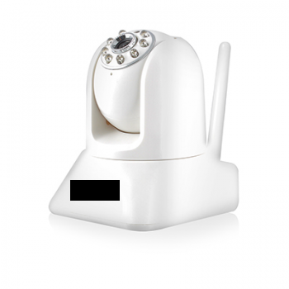
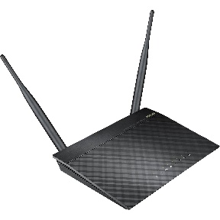
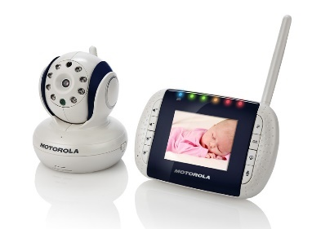
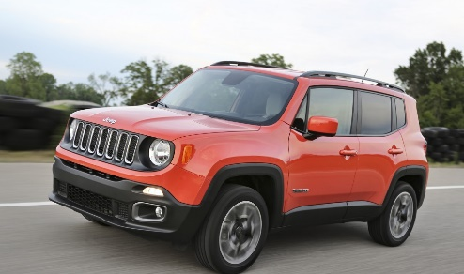
Examples of terrible home IoT devices
IP Camera
Router
Baby monitor
Smart home
NAS
Smart cars

Slide 5
Mandatory Shodan slide
https://images.shodan.io/?query=camera

Slide 6
Assumptions
For the next ~5-10 years, assume
Your IoT device has horrible security holes
It won’t receive any patches, ever
The question is
Now what????

Slide 7
IoT Security Excuses
a.k.a #YOLOSEC

Slide 8
I am safe, I changed all IoT passwords
https://www.youtube.com/watch?v=4YDgBSq1kB0
12345 ?
That's amazing,
I have the same
combination on
my luggage!

Slide 9
I am safe, I changed all IoT passwords
Vulnerabilities bypassing password protection
Memory corruption issues (BoF, Format string, …)
CSRF (later)
Backdoor accounts
Lack of brute-force protection
…

Slide 10
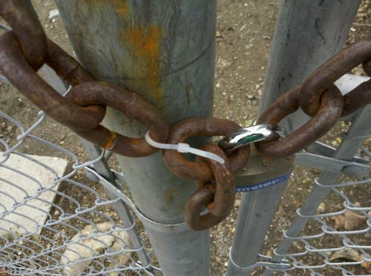
I am safe, I regularly patch all of my IoT devices

Slide 11
I am safe, I regularly patch all of my IoT devices
Patches are late by years
Most IoT devices do not get a patch, EVER

Slide 12
Problems with direct IPv4 connection
If your IoT device has an Internet routable IPv4 address, without any firewall port filtering
Just prepare for apocalypse
Seriously, don’t do that
CCTV is OCTV today

Slide 13
Problems with direct IPv4 connection
“These devices will show up on #Shodan like a hooker on a highway“
https://twitter.com/DEYCrypt/status/700426858719006721

Slide 14
Mirai Telnet passwords
root xc3511
root vizxv
root admin
admin admin
root 888888
root xmhdipc
root default
root juantech
root 123456
root 54321
support support
root (none)
admin password
root root
root 12345
user user
admin (none)
root pass
admin admin1234
root 1111
admin smcadmin
admin 1111
root 666666
root password
root 1234
root klv123
Administrator admin
service service
supervisor supervisor
guest guest
guest 12345
guest 12345
admin1 password
administrator 1234
666666 666666
888888 888888
ubnt ubnt
root klv1234
root Zte521
root hi3518
root jvbzd
root anko
root zlxx.
root 7ujMko0vizxv
root 7ujMko0admin
root system
root ikwb
root dreambox
root user
root realtek
root 00000000
admin 1111111
admin 1234
admin 12345
admin 54321
admin 123456
admin 7ujMko0admin
admin 1234
admin pass
admin meinsm
tech tech
mother fucker

Slide 15
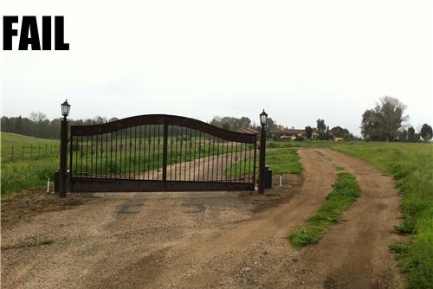
The IoT device is only available in a closed network

Slide 16
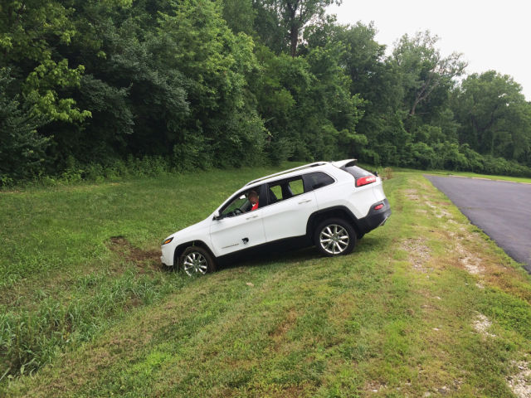
The IoT device is only available in a closed network
(•_•)
<) )╯What
/ \
\(•_•)
( (> The
/ \
(•_•)
<) )> fuck were you thinking???
/ \

Slide 17
The device is only exposed in my area Physically nearby to open WiFi

Slide 18
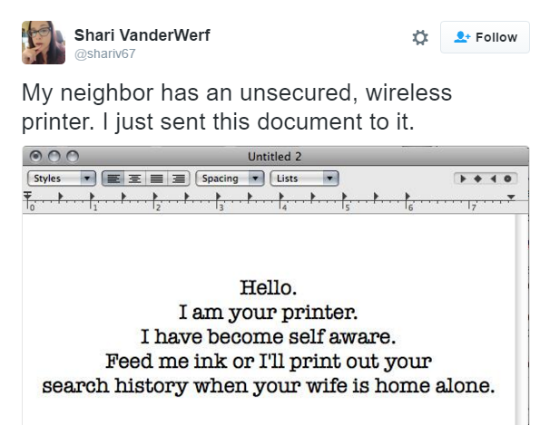
The device is only exposed in my area Physically nearby to open WiFi

Slide 19
I am safe, home network, behind NAT

Slide 20
I am safe, home network, behind NAT
Think again
UPNP
IPv6
Teredo
Cloud

Slide 21
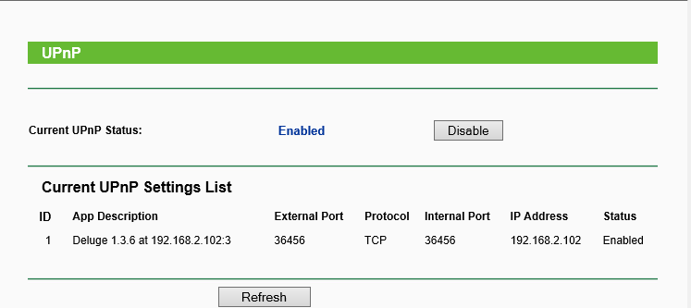
UPnP

Slide 22
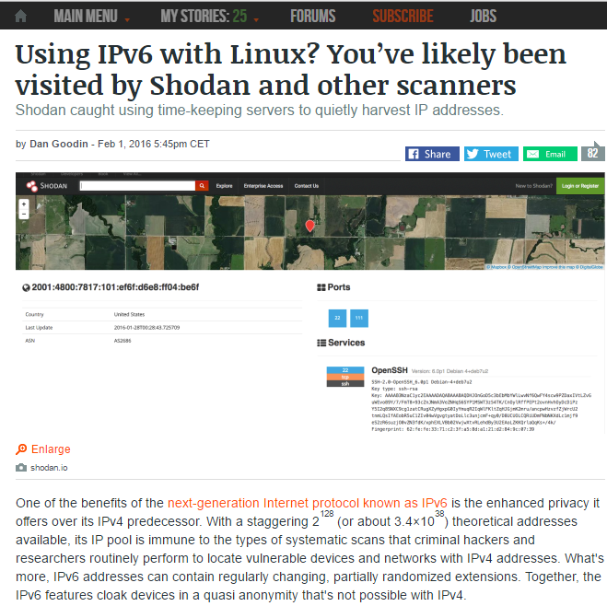
IPv6

Slide 23
Teredo in practice
According to a study by Arbor Networks, the 2008 adoption of IPv6 by µTorrent caused a 15-fold increase in IPv6 traffic across the Internet over a ten-month period.

Slide 24
IP camera cloud hack

Slide 25
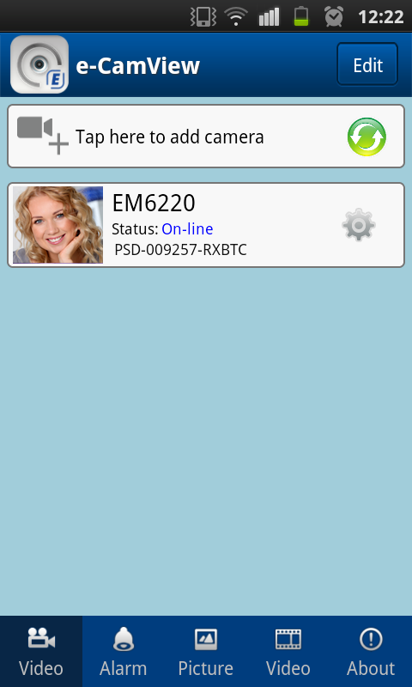
IP camera cloud hack
This research is work in progress
Lot of stuff to fine-tune, research
The camera has an Android/iOS app
The app can connect to the IP
camera even when it is behind NAT,
no port forward
But how???

Slide 27
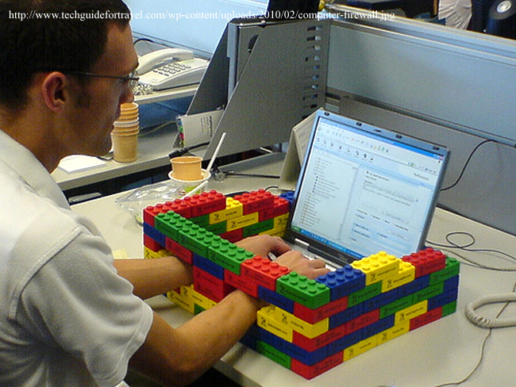
I am safe, none of these apply, my home network is Sup3rFirewalled
We will build a great wall along the network perimeter and the customer will pay for the wall!

Slide 28
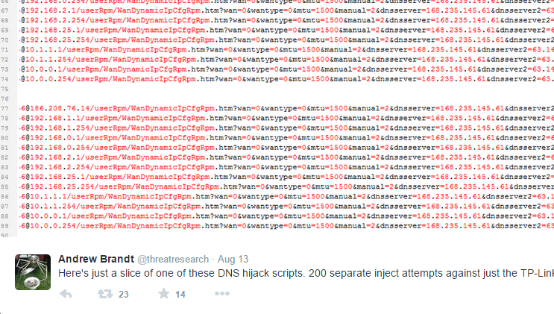
I am safe, none of these apply, my home network is Sup3rFirewalled

Slide 29
I am safe, I changed the network range from default (192.168.0.0/24)

Slide 30
I am safe, I changed the network range from default (192.168.0.0/24)
WebRTC (Web Real-Time Communication) is an API definition … that supports browser-to-browser applications for voice calling, video calling, and P2P file sharing …
WebRTC + STUN
Natively supported in
Chrome (2012)
Firefox (2013)
Opera 18 (2013)
Edge 21 (2015)
Blackberry
Not in Safari, mobile Chrome, IE

Slide 31
References, interesting links
Best IoT Talk ever! 115 batshit stupid things you can put on the internet in as fast as I can go by Dan Tentler
https://www.youtube.com/watch?v=hMtu7vV_HmY
https://github.com/mandatoryprogrammer/sonar.js/tree/master
https://jumpespjump.blogspot.com/2015/08/how-to-secure-your-home-against.html
https://jumpespjump.blogspot.com/2015/09/how-i-hacked-my-ip-camera-and-found.html
http://www.theverge.com/circuitbreaker/2016/7/12/12159766/internet-of-things-iot-internet-of-shit-twitter

Slide 32
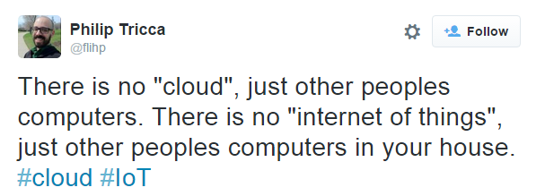

Slide 33
Hack the planet! One computer at a time …
zoltan.balazs@mrg-effitas.com
https://hu.linkedin.com/in/zbalazs
Twitter – @zh4ck
www.slideshare.net/bz98
Greetz to @CrySySLab, @SpamAndHex
Thx to Attila Bartfai for the conversation starter
JumpESPJump.blogspot.com

