Slide 1
A different approach to mobile development
@TomislavTenodi
#HWSW
Notes:
Hi, I’m here today to talk to you about a different approach to mobile development.

Slide 2
Tomislav Tenodi PRODUCT MANAGER @ Shoutem
Builder for mobile apps
Notes:
I’m Tomislav Tenodi and I work as a product manager in Shoutem. Shoutem is a builder for mobile apps that people without technical skills can use to create beautiful mobile apps. We’ve been on market for about 6 years and have published over 5000 apps to both App and Google Play Store.

Slide 3
#1
HISTORY OF MOBILE APPS
Notes:
Basically, we’re in love with mobile apps.

Slide 4
#1
HISTORY OF MOBILE APPS
2007
2008
2009
iPhone released
Android
released
Notes:
Ever since 2007 and 2008 when iOS and Android were initially released, mobile apps completely changed the world.

Slide 5
#1
HISTORY OF MOBILE APPS
2007
2008
2009
iPhone released
iPhone SDK
Android
released
Android SDK
App Store
Android market
Notes:
Soon after releasing operating systems, SDKs and stores were released which opened up space for third party developers to write and distribute their mobile apps. This changed the way we communicate, we plan our trip, share photos and organise our life. Third party apps allow developers to be innovative, to make their vision a reality.

Slide 6
SUCCESSFUL BUSINESS
INNOVATION
Notes:
However, innovation is often not enough to create a successful business. The cost of development needs to support innovative iterations. We need an affordable development.

Slide 7
SUCCESSFUL BUSINESS
INNOVATION
AFFORDABLE
DEVELOPMENT
Notes:
It didn’t take long before the idea of developing a single app that runs anywhere was born. It’s called … cross-platform development.

Slide 8
#2
CROSS-PLATFORM DEVELOPMENT
Notes:
… cross-platform development. And that idea still remains as attractive as ever.

Slide 9
#2
CROSS-PLATFORM DEVELOPMENT
2007
2008
2008/09
iOS
Android
PhoneGap
Notes:
Already in 2008 development on PhoneGap started which was later released in 2009. From then on, 3 main solutions to a cross-platform problem were introduced:

Slide 10
#2
CROSS-PLATFORM DEVELOPMENT
HTML web apps
HTML, CSS and JavaScript
Notes:
1) First one are HTML web apps, which means writing web pages optimized for smartphones. Two main disadvantages of this approach are lack of native functionalities (since not all smartphone features can be used in browser) and second is that users don’t like going to browser and then navigate to some app. Statistic says that in 2016, users spent 90% of their time while using smartphones in native mobile apps.

Slide 11
#2
CROSS-PLATFORM DEVELOPMENT
HTML web apps
HTML hybrid apps
HTML, CSS and JavaScript
PhoneGap
Ionic
Notes:
2) Second approach is HTML hybrid apps, which includes platforms like Ionic and PhoneGap, which use embedded WebView component, native browser, to load HTML web page. That way we have a separate mobile app and platforms expose additional smartphone features to the native browser.

Slide 12
#2
CROSS-PLATFORM DEVELOPMENT
HTML web apps
HTML hybrid apps
Compilers
HTML, CSS and JavaScript
PhoneGap
Ionic
Appcelerator’s Titanium
Xamarin
Notes:
3) And the last solution is using cross-platform compilers. Two most famous compilers are Appcelerator’s Titanium which compiles JavaScript and Xamarin which compiles C# into native app.

Slide 13
#2
CROSS-PLATFORM DEVELOPMENT
HTML web apps
HTML hybrid apps
Compilers
HTML, CSS and JavaScript
PhoneGap
Ionic
Appcelerator’s Titanium
Xamarin
Performance issues and increasing complexity
Notes:
Most of these platforms, except Xamarin, didn’t live up to the expectations due to the performance issues in transitioning, scrolling and generally rendering.

Slide 14
AND HERE COMES
React Native
Notes:
And then there’s React Native. Introduced to the public in the beginning of 2015, it quickly made a huge impact in developer community by the way it solves cross-platform problem.

Slide 15
#3
REACT NATIVE
JS framework that enables developers to write native apps using React
Notes:
So, what is React Native? React Native is a JavaScript framework that enables you to write mobile apps using React.

Slide 16
#3
REACT NATIVE
JS framework that enables developers to write native apps using React
Why React Native when there’s Xamarin?
Notes:
I hear you asking, why do we even need a React Native if I we have Xamarin? Xamarin was founded in 2011 by engineers who were working on MonoTouch and Mono for Android, libraries that enabled the usage of C# for writing native apps. It had some issues that people were complaining about like pricing, percentage of shared code, the way of structuring UI. Many of those problems are already solved and Xamarin is being developed even faster after Microsoft acquisition. So why would you even consider using React Native?

Slide 17
#3
REACT NATIVE
JS framework that enables developers to write native apps using React
Why React Native when there’s Xamarin? JavaScript and React
Notes:
I think that there are 2 main reasons: first is using JavaScript for mobile development, language that went through a remarkable transformation in the previous 2 years and its community. And the second is certainly React, a great library used by many web developers now. Just imagine all those web developers that are using JavaScript for years and now can make a professional mobile application without usual cross platform issues.

Slide 18
#3
REACT NATIVE
JS framework that enables developers to write native apps using React
Why React Native when there’s Xamarin? JavaScript and React
React vs. React Native
Notes:
So, writing mobile apps with React Native means using React. What’s the difference between the two? The talk after this one will probably go deeper into the specifics of each of them, but I would like to give a short overview.

Slide 19
#3
REACT NATIVE
JS framework that enables developers to write native apps using React
Why React Native when there’s Xamarin? JavaScript and React
React vs. React Native
What does it do?
JavaScriptCore which bridges JavaScript to native
Library of components
Notes:
React Native is a JavaScript framework and it basically does 2 things:
It uses a JavaScriptCore, built-in JavaScript engine for WebKit and enables you to bridge your JavaScript code to the native code
And it provides you with a library of components that simplify API of native iOS and Android components.

Slide 20
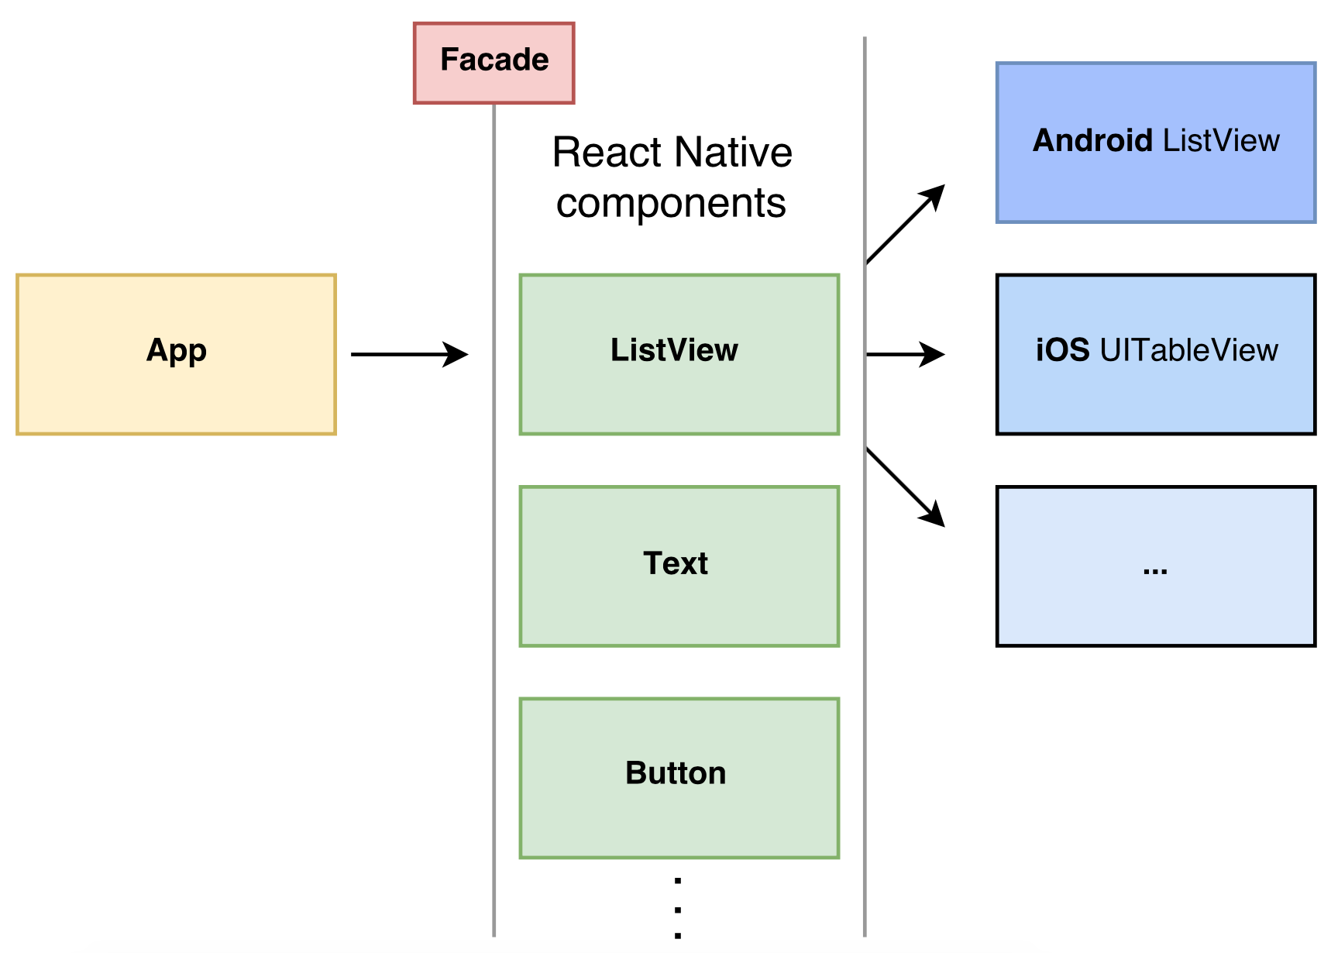
Notes:
Here React Native acts as a facade, because when you’re using ListView in your app, you don’t need to know the specifics of Android’s ListView and iOS’s UITableView, but rather you’re using facade API of a ListView component.
There are also other cross-platform components provided in the library like Text, Button, etc., but also some components which are platform specific.

Slide 21
#3
REACT NATIVE
JS framework that enables developers to write native apps using React
Why React Native when there’s Xamarin? JavaScript and React
React vs. React Native
What does it do?
JavaScriptCore which bridges JavaScript to native
Library of components
Learn once, write anywhere
Notes:
React Native’s most common tagline is: Learn once, write anywhere. Other cross-platform solutions had a different vision: “Write once, run anywhere”, but that’s impossible. Why? Both iOS and Android operating systems attract their users by the features that they provide. And those attractive features are usually not present in both operating systems or at least are not that similar. Take daydream, for instance. Android has advantage in support for virtual reality and iOS will soon make an official way of doing VR too, which will be different than the one in Android. How to solve that in cross platform way? It’s impossible. However, after some time, users will define what they expect from some feature and that will be bring both operating system together, making it possible to use that feature in cross platform way, just like we’re doing already with lists, tab bar, navigation, and so on…

Slide 22
#3
PERKS of REACT NATIVE
90% code reuse
Notes:
Despite the tagline, which doesn’t sound like React Native is cross platform solution, usual percentage of code reuse, that is reported, is around 90%, which makes it a cross-platform solution. The most important part is that with React Native’s way of solving cross platform problem we got apps that have native look and feel and are performative, which represented a problem in other cross platform solutio

Slide 23
#3
PERKS of REACT NATIVE
native look & feel
90% code reuse
+
Notes:
Despite the tagline, which doesn’t sound like React Native is cross platform solution, usual percentage of code reuse, that is reported, is around 90%, which makes it a cross-platform solution. The most important part is that with React Native’s way of solving cross platform problem we got apps that have native look and feel and are performative, which represented a problem in other cross platform solutions.

Slide 24
#3
PERKS of REACT NATIVE
native look & feel
good performance
90% code reuse
+
Notes:
Despite the tagline, which doesn’t sound like React Native is cross platform solution, usual percentage of code reuse, that is reported, is around 90%, which makes it a cross-platform solution. The most important part is that with React Native’s way of solving cross platform problem we got apps that have native look and feel and are performative, which represented a problem in other cross platform solutions.

Slide 25
#4
BOILERPLATE
Notes:
Ok, great, with cross-platform problem now being solved, we have affordable development and are able to focus only on innovation, right? Well, not quite.
Mobile app development is still expensive - which is surprising, there’s so much of repeated features in the apps, so much of boilerplate.

Slide 26
#4
BOILERPLATE
Push notifications
Advertising
Analytics
Authentication
User onboarding
...
Notes:
React Native enables you to cut the development time when developing app for multiple platforms, but leaves it to you to solve boilerplate and repeated functionalities like:
Push notifications
Integration with social networks
User onboarding
Analytics
Ads
And the list goes on

Slide 27
#4
FEATURES AS A SERVICE
Push notifications: Urban Airship, AWS, Firebase, PushWoosh, ...
Advertising: Media.net, AdMob, StartApp, Flurry, InMobi, …
Analytics: Flurry, Google Mobile Analytics, Amplitude, Appsee, …
Authentication: Tapglue, many SDKs available, ...
Branch.io for deeplinking, Mapbox for location, ...
...
Notes:
mplementing these functionalities is time consuming and it kills your innovative process. To tackle these problems, many features as a service have risen. Just for push notifications you have more than 20 services to chose from. It’s a bit tiring to analyze which one to use, but we only need to do that once. So, if we have those, why is mobile app development still expensive? Well first, many of those services still don’t have an integration layer with cross platform solutions, so you would need to do that yourself and second, every new app that you create, you need to make integration with so many services and on so many places, which is a hussle.
Even though, features as a service are there to help you out, using and keeping track of all of the ones you’re using is not an easy task to do. Furthermore, every year, there are new features that are a requirement for application to have. That’s not innovation, that’s a requirement that users expect application to have which doesn’t let you focus on the innovation and makes app development more expensive.

Slide 28
Shoutem
Notes:
That’s the problem with current state of mobile app development. At Shoutem, we are trying to tackle this problem by following 3 principles:
Put the innovation on the first place
Lower the cost of development
Keep the ease of use

Slide 29
Shoutem
Focus on innovation
Notes:
That’s the problem with current state of mobile app development. At Shoutem, we are trying to tackle this problem by following 3 principles:
Put the innovation on the first place
Lower the cost of development
Keep the ease of use

Slide 30
Shoutem
Focus on innovation
Lower the development cost
Notes:
That’s the problem with current state of mobile app development. At Shoutem, we are trying to tackle this problem by following 3 principles:
Put the innovation on the first place
Lower the cost of development
Keep the ease of use

Slide 31
Shoutem
Focus on innovation
Lower the development cost
Keep the ease of use
Notes:
That’s the problem with current state of mobile app development. At Shoutem, we are trying to tackle this problem by following 3 principles:
Put the innovation on the first place
Lower the cost of development
Keep the ease of use

Slide 32
Shoutem
5000 published apps in 6 years
Notes:
As I said in the beginning, Shoutem is a DIY builder for mobile apps. Over the 6 years that we’re on the market, we helped creating mobile apps in many diverse fields: media, local businesses, shops, restaurants and bars, radio and so on. Our clients were satisfied with their apps, but there was always something that they wanted to customize. Instead of focusing on building our platform, we needed to focus on building custom features. We worked hard, but it was impossible to meet the demand that lied ahead of us.

Slide 33
Shoutem
5000 published apps in 6 years
media, shops, restaurants, local businesses, radios, …
Notes:
As I said in the beginning, Shoutem is a DIY builder for mobile apps. Over the 6 years that we’re on the market, we helped creating mobile apps in many diverse fields: media, local businesses, shops, restaurants and bars, radio and so on. Our clients were satisfied with their apps, but there was always something that they wanted to customize. Instead of focusing on building our platform, we needed to focus on building custom features. We worked hard, but it was impossible to meet the demand that lied ahead of us.

Slide 34
Shoutem
5000 published apps in 6 years
media, shops, restaurants, local businesses, radios, …
custom features
Notes:
As I said in the beginning, Shoutem is a DIY builder for mobile apps. Over the 6 years that we’re on the market, we helped creating mobile apps in many diverse fields: media, local businesses, shops, restaurants and bars, radio and so on. Our clients were satisfied with their apps, but there was always something that they wanted to customize. Instead of focusing on building our platform, we needed to focus on building custom features. We worked hard, but it was impossible to meet the demand that lied ahead of us.

Slide 35
+
Open Shoutem platform
React Native
Notes:
We noticed problems in mobile development world and we decided to open Shoutem as a platform with React Native. We tested many technologies, both native and cross platform, and we firmly believe that React Native is the future of mobile development.
What does it mean, when I say we are opening Shoutem as a platform? We have a goal of becoming WordPress for mobile apps. Main idea is to divide application in smaller plug-ins, which can be reused over and over. We’re calling these plug-ins - Shoutem extensions.

Slide 36
Shoutem Extensions
Notes:
We noticed problems in mobile development world and we decided to open Shoutem as a platform with React Native. We tested many technologies, both native and cross platform, and we firmly believe that React Native is the future of mobile development.
What does it mean, when I say we are opening Shoutem as a platform? We have a goal of becoming WordPress for mobile apps. Main idea is to divide application in smaller plug-ins, which can be reused over and over. We’re calling these plug-ins - Shoutem extensions.

Slide 37
#5
Shoutem platform
Nothing new in software design
Modularity
Extensions, building blocks, modules, components, plug-ins, …
Prepared extensions eliminate boilerplate
Notes:
It’s important to say that we didn’t make a breakthrough in the mobile app development, we just used good old software design methodologies that have been here for decades and applied it on the larger scale. We’re taking a different approach to mobile development, actually the same one developers are using when creating any piece of software. At the core of design that we’re using is modularity - application is divided into extensions (building blocks, components). We prepared a lot of extensions that developers and application owners can start using right off, such as extensions for push notifications, analytics, ads and so on which are integrated with features as a services, but developers are also able to fully customize those extensions, as they are open sourced or to write the new ones.

Slide 38
#5
APP CREATION FLOW
Setup
Notes:
So, how does the flow of creating an application looks like? Developer creates a new application on Shoutem builder and installs extensions that he can find on the marketplace and suits his need. All of the source is available to him, so if he’s not satisfied with how any of the extensions works, he can change it and it’s easy to do so since there’s almost no Shoutem overhead, extensions are written using only React Native concepts. Finally, when he’s done with this fast setup, he focuses on innovative part of his application. There are no limitations to what developers can build as anything can be built with React Native and Shoutem simply lets you use React Native in modular way. That’s complete philosophy. Once your app is created, you can export it for both iOS and Android platforms or you can let Shoutem publish it to both stores, so you don’t even need to worry about signing your app, certificates, reviews process and all that. Shoutem guides through complete process and synchronises data to both stores.

Slide 39
#5
APP CREATION FLOW
Setup
Innovation
Notes:
So, how does the flow of creating an application looks like? Developer creates a new application on Shoutem builder and installs extensions that he can find on the marketplace and suits his need. All of the source is available to him, so if he’s not satisfied with how any of the extensions works, he can change it and it’s easy to do so since there’s almost no Shoutem overhead, extensions are written using only React Native concepts. Finally, when he’s done with this fast setup, he focuses on innovative part of his application. There are no limitations to what developers can build as anything can be built with React Native and Shoutem simply lets you use React Native in modular way. That’s complete philosophy. Once your app is created, you can export it for both iOS and Android platforms or you can let Shoutem publish it to both stores, so you don’t even need to worry about signing your app, certificates, reviews process and all that. Shoutem guides through complete process and synchronises data to both stores.

Slide 40
#5
APP CREATION FLOW
Setup
Innovation
Publish
Notes:
So, how does the flow of creating an application looks like? Developer creates a new application on Shoutem builder and installs extensions that he can find on the marketplace and suits his need. All of the source is available to him, so if he’s not satisfied with how any of the extensions works, he can change it and it’s easy to do so since there’s almost no Shoutem overhead, extensions are written using only React Native concepts. Finally, when he’s done with this fast setup, he focuses on innovative part of his application. There are no limitations to what developers can build as anything can be built with React Native and Shoutem simply lets you use React Native in modular way. That’s complete philosophy. Once your app is created, you can export it for both iOS and Android platforms or you can let Shoutem publish it to both stores, so you don’t even need to worry about signing your app, certificates, reviews process and all that. Shoutem guides through complete process and synchronises data to both stores.

Slide 41
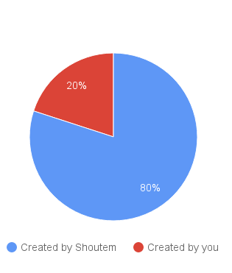
#5
RESULT
Notes:
With this way, 80% of mobile app is created by Shoutem. This includes usual extensions that you’ll install, CMS for your data and publishing of the application. The other 20% is really what makes your app unique and innovative. Maybe you don’t even need to do anything custom, the innovation is in the data you provide. Then Shoutem is going to make 100% of your app. It’s up to your needs.

Slide 42
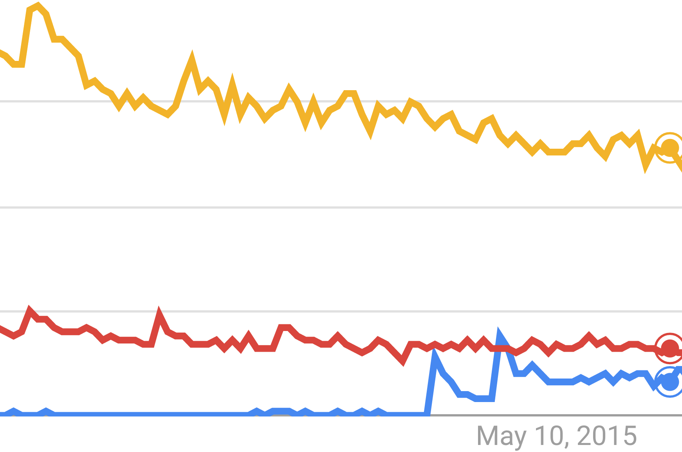
#6
RN - A YEAR AGO
React Native
iOS development
Android development
Notes:
Looking one year ago, when we started this project, React Native was only on the beginning. Documentation wasn’t complete, there many bugs and many features were still not supported. We took 2 months, did a lot of research on available technologies and finally decided to use React Native. What made use decide towards that way, despite all the issues React Native had at that time, was the vision of solving cross platform problem that React Native brought and the ability to use React which was already heavily used on Web at that time. It would be much easier to make a decision today and we’re so happy that we went React Native. This is how Google trends look today for React Native. The interest blew iOS and Android development.

Slide 43
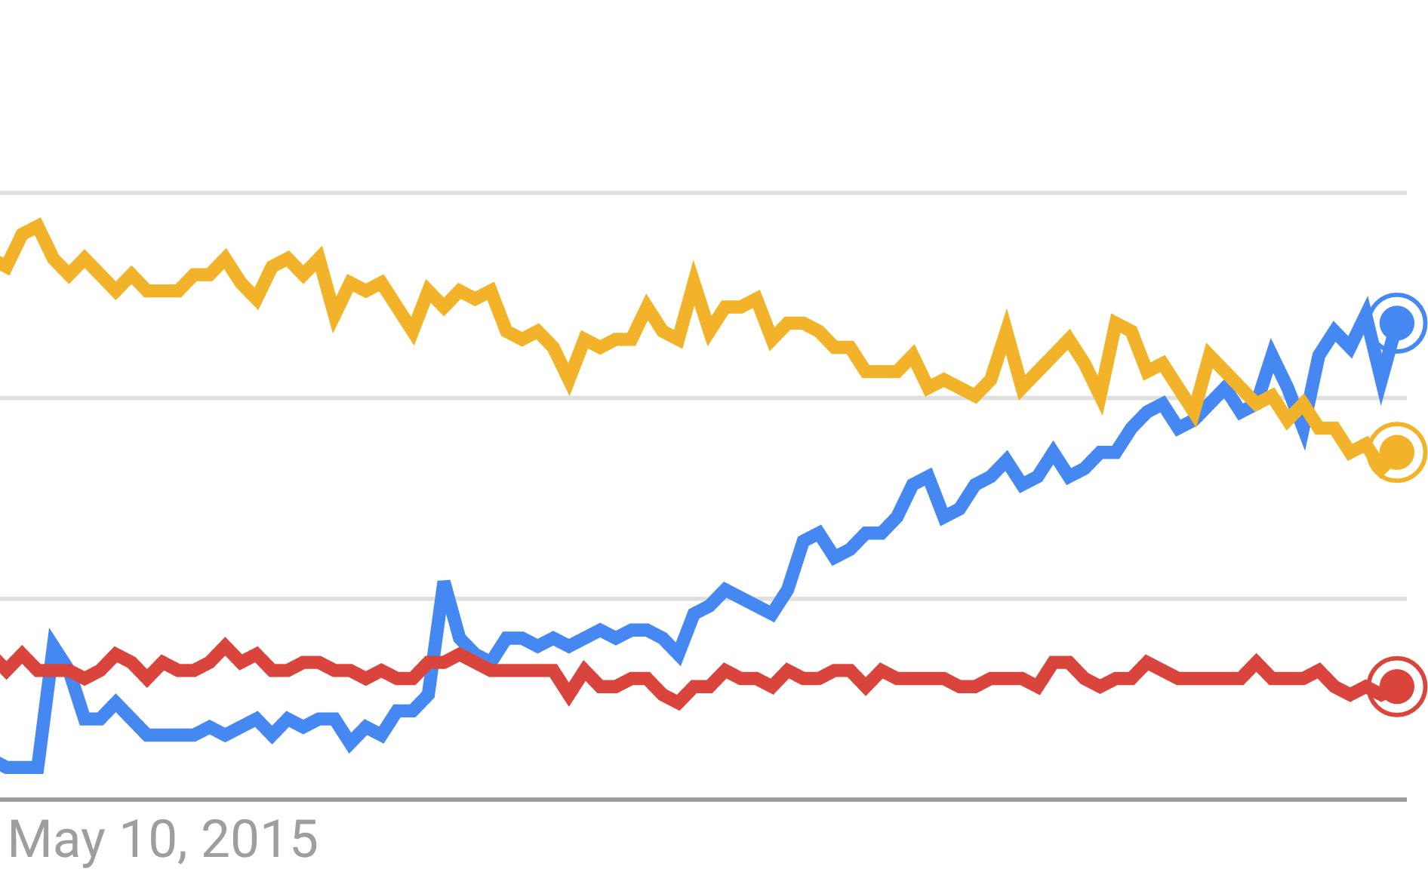
#6
RN - NOW
React Native
iOS development
Android development
Notes:
Looking one year ago, when we started this project, React Native was only on the beginning. Documentation wasn’t complete, there many bugs and many features were still not supported. We took 2 months, did a lot of research on available technologies and finally decided to use React Native. What made use decide towards that way, despite all the issues React Native had at that time, was the vision of solving cross platform problem that React Native brought and the ability to use React which was already heavily used on Web at that time. It would be much easier to make a decision today and we’re so happy that we went React Native. This is how Google trends look today for React Native. The interest blew iOS and Android development.

Slide 44
React Europe 2016
Notes:
One thing that I didn’t put enough emphasis in this talk is definitely React and React Native community. We were fortunate enough to pay a visit to React Europe conference this year, where we met core contributors for both libraries. It’s a big conference in Paris with great talks and a huge concentration of one of the most ambitious, passionate and friendly developers that I ever had a chance to meet. I would definitely recommend you to attend it, if you’ll have a chance. In fact, we love community so much that we decided to contribute in the community and we we did it by open sourcing our UI toolkit for React Native, but we have also some other open source projects coming up very soon.

Slide 45
Shoutem
Focus on innovation
Lower the development cost
Keep the ease of use
Notes:
React Native helped us achieve a modular mobile app development which follows all the 3 principles that we’ve put ahead of us:
It puts the innovation on the first place, by eliminating all the boilerplate and repeated functionalities with Shoutem tools,
which results in the lower cost of development, as only 20% of app needs to be developed and
since there’s in almost no Shoutem overhead, it’s as easy to use React Native.

Slide 46
shoutem.github.io
Notes:
Shoutem is currently in beta, launching in the beginning of the next year, but the UI toolkit for React Native is already out and used in production. Find more information on shoutem.github.io.

Slide 47
Notes:
Thanks for the attention.

