Slide 1
Chatbotok – hol tart ma a tudomány?
Balint Farkas
Technical Evangelist
Microsoft

Slide 2
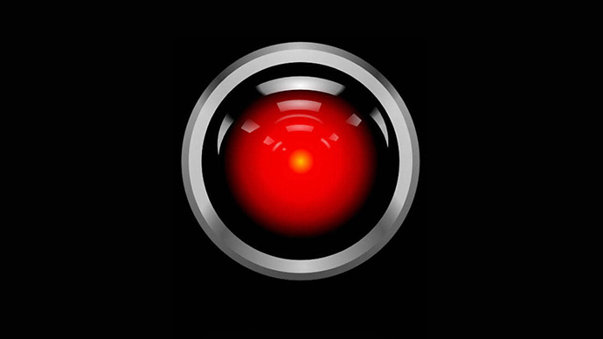
I’m sorry, Dave, I can’t let you do that

Slide 3
Bot Framework
Portal
@balint_farkas
@the_bot
HTTP endpoint
built with Bot Framework
SDK
hosted anywhere but hopefully in
Azure (Bot Service)
Persists state & handles dialogs
LUIS
Turns text into intent&parameters
Your Business Services

Slide 4
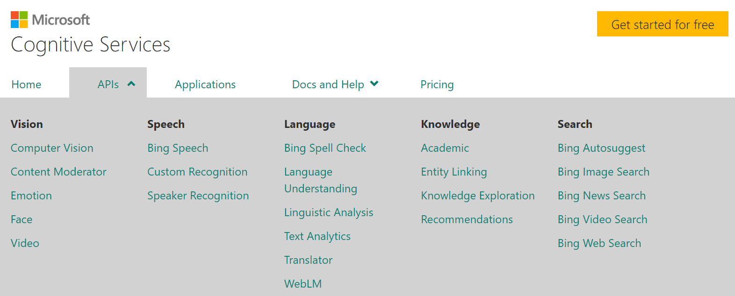

Slide 5
botframework.com microsoft.com/cognitive-services

