Slide 1
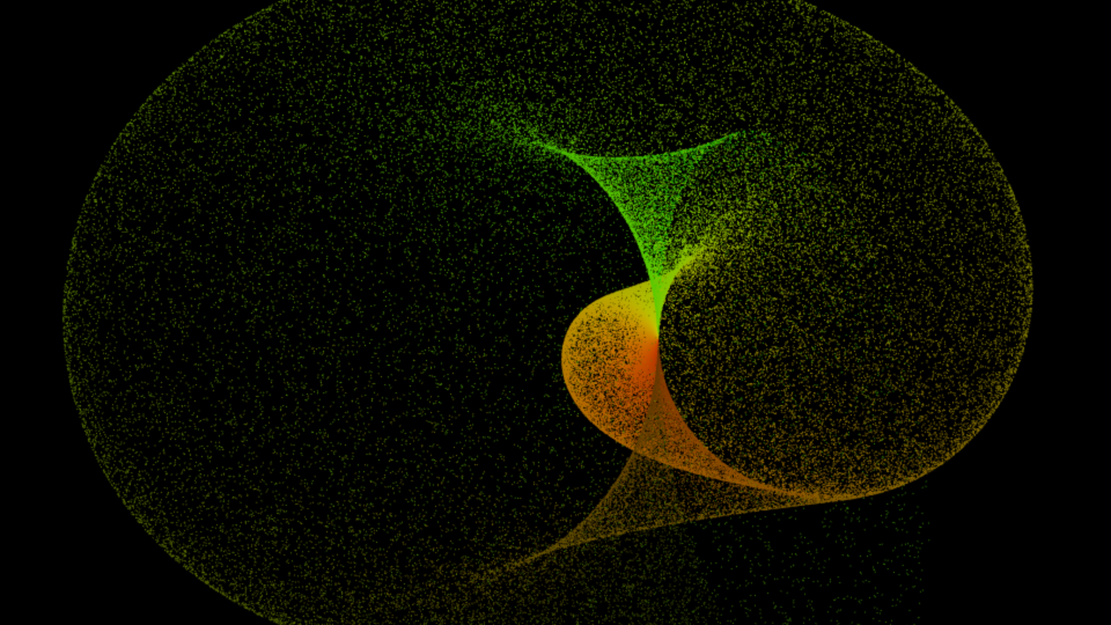
Java performance mistakes
Peter Veres
Senior Software Engineer
Peter_Veres2@epam.com

Slide 2
Common performace issues
Performance is a business goal
Most performance issues in Java can be attributed to a handful of root causes

Slide 3
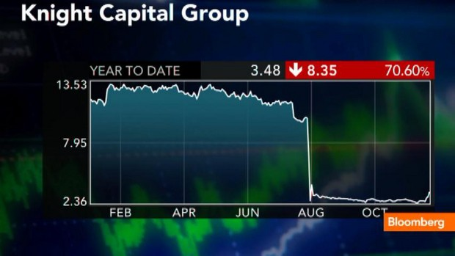
Performance failures are exepensive
2012, Knight Capital: The most expensive faulire
Instead of shutting down gracefully, computers began issuing commands to buy and sell securities
It only took a half hour, but by the end the losses totaled an estimated $440 million
Many similar failures aren’t as visible
Only slow down or halt a website without leaving much of a trail
The customers show up, click in vain, then move on
Notes:
http://www.bloomberg.com/news/articles/2012-08-02/knight-shows-how-to-lose-440-million-in-30-minutes
http://www.bloomberg.com/news/articles/2012-11-28/getco-proposes-buying-knight-capital-at-3-50-a-share
In 2012, Knight Capital’s computers started to fail in the worst possible way. Instead of shutting down gracefully, they began issuing commands to buy and sell securities. The orders were queued up to be executed over the coming weeks, but the errant computers dumped them on the market all at once, causing a buying and selling frenzy like a clerk who’d gone insane.

Slide 4
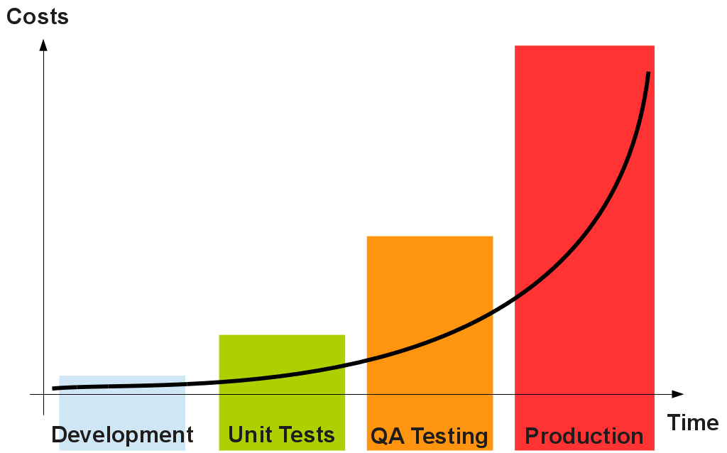
Time spent in bug fixing
Notes:
Also mention 80% of the bugs caused by 20% pattern
Metrix are important

Slide 5
JAVA PERFORMACE
General problems

Slide 6
General problems
Bad „architecture” decisions
Using of existing APIs in a wrong way
Notes:
Bad using of existing API
google-ing
Use a solution in a wrong way

Slide 7
JAVA PERFORMACE
SQL

Slide 8
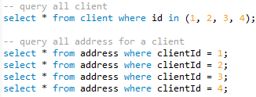
N+1 problem
Notes:
Tools:
Lazy associations
Tuning fetch strategies

Slide 9
Caching
No cacheing
Configurare caching
Distributed caches
Notes:
No cacheing
Unless you have specific reasons not to cache, you should be caching
Configurare caching
Cache with fixed size -> optimize it
Distributes caches
The performance challenge is to balance your distributed caching behavior with your business rules: try to opt for the loosest distribution strategy that satisfies your business requirements (example: Facebook posts)
This is the 2nd level cache in Hibernate

Slide 10
Connection pooling
Reasons
Relatively expensive to create/close
Share connections across business transactions
Limit to load (load testing)
Notes:
Size of pool: too much load to the database vs performance of the app

Slide 11
JAVA PERFORMACE
Memory

Slide 12
Stop-the-world GC
Managed memory management in Java
Major GC stops-the-world
Apply a GC strategy
sun.misc.UnSafe / Off-heap APIs
Notes:
Managed memory: JVM in this case, not the programmer.
2-3 gigabyte heap this might be 3-5 seconds,
30-gigabyte head this could be more on the order of 30 seconds
Solutions
Concurrent Mark Sweep (CMS) garbage collection strategy
G1 garbage collection strategy (Java 7 Update 9 )
Zing JVM
Use an off-heap API (eg. OpenHFT)

Slide 13
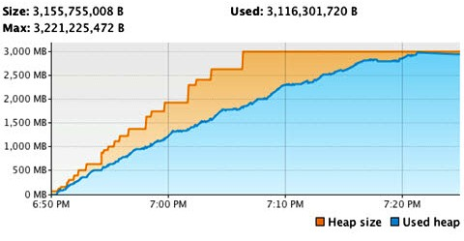
Memory leaking
Reference to an object that it does not ever intend to use again
Tipically Collection framework classes with unbounded growth
Running out of memory vs memory leak
Notes:
JVM to eventually exhaust its memory and throw the dreaded OutOfMemoryError, which usually means you have to restart your JVM
-XX:-HeapDumpOnOutOfMemoryError

Slide 14
JAVA PERFORMACE
Problems with the code

Slide 15
StringBuilder
String result = "<" + epam + ">";
System.out.println(result);
String result = (new StringBuilder("<"))
.append(epam).append(">").toString();
System.out.println(result);
String result = (new StringBuilder("<"))
.append(epam).append(">").toString();
result = (new StringBuilder(String.valueOf(result)))
.append("</").append(epam)
.append(">").toString();
System.out.println(result);
String result = "<" + epam + ">";
result+= "</" + epam + ">";
System.out.println(result);
StringBuilder result = new StringBuilder("<");
result.append(epam).append(">").append("</").append(epam).append(">");
System.out.println(result);
Notes:
On the right the compiled code
+ mention JIT (run-time compilation to reach better performance)

Slide 16
Iterator
List values = new ArrayList();
String value;
// return new Itr();
for(Iterator iterator = values.iterator(); iterator.hasNext();
System.out.println(value))
value = (String)iterator.next();
}
List<String> values = new ArrayList<String>();
for (String value : values) {
System.out.println(value);
}
Notes:
Avoid iterator
A common source of garbage are Iterators

Slide 17
Using the stack
// on the heap
Integer value = 123456;
// on the stack
int value = 123456;
// 3 objects on the heap
Integer[] i = { 123456, 654321 };
// 1 object on the heap
Integer[] i = { 123456, 654321 };
Notes:
In Java that collections framewrok cannot be used on primitive types.
Use arrays or use a special library for primitive types (like trove4j)

Slide 18
.valueOf()
Integer i1 = Integer.valueOf(NUM);
Integer i2 = Integer.valueOf(NUM);
System.out.println(i1 == i2);
Integer i1 = NUM;
Integer i2 = NUM;
System.out.println(i1 == i2);
Notes:
Boolean a1 = true; // ... syntax sugar for:
Boolean a2 = Boolean.valueOf(true);
Byte b1 = (byte) 123; // ... syntax sugar for:
Byte b2 = Byte.valueOf((byte) 123);

Slide 19
Recursion
Recursive methods solve difficult problems in a really simple way
Each recursive call adds a new frame to the stack
Some compilers optimizing tail-recursing algorithms back into iterative ones, but javac NOT
int sum(int actual, int total) {
if (actual == 0) {
return total;
}
else {
return sum(actual - 1, total + actual);
}
}
int sum(int actual) {
int total = 0;
for (int i = actual; i > 0; i--) {
total+=i;
}
return total;
}

Slide 20
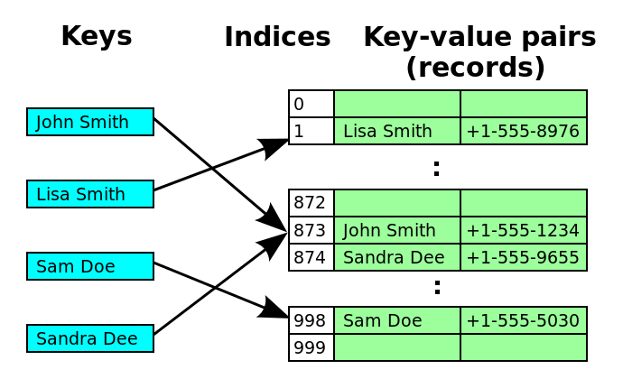
hashCode() and equals()
JDK hash based collections store their values in an array. Hash code is used to calculate an initial lookup position in this array
If all values will have the same hash code, hash map (or set) will degrade into a list
Notes:
Topics not touched:
Concurrency
Algorithms
Network
Scalability

Slide 21
Metrics vs checking code
Before you start the check the code manually, check metrics
SQL executions
Time spent in functions
3rd party calls
Memory usage
GC runs
Heap dump
etc.
Notes:
Tools:
JMH
Jvisual VM
Jprofiler
Heap analyzer

Slide 22
Test automation
Goal: functional and architecture confidence
Automate and measure you application
Use the metrics as quality gates

Slide 23
Thanks for your kind attention
Peter Veres
Senior Software Engineer
Peter_Veres2@epam.com

