Slide 1
Caring About Code Quality
Tamas Korozsi
2015

Slide 2
ME

Slide 3
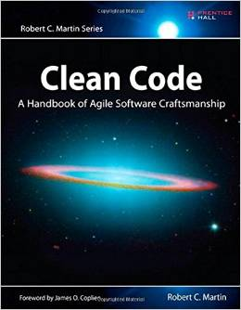
The Book
Clean Code: A Handbook of Agile Software Craftsmanship
by Robert C. Martin

Slide 4
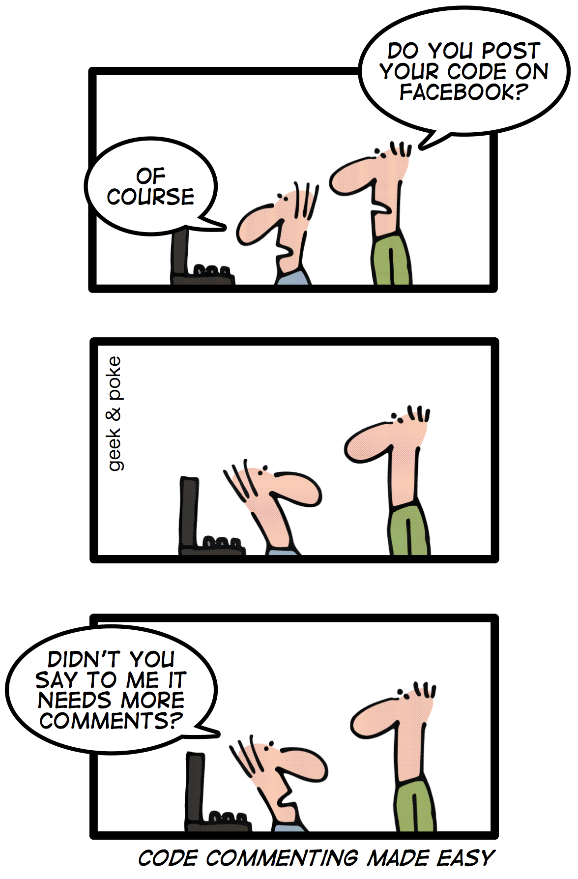
What is Clean Code?
Does it work?
Is it easy to understand?
Is it clever?
Is it esthetic?
Is it short?
Is it testable?
Is it well-structured?
Does it scale?
Is it object-oriented?
Does it have explanatory comments?
Is it maintainable?

Slide 5
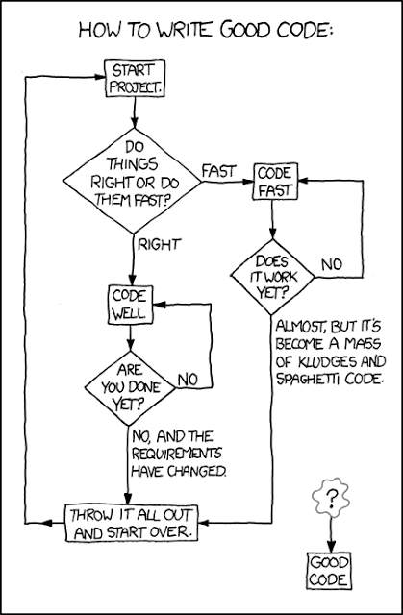
What is Clean Code after all?
Focused
Single-minded attitude
Undistracted and unpolluted
Readable, simple and direct
Compact and literate
Contains only what is necessary
Makes it easy for other developers to enhance it
Tests should be also clean
Looks like it’s author cares
Contains no duplicates
Foundations are established on tiny abstractions

Slide 6
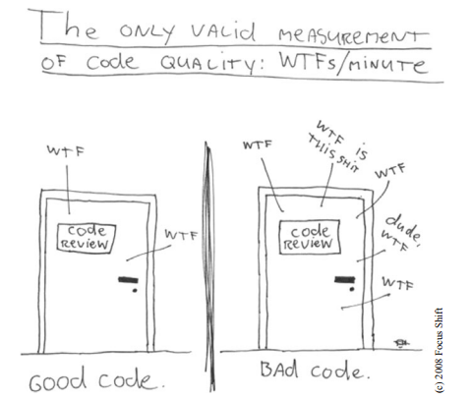
The need for measurement
Subjective
If you can’t measure, you can’t improve
Identify what matters
Defend and justify decisions.

Slide 7
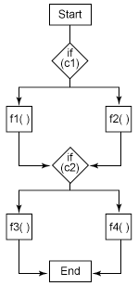
Cyclomatic complexity
Upper bound for the number of test cases that are necessary to achieve a complete branch coverage
Lower bound for the number of paths through the control flow graph
Desirable value: below 10
public void foo() {
if (c1) {
f1();
} else {
f2();
}
if (c2) {
f3();
} else {
f4();
}
}
Cyclomatic complexity: 3

Slide 8
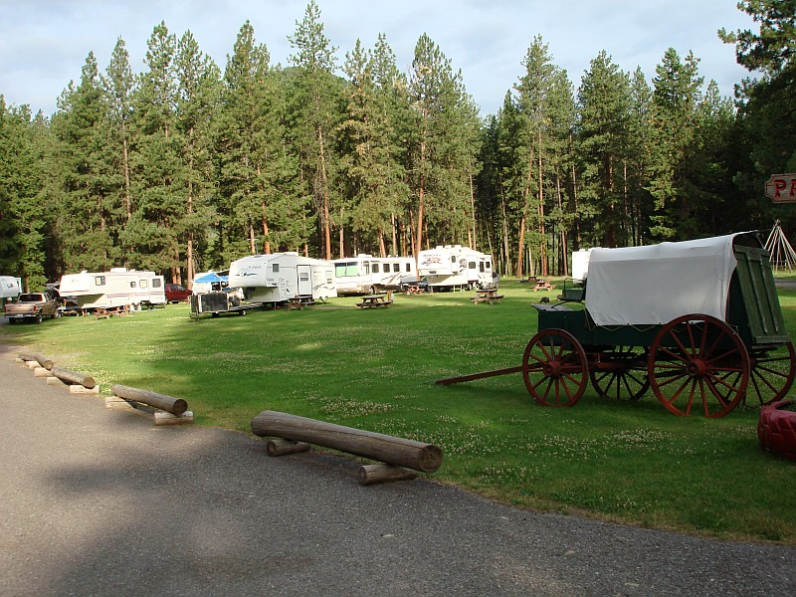
The Boy Scout Rule
Always leave the campground cleaner than you found it.

Slide 9
Broken Window Theory
Came from city crime researchers
A broken window will trigger a building into a smashed and abandoned derelict
So does the software

Slide 10
Composed method example
public void add(Object element) {
if (!readOnly) {
int newSize = size + 1;
if (newSize > elements.length) {
Object[] newElements = new Object[elements.length + 10];
for (int index = 0; index < size; index++) {
newElements[index] = elements[index];
elements = newElements;
}
}
elements[size++] = element;
}
}

Slide 11
Implementation patterns

Slide 12
Composed method pattern by Kent Beck
Divide your program into methods that perform one identifiable task
Keep all of the operation in a method at a same level of abstraction
This will naturally result in programs with many small methods, each few lines long.

Slide 13
Composed method example
public void add(Object element) {
if (!isReadOnly()) {
if (atCapacity()) {
grow();
}
addElement(element);
}
}

Slide 14
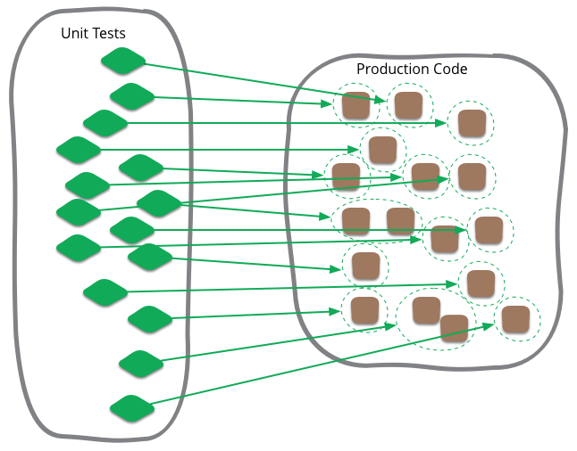
Advantages of Unit tests
Instant feedback
Allows you to make changes to code quickly
Help you understand the design of the code you are working on
Writing testable code helps to achieve better code quality
Unit tests are a form of sample code
Test-first forces you to plan before you code

Slide 15
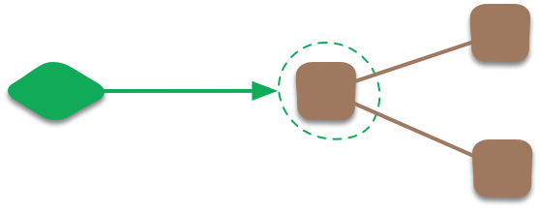
Unit tests collaborator isolation
Whether the unit you're testing should be isolated from its collaborators
Mockist approach
Isolate from dependencies
More flexible in what you can test
Classic approach
No attempt to isolate unless communicating with the collaborator is awkward
Less brittle tests

Slide 16
C.R.A.P. metric
Change Risk Analysis and Prediction
Help you identify code that might be particularly difficult to understand, test, or maintain
$CRAP\left(m\right)={cycl_comp(m)}^{2}∗{\left(1−coverage\right) }^{3}+cycl_comp(m)$
A method with a CRAP score over 30 is considered unacceptable
Cyclomatic Complexity | Coverage required
0 – 5 | 0%
10 | 42%
15 | 57%
20 | 71%
25 | 80%
30 | 100%
31+ | Not possible

Slide 17
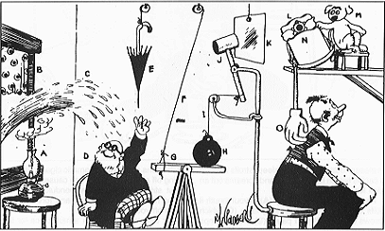
Rube Goldberg Machines
Don’t build complex machines
Don’t build frameworks
Make the software so simple that there are obviously no deficiencies
Keep it simple, stupid (KISS)

Slide 18
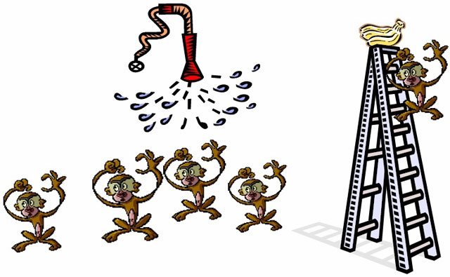
Angry monkeys experiment
Avoid Cargo cult programming
Question authority
Accept feedback and give feedback

Slide 19
EPAM Academy
Aniko_b

Slide 20
QUESTIONS?
Thank you for attention!
Tamas_KOROZSI@EPAM.COM

