Slide 1
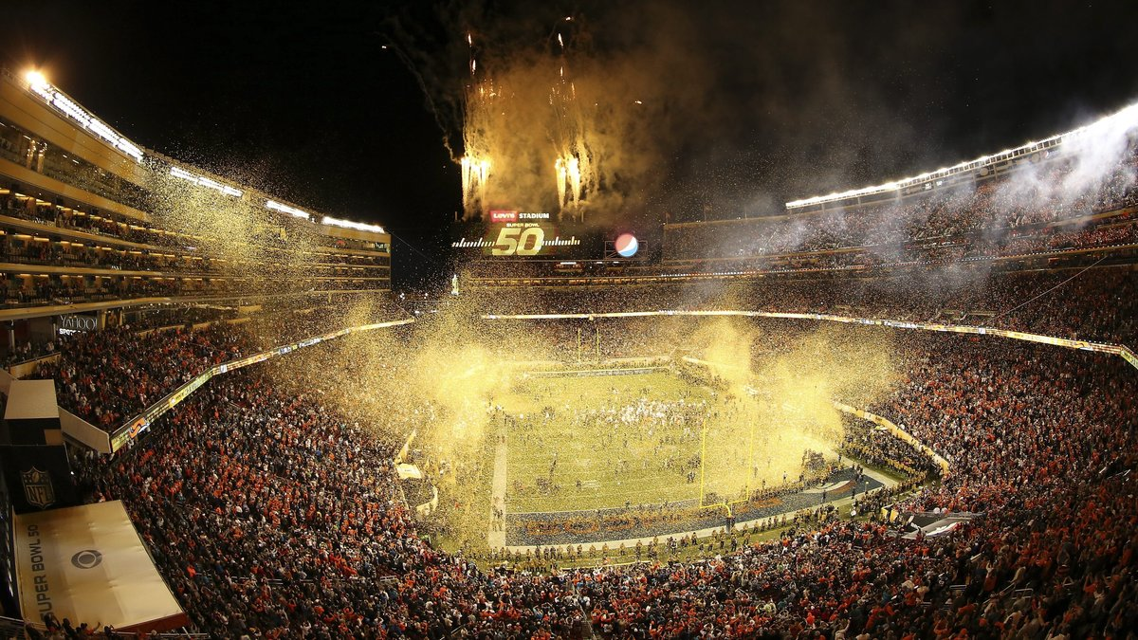
Openstack alapú nyilvános felhő üzemeltetése Magyarországról
Gerner Péter
2016. 06. 23.

Slide 2




CompaNy Namespace…
DTAG
100%
59,21%
International
Magyar Telekom
100%
100%
ICT SERVICES AND SOLUTIONS FOR LOCAL CUSTOMERS (HU)
ICT OUTSOURCING FOR NEARSHORE AND GLOBAL CUSTOMERS
Hungary

Slide 3
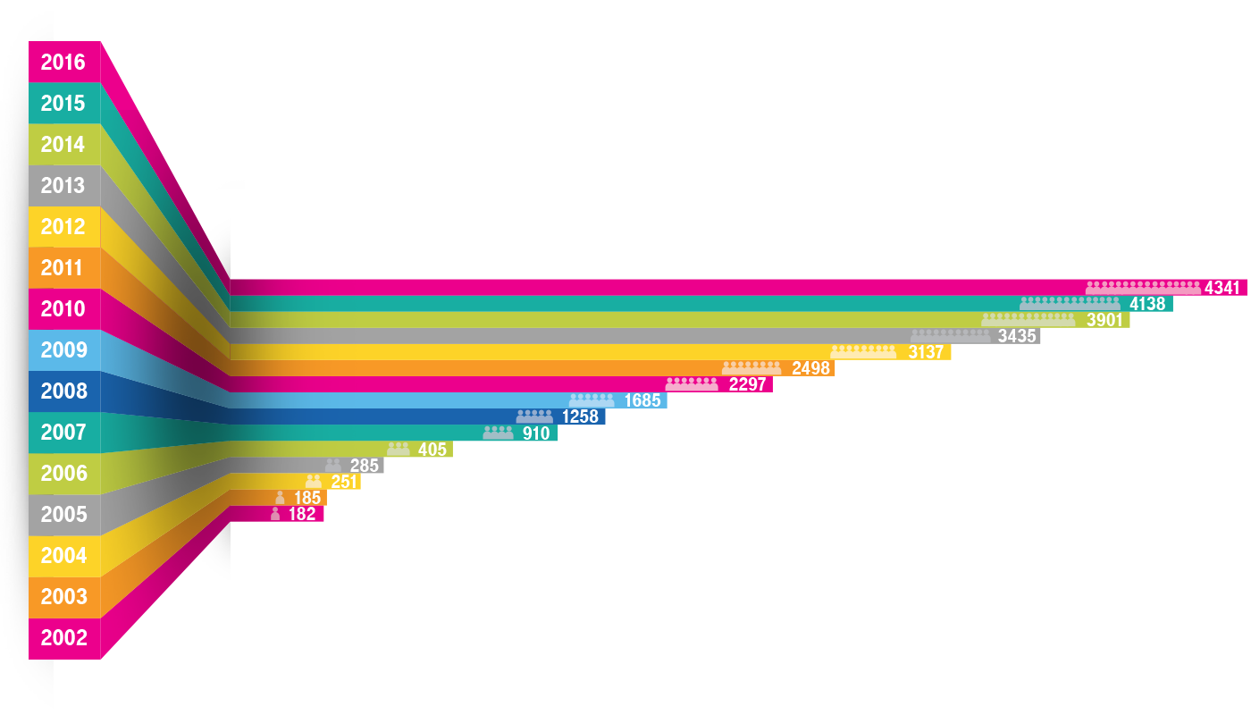
10 ÉV ITSH

Slide 4
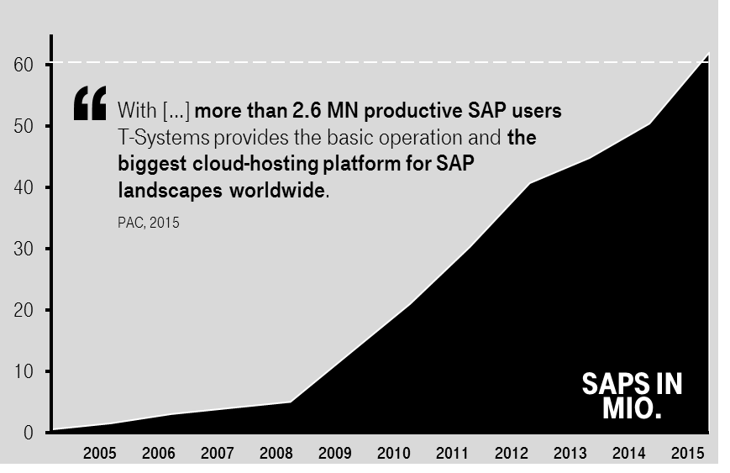
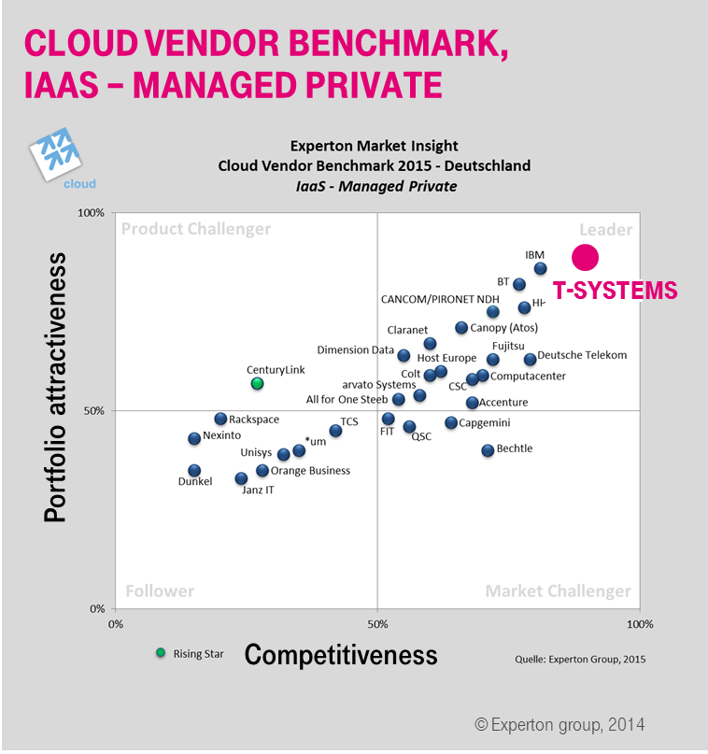
Our
Platforms
ARE READY
Notes:
Zitat PAC 2015: With more than 40 million SAPS (SAP Application Performance Standard) and more than 2.6 million productive SAP users T-Systems provides the basic operation and the biggest cloud-hosting platform for SAP landscapes worldwide

Slide 5
Top 10 Quartile in
Customer
Satisfaction
is in our
Since 2013
Reliability
DNA
tri*m 90

Slide 6
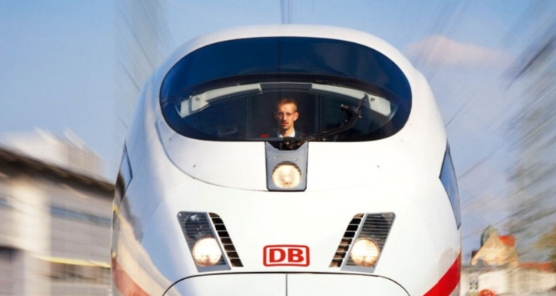

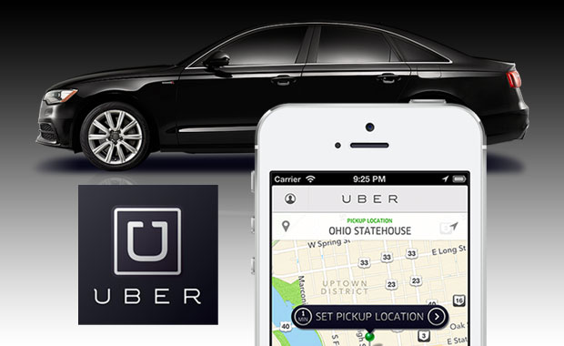
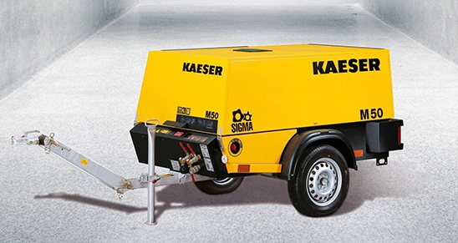



Digitization changes
Business Models
Predictive Maintenance
Smart Home
New business models
Smart Production

Slide 7


The UN-Outsourcer
The Next
LEVEL
The! Cloudifier
Open Telekom CLoud
(Containers)

Slide 8

#UN
Outsourcer
Our un-outsourcer offer:
Run-on-satisfaction for Dynamic SAP services
Exceptionally flexible contracts thanks to short terms
Special termination rights after the hypercare phase
For more information t-systems.com/un-outsourcer

Slide 9
Integration & Transformation
The Cloudifier
Enable the cloud
Operate the cloud
Unlock Classic
Degree of value added depending
on customer situation:
Open
Telekom
Cloud
Migrate
Modernize
&
Build
Digital
Harmonize
Mobile
Apps/Devices
PaaS
Lift & shift
Zero Outage
SaaS apps
99.95 % availability
With end-to-end packages in
T-shirt sizes at fixed prices
With expertise in hybrid scenarios
and multi-cloud management
XS
S
M
l
XL

Slide 10
Open
elekom
Cloud
Simple
Secure
affordable

Slide 11
Public
Cloud
Hybrid
Cloud
we
expand
our cloud
portfolio
Classic
IT
Private
Cloud

Slide 12
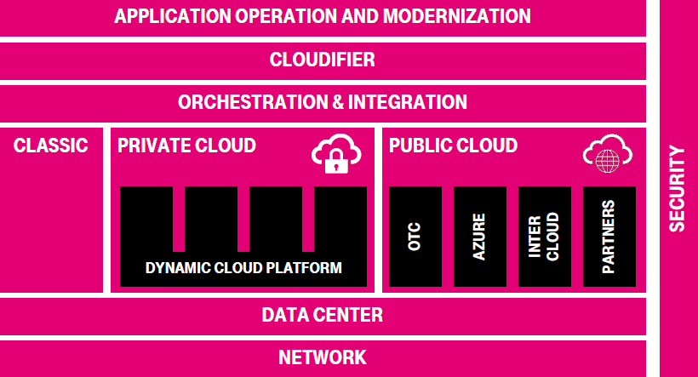

Slide 13

  One of the largest German public clouds
Open Telekom Cloud
E2E service
As a powerful partner, Deutsche Telekom offers infrastructure-as-a-service in enterprise quality for European customers
User-friendliness
Costs
  With additional customized services for strategic sourcing in times of digitization
Open
Security
Special Add-On:
Transformation &
Integration

Slide 14


Open
Future-proof with OpenStack
Multi-cloud management
is efficiently supported
Docker Container Service
for simple migration of data and workloads
Ideal environment
for native applications
Potential for
the desired
cloud standard
High degree of maturity
driven by many large industrial companies and the community
Independence
Reduction of technical dependencies, open standard API
No vendor lock-in
Freedom of choice with simple service exit
Already established
in the cloud environment
b
  Openness out of responsibility FOR OUR CUSTOMERS’ AGILE
  BUSINESS 4. 0 IN TIMES OF DIGITIZATION

Slide 15
Open Telekom Cloud
Service catalog from network to services
IN 2016
Services
Container Service
Relational Database Service
Beta
Management
Cloud Eye
Security
Compute
Storage
Identity
and Access
Management
Elastic
Cloud
Server
Auto-
scaling
Image
Mgmt.
Service
Object
Storage
Service
Elastic
Volume
Service
Volume
Backup
Service
Anti-DDoS
Network
Elastic IP
Virtual Private Cloud
Elastic Load Balance

Slide 16

#un outsourcer
What I´D like
The! Cloudifier
you to keep
in mind
From HU
To Eu

Slide 17


Magyarországról?

Slide 18


