Slide 1
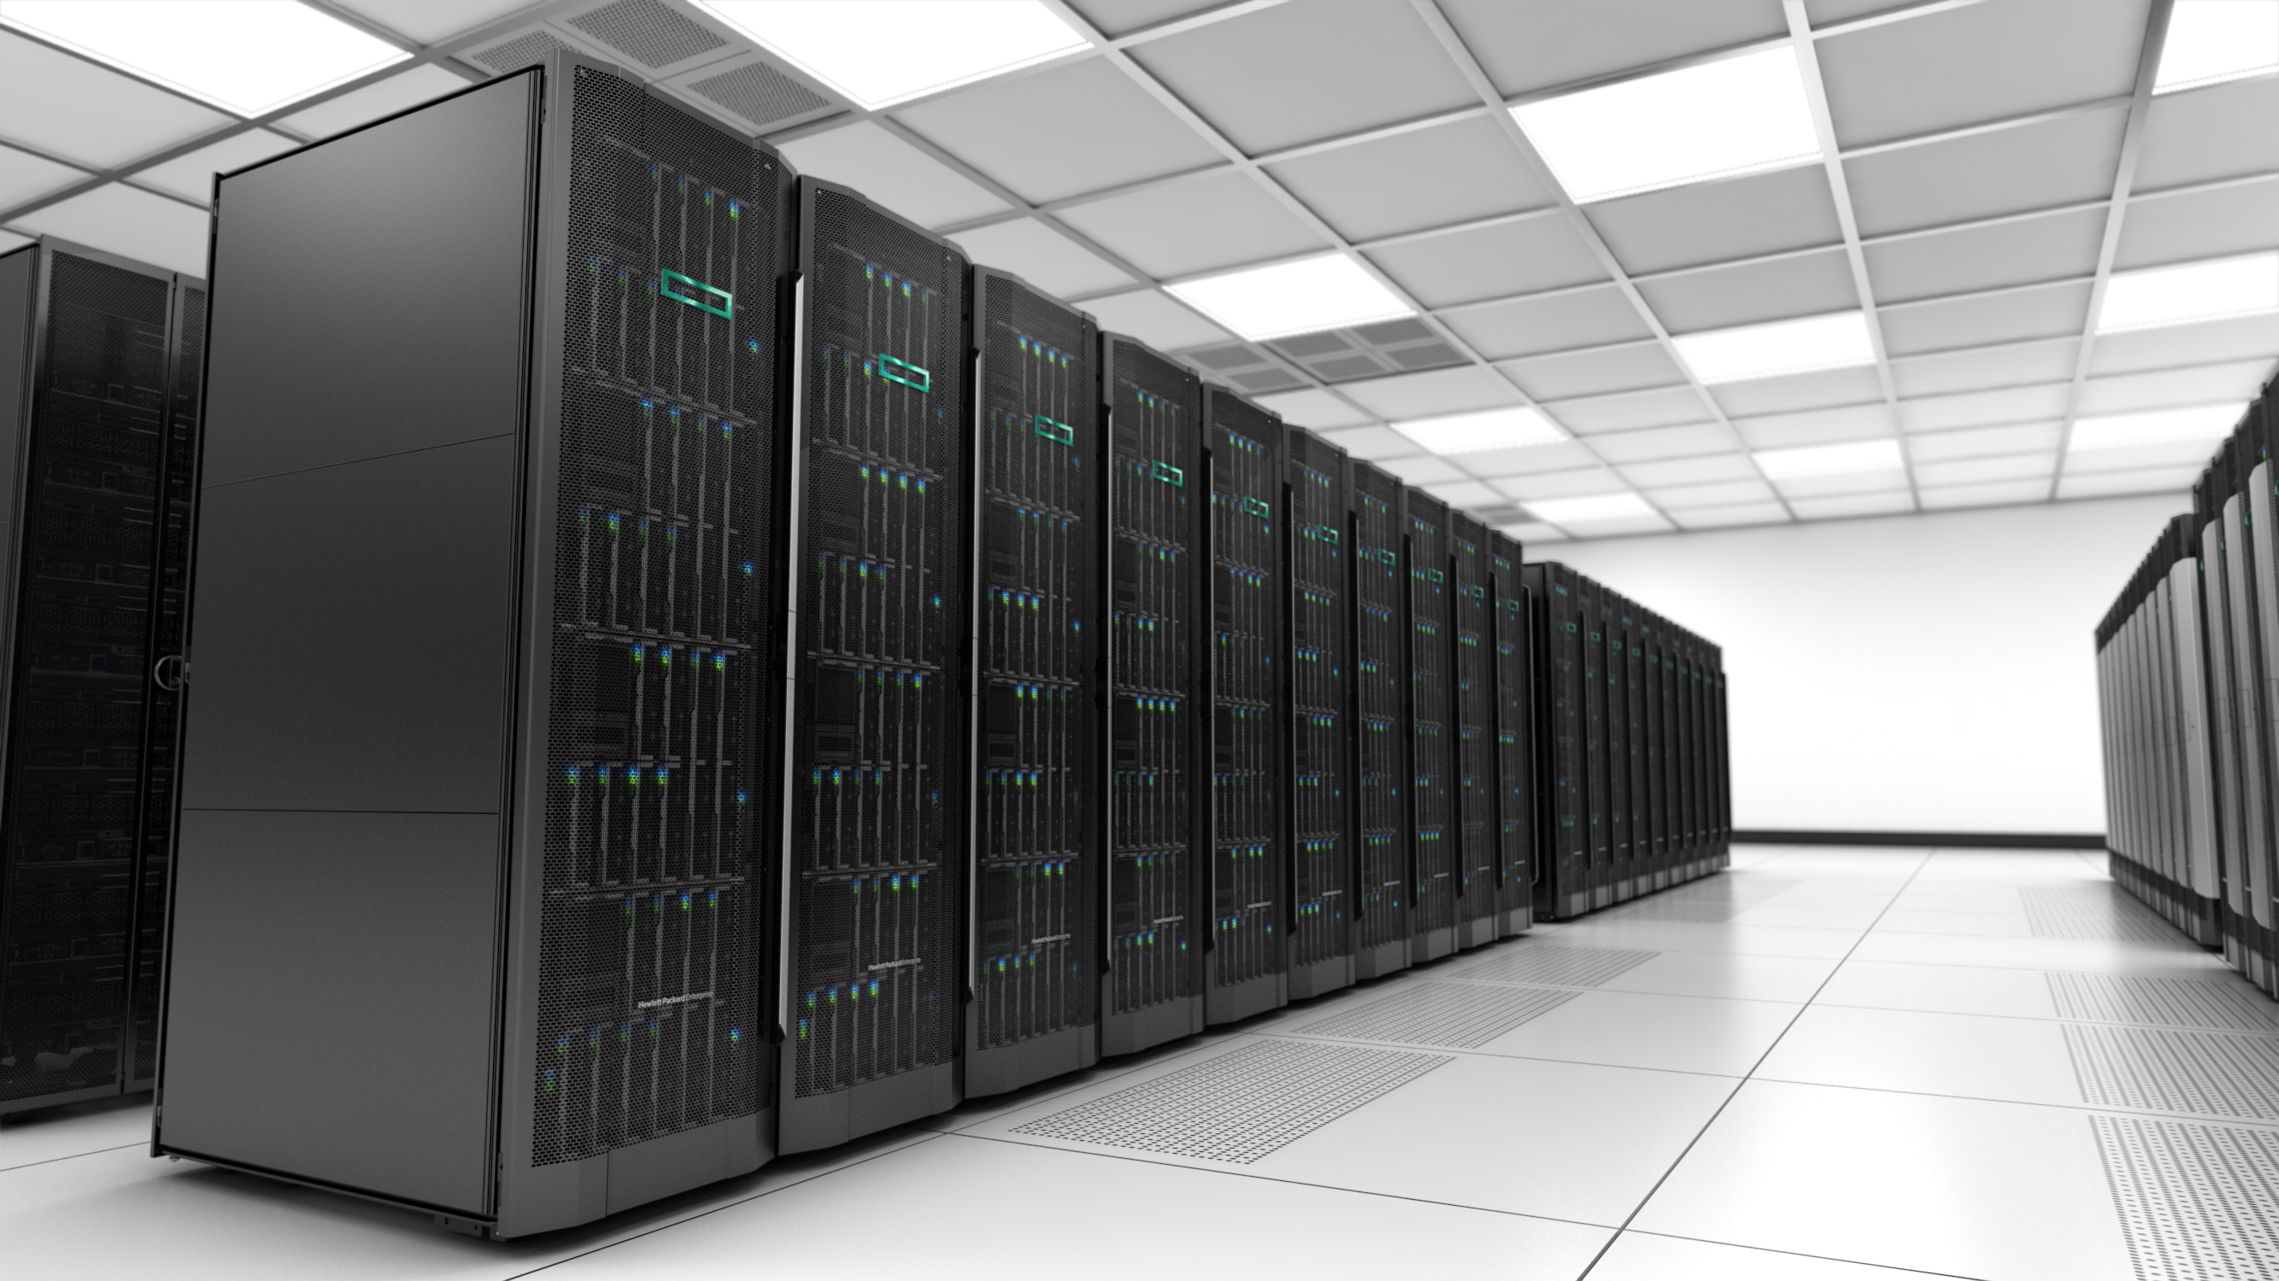
Composable Infrastructure
Hogyan váltsunk szemléletet software alapú adatközponti irányba
Zeisel Tamás
Vezető Presales architect
Tamas.zeisel@hpe.com
2016. Június 23.

Slide 2
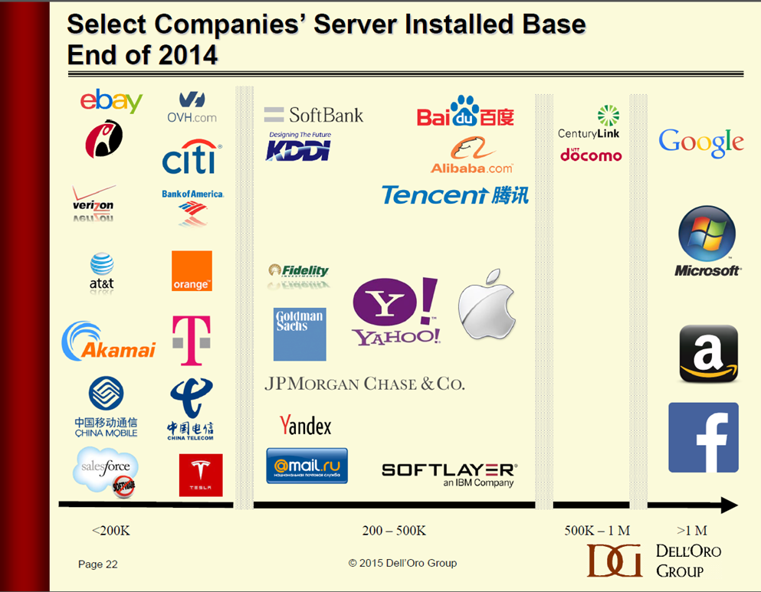
Kik azok a „Cloud Óriások”?
Google, Microsoft, Amazon, Facebook több mint 1 Millió Szervert használ
Tipikusan tíz-százezres számban vásárolnak szerver infrastruktúrát
Ref: 4Q14 Dell’Oro Group Ethernet Switch and Server Reports
Notes:
Notes from Bill Dicke, 8/26/2015:
Dell’Oro slide snapshot used with permission from Alan Weckel, VP, Dell’Oro Group, Aug 26, 2015
Per Dell’Oro Group, Worldwide Data Networking and Telecommunications, Ethernet Switch Market Update, 4Q14
19 companies have server installed bases of 200k to more than 1 million
I verified with Alan Weckel/Dell’Oro on 8/25/2015 that the “>1M” names are still accurate. He said the only significant change coming soon is that IBM SoftLayer will move up into the 500K-1M group. This does not impact statements on slide.
Notes below are per HP internal sales data (per John Clarke data sets covering “BL & DL servers 2013Q4-2015Q3” and “ all HP Server Models 2014Q1-2014Q4”)
HP has sold BL &/or DL servers to:
Google, Microsoft, Amazon, Facebook, CenturyLink, Baidu, Alibaba, Tencent, Yahoo, Apple, SoftBank, KDDI, Fidelity, Goldman Sachs, JP Morgan Chase,
I (Bill Dicke) have not found evidence of BL or DL sales to:
NTT Docomo, IBM Softlayer, Yandex (Russian), @mail.ru (Russian)
In period 2013Q4-2015Q3, Total server unit shipments to the following companies were basis for third bullet above:
Alibaba 28,483 units
Apple Inc 22,427
Facebook 23,026
Microsoft 309,721
Softbank 53,838
Tencent 31,432

Slide 3

Ahhoz, hogy a Cloud Óriások hatékonyságát megközelítsük először a szemléletüket kell magunkévá tenni
Cloud Óriások egészen másként tekintenek az infrastruktúra optimalizálásra mint a hagyományos nagyvállalatok:
Infrastruktúra felépítés
Alkalmazás Optimalizáció
Üzemeltetés

Slide 4
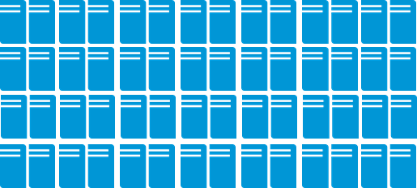

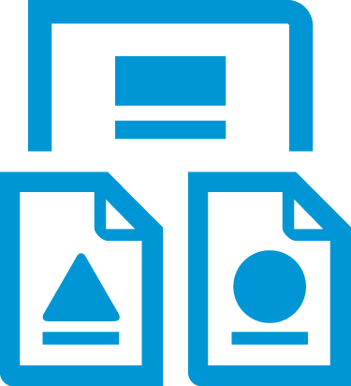
Cloud Óriások nem másolhatók, de a szemlélet átvehető
Két nagyságrenddel nagyobbak, maguk írják az alkalmazásaikat
Cloud Óriás
Hagyományos
Nagyvállalat
100X
Méret:
1,000,000+ szerver
~10,000 szerver
Teljes Kontrol
Alkalmazás:
Maguk írják
1000es számú alkalmazás csomag
Saját alkalmazások

Slide 5

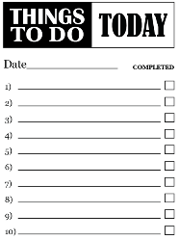
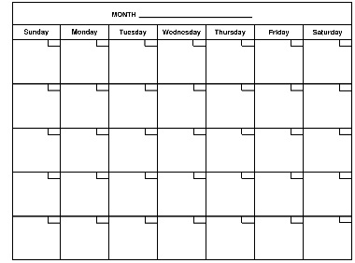
Cloud Óriások hatékonysága
Cloud Óriás
Hagyományos
Nagyvállalat
Működési Költség
20,000 szerver per admin
Emberi erőforrás~ 3X eszköz ár
Változáskezelés
x50
50+ update naponta
50 napos rollout tipikus

Slide 6
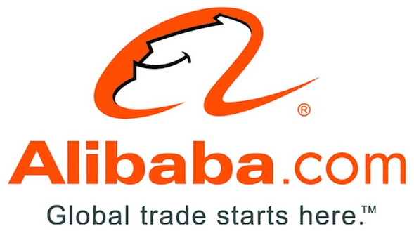


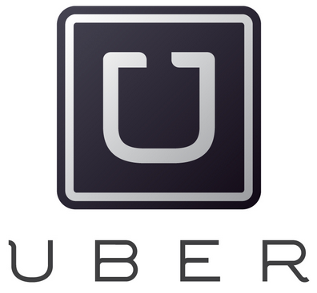
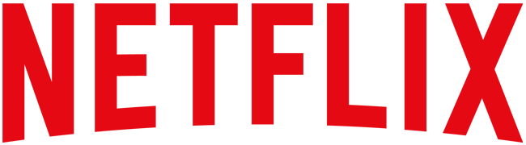
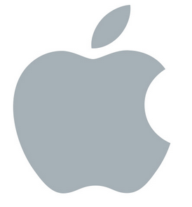

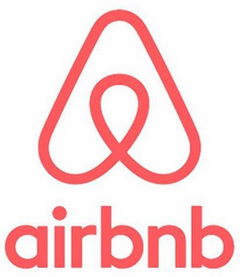

Ötlet alapú gazdaság (Idea Economy) más tipusú üzletet vár el
Világ legnagyobb áruháza………………………...........................
Világ legnagyobb Software Vállallata………………………………
Világ legnagyobb Telekom szolgáltatója…..………………………
Világ legnagyobb Szállás szolgáltatója…..………………………..
Világ legnagyobb Taxi vállalta.….………………...........................
Világ legnagyobb Mozi vállalta…………………............................
Világ legnagyobb média szolgáltatója…………………………….
Nincs raktára
Nincs alkalmazása
Nincs Telco Infrastruktúrája
Nincs ingatlana
Nincs járműprkja
Nincs mozi terme
Nincs saját tartalma

Slide 7

Legfontosabb prioritás az idő faktor
Jelenleg
Jövőben
Folyamatos
Változás
$
Value
$
Idea
Value
Value
Time
Time
Notes:
Let’s start with the why?
Success today is defined by how quickly an enterprise can turn ideas into value . . . how quickly you can experiment, learn fast, test, tune and make it better.
Many organizations focused on time to value are adopting approaches like DevOps that enable more continuous value creation. In a DevOps environment, development does not build code and then throw it over the proverbial wall for operations to deploy in a serial process. Instead, development specifies within software what the infrastructure build should look like. Operations provides development the parameters to use, but infrastructure becomes code.
Approach is being used by web-scale companies like Google and Facebook and also large enterprises. Developers already use infrastructure as code for apps deployed in a public cloud and want to use it for apps in a private cloud.
Now who is looking at this?
Transformational so led by senior executives and architects
Tend to be larger enterprises, though there are also medium sized firms … what they have in common are that they tend to be fairly sophisticated users of technology.
Same kinds of companies who are looking at internal deployments of OpenStack.
Across all verticals, with a particular interest by financial services firms.
Previewed with VP at a major financial institution, and his reaction was “You’ve just shown fire to a cave man”. Understood the value and how it bridged the traditional HPE BladeSystem environment with the leading edge work they were doing in a private cloud.
Listen for some of these catch phrases like ‘DevOps” and “Infrastructure as code”

Slide 8
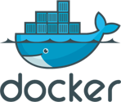

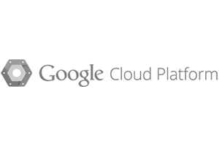
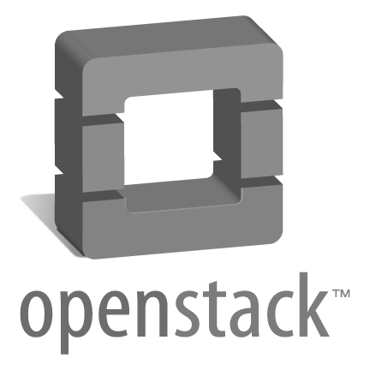
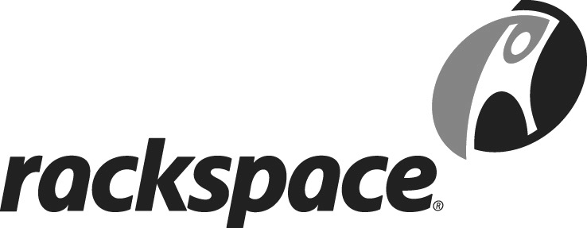
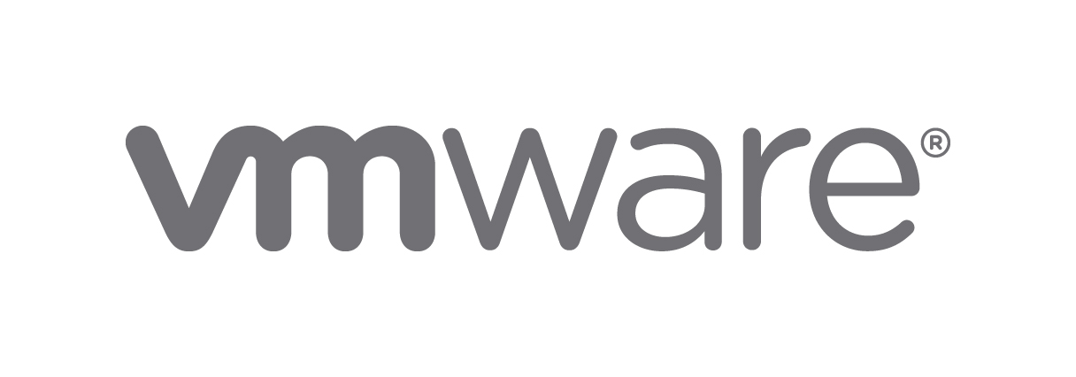
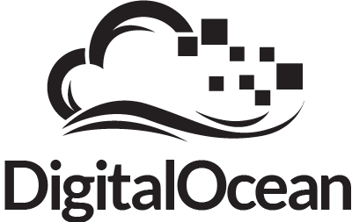
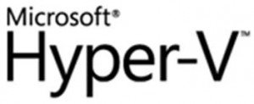

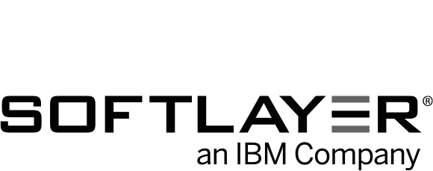
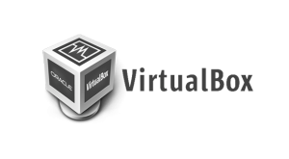
DevOps: Fejlesztés-Élesüzem közelség
Alkalmazás környezet változás - konténer
containers
Konténer kezelő infrastruktúra
Docker Konténerek a software környezet valamennyi elemét (filesystem, System library, system tool…) tartalmazzák, ami egy adott alkalmazás, kód futtatásához szükséges
Konténerek tartalmazzák az alkalmazást és a kernelen keresztül kommunikálnak más konténerekkel
Infrastruktúra függetlenek – Docker konténerek bármely környezetben futtathatók cloud (VM, OpenStack, public cloud Fizikai szerver)
Konténerek izoláltak, megosztják az OS kernelt, és a szükséges adatokat és könyvtárakat
Fejlesztők – Egy kód bármely környezetre
IT üzemeltetés – Egy környezet bármely alkalmazásra
Notes:
Docker containers wrap up a piece of software in a complete file system that contains everything it needs to run: code, runtime, system tools, system libraries—anything that can be installed on a server. This guarantees that it will always run the same, regardless of the environment it runs in. It gives programmers, development teams, and operations engineers the common toolbox they need to take advantage of the distributed and networked nature of modern applications.
Like in a virtualized environment, containers allow multiple applications to gracefully share the same underlying infrastructure. Containers running on a single machine share the same operating system kernel, which allows them to start instantly and make very efficient use of system resources.
Docker is based on open standards, allowing containers to run on all major Linux distributions and cloud platforms. Security is achieved through isolation—Docker containers are isolated from each other and from the underlying infrastructure.
Containerized applications are packaged with their configurations and dependencies, making it easier to share apps from machine to machine. This simplifies collaboration within development teams and between developers and testers. Since developers don’t need to worry about setting up and maintaining environments, they can put their full focus on creating new features, fixing issues, and shipping software.
A Docker host is an environment configured to run containers. Docker containers can run on any computer from a laptop to the cloud. To date, most large Docker environments have been deployed on the public cloud or inside virtual machines within enterprises. However, Docker containers running on top of bare-metal infrastructure, can reduce process latency.
Docker Machine lets users create Docker hosts on their computers, on cloud providers, and inside their data centers. It automatically creates hosts, installs Docker on them, then configures the Docker client to talk to them.
www.docker.com
Lightweight
Containers running on a single machine all share the same operating system kernel so they start instantly and make more efficient use of RAM. Images are constructed from layered filesystems so they can share common files, making disk usage and image downloads much more efficient.
Open
Docker containers are based on open standards allowing containers to run on all major Linux distributions and Microsoft operating systems with support for every infrastructure.
Secure
Containers isolate applications from each other and the underlying infrastructure while providing an added layer of protection for the application.
How is this different from virtual machines?
Containers have similar resource isolation and allocation benefits as virtual machines but a different architectural approach allows them to be much more portable and efficient.
Virtual Machines
Each virtual machine includes the application, the necessary binaries and libraries and an entire guest operating system - all of which may be tens of GBs in size.
Containers
Containers include the application and all of its dependencies, but share the kernel with other containers. They run as an isolated process in userspace on the host operating system. They’re also not tied to any specific infrastructure – Docker containers run on any computer, on any infrastructure and in any cloud.
How does this help you build better software?
When your app is in Docker containers, you don’t have to worry about setting up and maintaining different environments or different tooling for each language. Focus on creating new features, fixing issues and shipping software.
Accelerate Developer Onboarding
Stop wasting hours trying to setup developer environments, spin up new instances and make copies of production code to run locally. With Docker, you can easily take copies of your live environment and run on any new endpoint running Docker.
Empower Developer Creativity
The isolation capabilities of Docker containers free developers from the worries of using “approved” language stacks and tooling. Developers can use the best language and tools for their application service without worrying about causing conflict issues.
Eliminate Environment Inconsistencies
By packaging up the application with its configs and dependencies together and shipping as a container, the application will always work as designed locally, on another machine, in test or production. No more worries about having to install the same configs into a different environment.

Slide 9

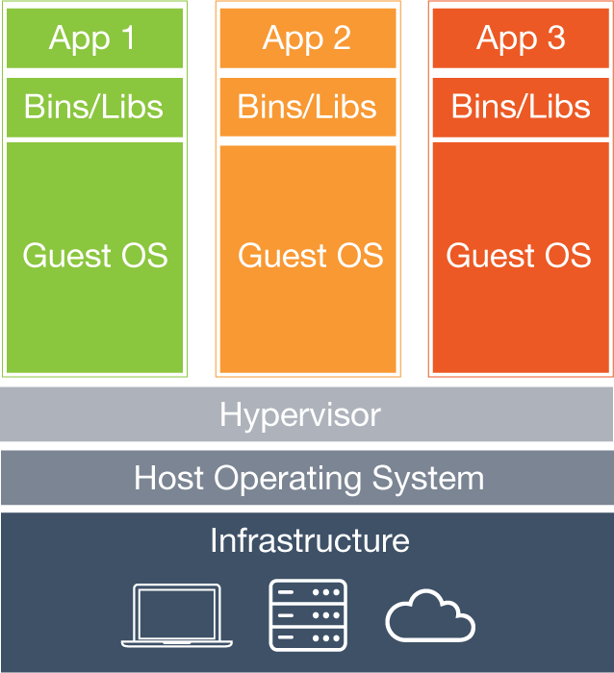
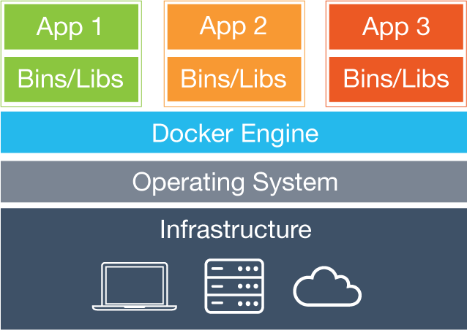
Mi a különbség a Virtuális géphez képest?
Konténerek a virtuális géphez hasonló erőforrás allokálást és izolációt biztosítanak, de a más architektúra nagyobb hatékonyságot és portabilitást biztosít.
Virtual Machine
Valamennyi Virtuális gép tartalmazza az alkalmazást annak teljes környezetével, operációs rendszerével együtt, akár néhányszor 10GB méretben
Konténer
Konténerek tartalmazzák az alkalmazást és annak futtatásához szükséges környezetet, könyvtárakat, de megosztják a kernelt. Szeparált Userspace környezetben futnak, megvalózsítva ezzel a biztonságot.

Slide 10
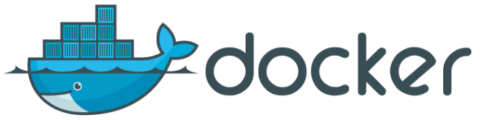








DevOps Fejlesztések: Infrastruktúra – mint Kód speciális „Composable” Fizikai Infrastruktúrát igényel
Egyetlen mód a fizikai Infrastruktúra közvetlen Dockerből történő provizionálására
Hogyan generálható gyorsan?
Provision hosts for docker-machine
Felhasználó/fejlesztő
HPE Composable Infrastructure API
OS Image
OS Image
OS Image
IT Szervezet/Üzemeltető
Hogyan Futtatható?
OS Image
OS Image
OS Image
Server
Storage
Networking
Notes:
Operations controls the deployment model by defining the build processes and templates.
Developers can take action directly with no manual handoffs and no complex change processes.
This ensures that configurations are deployed consistently and always from the same starting point. It removes the variability in the deployed environment and allows them to focus on app development and not infrastructure management.
It also provides an increased level of security and compliance by providing an on premise environment to develop, test and run Docker environments within their own networks, eliminating concerns for running on a public cloud

Slide 11


Hagyományos és Ötlet alapú alkalmazás támogatás
Két infrastruktúra modell támogatása a feladat
?
Hagyományos
alkalmazások
Működés centrikus
Ár fókuszú
Felhő
alkalmazások
Alkalmazás centrikus
Rugalmasság
fókuszú
Hagyományos
Üzletmenet
Ötlet alapú
Gazdaság
Hogyan támogathatjuk
mindkettőt?
Notes:
Meeting this challenge means leveraging the power of technology to quickly fuel the creative process and bring ideas to life. IT’s role must evolve from keeping the business running to accelerating time to business value. Although IT agrees with this new charter, it is difficult for them to deliver on these priorities as traditional infrastructure is optimized for stability, scalability, and performance but not for speed. In the Idea Economy, infrastructure must be the engine of value creation, not the bottleneck to success.
What has worked in the past isn’t going to work in the future, as IT must now be able to support two operating environments.
Traditional applications that are designed to support and automate existing business processes such as collaboration, data processing and analytics, supply chain, and web infrastructure.
A new breed of applications and services which drive revenue and new customer experiences by leveraging Mobility, Big Data, and Cloud Native technologies.
IT is being stretched in traditional environments to lower operating costs while at the same time being stretched in the new application environment to increase operational velocity.
--------------------------------------------------------------------------------
KEY TAKEAWAYS: Discuss the key challenge we’re hearing loud and clear that our customers are facing - bridging from traditional to the new style of business. They require the ability to do both. IT must be flexible to meet applications needs instantly.
Traditional: Customers find themselves with two modes of business that need to be addressed by IT and there’s nothing out there that allows them to do that with a single solution. From a tradition standpoint, we’re delivering technology solutions that are stable and allow customers to roll out applications and services in a very planned, longer term time frame. Support the business: Databases, OLTP, VMs (invisible)
New Style of Business : (Digital Enterprise, Digital Economy)
I.T. IS the business: Drives revenue/profit (mobile apps: res, bank)
With the emersion of cloud and other technologies, a new style of business is required, with more agility to do things more quickly to better drive more profitability into their organization agility
Our customers want to be relevant to and succeed at both
Our goal is to help them on the journey and to succeed at both
Discuss the key challenge in bridging from traditional to the new style: Bi-Modal
To help bridge, it would be great if one infrastructure could do both
To do that it would need to be able to flexibly change personalities
1) Reliable, low cost, secure
2) Agile, flexible, and fluid
Can’t be static, must take on different personas dynamically
Must be able to flex to what the application needs, not overprovision
There are fundamental differences in the tools and technologies required to run “traditional” and New Style of Business application workloads.
To meet both the different needs, companies are investing in two separate environments, which increases costs and complexity. Gartner calls this Bi-Modal computing
API proliferation, for example, with different or no APIs in traditional IT. And different API’s in new style of business.
We see a new class of infrastructure is needs which can Increase IT Efficiencies for Traditional Apps and enable Continuous Services Delvers for the New Style of Business

Slide 12
Új típusú Infrastruktúra megoldásra van szükség az új Üzletmenethez
Komponálható „Composable”
Egyszerűsített szolgáltatás alapú infrastruktúra
Hardware & Software alapú integrált architektúra
Rugalmas IT
Minden komponens Software defined
Fizikai, virtualizált, és konténer alapú alkalmazások
Percek, Másodpercek
Hyper-konvergens
  Egyszerűsített telepítés
  SAN elhagyásával egyszerűsített megoldás
  Rugalmas virtuális IT
  Software defined storage
  Virtuális alkalmazások
Órák, percek
Konvergens
Alkalmazás optimalizált
Napok
  Üzemeltetés optimalizált
Menedzsment alapú, elő tesztelt de rugalmatlanabb IT
Előkonfigurált fizikai Infra
Hardware definiált
Előre definiált alkalmazások
Hagyományos
Silo alapú
Bonyolult folyamatok
Statikus, siló alapú IT
Silókként szervezett
Fizikai, virtualizált, és konténer alapú alkalmazások
Hetek, hónapok
Komponálhatóság
Működés optimalizált
Notes:
Looking at the past couple of years, we have had Traditional Infrastructure that is siloed and can take months to stand up.
Then, we introduced Converged Infrastructure that is shared and where you can get to time to value in days.
Recent buzz has been a lot about Hyper-Converged which is indeed simpler and where you can go from power-on to provisioning virtual machines in minutes.
But what you really need is a Composable infrastructure that is fluid and is optimized to deliver infrastructure in seconds for both your traditional and new apps. Infrastructure for the Idea Economy.

Slide 13
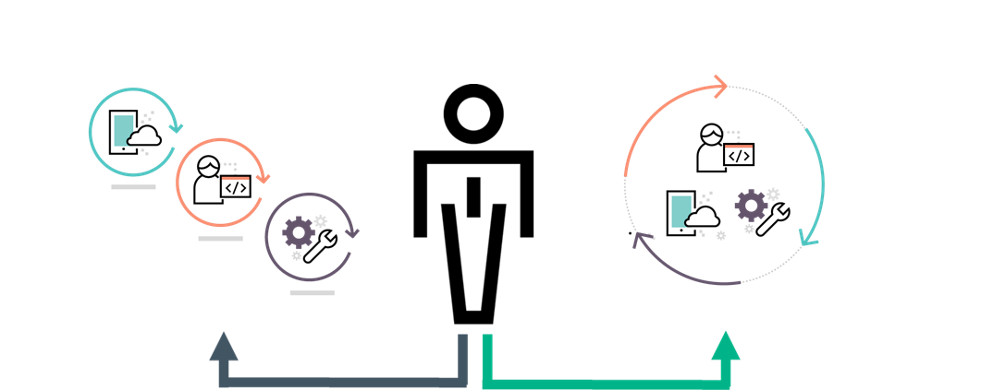

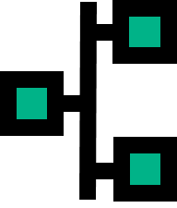


Komponálható „Composable” Infrastruktúra
Architektúrális alapelvek
Közös egyesített API
  Egyetlen közös pont az infrastuktúra valamennyi komponensének kezeléséhez.
  Teljes infrastruktúra programozhatóság
  Interface a fizikai komponensekhez az IaS szolgáltatáshoz
Komponálható Infrastruktúra
Rugalmas erőforrás halmazok
Közös infrastruktúra a csoportokba gyűjtött erőforrás halmazokhoz
Fizikai, virtualizált, és konténeres
Automatikus kapacitás kezelés
Közös API
API
Software Defined Intelligencia
Software-Defined Intelligencia
Rug. erőf.halmazok
Software-Defined Intelligencia
Template alapú erőforrás provizionálás
Rugalmas, folyamatos működés
Rug. erőf.halmazok
Notes:
Fluid Resource Pools
A single infrastructure with fluid pools of compute, storage, and fabric, so all the resources are now always available and can be instantly configured according to the specific needs of each application, reducing the need for costly infrastructure silos.
Single infrastructure of disaggregated pools of compute, storage and fabric that boots-up ready for any workload
Physical, virtual and containers
Auto-integrating of resource capacity
Software-Defined Intelligence
Internal software-defined intelligence with template driven, frictionless operations abstracts away the need for IT admins to understand operational minutiae of various hardware components replacing it with high-level, automated operations.
Template-driven workload composition
Frictionless operations
Unified API
The Unified API increases productivity and control across the data center by integrating and automating infrastructure operations and applications, eliminating time-consuming scripting of multiple varied low-level tools and interfaces.
Single line of code to abstract every element of infrastructure
Full infrastructure programmability
Bare metal interface for Infrastructure as a Service

Slide 14





Komponálható Infra optimalizálja az alkalmazás és szolgáltatás szinteket
Hagyományos infrastruktúra statikus, bonyolult, erőforrás pazarló
Rugalmas erőforrás halmazok
  Előrekonfigurált statikus fizikai IT vagy virtual IT
  Túl- tartalékolt erőforrás pocsékló infrastruktúra
  Bonyolultság és az ár a mérettel nő
Kapacitás gazdálkodás csoportokba gyűjtött erőforrás halmazokon
Valamennyi az alkalmazás számára szükséges erőforrás azonnal rendelkezésre áll
Biztosítja az erőforrás halmaz optimális kihasználását
Kihasználatlan kapacitás eltávolítható
Kihasználatlan kapacitás
Alacsony ROI
Rugalmas erőforrás halmazok
Notes:
So if we look at where we came from with traditional infrastructure we have a collection of kind of siloed products, we have servers, storage and networking products, and typically when you go deploy these things it’s very complex because you build up all these silos and you have to connect them all together, the process takes a long time and customers figure, well the last thing I want to do is do that again, so they tend to overprovision the infrastructure, sometimes it can be as much as 80% or 2X more than what is actually needed. And with that overprovisioning of course comes with additional cost as well so you spend a lot more CAPEX up front but then of course you have to keep that infrastructure maintained which means you spend more on OPEX over time as well. So what we do is we take that instead and replace it with fluid pools of compute, storage and fabric. What we do is take the essence of the server, storage, and networking and reduce it down to its bare elements, compute, storage, and fabric that can kind of start their lives as stateless and anonymous resources that can then be easily combined and configured to deliver to the needs of an application in a near instantaneous fashion. As more infrastructure is added in it’s auto-assembled with the existing infrastructure so it’s ready to go and just becomes part of the pool of capacity. Because it’s so easy to combine resources on the fly it really eliminates the need to so dramatically overprovision infrastructure, and instead allows infrastructure to be provisioned right sized and easily grown or shrunk as needed.

Slide 15




Komponálható Infrastruktúra felgyorsítja a szolgáltatás létesítést és csökkenti az üzemeltetés nehézségét
Hagyományos Infrastruktúra bonyolult – több független Siló
Rugalmas erőforrás halmazok
Software-Defined intelligencia
Egyetlen menedzsment interface integrálja a silókat
Integrált intelligencia megszünteti a bonyolultságot
Template alapú menedzsment felgyorsítja a szolgáltatás
létesítést
Rugalmas változás kezelés megszünteti a felesleges
leállásokat
  Külön Software réteg bonyolult komplex kezelés
  Hardware template alapú
  Bonyolult lifecycle management, függőség kezeléssel és leállással
Software-defined Intelligencia
Rugalmas erőforrás halmazok
Notes:
HPE Synergy enables IT to accelerate application and service delivery through a single interface that precisely composes and recomposes logical infrastructures into any combination at near-instant speeds. Composable resources are provisioned together with their state (bios settings, firmware, drivers, protocols, etc.) and the Operating System image using repeatable templates. This is ideal for traditional IT as well as DevOps approach as it eliminates time-consuming provisioning processes across operational silos that often delay projects for weeks or months. With
HPE Synergy reduces operational effort and cost through internal software defined intelligence with template driven, frictionless operations. Templates define how the infrastructure needs to function, and the infrastructure’s internal software defined intelligence implements the needed changes programmatically without human intervention.
This changes the paradigm of how infrastructure is managed. Historically, change operations required coordination across multiple teams, multiple tools and complex interdependent processes that can often take weeks to complete. HPE Synergy abstracts away operational minutia replacing it with high-level, automated operations. Now, change operations such as updating firmware, adding additional storage to a service, or modifying network connectivity are automatically implemented via a template, significantly reducing manual interaction and human error. This empowers IT to configure the entire infrastructure for development, testing, and production environments using one interface and in one step with precision, accuracy, and speed.

Slide 16

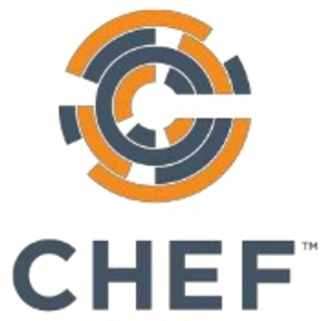


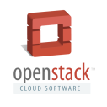
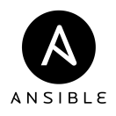
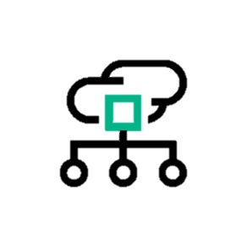
Komponálható Infrastruktúra növeli a produktivitást és az egész adatközpontra kiterjedő ellenőrzést
Rugalmas erőforrás halmazok
Rugalmas erőforrás halmazok
Software-defined intelligencia
Software-Defined intelligencia
Composable Infrastruktúra
Egységes API
Egységes API
Egyetlen API valamennyi infrastruktúra komponens
programozásához
Nyitott integráció megnöveli az infrastruktúra hatékonyságát a teljes adatközpontban
Másodpercek alatt biztosítható a változtatás
Egységes API
Software-defined Intelligencia
Rugalmas erőforrás halmazok
Notes:
HPE Synergy increases productivity and control across the data center by integrating and automating infrastructure operations and applications through a unified API. The unified API provides a single interface to discover, search, inventory, configure, provision, update, and diagnose the composable infrastructure. A single line of code fully describes and can provision the infrastructure required for an application, eliminating time-consuming scripting of more than 500 calls to low-level tools and interfaces.
In traditional environments, IT can now automate their IT operational processes and design their workflow around enterprise needs. For the new breed of applications, DevOps can now automate applications through infrastructure deployment, scaling, and updates. The unified API aggregates physical resources in the same way as virtual and public cloud resources, so developers can code without needing a detailed understanding of the underlying physical elements.
This fully programmable interface integrates into dozens of popular management tools such as Microsoft SystemsCenter®, Redhat®, and VMWare vCenter®, among others. It is also future proofed by integrating into open source automation and DevOps tools such as Chef, DockerTM, and OpenStack.

Slide 17
Köszönjük a figyelmet
Zeisel Tamás
tamas.zeisel@hpe.com

