Slide 1
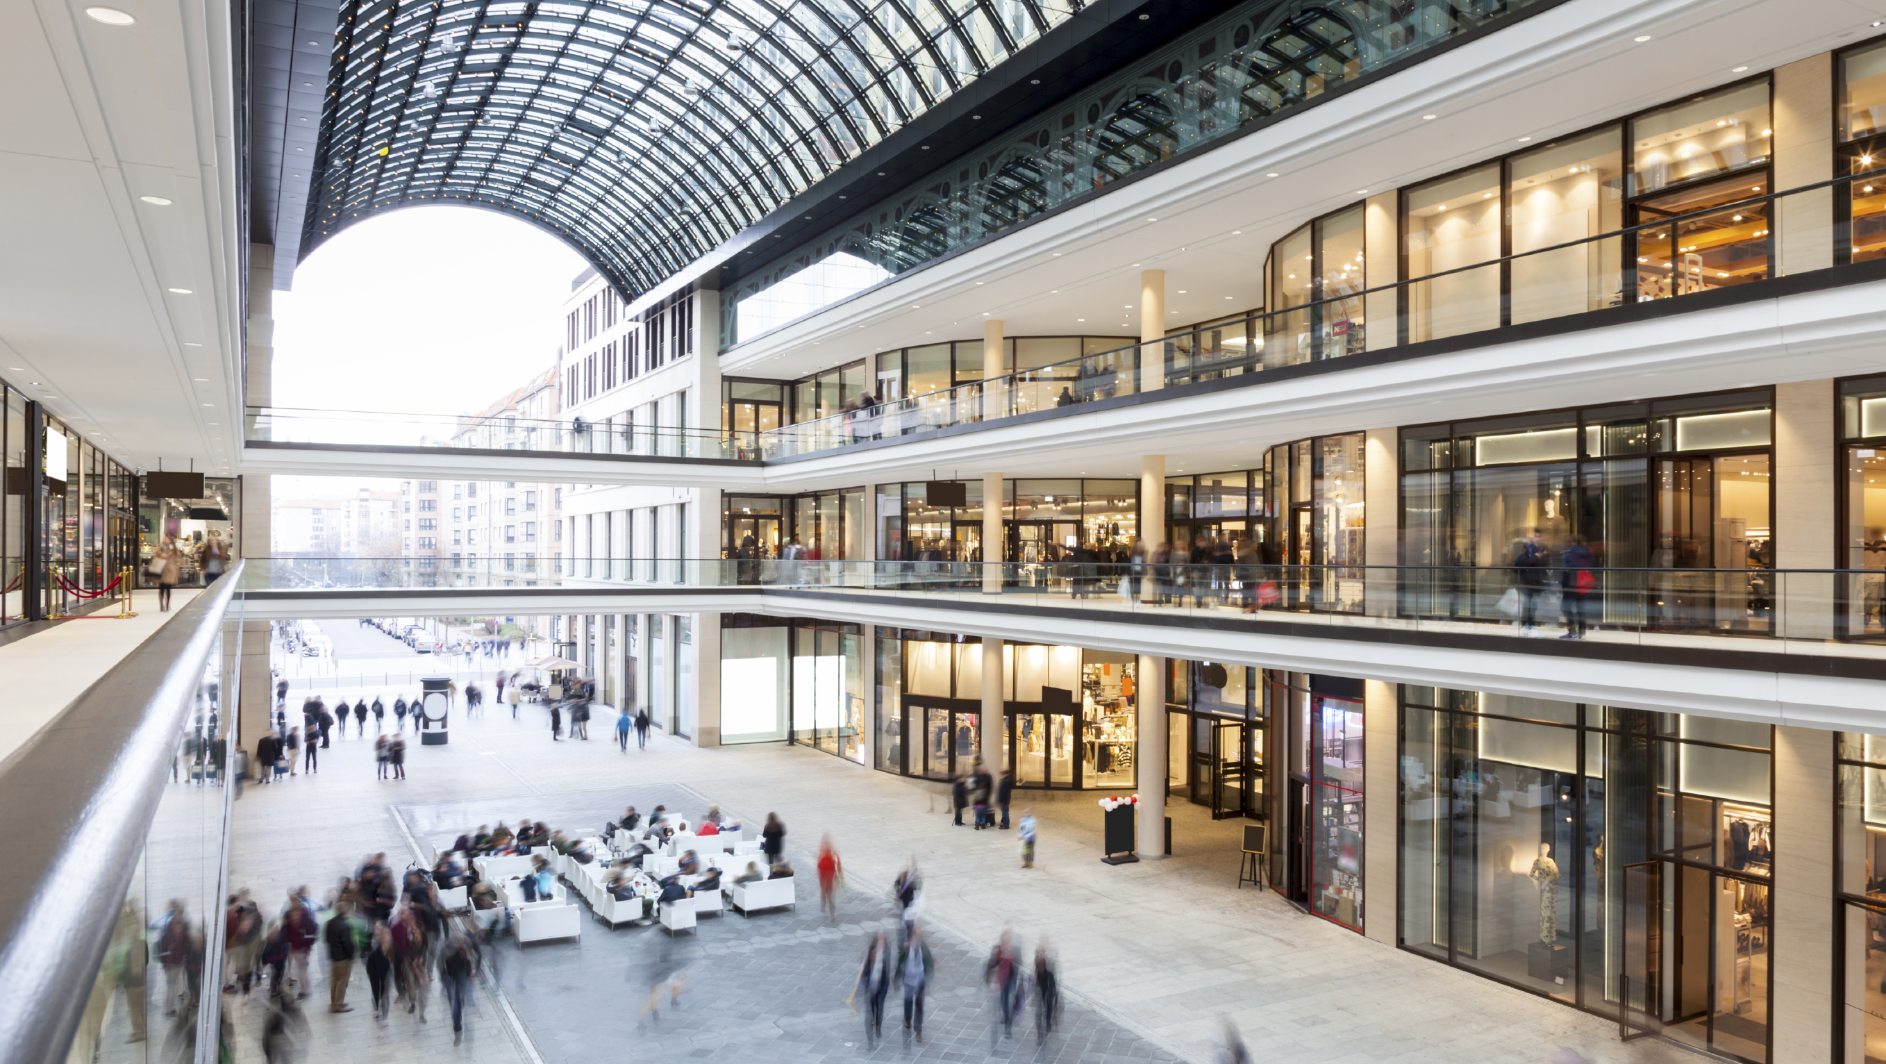
Hyperconvergence
Janos Strausz,
June 23th 2016
Notes:
Notes Duarte: Look for more branch or retail intro background

Slide 2
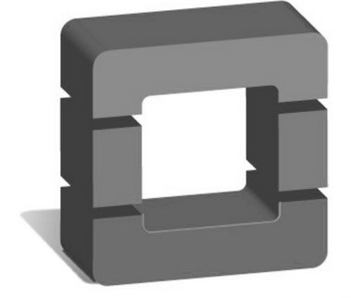
Applications Drive Architecture Diversity
Freestanding
infrastructure
Integrated Infrastructure
Hyperconverged
Scale Out
Mainstream Business Applications
OLTP, ERP, Database, Collaboration
Virtualized Applications
Desktop Virtualization
Production Cloud
Lighter, Virtual Only
VDI
Branch/Remote
Big Data
Industrial Grid
Test/Dev
DevOps Cloud
EDA
APPS
Infrastructure
Pre-Engineered with App Sizing
Platform Level Automation
Flexible Resource Ratios
Appliance Model
Fixed Resource ratios
Storage Virtualization
Bare Metal
Disk-optimized Rack Mount Servers
A La Carte Design
Servers, Networking, SAN
Attributes
Notes:
Andy Butler: the vast majority of IT will still need to operate on the first two modes, even though the two on the right are sexy and growing fast. TB: need to find some data to show the mix here 80% left 20% right
VO: You will need some or all of these infrastructure architectures
- On the left we have centralized storage, on the right the applications utilize or virtualize local server storage
Jeremy: divide workloads into multi-purpose vs. engineered such as exalogic
There is a cost/labor trade off as you move from a la acarte to converged to hypercoverged.

Slide 3
Market Shifting Towards Server-Based Ecosystem
$45,000
$40,000
$35,000
$30,000
Hyper
Converged
Infrastructure
$25,000
$20,000
Traditional
Network
Storage
$15,000
$10,000
$5,000
$0
2012 2013 2014 2015 2016 2017 2018 2019 2020 2021 2022 2023 2024 2025 2026 2027
~$1B
~$15B
Source: Wikibon Server SAN Research 2014
Notes:
Redo chart, change colors, make chart bigger

Slide 4
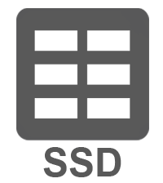
What Is Hyperconvergence?
Traditional Approach
SERVERS
On-Demand
Agile
Efficient
Simple
APP
••••••••••••
+
APP
APP
APP
+
SERVER VIRTUALIZATION
+
•••••••••••••••
CPU
CPU
+
CPU
CPU
MEM
MEM
MEM
MEM
Hyperconvergence
+
On-Demand
Agile
Efficient
Simple
Scalable
Enterprise Ready
Cost Effective
STORAGE
APP
•••••••
+
APP
APP
APP
APP
APP
+
–
1-3yr Planned
Large Footprint
Inefficient
Complex
HYPERCONVERGENCE
+
–
CPU
•••••••
+
MEM
CPU
+
–
MEM
–
+
Traditional NAS
Hybrid Storage
All Flash Storage
NO LEGACY STORAGE CONTRUCTS
Vendor E
Vendor N
Vendor P
Notes:
Adjust colors

Slide 5
Software Modules inside a Server
VM
VM
VM
VM
VM
VM
VM
VM
VM
VM
VM
VM
VM
VM
VM
HYPERVISOR/
CONTROLLER
VM
HYPERVISOR/
CONTROLLER
VM
HYPERVISOR
CONTROLLER
VM
HYPERVISOR
CONTROLLER
VM
HYPERVISOR
CONTROLLER
VM
HYPERCONVERGED DATA PLATFORM
HYPERCONVERGED DATA PLATFORM
HYPERCONVERGED DATA PLATFORM
HYPERCONVERGED DATA PLATFORM
VM
VM
VM
VM
VM
HYPERVISOR
CONTROLLER
VM
IOVisor
VAAI
DATASTORE/VOLUME
HDD
SDD
HDD
SDD
Controller VM has
Direct access to drives
VAAI Plugin offloads snapshots and clone operations
IOVisor Module Presents NFS to ESX and Stripes IO

Slide 6
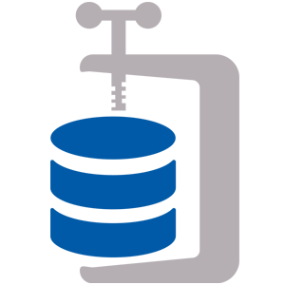
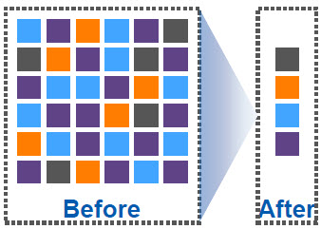
2-5X Data Reduction without impacting performance
Inline Deduplication 20-30% space savings
Inline Compression 30–50% Space Savings
No Special Hardware
No Performance Impact

Slide 7
Common Use Cases
VIRTUAL DESKTOP INFRASTRUCTURE
SERVER VIRTUALIZATION
TEST & DEVELOPMENT
Low upfront costs
Consistent performance
Predictable scaling
Reduce operational complexity
Adaptive Scaling
Always-on resiliency
Agile provisioning
Frequent iterations
Instant cloning and snapshots

Slide 8
Thank You.

