Slide 1
Gondolatok az adattárolás jövőjéről
Pulai András

Slide 2
Mi az ami várható?
„Gazdaságos” SSD (1.92TB, 3.84TB)
Nagy és gazdaságos SSD (8TB)
Hatalmas NL-SAS diszkek (10TB)
LTO-7 szalagok (300MB/s írásra tömörítés nélkül, 6TB/kazetta) *2
Teret nyernek az All-Flash tárolók
Eltűnnek a 15K-s diszkek és a SAS jövője is bizonytalan
Ez egy picit unalmas …

Slide 3
Mi az ami látható?
Csökken (drasztikusan) a kapacitás / sávszélesség arány
Baj van a RAID-del:
  olyan hosszú újraépítési idők jelennek meg, hogy az már nem elfogadható
  Minél nagyobb diszkek lesznek, annál hangsúlyosabban jelenik meg a probléma
  Vannak persze mentőötletek (fast rebuild kialakítás)
Baj van a fájlrendszerekkel:
  Olyan számosságú állományban gondolkodunk, amivel már nehezen bírkóznak meg a fájlrendszerek
  Mentés – helyreállítás nagyon nehéz – különösen nagy mennyiségben
Alternatív megoldások születnek

Slide 4
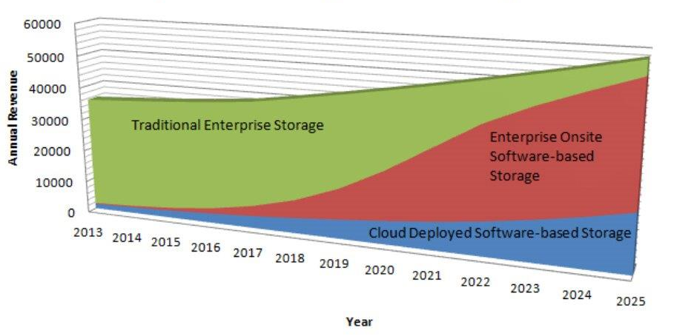
Enterprise Data Storage Market
Transition Projection
Source: Suse
$1.4 Billion in 2014 to $6.2 Billion by 2019
Estimated Compound Annual Growth Rate (CAGR) of 34.6% from 2014 to 2019.
By 2018, open-source storage will gain 20% of the market share, up from less than 1% in 2013 (Gartner)
Notes:
Trend
New Offerings
Why Impact on workloads and applications

Slide 5
Software-based vs Software defined storage
Software-based Storage describes a method of separating physical storage hardware, typically on x86-based servers in volume configurations from leading server vendors, from the storage management and virtualization logics
Software-based storage solutions are sometimes also referred to as software-defined storage but as this term is mostly used by one vendor (VMware) the industry introduced a broader definition with Software-based storage

Slide 6
Példák: Software Based Storage megoldásokra
GlusterFS – amit re-brandeltek "Red Hat Gluster Storage".
Ceph – elosztott fájlrendszer (Inktank storage fejlesztette – amit megvett az RH)
Lustre FS – ez is egy elosztott FS
Hadoop FS – ez egy harmadik fajta elosztott FS
VMware VSAN (ja nem, ez a SW defined! ☺ )
MSFT Storage Spaces

Slide 7
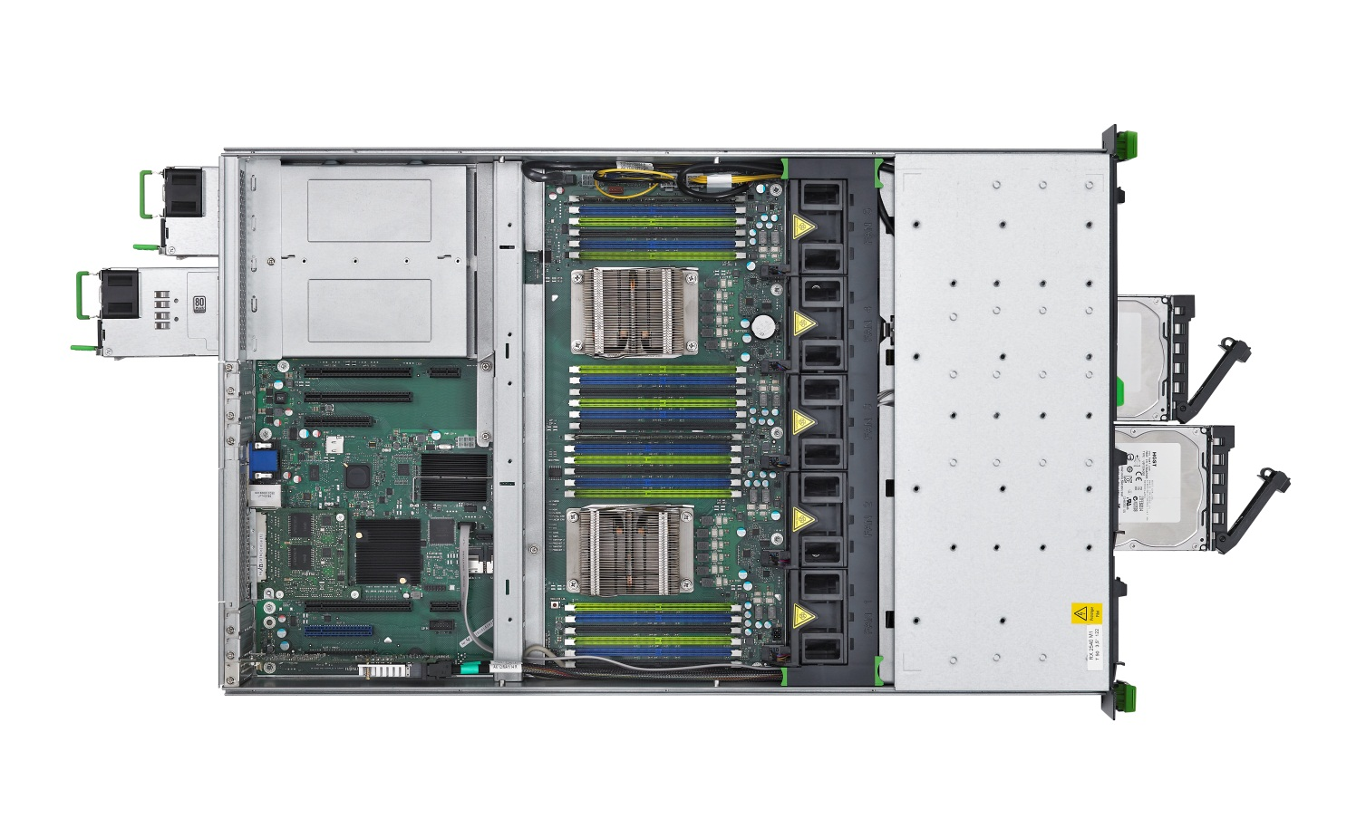
Ez szerver vagy tároló? 24 diszk megy bele, és RX2540 M1-nek hívják
Memory
ECC
Hot spare, Mirroring,
Scrubbing, SDDC, …
Intel® Xeon® processors:
Automatic Server Restart
and Reconfiguration (ASR&R)
Intel® Secure Key
Intel® OS Guard
Fans
Redundant
hot-plug/easy change
HDDs / SSDs
Hot-plug
Easy change
Power Supplies:
Redundant
hot-plug
Highly efficient
Status info:
LocalView
LSD or LSP
LEDs, switches
DynamicLoM
HDD Controllers
Integrated Mirroring
on board RAID and
choice of PCI RAID controllers
FBU
Management
Remote Service
iRMC
Temperature
Control
Cool-safe® ATD
PCI and PCIe
Hot-plug
Notes:
PRIMERGY systems and the built-in components provide a variety of functions to increase reliability

Slide 8

Software-based
Storage: Ceph

Slide 9
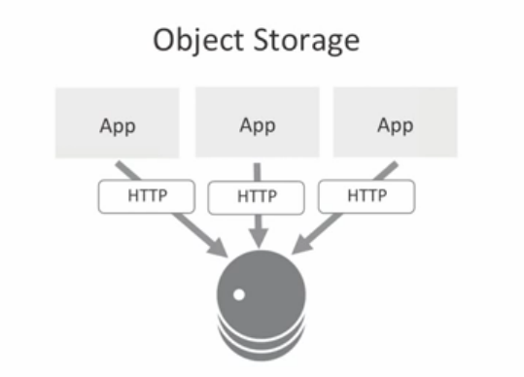
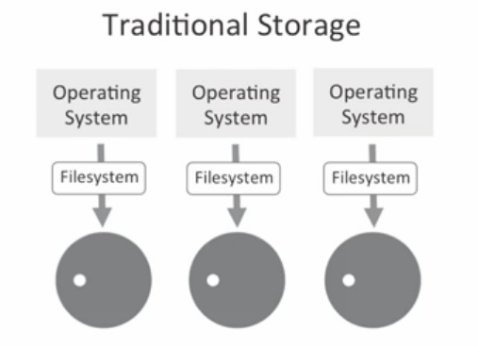
Ne csak fájlrendszerben gondolkozzunk!

Slide 10
True Scalability, Disaster Resilience, Seamless Lifecycle
RAID
SW based approach / Ceph
Access network
Controller 1
Controller 2
Node 1
Node 2
Node 3
Node 4
…
Limited Scalability
DR only with multiple systems and additional software
Major migration efforts at EOSL
Unlimited Scalability
Built in DR
Seamless migration to new nodes, no EOSL
Notes:
The figure shows the architectural differentiation between conventional scale-up vs. distributed scale-out storage systems and how the controller and nodes resilience is achieved. The scalability of the distributed model is very high based on its node characteristics.
In the distributed scale-out model which is part of the ETERNUS CD10000, multiple server nodes and drives can fail because of the node-way resilience of the architecture. Due data placement and management algorithm all nodes of the scale-out model can automatically coordinate the replication and the recovery in a short timeframe. This provides the ETERNUS CD10000 system with full redundancy for the data and the coordination for the recovery will be done automatically by the nodes. One of a big benefit of this technology is certainly the fact that no “planned downtime” of the system is necessary anymore and we are talking about “zero downtime” scenarios. This also emphasizes the high availability model of the data structure.

Slide 11

Ceph
Ceph is an open source, software defined storage platform
Designed to present object, block, and file storage from a distributed x86 compute cluster, scalable to the Exabyte level
Data are replicated over disks and nodes, delivering fault tolerance
The system is designed to be both self-healing and self-managing
Objective is to reduce investment and operational costs
Ceph is part of the OpenStack project
Ceph software is the core storage element
of the OpenStack project
OpenStack enables IT organizations building private
and public cloud environments with open source software


Notes:
The question at this point is really: How does the system handle and manage this new distributed file system?
The key for this performant and high failure tolerance comes with the OpenSource based software Ceph which is part of the OpenStack project.
The explanation what Ceph is and how it works in general is described in the slides.
Important is that the new scale-out storage from Fujitsu has implemented and refined the Ceph software and OpenStack developments.

Slide 12
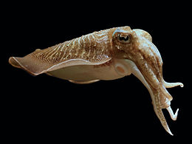
Honnan jön a Ceph?
Válasz: az Inktank és a Cephalopodák
InkTank: SW cég, aki elkezdett fejleszteni egy SW alapú tároló megoldást.
A tinta-tartáylban, nyilván tintahalak laknak
A tintahal egy Cephalopoda, mert
A közönséges tintahal vagy szépia
(Sepiaofficinalis) a fejlábúak
(Cephalopoda) osztályának
a tintahalak (Sepiida) rendjébe, ezen belül a törpeszépiák (Sepiidae) családjába tartozó faj.

Slide 13
CRUSH Data Placement – A Ceph lelke…
Controlled Replication Under Scalable Hashing (CRUSH)
Metadata computed instead of stored
Almost no central lookups
No hot spots
Pseudo-random, uniform (weighted) distribution
Dynamic adaption to infrastructure changes
Adding devices has no significant impact on data mapping
Infrastructure aware algorithm
Placement based on physical infrastructure
E.g., devices, servers, cabinets, rows, DCs, etc.
Easy and flexible placement rules
"Three replicas, different cabinets, same row"
Quickly adjusts to failures
Automatic and fast recovery from lost disks



CRUSH




Nem beszél RAID-ről…
Notes:
The core technology enabler for allocation of data is managed by the CRUSH data placement that controls and manages the ETERNUS CD10000 appliance.
Instead of producing hot spots which is the usual way of acting in conventional scale-up storage systems, the ETERNUS CD10000 works with a pseudo-random and uniform (weighted) distribution to establish a homogeneous allocation of the data.
Therefore adding new devices (HDDs or nodes) will have no negative impact on the data mapping. The new devices become part of the system without effects of bottle-necks or hot-spots.

Slide 14
Ceph – Architectural components
APP
HOST/VM
CLIENT
Ceph Object Gateway (RGW)
A web services gateway for object storage, compatible with S3 and Swift
Ceph Block device (RBD)
A reliable, fully-distributed block device with cloud platform integration
CEPH FS
A distributed file system with POSIX semantics and scale-out metadata management
LIB RADOS
A library allowing apps to directly access RADOS (C, C++, Java, Python, Ruby, PHP)
RADOS
A software-based, reliable, autonomous, distributed object store comprised of self-healing, self-managing, intelligent storage nodes and lightweight monitors

Slide 15
Miért Ceph?
Nincs benne meta adat szerver / bármilyen kitüntetett szerver
Nincs benne „szűk keresztmetszet”
Ez egyértleműen hatalmas előny!

Slide 16
Software Architecture
Generic-OS
ESX
Generic-Block
Generic-File
S3
Open-Stack
Hyper-V
NFS-Client
SMB-Client
Generic-File
App
Solaris, XEN,
Hyper-V, ESX
S3
Swift
kvm
Hyper-V
Ceph
Client
FC
IB
iSCSI
FCoE
/dev
/mnt
RGW
NFS-
gane-
sha
SMB-
samba
Ceph-
fuse
LIO-Target
rbd.ko
ceph.ko
librgw
librbd
libcephfs
libceph.ko
librados
Storage
Node
RADOS = OSD-Swarm
not yet implemented
experimental

Slide 17
Workloads requiring business-centric storage
ETERNUS CD
Application-centric
FASTER
FASTER
Business Process Management
OLTP
Databases
BIGGER
Video
& Audio
ERP/CRM/ SCM
Collaboration UC/ Sharepoint/Mail
Backup
& DR
Enterprise
Sync & Share
Business Intelligence Solutions
CCTV
Solutions
Capacity-optimized
OpenStack
Virtualization
VMware/Hyper-V
Performance-optimized
BigData
OLAP
Data Mining / Warehousing
Online Archiving
HPC Solutions
Object Storage
File Services
ETERNUS DX
Infrastructure-centric

Slide 18

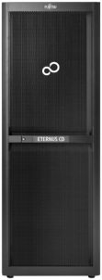
Ceph Challenge: Installation
Manual Ceph Installation (Plain Ceph)
  Setting-up a Ceph cluster with 240+ OSDs
    1.5 – 2 admin days
  Adding an additional node
    from 3 admin hours up to half a day
Automated installation (CD10000)
  Setting-up a Ceph cluster with 240+ OSDs
    1 hour
  Adding an additional node
    0.5 hour

Slide 19
Összefoglaló
Jelennek meg újabb nagyobb diszkek
Érezhetően probléma van a hagyományos
RAID szervezéssel, méret/sávszélesség arányokkal
Megjelent egy SW irányú eltolódás a piacon
  Egyszerű, sok diszkes szerverek
  JBOD jellegű egyszerű tárolók
Van aki árul Ceph alapú tárolót

Slide 21
SERVICE MODELS / WORKLOADS
TRADITIONAL WORKLOADS
Stateful VMs, application defined in VM
Big VMs: vCPU, vRAM, local storage inside VM
Application SLA = SLA of VM
SLA requires enterprise virtualization features to keep VMs highly available
Lifecycle measured in years
VMs scale up: add vCPU, vRAM, etc.
Applications not designed to tolerate failure of VMs
CLOUD WORKLOADS
Stateless VMs, application distributed
Small VMs: vCPU, vRAM, storage separate
Application SLA not dependent on any one VM
SLA requires ability to create and destroy VMs where needed
Lifecycle measured in hours to months
Applications scale out: add more VMs
Applications designed to tolerate failure of VMs

Slide 22

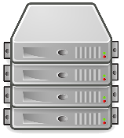



SERVICE MODELS / WORKLOADS
TRADITIONAL
WORKLOADS
CLOUD
WORKLOADS
Pets are unique, lovingly hand raised and cared for
They are given names
When they get ill you nurse them back to health
Cattle are almost identical to each other
They are given numbers
When they get ill you get another one
Credit : Bill Baker @ Microsoft & Tim Bell @ CERN

Slide 23
OpenStack Architecture
Heat
Orchestrates cloud
Horizon
Provides UI
Provides network connectivity for
Neutron
VM
Provides volumes for
Provides images for
Cinder
Nova
Glance
Stores images in
Swift
Provisions
Monitors
Ceilometer
Provides auth for
Keystone
Backups volumes in
As of Havana
Notes:
Havana Status
Trove starting with Icehouse missing
Sahara starting with Juno missing
Ironic starting with Juno missing (FJJ Focus)

Slide 24

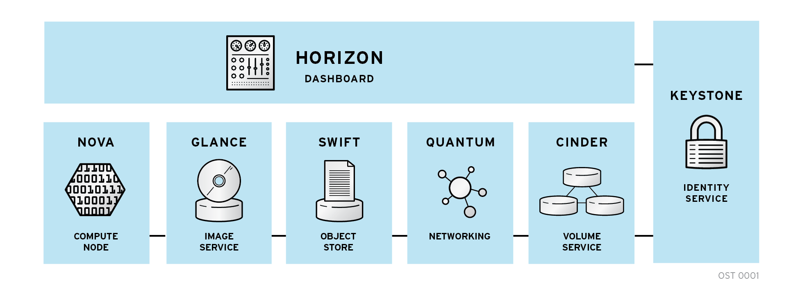
OPENSTACK ARCHITECTURE
Modular architecture
Designed to easily scale out
Based on (growing) set of core services
Neutron

