Slide 1
Managing Hurricane Sandy without loss of service
Gergely Tomka, Tamas Csillag

Slide 2
Technology at Morgan Stanley is…
Extensive Scale
The Firm invests significantly in technology infrastructure and development annually. This investment results in quantitative trading systems, cutting-edge modelling and simulation software, comprehensive risk and security systems, and robust client relationship capabilities, plus the worldwide infrastructure that forms the backbone of these systems and tools
Our global network of 7,000 technologists, 72,000 physical servers, 34 petabytes of storage, works in 24 countries around the world, and develops 80% of the Firm’s business applications in house
Innovation to Pioneer New Capabilities
Designed a cross-asset algorithm and high-frequency trading platform with single-digit microsecond latency
Developed mobile app, allowing clients to read Morgan Stanley research on their iPhone, iPad, or Android device
Deliver flex-based framework that empowers users to customize their queries and web components in real time

Slide 3
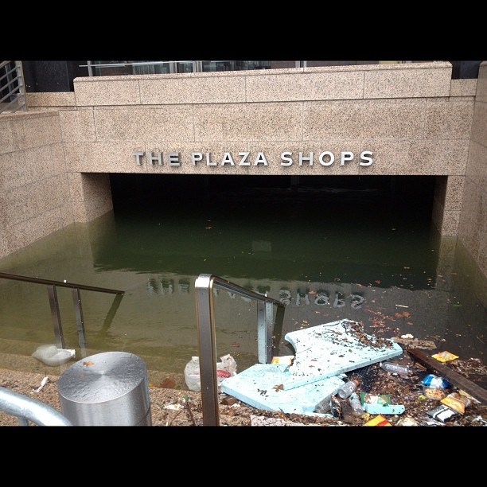

Slide 4
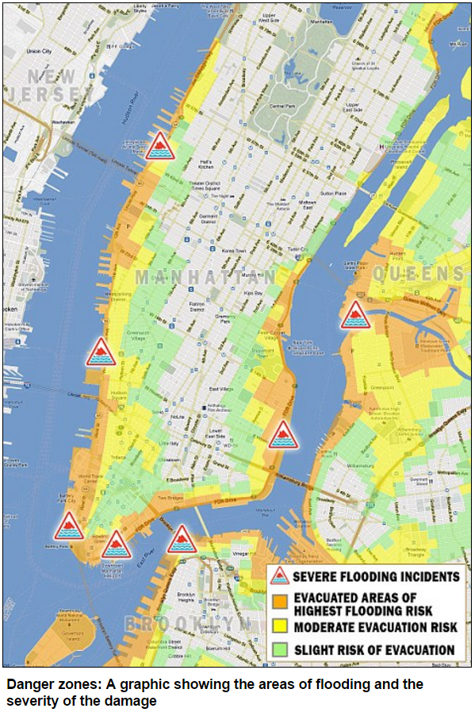

Slide 5
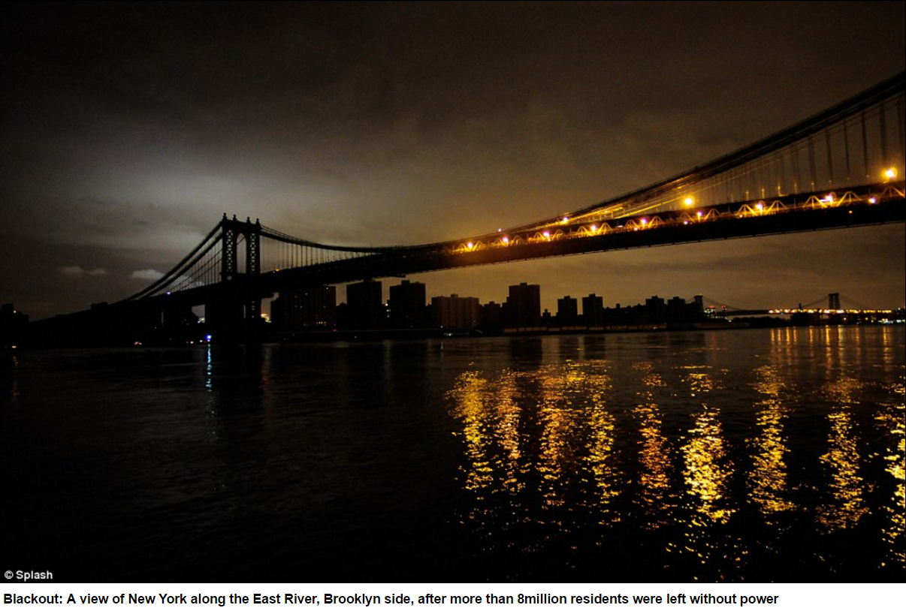

Slide 6
Preparations
Hardware
Building failovers (VCS – SAN – AFS)
Fuel stores check and refill
Consultations with FEMA, electricity providers etc.
Wetware
Follow-the-sun changes, Asia and Europe takes over half-shifts
Business continuity sites check (ie. office space for evacuated people)
Convincing the folks in New York that they have to evacuate

Slide 7
Long term changes
Abandonment of downtown datacenters
Cost is another driver
Migrating decade old services is a learning opportunity
Improved clustering and resource handling
Different fencing solutions
Improved build tools
Container based services, “private cloud”
Updated DR plans

