Slide 1
Zoltán Balázs MRG Effitas
A ransomware jelenség
mellet nem lehet elmenni

Slide 2
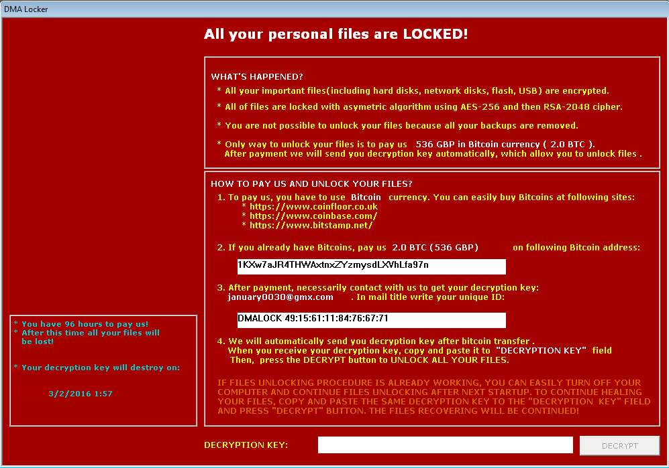

Slide 3
Main problems with ransomware detection
Any reactive technology will fail
Antivirus signatures
IDS/IPS
Spam filter
Previously, reactive malware detection was fine for most people, it was OK if the malware was found in 24 hours
With ransomware, 1 hour detection rate is a real issue
Reputation based protection is a lot better than signatures

Slide 4
(Almost) Free tips - exploit
Enforce Chrome for Internet browsing
Use EMET free
It only protects IE, but not Firefox or Chrome!
Instead of EMET, use paid MBAE or HitmanPro Alert
The paid versions protect all browsers against exploits

Slide 5
(Almost) Free tips - macro
Macro malware
Disable all macros except digitally signed macros OR
Office 2016 GPO Block macros from running in Office files downloaded from the Internet

Slide 6
(Almost) Free tips
Whitelist C:\Users\ execution
Windows built-in Applocker
http://www.mcbsys.com/blog/2013/10/block-user-folder-executables/
.exe, .scr, .com, .js, .jse, .wsh, .vbs, .cs, .cab, …
This is a lot of work, lot of things will break. But works.
Backup
Offline backup is more important than ever
Show hidden file extensions
Use generic ransomware protection product
Comparative test coming soon ;P

