Slide 3
ancient dice
Ancient dice

Slide 4
Phil Toledano - Epic win
3 billion hours of game play a week
$8bn splashed out on game credit a year

Slide 5
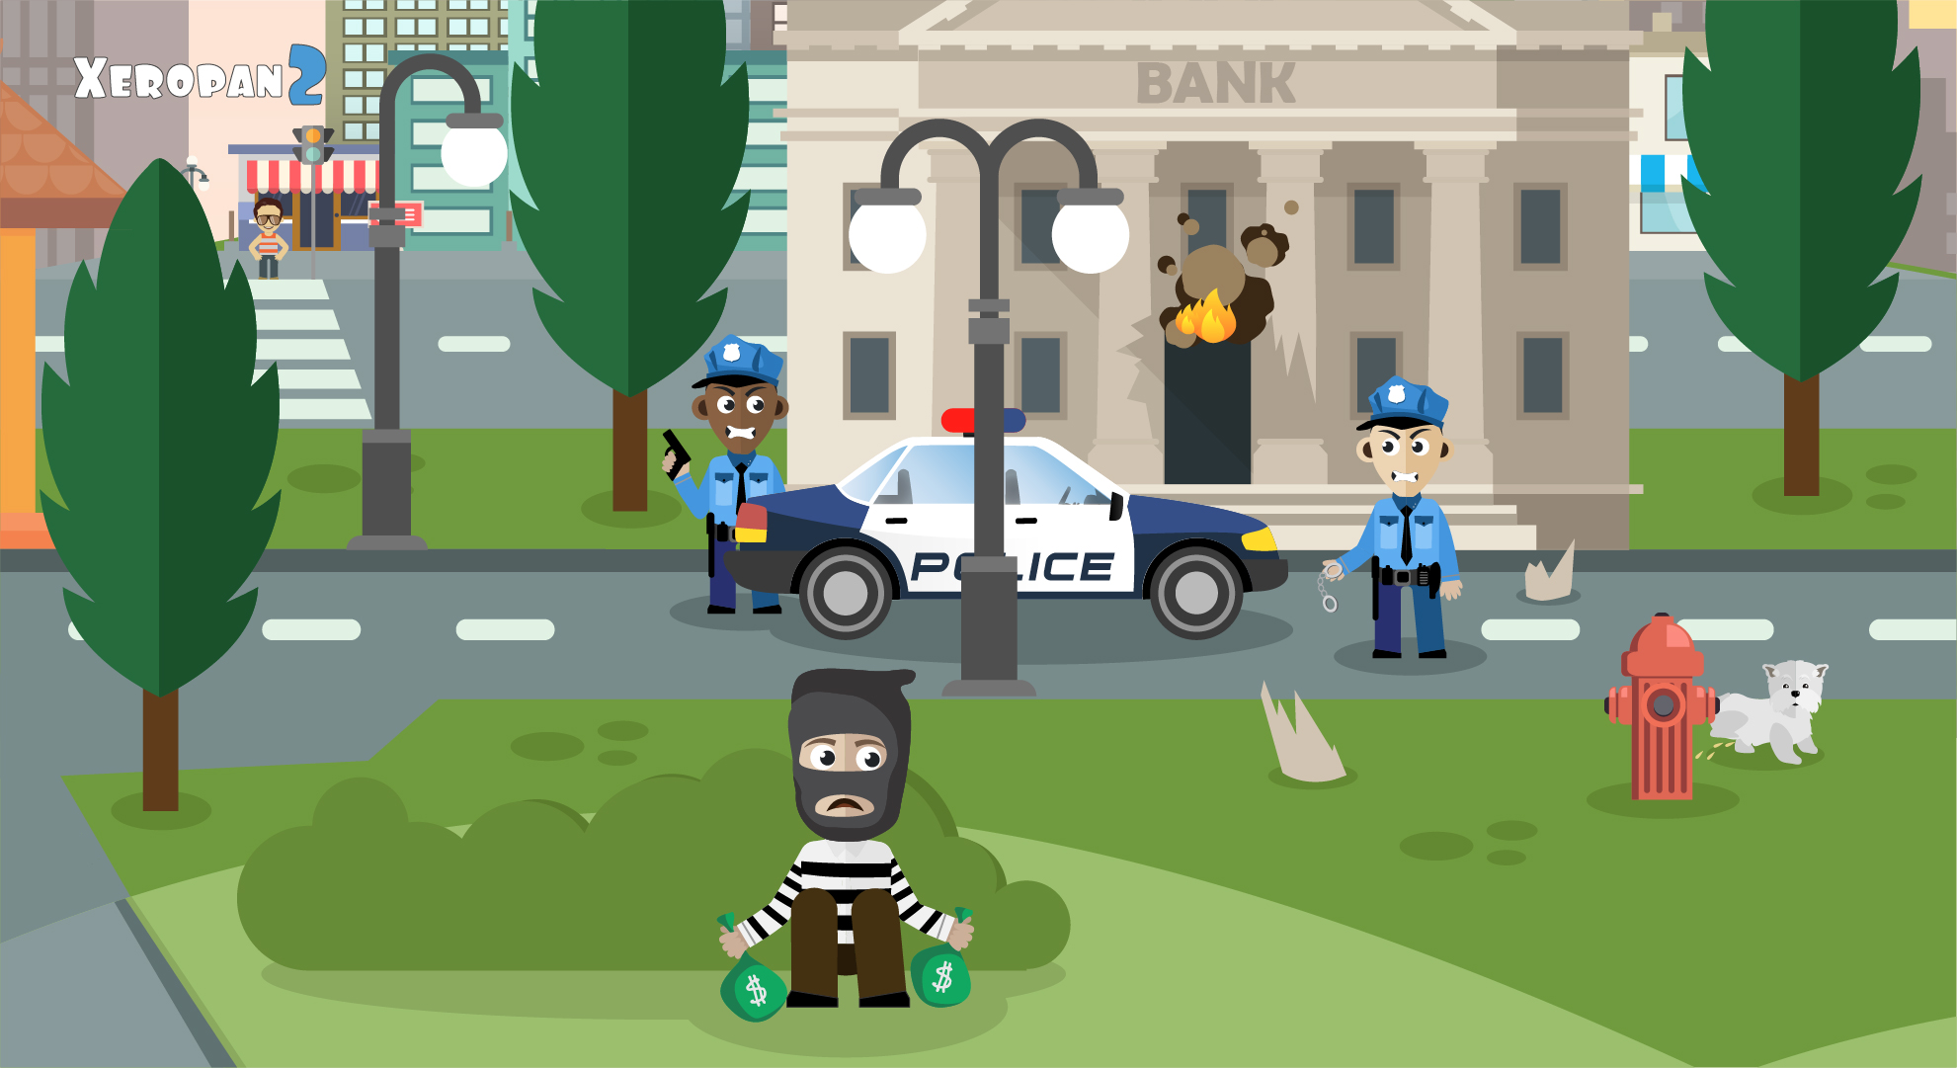
The word gamification has been kidnapped

Slide 6
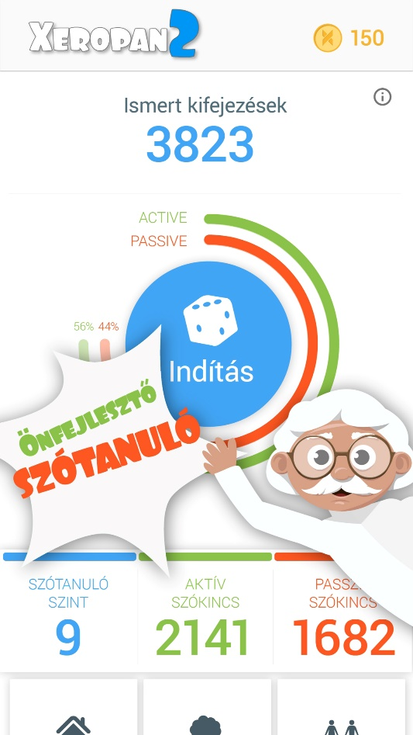
then
now

Slide 7
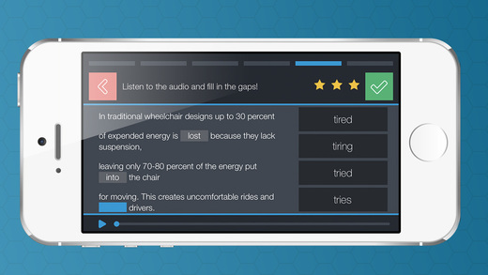
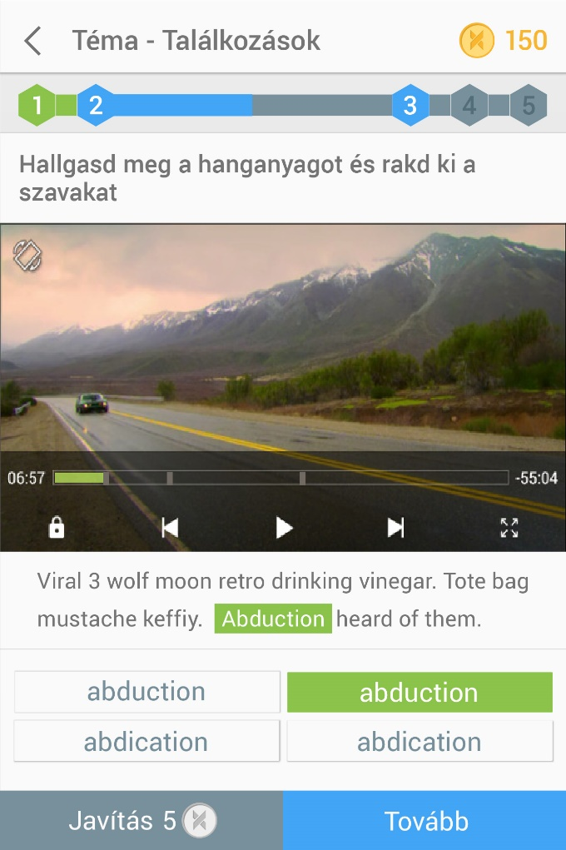
then
now

Slide 8
In game credit

Slide 9
reward schedule

Slide 10
clockwatch

Slide 11
Boss fights

Slide 12
-double sided referral system
-10%

Slide 13
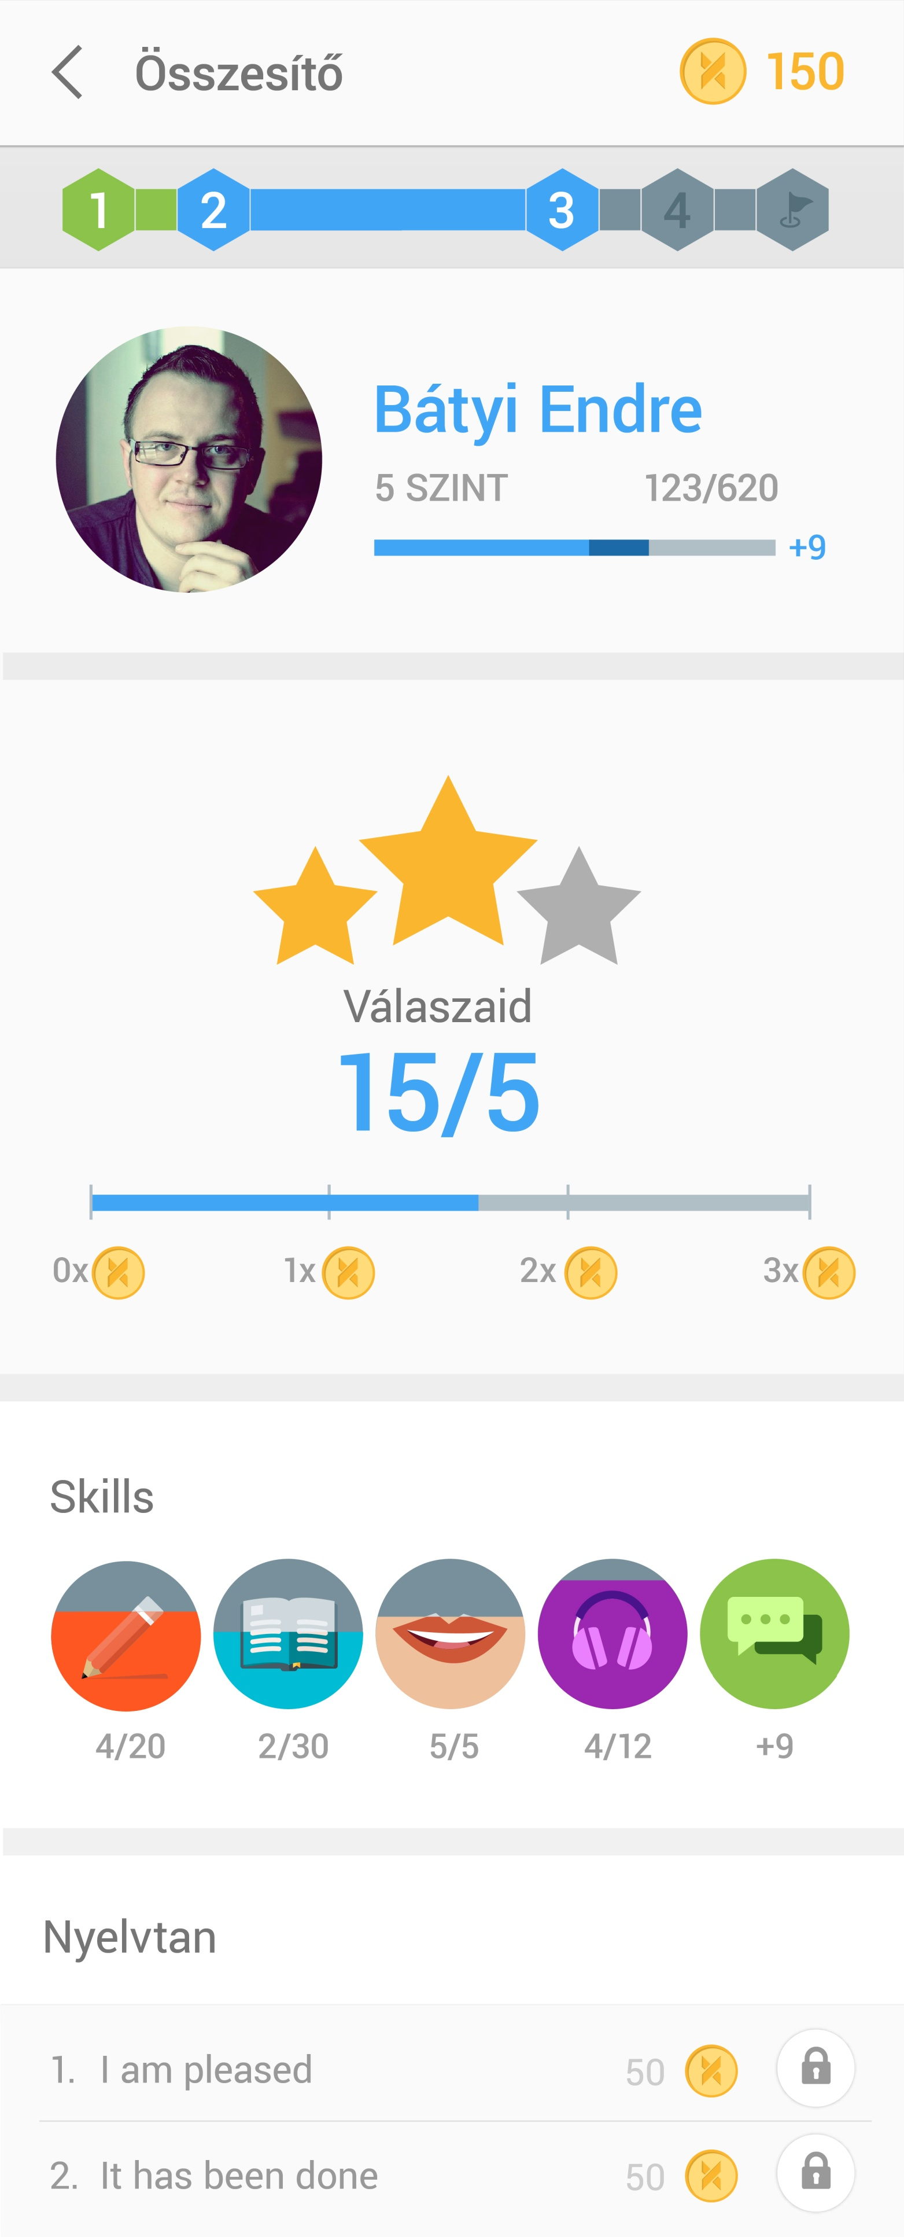
-reward effort – nem büntetünk hanem motiválunk

Slide 14
-element of uncertenity

Slide 15
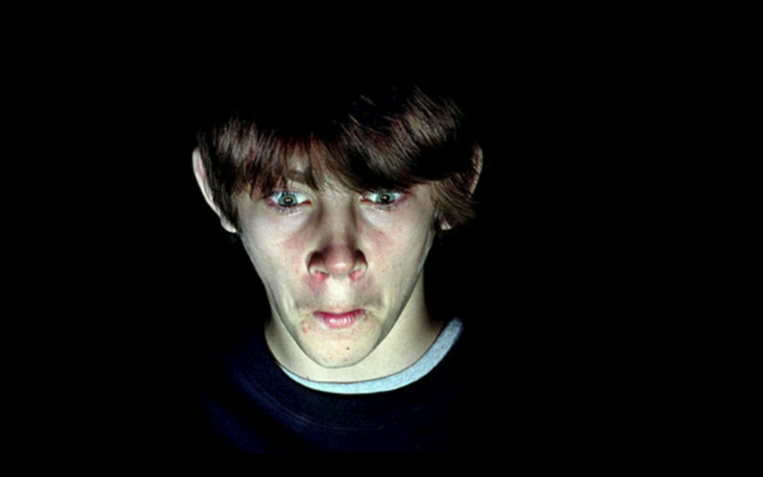
Epic win
28th November 2015

