Slide 1
Mobile Application Development for Financial Services
Brian Maguire
brian@budavar.com

Slide 2
What do we mean by Financial Services
Three Main Verticals with a services layer
To date the majority of Mobile focus is on Banking
Disrupting traditional means of transferring cash, making payments and most recently focusing on true mobile banking startups
However there is only so much you can do with banking before you need to be a “Bank” or a “Payment Channel” with limitations to entry in terms of cost and legislation
Banking
Insurance
Insurance
Investment
Independent Advisors / Brokers
Independent Advisors / Brokers

Slide 3
The Current State
Financial Services has few true Mobile App’s that are considered game changing
Insurance is pretty much ignored, mostly serviced by;
Enterprise incumbents trying to modernize legacy offerings
Insurance companies themselves trying to figure out how to leverage mobiles and tablets
There are very few real Mobile App focused startup’s
This is Primarily down to;
A closed Eco-system
Adversity to change
Local, regional and global diversity in business
Regulation & Security

Slide 4
The Current State
The traditional approach for Financial services to mobile is one of service enablement via platform & cost reduction
This is innovative in how existing services are delivered and communicated but it is not truly innovative from a business context, it only focuses on communication
Web
Enabled
Mobile
Enabled
Branch
Call Centre

Slide 5
Taking a Step Back – The Power of Mobile
Killer apps are still;
email, calendar, task, reminders, etc
They create stickiness
Always on – always with me
Exciting, Game Changing Mobile App’s utilise;
Platform
Location
Environment
Context
Comfort factor
Expectation factor
Data gathering and Data driven event initiation

Slide 6
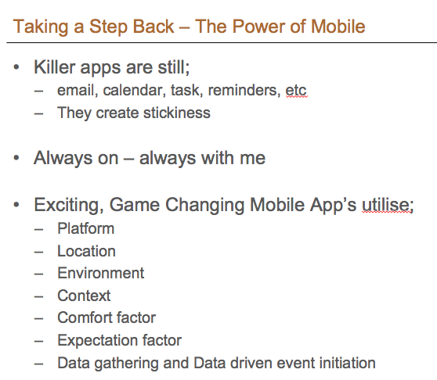
The Evolutionary (Lazy) Approach – Most Common today
Mobile enable current web-enabled activities
Banks
Account Management (Balance enquiry, etc)
Payment Initiation
Payee Management
Bill Management
Insurance & Investment
Policy & Portfolio Enquiry
Investment Changes
Advisors / Brokers
Information accessibility
Data Capture

Slide 7
There are Numerous Areas of Opportunity
Improvement of “Business as Usual” (BAU) activities
Operational Efficiency (Faster, more convenient)
Reduction in Cost (Cheaper)
Increase in Revenue (Up Selling and Cross Selling)
Differentiation
“Mini-Disruption”
Allows a business to stand out in the marketplace
Disruption
Using mobile to “do it” different, not just better, faster, cheaper.
Run an industry vertical or part of it primarily in the mobile eco-system (Atom Bank, SnapSheet, MetroMiles, Square, Transferwise, etc)

Slide 8
Financial Services is a Truly Legacy Environment
Financial Services & their IT environments;
Old and Slow to change
Generally follow a Waterfall development cycle
Most always use an On-line / Batch processing model
Mobile App environments;
New and Dynamic
Development is agile
Are always on
Integration is a Key Requisite;
You will be integrating with diverse legacy back end's
Mobile apps must be able to work offline and re-sync on uptime
Mobile apps must assume they will be pulling and pushing data to and from fundamentally different style of systems and different processing models

Slide 9
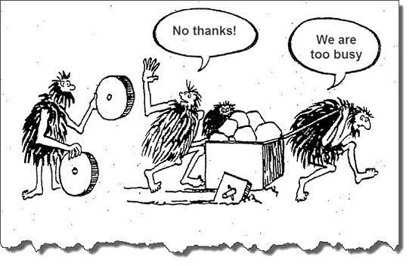
The Financial Services Industry 800lb Adoption Gorillas
Regulation
Different in every country
Security
Biggest issue to focus on
Local v Global
Operationally different due to local cultures
Governance
Bureaucracy & Process
Legacy
Old and slow to change
Risk Averse
It is their nature

Slide 10
The Innovation Approach – Areas of focus
Understand the business and product lines
Understand the customer lifecycle and how a mobile first approach could be utilised
Identify the differentiation & advantages mobile first will provide
Attract
Capture
Service
Retain
Separate

Slide 11
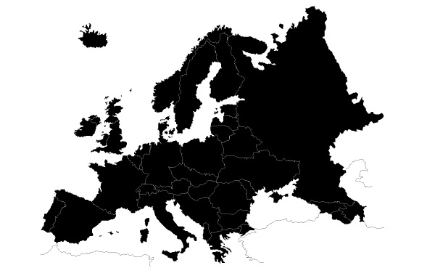
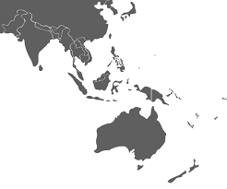
The Innovation Approach – Areas of Focus
Identify the geographic market you want to target
Think about integrating Financial Services needs into a non financial services app
Are you going to build a Finanical Services App
Or a Lifestyle / Business App with Financial Services hooks
How can lifestyle, activities, events and locations be used to tie in and/or prompt financial events
I am currently doing X, travelling to Y, located at Z, etc.
This means I should be considering Service ABC

Slide 12
The Innovation Approach – Do not forget about IoT
Sensors
Automotive
Property
Wearable's
Watches
Fitness Bands
Phone / Tablet
Location
Environment
Context

Slide 13
Takeaways
Financial Services are under serviced by mobile apps
The industry is aware of this
The industry is searching for innovation
The industry is constrained by issues mentioned earlier
Change will have to come from outside the industry
You do not have to be a disruptor to be successful
You can be successful by focusing on Improvement and Differentiation
However – Find a disruptive approach to any area of the insurance vertical and you will get noticed
The opportunity is huge

Slide 14
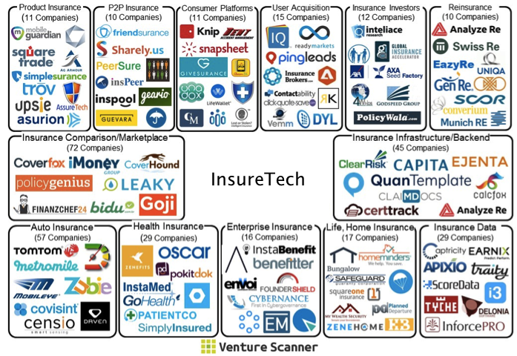
Some Final Thoughts

