Slide 1
UX Reviews: the power of constructive criticism

Slide 2
Mobile product development...
THE IDEAL SCENARIO

Slide 3
Prototyping
User Research
UX Strategy
UX and UI Design
Analyze the business problem
Architectural planning and specification writing
Agile development with continuous user testing

Slide 4
Mobile product development...
THE LESS THAN IDEAL SCENARIO

Slide 5
UX Strategy
Analyze the business problem
Architectural planning and specification writing
Prototyping
Agile development with continuous user testing
UX and UI Design
User Research

Slide 6
Its hard to tell people their UI sucks. Even harder to tell the whole UX sucks.

Slide 7
Analyze.life

Slide 8
Beautiful doesn’t equal usable.

Slide 9
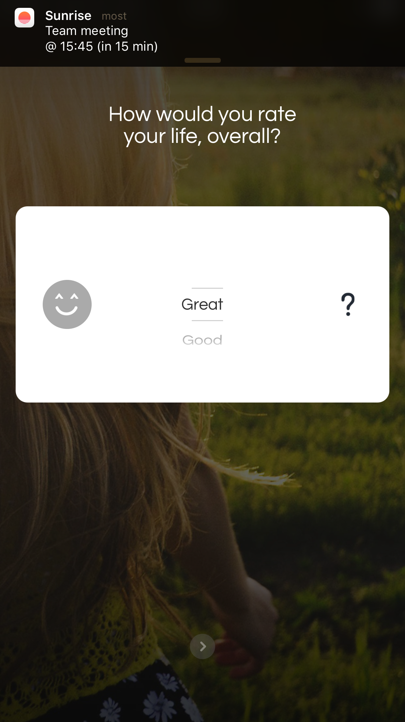

Slide 10
“If you look up navigation in a dictionary, it’s about doing two things: getting from one place to another, and figuring out where you are… …. “figuring out where you are” is a much more pervasive problem on the Web than in physical spaces.” No sense of scale. No sense of direction. No sense of location. Steve Krug: Don’t make me think

Slide 11
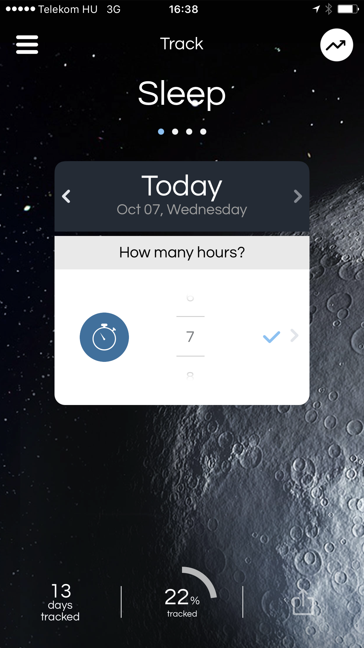
?
?

Slide 12
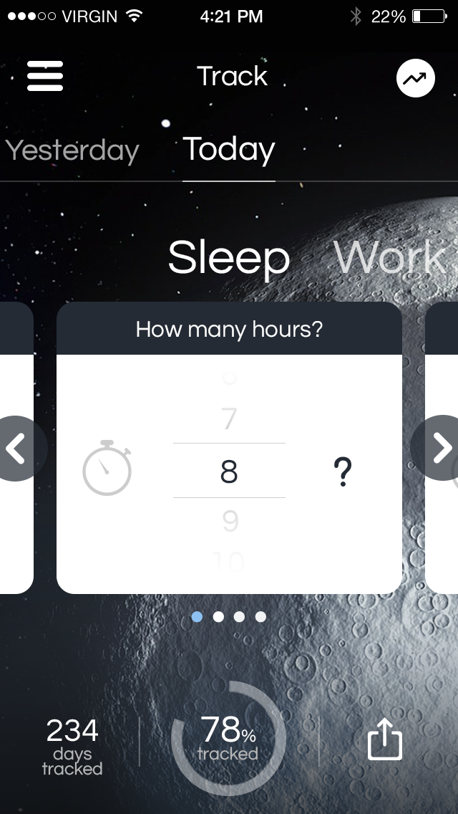
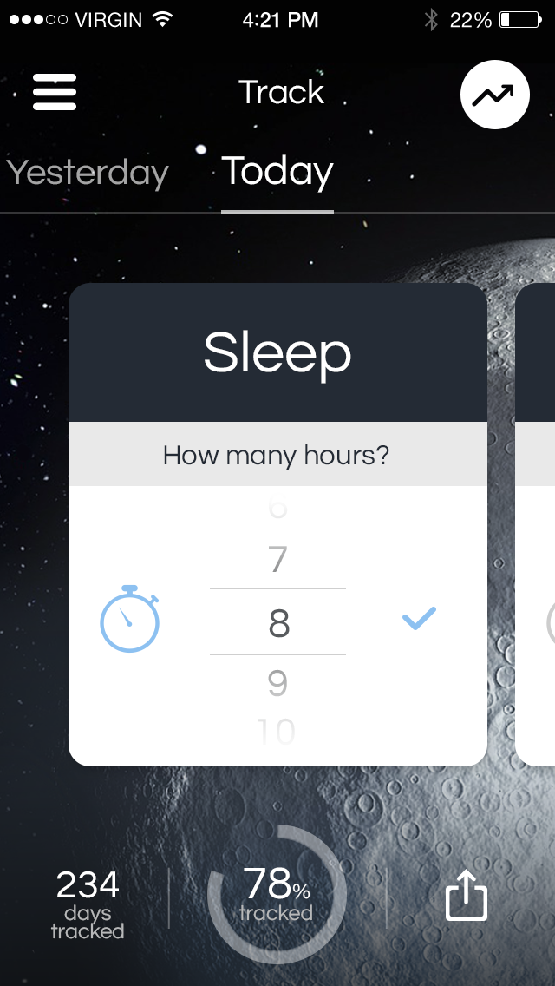

Slide 13
You can’t teach users how to use a mobile UI*. You can give them hints.

Slide 14
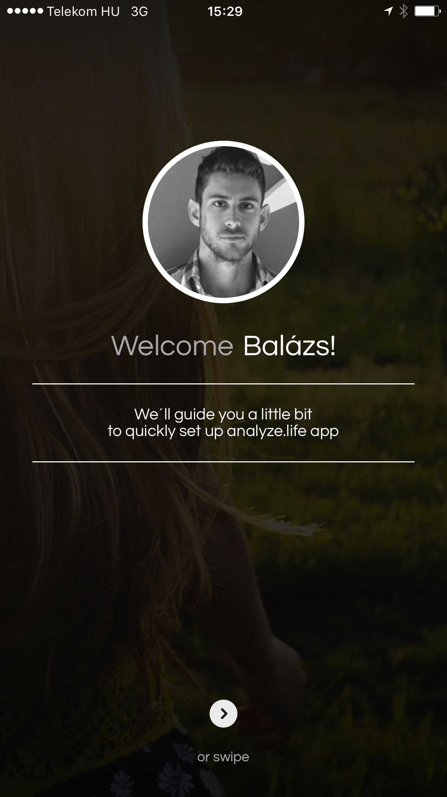
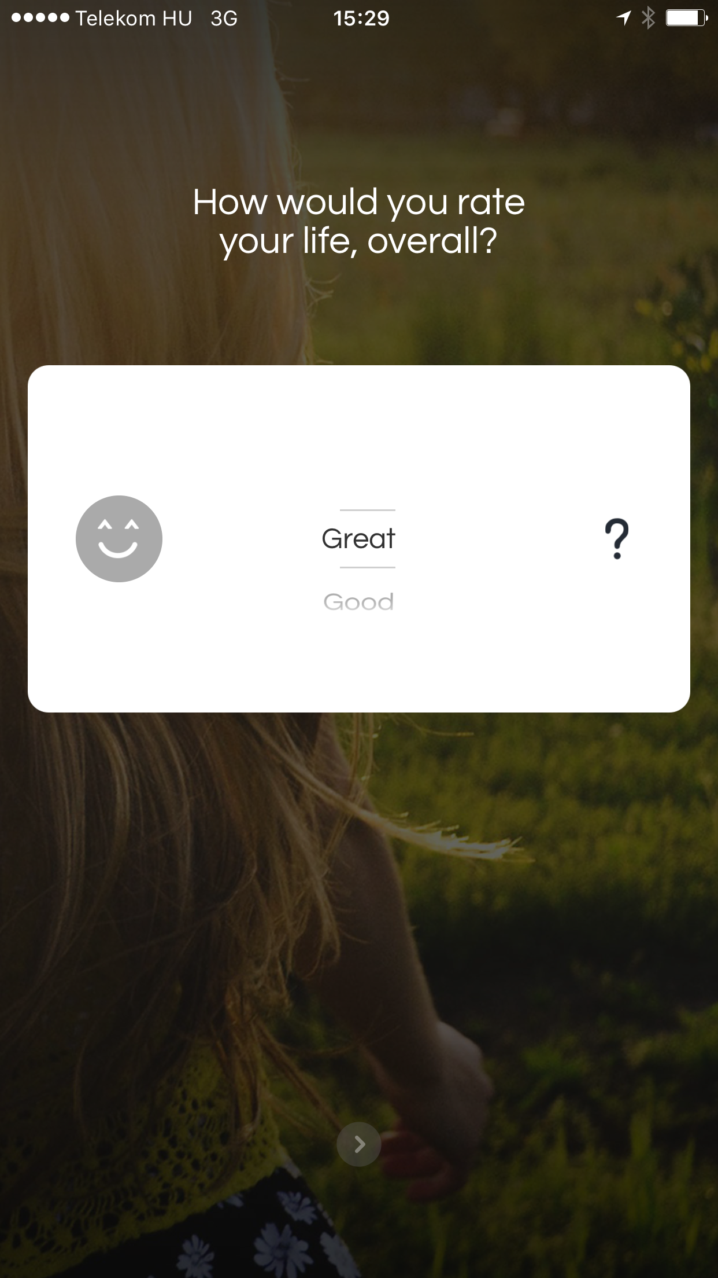
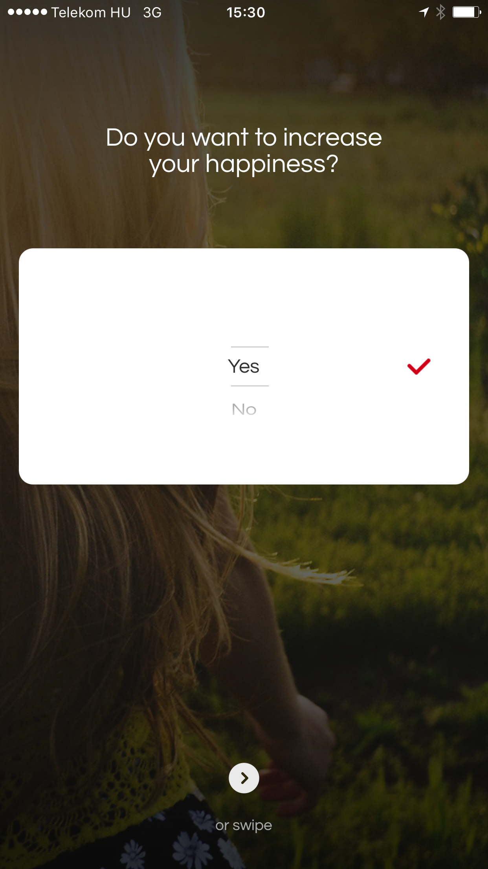
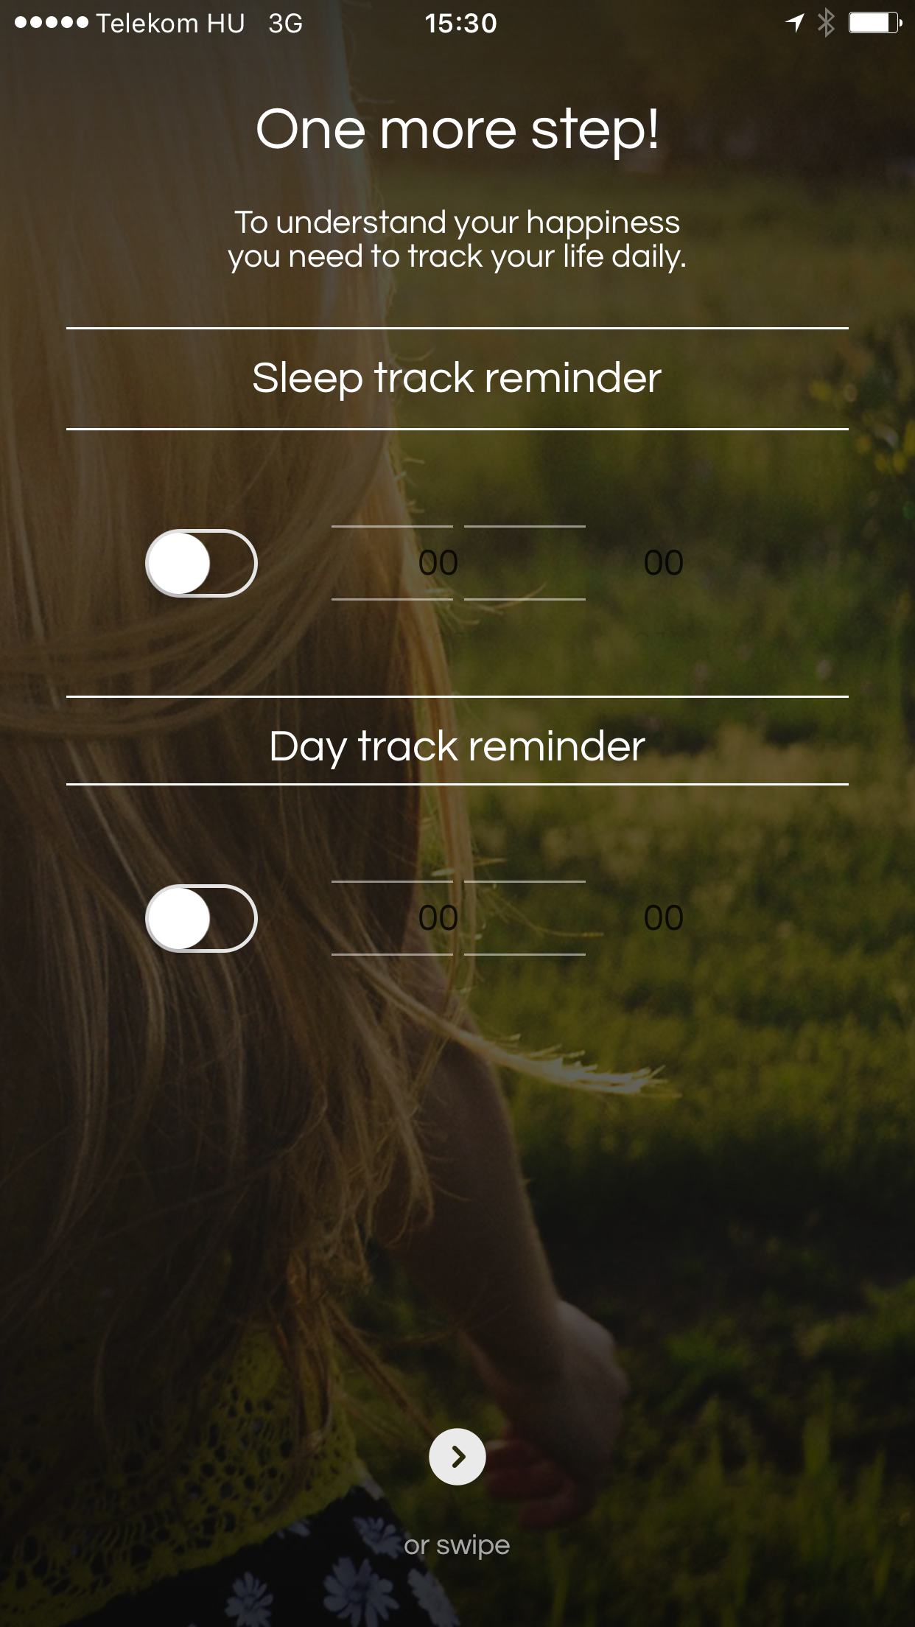
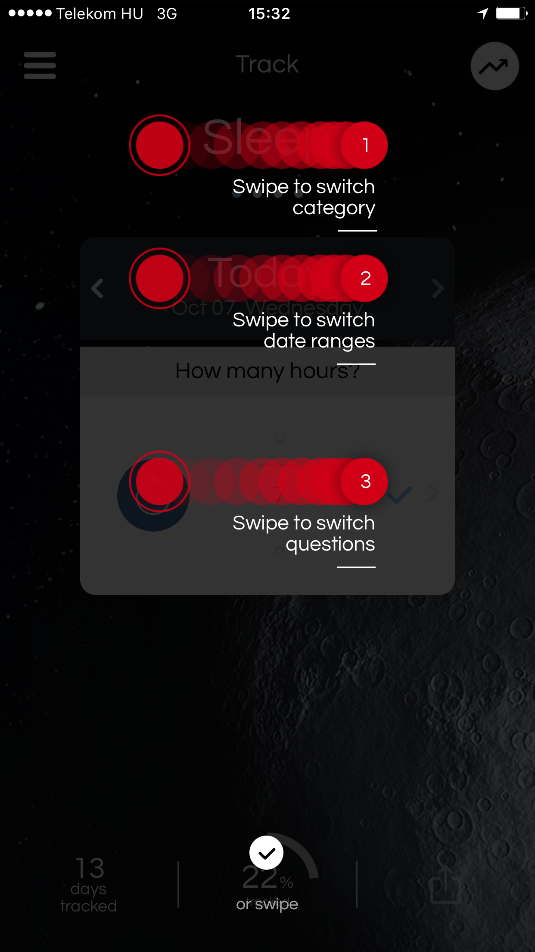

Slide 16
UX is never perfect.

Slide 17
Oliver

Slide 18
When bad onboardings happen to good apps…

Slide 19
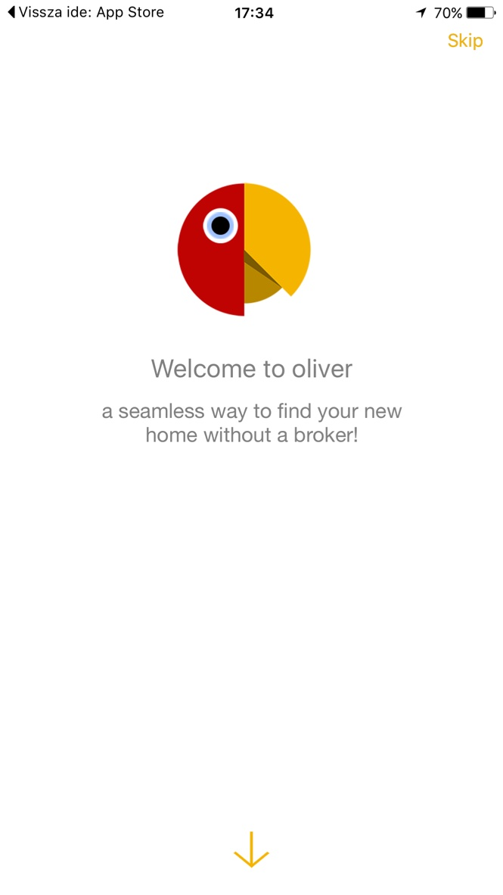
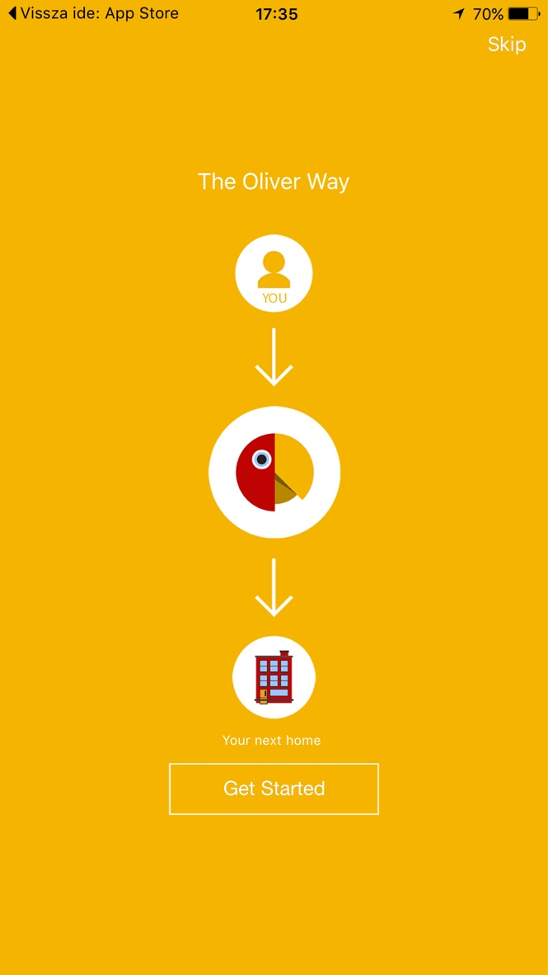
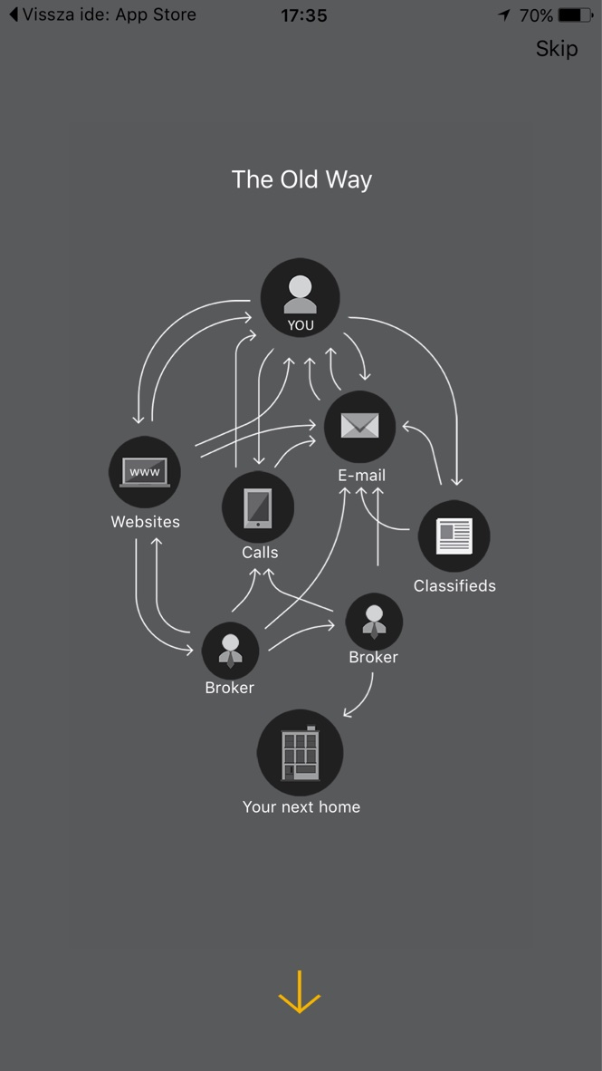
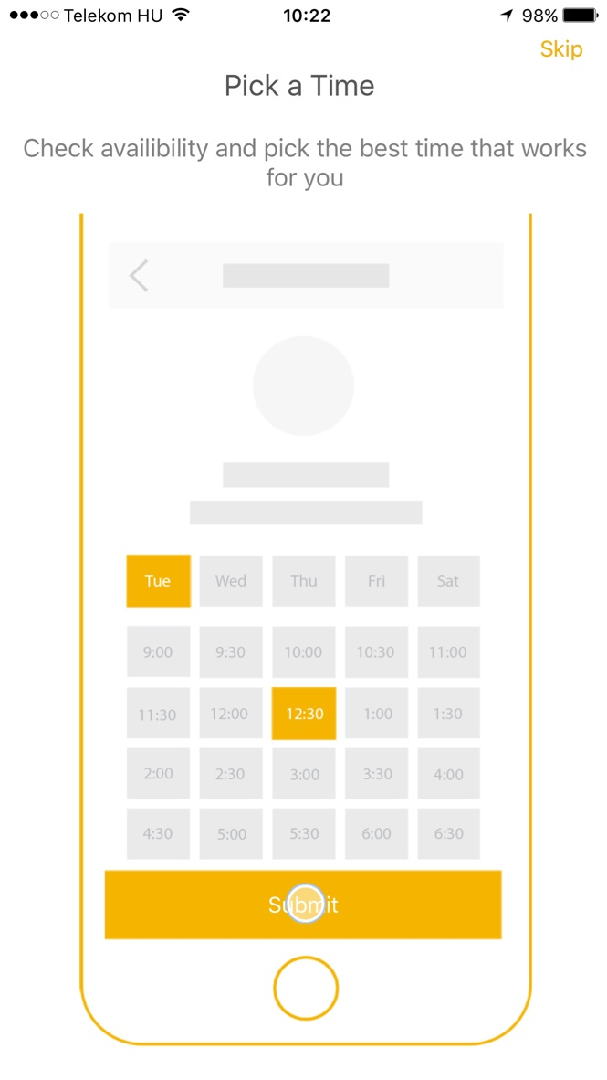
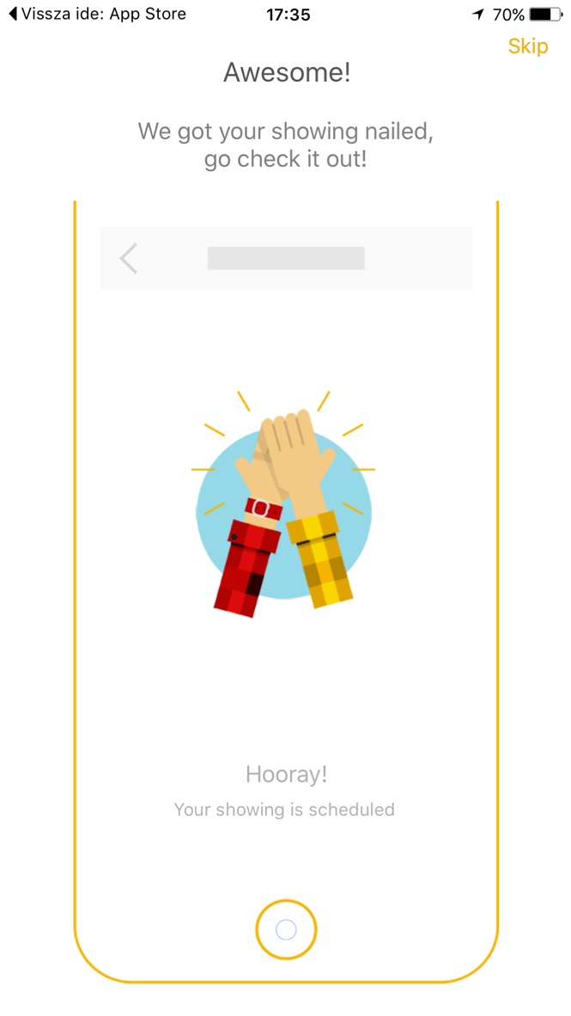

Slide 20
Don’t explain a UI before the user ever saw it…

Slide 21
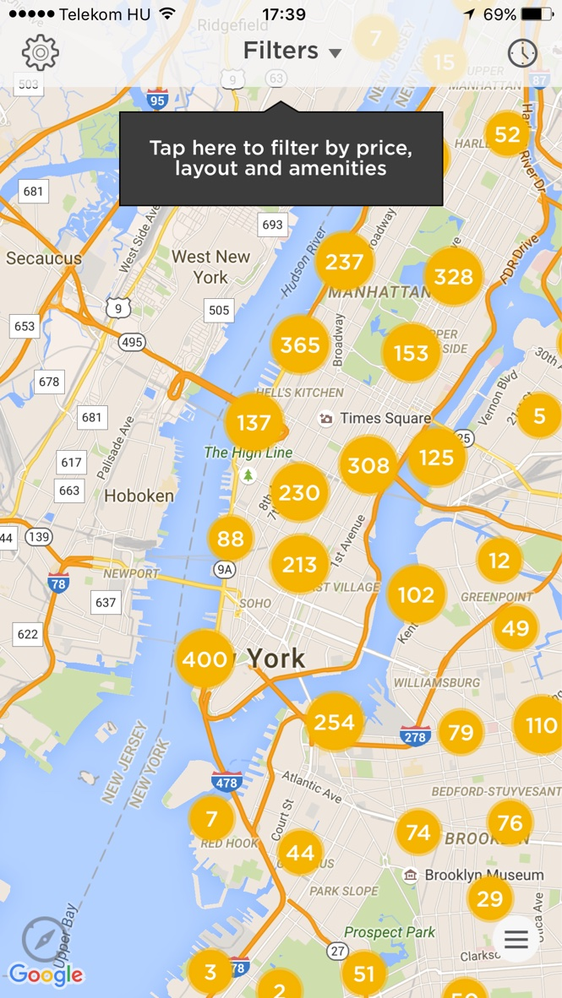

Slide 22
Users don’t understand most of your icons.

Slide 23
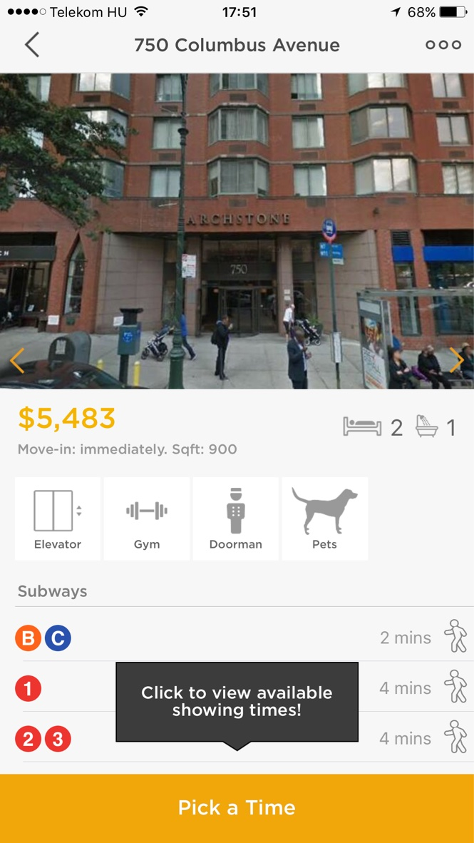
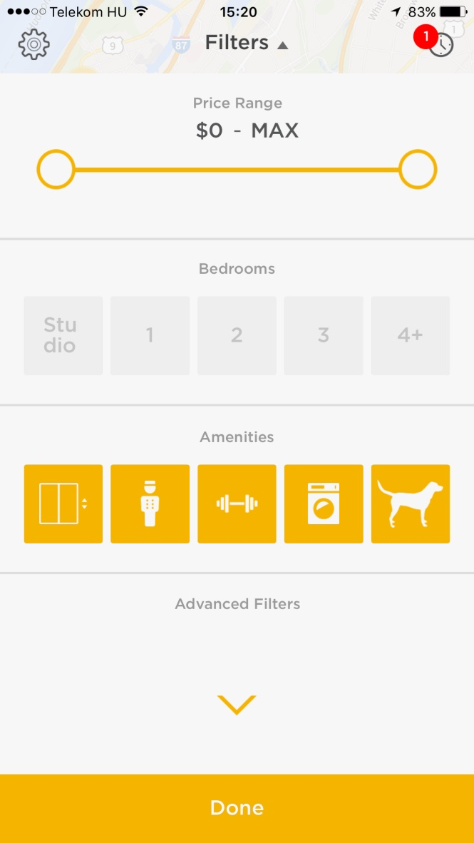

Slide 24
Hiding important interactions is not the right way to guide users.

Slide 25
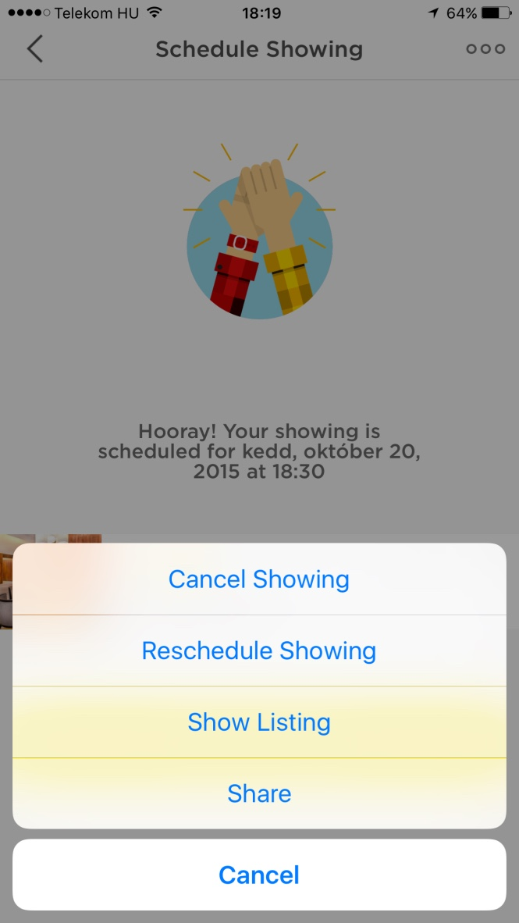

Slide 26
Without feedbacks the user is lost.

Slide 27
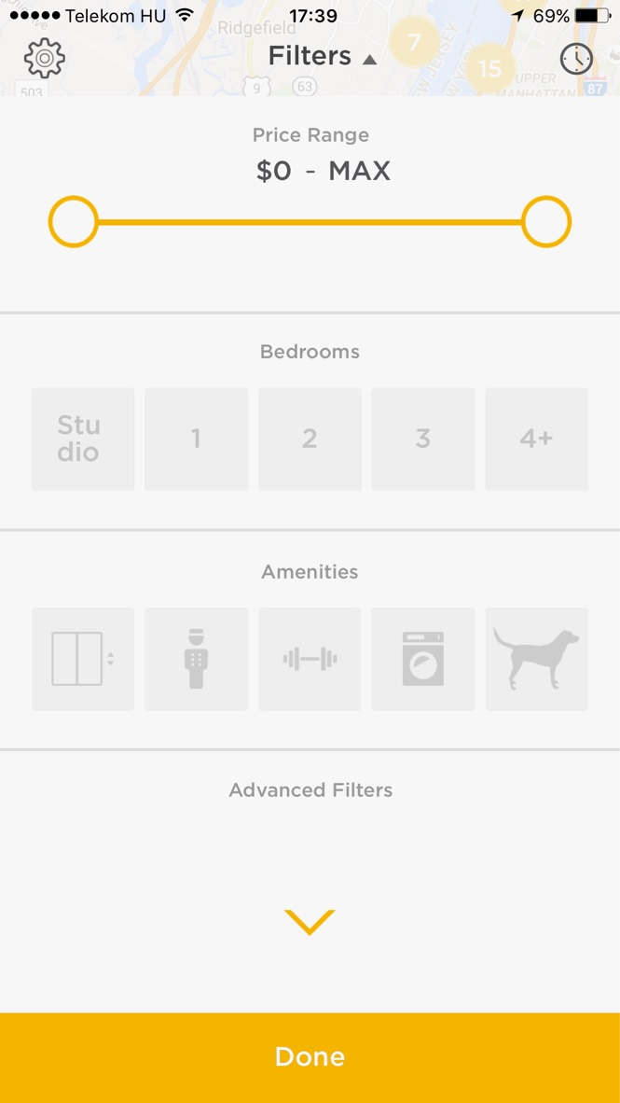
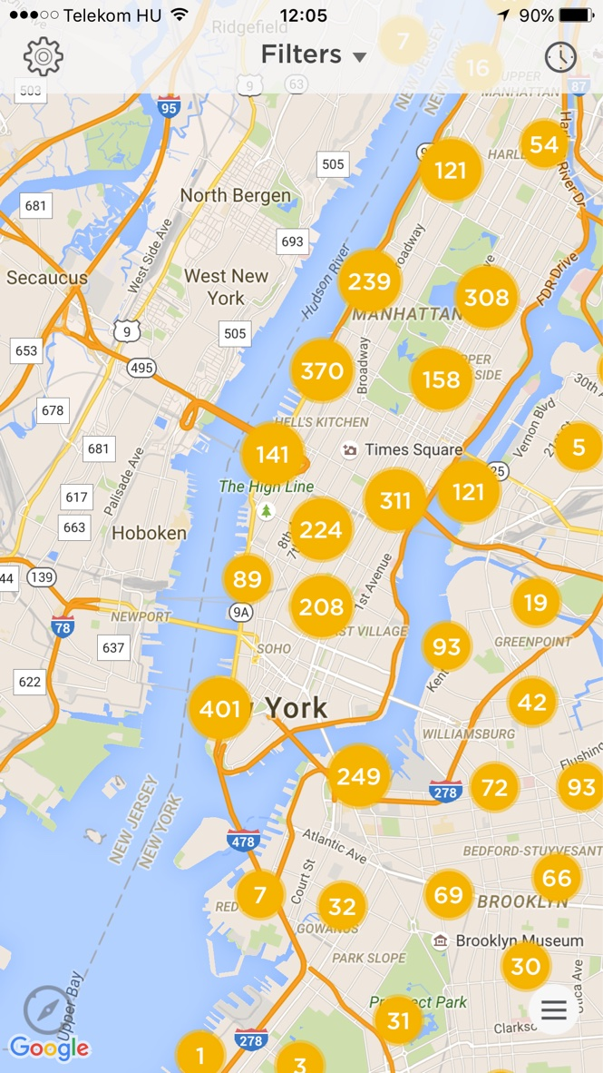

Slide 28
You can’t be your own critic. No matter how hard you try.

Slide 29
Thanks for your attention! Contact me: balazs.fonagy@supercharge.io
Balázs Fónagy
Supercharge
UX Lead
www.supercharge.io

