Slide 1
Mobile Threats 2013: Android Malware & Vulnerabilities
Robert Lipovsky lipovsky@eset.sk

Slide 3
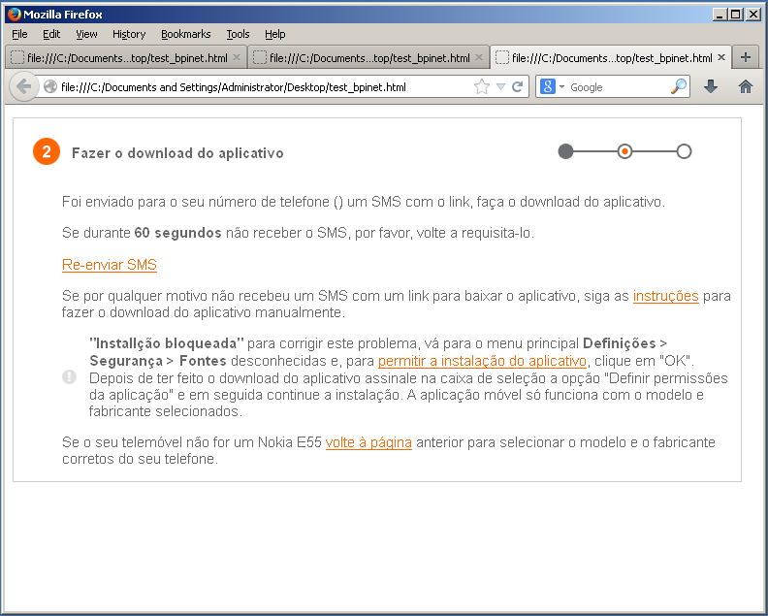
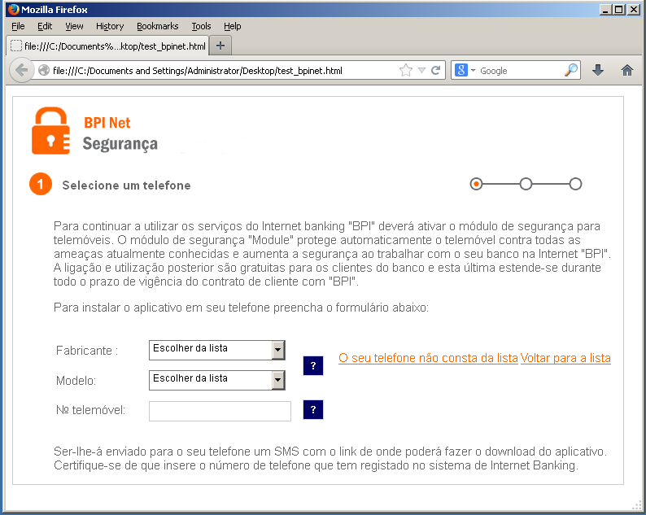
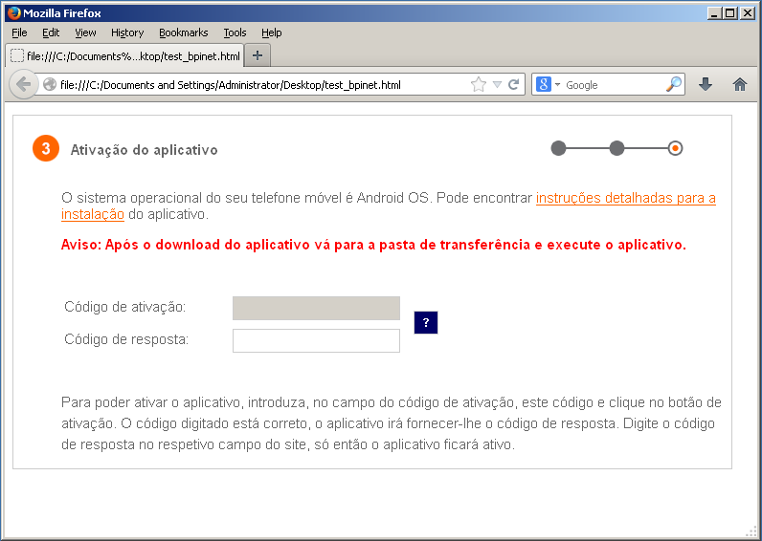
Banking Trojans
Notes:
Transition: Web-injects – Instructions to install mobile component – Show, explain

Slide 4
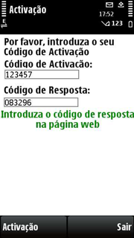
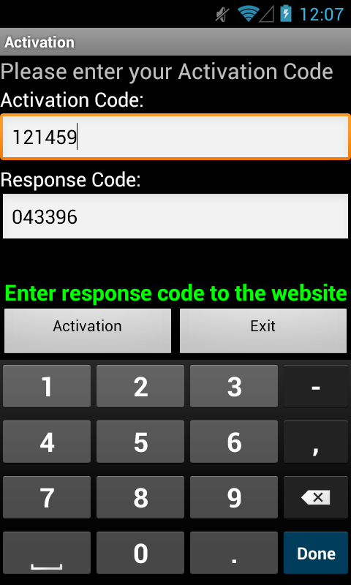
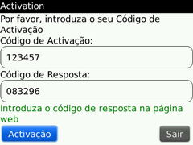
Banking Trojans
Bypassing mTAN 2-factor authentication
SpitMo, ZitMo, Carberp, Hesperbot, …

Slide 5
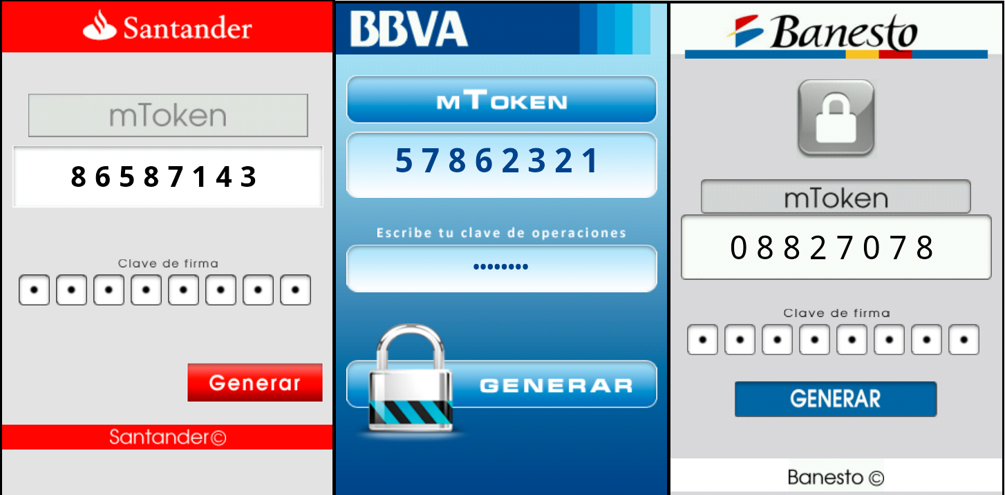
Banking Trojans
Rogue token generation apps

Slide 6
SMS Trojans
1st well-documented Android malware (FakePlayer)
Most prevalent category on Android
Premium SMS
Subscription to paid services
Notes:
Varying services according to operators

Slide 7
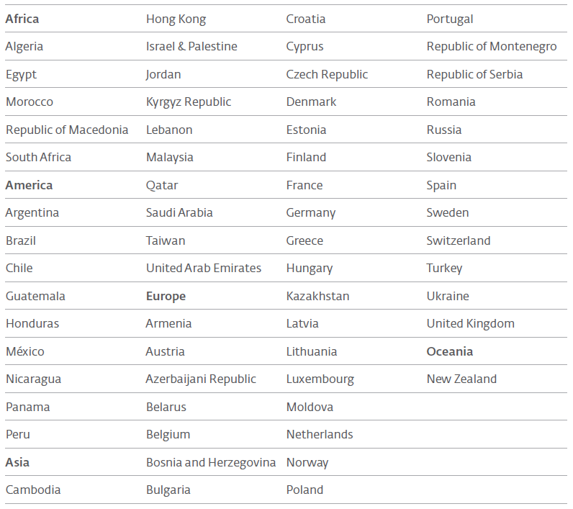
Android/TrojanSMS.Boxer
Targeted 60+ different countries
Disguised as:
Sim City Deluxe Free, Need for Speed Shift Free, Assassin Creed, Angry Birds, …
Google Play & unofficial markets
Notes:
MCC (Mobile Country Code) and MNC (Mobile Network Code)

Slide 8
“Regular” Malware / Spyware
Android/Spy.GPSpy.A
Botnets
Download more malware
Open websites
Data theft:
Messages, Contacts, Location, Apps, …
Access GPS sensor, microphone, camera, …
Notes:
Find more info…

Slide 9
Adware
Android/Adware.Waps
Android/Adware.Airpush
Homescreen shortcuts
Browser bookmarks/homepage
Notifications
Collect information
Etc.
Notes:
Recently Google added a clause in Google Play developers’ terms of service preventing this…
We’ll see…

Slide 10
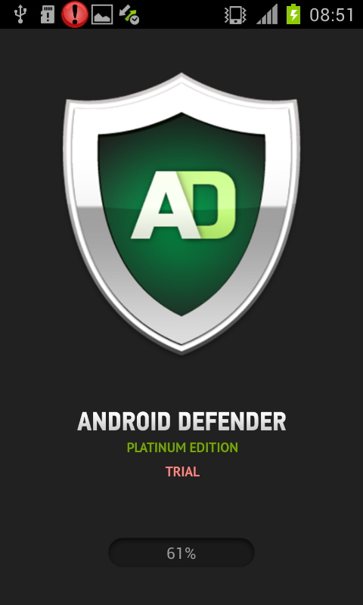
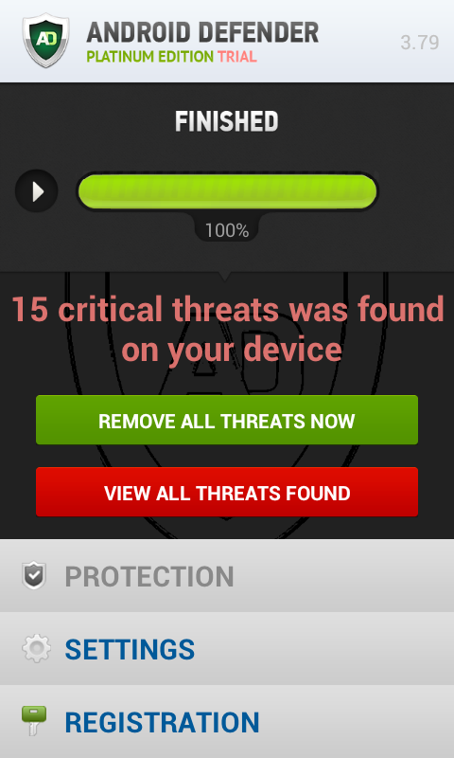
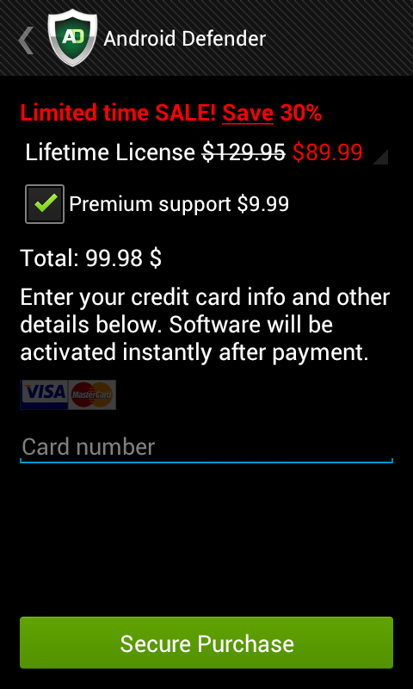
Scareware & Ransomware
Android/FakeAV
Notes:
Android/FakeAV
Prvý Android ransomware, vydieranie
Jún 2013
Vystupuje pod identitou AV
Pokúša sa získať administrátorské práva k zariadeniu
Snaží sa získať od používateľa informácie o platobnej karte
Agresívne blokuje mobilné zariadenie

Slide 11
Malware operations
Pay-per-install schemes
Botnets
DDoS
…
Notes:
Penguins??

Slide 12
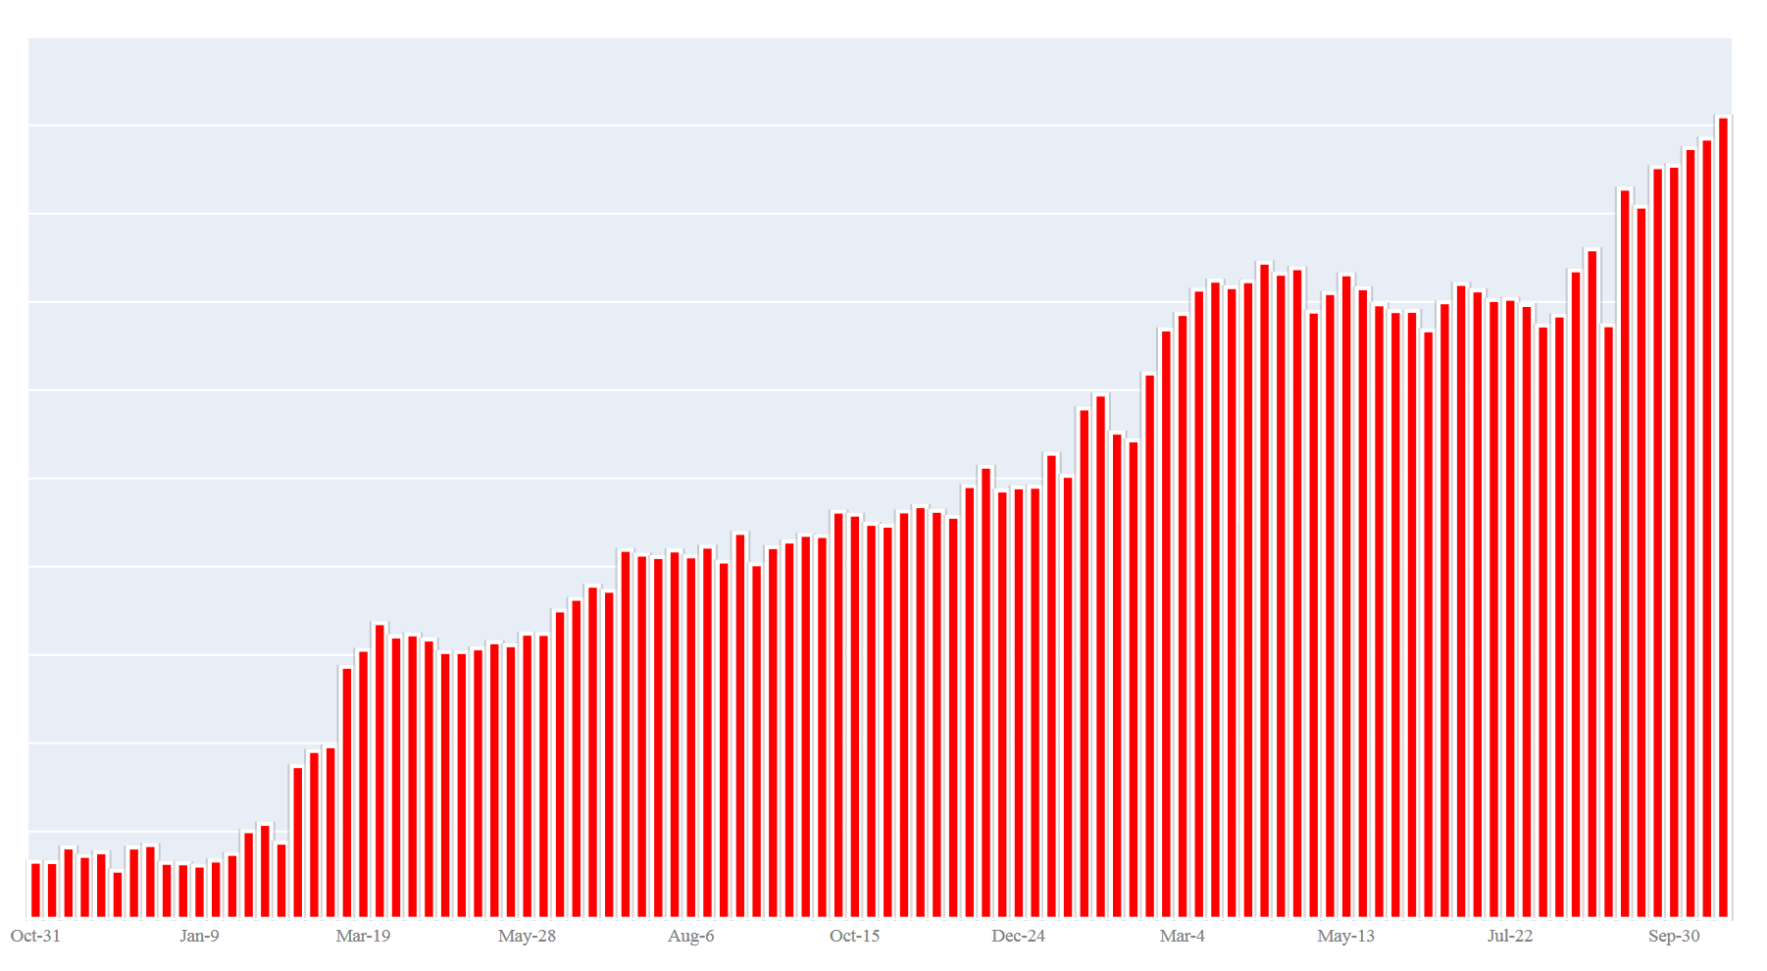
Android Malware Detection Statistics
November 2011 – October 2013

Slide 13
Some Recent Vulnerabilities…

Slide 14
The “BitCoin Vulnerability”
Java Cryptography Architecture
SecureRandom, KeyGenerator, KeyPairGenerator, KeyAgreement, Signature
OpenSSL PRNG
seed from /dev/urandom
Patched -> OHA
55 Bitcoins stolen in August
Notes:
Applications that use Java Cryptography Architecture – and for key generation, signing, or random number generation have not always received cryptographically strong values…
…improper Pseudo-Random-Number-Generator initialization
SecureRandom is supposed to run Android’s OpenSSL PRNG with an entropy seed from /dev/urandom. But with this exploit, Android applications didn’t do that.
This affected Bitcoin wallet applications that generated the private keys on the device. Because of possible signature collisions, the private keys could be guessed.
Open Handset Alliance members

Slide 15
“WebView Vulnerability”
WebView – load HTML content within app
addJavascriptInterface (Object object, String name)
JavaScript can access object’s methods

Slide 16
“WebView Vulnerability”
Problem: access to all public (incl.inherited) methods
Execute commands remotely in the context of the application through reflection
Android <4.2
Since 4.2: @JavaScriptInterface annotation
Notes:
The component is also used to serve ads within apps. If the channel is susceptible to MitM, an attacker can inject arbitrary JavaScript into the WebView.
If you've set your targetSdkVersion to 17 or higher, you must add the @JavascriptInterface annotation to any method that you want available to your JavaScript (the method must also be public). If you do not provide the annotation, the method is not accessible by your web page when running on Android 4.2 or higher.

Slide 17
“Master Key” Vulnerability
Replacing code within application…
…without breaking its digital signature!
Android crypto verifier – MANIFEST.MF
Multiple files with same name in APK
Replace code, permissions, etc.
System applications
Notes:
Android's cryptographic verifier validates the first version of any repeated file in an APK archive, but the installer extracts and deploys the last version
Used by malware
Jeff Forristal @ Black Hat 2013 (Blue Box)

Slide 18
USSD Vulnerability

Slide 19
Thank you!
lipovsky@eset.sk
samples@eset.sk
WeLiveSecurity.com
VirusRadar.com
Notes:
Closing thoughts:
The Android Update ecosystem needs to be improved – many bugs have been patched, but users are getting the updates late or not at all
Even still, most threats rely on social engineering rather than exploiting software vulnerabilities, so user education is absolutely crucial.

