Slide 1
Cellum Motion QR
November, 2013
© Copyright 2013 Cellum. All rights reserved.

Slide 2
Cellum Global: m-commerce Wallet services
Acquisition
Advertisement
Customized
Couponing
Location based
Differential levels
Micro loan
Gift card
Purchase toolset
Scan/recognition
1D,2D codes, OCR, MDQR
Object – Pattern – Logo
Voice
Templates
ID / Receipt / tickets
Shopping chart
WEB Check-out / MasterPass int.
Cellum
Mobile NEXT
Vouchers
Loyalty card storage / balance
Cross acceptance – multi merchant
New Loyalty logic
Frequency
Exponential
Retention
P2P
MPI management
Mobile Bank Card
SVA
Security
TRX management
Merchant services
NFC
Payment services

Slide 3
Static QR limitations
Few data… or over detailed/complex code
Easy to copy, printable ( over 10% fraud )
ID data integration is missing

Slide 4
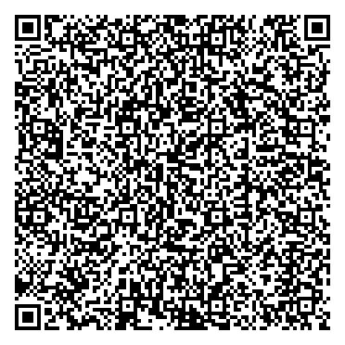
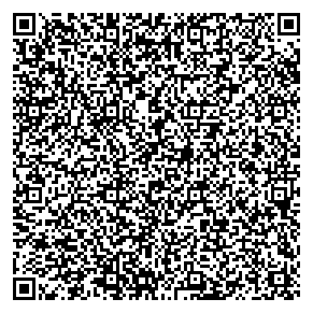
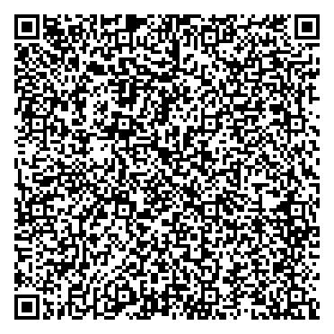
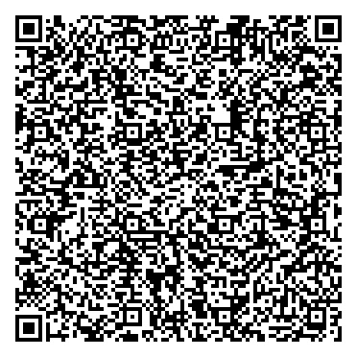
Multiple randomly generated subsets of data
Picture
Signature
Alphanumeric data
Digitalized biometric data
Personal
Event
Purchase
Validity
Encrypted bankcard
etc.
Digitalized
encrypted data set
0111010101000100111101011010110100011110110101010101110011001111011100111100110011111001110001111101100010001001010111101000011000111
0111010101000100111101011010110100011110110101010101110011001111011100111100110011111001110001111101100010001001010111101000011000111
0111010101000100111101011010110100011110110101010101110011001111011100111100110011111001110001111101100010001001010111101000011000111
0111010101000100111101011010110100011110110101010101110011001111011100111100110011111001110001111101100010001001010111101000011000111
Static QR #1
Static QR #2
Static QR #3
Motion-dynamic QR

Slide 5
Dancing QR opportunities
Unlimited data and controlled complexity
Crypto keylength
Presentation time fault tolerant coding
Time stamp
Unique session code
ID data - picture, signature, biometric data etc.- integration
Control device representation process
Data combination

Slide 7
Cellum Motion QR
November, 2013
© Copyright 2013 Cellum. All rights reserved.

